Slide 1
Memory Management Paging

Slide 2
Paging
In a Paging System, when a process needs to refer to an address, it specifies the page AND the displacement within the page at which the item resides.
In other words, a virtual address is denoted by a pair (p,d) - where p is the page, and d is the displacement.
A process can run if its current page is in primary memory.
Pages are transferred from secondary to primary memory and placed in blocks called page frames.
An incoming page can be placed in any free page frame (page frames and pages are of the same size).

Slide 3
Paging
A computer can address more memory than the amount physically installed on the system. (virtual memory) and it is a section of a hard disk that's set up to emulate the computer's RAM.
Paging technique plays an important role in implementing virtual memory. It is a memory management technique in which process address space is broken into blocks of the same size called pages
(Page size is power of 2, between 512 bytes and 8192 bytes). The size of the process is measured in the number of pages.
Similarly, main memory is divided into small fixed-sized blocks of (physical) memory called frames and the size of a frame is kept the same as that of a page to have optimum utilization of the main memory and to avoid external fragmentation.

Slide 4
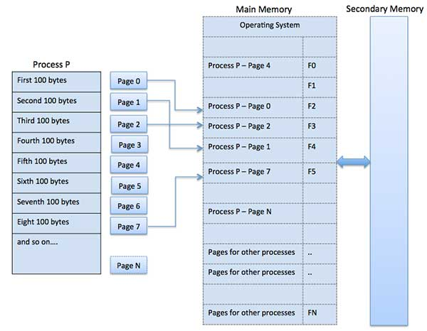
Process, Pages & Frames

Slide 5
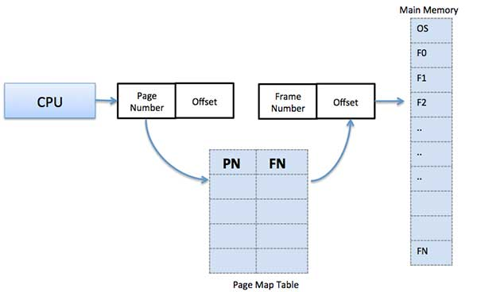
Address Translation
Page address is called logical address and represented by page number and the offset.
Logical Address = Page number + page offset
Frame address is called physical address and represented by a frame number and the offset.
Physical Address = Frame number + page offset
A data structure called page map table is used to keep track of the relation between a page of a process to a frame in physical memory.

Slide 6
Example
When the system allocates a frame to any page, it translates this logical address into a physical address and create entry into the page table to be used throughout execution of the program.
When a process is to be executed, its corresponding pages are loaded into any available memory frames.
E.g., suppose you have a program of 8Kb but your memory can accommodate only 5Kb at a given point in time, then the paging concept will come into picture.
When a computer runs out of RAM, the operating system (OS) will move idle or unwanted pages of memory to secondary memory to free up RAM for other processes and brings them back when needed by the program.
This process continues during the whole execution of the program where the OS keeps removing idle pages from the main memory and write them onto the secondary memory and bring them back when required by the program.

Slide 7
Paging Map Table
Say a running process references a virtual address v = (p, d). A page mapping mechanism looks up page p in a Page Map Table in order to find p.
Entries in a Page Map Table have three fields:
Page residence bit. This indicates if the page is in real storage (1), or on secondary storage (0).
Secondary storage address. If the page is not in real storage.
Page frame number. If the page is in real storage.
techniques of performing page mapping….

Slide 8
Address Translation by Direct Mapping
Before a process begins running, the OS loads the address, b, of the Page Map Table into the Page Map Table Origin Register.
Say a running process references a virtual address v = (p, d).
The address of the entry for page p in the Page Map Table is b + p.
This indicates that page p has been loaded into page frame p′.
The real address is formed by concatenating p′ and the displacement d.
This is called direct mapping because there is an entry in the Page Map Table for every page in the process’s virtual storage.
The problem with direct mapping is the time taken to reference the Page Map Table.
It is quite large, and is usually kept in primary storage, so the operation to access it requires one complete primary storage cycle.

Slide 9
Direct Mapping
Primary Memory
Virtual Address (p,d)
p
d
Page Map Table Origin Register
b
Page Map Table
...
d
Page Frame p'
p
Base address of Page Map Table
p'
p' d
“Real” Storage
Location
...
“Real” Address

Slide 10
Address Translation by Associative Mapping
With Associative Mapping, a very fast Associative Storage which is content addressed.
When a running program references address (p, d), every entry in the associative storage is searched simultaneously for page p.
As before, the page frame p′ is returned and this is concatenated with d to form the real address.
Because every cell in the associative storage needs to be searched simultaneously, it is prohibitively expensive.
Virtual Address (p,d)
p
d
p'
p' d
Associative Map

Slide 11
Address Translation by Combined Direct / Associative Mapping
In practice, many OSs combine the direct and associative mapping techniques.
The associative storage contains only a few entries.
When a program references the virtual address (p, d), the associative storage is searched to find page p.
If it is there, the page frame p′ is returned and this is concatenated with d to form the real address.
If there is no match, the Page Map Table must be referenced and the real address is found by Direct Mapping.
In addition, the Page number and Page Frame number are added to the Associative Storage so that the page can be accessed quickly the next time it is referenced.
The Associative Storage does not need to be large to achieve good performance. The 80486 processor has 32 entries, and claims a 98% hit ratio.

Slide 12
Combined Direct / Associative Mapping
Virtual Address (p,d)
p
d
Page Map Table Origin Register
TRY THIS FIRST...
b
only if match found
TRY THIS IF NO MATCH FOUND IN ASS. MAP...
p'
p' d
Partial
Associative Map
p
“Real” Address
p'
Page Map Table
(all pages)

Slide 13
Virtual Storage Management Strategies
Virtual Storage Management is the process of controlling what happens when a referenced address is not in main memory.
They are divided into the following categories:
Fetch Strategies. These are concerned with when to transfer a page or segment from secondary storage to main storage. Traditionally, demand fetch has been used, ie. a page is transferred when it is referenced. Anticipatory fetching tries to determine in advance what pages or segments will be referenced by a program.
Placement Strategies. These determine where in main storage to place an incoming page or segment. Pages may be placed in any free page frame. With segments, the placement strategies are the same as those discussed for variable partition multiprogramming.
Replacement Strategies. These determine which page or segment to move out of main storage in order to make room for the incoming one.

Slide 14
Page Replacement Strategies
It is common in paging systems for all page frames to be in use. Therefore when a page is to be brought in, another page must be moved out to make way for it.
The objectives of a page replacement strategy are to
keep in main memory what is most likely to be used in the near future, and to
replace what won’t be needed for the longest time.
Optimum performance cannot be achieved because the OS cannot predict what the system will do, so several sub-optimal replacement strategies exist.

Slide 15
Page Replacement Strategies
Random Page Replacement.
Replacement decisions can be made quickly, but is unpredictable and never used.
First-In-First-Out (FIFO) Page Replacement
Choose the page that has been in storage longest.
This will discriminate against pages that are in constant use (eg. a text editor).
This would be a poor choice as the page would need to be recalled to memory almost immediately.
Least Recently Used (LRU) Page Replacement
Choose the page that has not been used for the longest time.
The danger with this strategy is that the page may be about to be referenced, as the program cycles its way around a loop involving several pages.
This is not often used because of the overhead involved in implementing it.
Least Frequently Used (LFU) Page Replacement
Count the number of times a block is used; replace the one with the smallest count.
But this page may be the one that has most recently been loaded, and is likely to be used again soon.

Slide 16
Page Replacement Strategies
Not-Used-Recently (NUR) Page Replacement
This scheme tries to approximate the LRU strategy. Each page has two hardware bits: referenced bit. This is 0 if the page has not been referenced; 1 otherwise. modified bit. This is 0 if the page has not been modified; 1 otherwise.
Initially, the referenced bits are all set to 0.
When a reference occurs, this bit is set to 1. The modified bits operate in the same way.
When a page is to be replaced, we try to find a page that has not been referenced.
If all pages have been referenced, we choose a page that has not been modified for replacement. This is because there is more overhead involved in moving a modified page back to secondary storage.
Eventually, most pages will have their referenced bits set to 1, at which time it is impossible to distinguish which pages it is desirable to replace. This problem can be overcome by periodically resetting all referenced bits back to 0.

Slide 17
Locality
Central to most storage management strategies is the concept of locality: processes tend to reference storage in non-uniform, highly localised patterns.
There are two aspects to locality; temporal and spatial.
Temporal locality means that pages referenced recently are likely to be referenced in the near future (eg. loops, subroutines, stacks, variables)
Spatial locality means that storage references tend to be clustered so that once a page is referenced, it is highly likely that nearby pages will be referenced (eg. sequential code execution; related variables close together)
The most important consequence of locality is that a program can run efficiently as long as its favoured subset of pages is in primary memory.

Slide 18
Working Sets
The pages which have been used most often recently are a program’s working set.
The objective of a working set storage management policy would be to maintain the working sets of active processes in primary memory.
A new process can be accommodated if there is enough primary memory available for its working set.
How recent is “recent”?
The time into the past the one looks in order to determine the recently accessed pages is called the “working set window”.
The bigger the window, the larger the working set is likely to be.

Slide 19
Working Sets
Working sets change. As a process goes from one phase to another, it is likely to use different variables and call upon different subroutines.
This will mean that the pages in the working set are likely to change, and so is the number of pages in the working set.
eg. initialisation, input, calculations, making reports, output...
When a process starts moving to a new phase, it starts to use new pages. The working set window will contain the pages of the old working set and the pages which will make up the new working set.
During these transitions, the number of pages in the working set will be greater than before or after the transition.
The system doesn’t know whether its a change or an increase
EXAMPLE: wsw=10; pages = 2 6 1 5 7 7 7 7 5 1 6 2 3 4 1 2 3 4 4 4 3 4 3 4 4 4 1 ...

Slide 20
Page Faults and Thrashing
Consider what happens if a process does no have enough page frames allocated to it.
It cannot fit its working set in memory, and it will very quickly page fault (ie. reference a page not currently in memory).
It must replace some page.
However since all pages are in active use, the replaced page will be needed again straight away, causing another page fault.
When a process continues to page fault continuously, this activity is known as thrashing. A process is thrashing if it is spending more time paging than executing.

Slide 21
Page Fault Frequency Algorithm
The performance of the paging system may be measured by the page fault rate.
The Page Fault Frequency Algorithm adjusts a process’s resident page set (those pages currently in memory) based on the frequency at which the process is faulting.
The algorithm observes the time between the last and current page faults.
If that time is larger than an upper threshold value then all pages unreferenced in that interval are released.
If it is less than a lower threshold value, the incoming page becomes a member of the process’s resident page set.

Slide 22
Page Size
The size of the pages is another (lesser) consideration in virtual storage management. There is no definitive answer as to what is the optimal page size. Some of the arguments are listed below:
In favour of small pages:
The larger the pages, the more data in them that will not be referenced by the process.
Smaller pages can establish a tighter working set.
Larger pages exhibit internal fragmentation.
In favour of large pages:
The smaller the pages, the larger the page tables need to be.
page tables need to be in MM
As I/O is time consuming, we want to minimise that amount of time performing I/O.
Typical page sizes are between 512 bytes (VAX 8800) and 4kbytes (80386).

