Slide 1
Reading and Writing Bits
Let assume the character encoding for some char say ‘x’ is 011
We don’t want to write the String “011” to a file
// assume output writes to a file
output.print(“011”); // bad!
Why?
  we just replaced a single character (‘x’) with three characters (‘0’, ‘1’, and ‘1’)
  so now we’re using 24 bits instead of just 8 bits!
Instead, we need a way to read and write a single bit, but package the reads/writes into 8-bit chunks

Slide 2
Decoding an Encoded File
To decode a file:
  Start at the top of the Huffman tree
  Until you’re at a leaf node
    Read a single bit (0 or 1)
    Move to the appropriate child (0 → left, 1 → right)
  Write the character at the leaf node
  Go back to the top of the tree and repeat until you’ve decoded the entire file

Slide 3
End of File
But how do we know when the file ends?
Every file must consist of a whole number of bytes
  so the number of bits in a file must be a multiple of 8
This was fine when every character was also exactly one byte, but it might not work out well with our variable-length encodings
  Suppose your encoding of a file is 8001 bits long
  Then the resulting encoded file will have 8008 bits
  Clearly, there are 7 bits at the end of the encoded file that don’t correspond data in the original file
  But 7 is a lot of bits for Huffman, and it’s likely that we would decode a few extra characters

Slide 4
End of File
To get around this, we’re going to introduce a “fake” character at the end of our file
  we’ll call this fake character the “pseudo-eof” character
  “pseudo-eof”: pseudo end-of-file
This character does not actually exist in the original file
  it just lets us know when to stop
Because the pseudo-eof is fake, it should have a character value different than the other characters
  characters have values 0 to n, so our pseudo-eof will have value (n+1) (i.e. one larger than the largest character value) For ASCII n is 255, so our pseudo-eof will have value 256

Slide 5
End of File
Using the pseudo-eof when creating a Huffman tree:
  you’ll need to create a leaf node containing the character value for your pseudo-eof with frequency 1 when you’re creating the other leaf nodes
  the rest of the algorithm stays the same
Using the pseudo-eof when decoding a file:
  if you ever decode the pseudo-eof (i.e. reach the leaf node containing the pseudo-eof), you need to stop decoding
  we don’t want to decode the value of the pseudo-eof because the pseudo-eof is completely fake

Slide 6
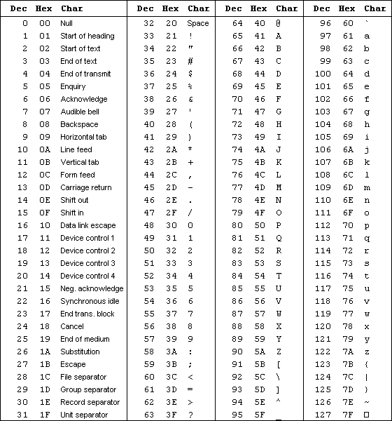
ASCII Table

Slide 7

Extended ASCII Table

