Slide 1
ArrayLists

Slide 2
Collections
Java provides an interface called Collections.
A collection represents a group of objects, known as its elements.
Some collections allow duplicates, List, and others do not, Set. Some are ordered, i.e. preserves the insertion order, List, some are not, Set.
We will look at an ordered collections of type List:
ArrayList
Lists allow duplicate elements

Slide 3
ArrayLists
Java includes the ArrayList class
Must import java.util.ArrayList;
Works much like an array with extra features and methods.
Like an array, an ArrayList contains elements that are accessed using an integer index
Unlike arrays, the size of an ArrayList is not fixed, expands as needed-dynamically resizable.
Contains an array of object references

Slide 4
ArrayLists Disadvantages
Because only object references can be placed into an ArrayList, you cannot use primitive data types like int or double etc.
Use ArrayList when there will be a large variation in the amount of data that you would put into an array.
Arrays should be used when there is a constant amount of data and for primitive data types
Class Definition:
http://docs.oracle.com/javase/7/docs/api/java/util/ArrayList.html

Slide 5
Creating ArrayLists
To create an ArrayList of Strings:
ArrayList<String> streets = new ArrayList<String>();
Object type is ArrayList, and the type of data it will hold is references to Strings
Note the “angle brackets” on each side of String
ArrayList is a generic type, which means that its constructor specifies both the type of object to construct and the type that the new object will hold.
The type the object will hold is placed inside angle brackets like this: <DataType>.
By default starts out with 10 empty cells.

Slide 6
Capcity & Size
ArrayList has:
a capacity (number of available cells) and
a size (number of cells that have data in them).
streets.size() returns the size of the ArrayList i.e the number of cells that have data in them.

Slide 7
Adding Elements to ArrayLists
streets
Adds three string references to streets
streets.add(“Grafton Street”);
streets.add(“Capel Street”);
streets.add(“South Anne Street”);
Grafton Street
Capel Street
South Anne Street
Various Methods

Slide 8
Adding Elements to ArrayLists
boolean add(E element)
Appends an element to the end of the list
Returns success of add method, (returns false if the collection doesn’t permit duplicates and already contains the element)
void add(int index, E element)
Inserts the element at the specified position
Shifts the current element at the position to the right (adds one to their indices)
E set(int index, E element)
Replaces the element at index with the new element passed in.
Returns the element previously at the specified position
E indicates a reference to an object, in this example a String

Slide 9
Adding Elements to ArrayLists
streets.set(0, “William Street”);
streets.add(2, “HenryStreet”);
//shifted “South Anne Street” to
next position
streets
William Street
Grafton Street
Capel Street
Henry Street
South Anne Street
Various Methods

Slide 10
Getting Elements from ArrayList
Return the four string references in streets
streets.get(0); // William Street
streets.get(1); // Capel Street
streets.get(2); // Henry Street
streets.get(3); // South Anne Street
Search list and find the first occurrence of:
streets.indexOf(“Capel Street”);
Returns index 1
If did not exist would return -1
Search list & check if element exists in list:
streets.contains(“Capel Street”);
Returns true
If did not exist would return false

Slide 11
Removing Elements from ArrayList
remove( int index ) method
Removes element at index, returns the element removed
All other elements are shifted over one to the left to fill the gap (subtracts one from their indices)
IndexOutOfBoundsException if index does not exist.

Slide 12
Looping through ArrayList
If you need to access elements of ArrayList one by one
There are a number of ways to do this:
For loop
For Each Loop
1. For Loop:
Access with a get() method
for (int i=0; i < streets.size(); i++) { System.out.println( streets.get(i) ); }

Slide 13
Looping through ArrayList
2. For Each Loop:
for(String s : streets) { System.out.println(s); }
The enhanced for-loop is a popular feature introduced with the Java SE platform in version 5.0. Its simple structure allows one to simplify code by presenting for-loops that visit each element of an array/collection without explicitly expressing how one goes from element to element,
Specifically designed for iteration over collections and arrays
Syntax:
for (data_type variable: array_name){
…..
}
They can be used when you wish to step through the elements of the array in first-to-last order, and you do not need to know the index of the current element

Slide 14
Enhanced For (For Each) Loop
class EnhancedForDemo {
public static void main(String[] args){
int[] numbers = {1,2,3,4,5,6,7,8,9,10};
for (int item : numbers) {
System.out.println("Count is: " + item); }
}
}
In this example, the variable item holds the current value from the numbers array.
Count is: 1
Count is: 2
..
Count is: 10

Slide 15
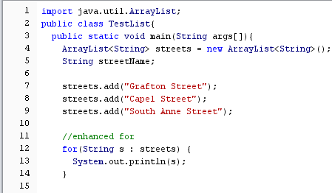

Sample Code
Output

Slide 16
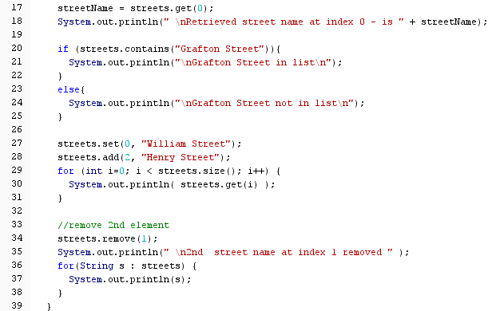
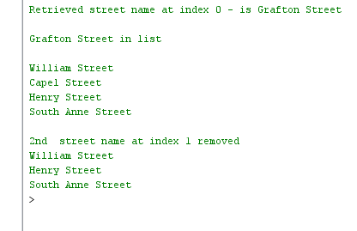
Output

Slide 17
Sample code
//creating an arraylist of PersonClass objects
PersonClass p2 = new PersonClass("Zak", 99);
ArrayList<PersonClass> persons = new ArrayList<PersonClass>();
persons.add(new PersonClass("Able",10));
persons.add(new PersonClass("Bob", 12));
persons.add(new PersonClass("Carol",16));
persons.add(p2);
for(PersonClass p : persons) {
p.print();
}
/*outputs
Name Able
Age 10
Name Bob
Age 12
Name Carol
Age 16
Name Zak
Age 99 */

Slide 18
Wrapper classes
ArrayLists only hold objects, if we want to use primitive data we need to use Wrapper classes, i,e, to have an arrayList of ints you must use the Integer wrapper class. Conversion between primitive types and corresponding wrapper classes is automatic.
Double d = 28.65;
double primD = d;
System.out.println(" Primitive "+d);
Wrapper classes
Primitive Type | Wrapper Class
boolean | Boolean
char | Character
byte | Byte
short | Short
int | Integer
long | Long
float | Float
double | Double

Slide 19
ArrayLists of Wrapper classes
Remember to use Wrapper classes for arraylists of primitives.
ArrayList<Integer> values = new ArrayList<Integer>();
values.add(10);
values.add(20);
Exercise:
Write the code snippet that would create an ArrayList of integers. Write a loop that would insert the numbers 1 to 20 into the ArrayList.

Slide 20
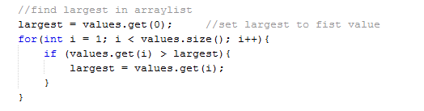
Exercise
Print the array list using for each loop
Find the largest in the arraylist

Slide 21
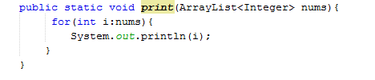
Exercise
Remove the value 13 from the list
Call print method by passing arraylist name to it
Static method to print arrayList – parameter is arrayList of integers

Slide 22
Vector
Implements a dynamic array
Similar to ArrayList, but two differences:
Vector is synchronized
Data Growth Methods
A Vector defaults to doubling the size of its array, while the ArrayList increases its array size by 50 percent.
Vector contains many legacy methods that not are not part of the collections framework
Rule of thumb is to use ArrayLists if there are no specific requirements to use Vectors.

Slide 23
Vector
import java.util.Vector
Vector<String> street=new Vector<String>();
street.add(“Grafton Street”);
street.get(0);
street.elementAt(0);
street.contains(“Grafton Street”);
street.remove(0);
street.size();

