Slide 1
Arrays of Objects

Slide 2
There are 52 cards in a deck, each of which belongs to one of four suits and one of 13 ranks.
The suits are Spades, Hearts, Diamonds and Clubs.
The ranks are Ace, 2, 3, 4, 5, 6, 7, 8, 9, 10, Jack, Queen and King.
Depending on what game you are playing, the rank of the Ace may be higher than King or
lower than 2.
If we want to define a new object to represent a playing card,
it is pretty obvious what the instance variables should be:
rank and suit.
It is not as obvious what type the instance variables should be.
One possibility is Strings, containing things like "Spade" for suits and "Queen" for ranks.
One problem with this implementation is that it would not be easy to compare cards to see
which had higher rank or suit.
An alternative is to use integers to encode the ranks and suits.
The obvious feature of this mapping is that the suits map to integers in order, so we can compare suits
by comparing integers.
The mapping for ranks is fairly obvious; each of the numerical ranks maps to the
corresponding integer, and for face cards:
Spades | -> | 3
Hearts | -> | 2
Diamonds | -> | 1
Clubs | -> | 0
Jack | -> | 11
Queen | -> | 12
King | -> | 13

Slide 3
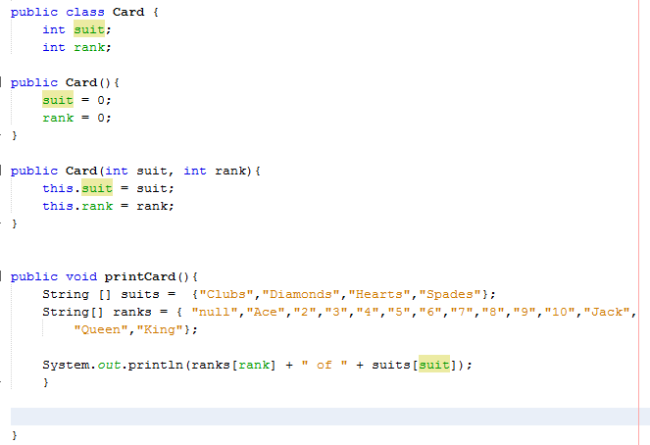
To create an object that represents the 3 of Clubs, we would use the new command:
Card threeOfClubs = new Card (0, 3); The first argument, 0 represents the suit Clubs.

Slide 4
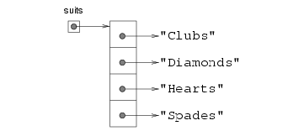
In order to print Card objects in a way that humans can read easily, we want to map the integer codes onto words. A natural way to do that is with an array of Strings. You can create an array of Strings the same way you create an array of primitive types:
String[] suits = new String [4]; Then we can set the values of the elements of the array.
suits[0] = "Clubs"; suits[1] = "Diamonds"; suits[2] = "Hearts"; suits[3] = "Spades"; Creating an array and initializing the elements is such a common operation that Java provides a special syntax for it:
String[] suits = { "Clubs", "Diamonds", "Hearts", "Spades" };
The effect of this statement is identical to that of the separate declaration, allocation, and assignment. A diagram of this array might look like:

Slide 5
Card Class
We need is another array of Strings to decode the ranks:
String[] ranks = { "null", "Ace", "2", "3", "4", "5", "6", "7", "8", "9", "10", "Jack", "Queen", "King" }; The reason for the "null" is to act as a place-keeper for the zeroeth element of the array, which will never be used. The only valid ranks are 1--13. This wasted entry is not necessary, of course. We could have started at 0, as usual, but it is common to encode 2 as 2, and 3 as 3, etc.

Slide 6
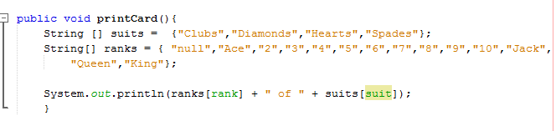
Using these arrays, we can select the appropriate Strings by using the suit and rank as indices. In the method printCard,
the expression suits[suit] means "use the instance variable suit from the object as an index into the array named suits, and select the appropriate string." The output of this code
Card card = new Card (1, 11); card.printCard ();
is Jack of Diamonds.

Slide 7

Array of Cards
Arrays of cards
There is an obvious use for an array of cards---a deck. Here is some code that creates a new deck of 52 cards:
Card[] deck = new Card [52]; Here is the diagram for this object:
The important thing to see here is that the array contains only references to objects; it does not contain any Card objects. The values of the array elements are initialized to null. You can access the elements of the array in the usual way:
if (deck[3] == null) { System.out.println ("No cards yet!"); }

Slide 8
Array of Cards
But if you try to access the instance variables of the non-existent Cards, you will get a NullPointerException.
deck[2].rank; // NullPointerException (rank is package access so direct access allowed)
Nevertheless, that is the correct syntax for accessing the rank of the "twoeth" card in the deck (really the third---we started at zero).
The easiest way to populate the deck with Card objects is to write a nested loop:
int index = 0; for (int suit = 0; suit <= 3; suit++) { for (int rank = 1; rank <= 13; rank++) { deck[index] = new Card (suit, rank); index++; } }

Slide 9
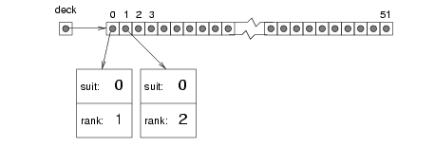
Array of Cards
The outer loop enumerates the suits, from 0 to 3. For each suit, the inner loop enumerates the ranks, from 1 to 13. Since the outer loop iterates 4 times, and the inner loop iterates 13 times, the total number of times the body is executed is 52 (13 times 4).
The variable index is used to keep track of where in the deck the next card should go. The following diagram shows what the deck looks like after the first two cards have been allocated:

Slide 10
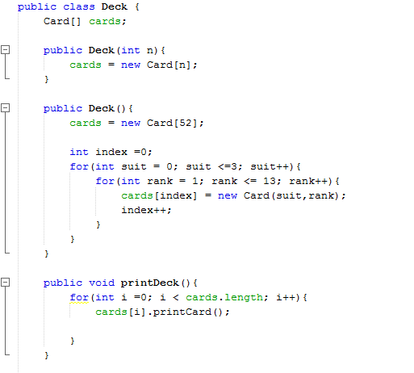
Deck class
As usual, the default constructor initializes the instance variable, but in this case it uses the new command to create the array of cards. It doesn't create any cards to go in it, though. For that we could write another constructor that creates a standard 52-card deck and populates it with Card objects:

Slide 11
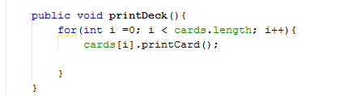
Print the deck of cards
Whenever you are working with arrays, it is convenient to have a method that will print the contents of the array. We have seen the pattern for traversing an array several times, so the following method should be familiar:
Access each card in deck and call the printCard method on that card object

Slide 12
The compareCards method
For primitive types, there are conditional operators that compare values and determine when one is greater or less than another. These operators (< and > and the others) don't work for object types. For Cards we have to write our own, which we will call compareCards.
The set of playing cards is partially ordered, which means that sometimes we can compare cards and sometimes not. For example, we know that the 3 of Clubs is higher than the 2 of Clubs, and the 3 of Diamonds is higher than the 3 of Clubs. But which is better, the 3 of Clubs or the 2 of Diamonds? One has a higher rank, but the other has a higher suit.
In order to make cards comparable, we have to decide which is more important, rank or suit. The choice is completely arbitrary. For the sake of choosing, we will say that suit is more important, because when you buy a new deck of cards, it comes sorted with all the Clubs together, followed by all the Diamonds, and so on.
With that decided, we can write compareCards. It will take two Cards as parameters and return 1 if the first card wins, -1 if the second card wins, and 0 if they tie .
First we compare the suits:
if (c1.suit > c2.suit) return 1; if (c1.suit < c2.suit) return -1; If neither statement is true, then the suits must be equal, and we have to compare ranks:
if (c1.rank > c2.rank) return 1; if (c1.rank < c2.rank) return -1; If neither of these is true, the ranks must be equal, so we return 0.
In this ordering, aces will appear lower than deuces (2s).

Slide 13
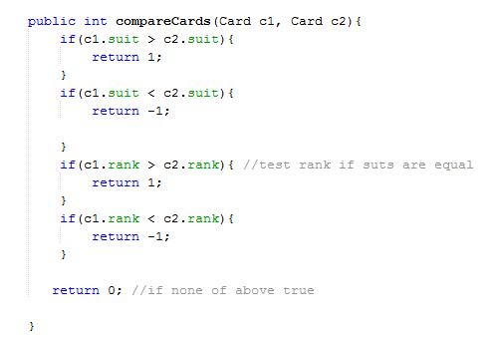
Deck Class

Slide 14
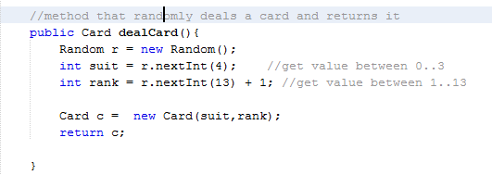
Deck Class
We can write a method that randomly selects a card from the deck. We create a random number generator and generate a random suit number and a random rank number and create and return this card
Return the randomly generated card

Slide 15
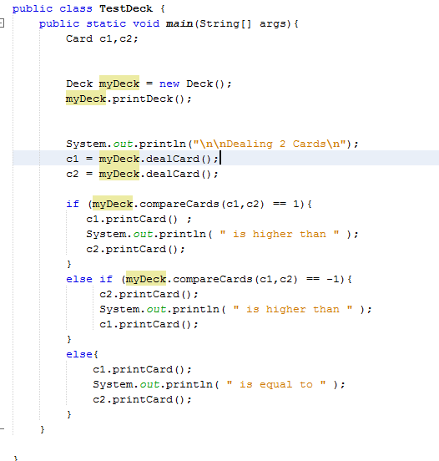
Test class
Create and print deck
Deal two cards and save them
in c1 and c2
Compare cards and print
highest

Slide 16
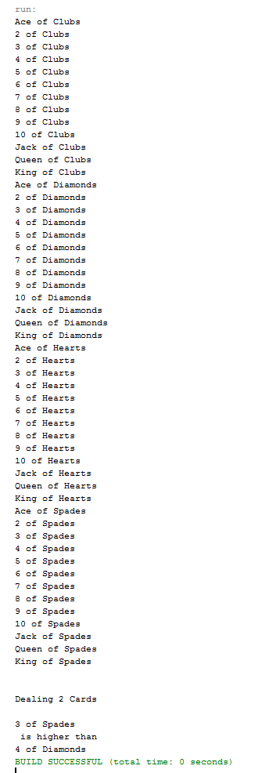
Sample Output
Deck printed
Cards dealt and compared

