Slide 1
Software Development 3
Composition

Slide 2
Composition & Inheritance
There are two ways to reuse the existing classes, namely, composition and inheritance.
With composition (or aggregation), you create a new class, which is composed of existing classes.
With inheritance, you create a new class, which is based on an existing class, with some modifications or extensions.
See example on Moodle (CompositionExample.zip)

Slide 3
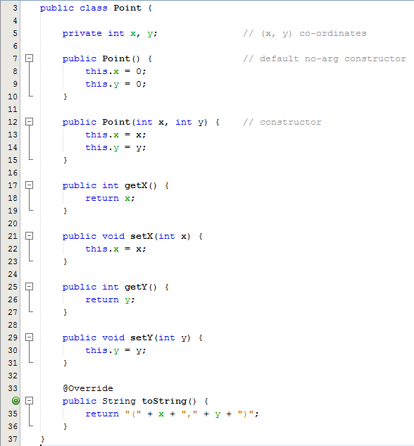
Composition Example
Here we have a class definition for a Point
A point has two member variables which represent the x and y co ordinates of the point
Default constructor
Overloaded constructor
Getter and setter methods
The toString method is overridden
Recap: The this keyword is used to refer to the current class instance variable.

Slide 4
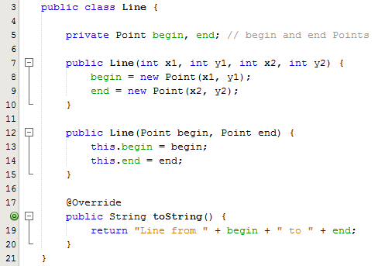
Composition Example
Suppose that we need a new class called Line, we can re-use the Point class via composition
We say that "a line is composed of two points", or "a line has two points"
Composition exhibits a "has-a" relationship
Note the parameter list for each constructor
The 1st constructor takes 4 integers as parameters
The 2nd constructor takes 2 object references of type Point as parameters

Slide 5
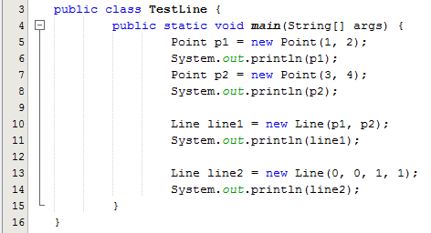
Composition Example
Line 5 creates an object reference of type Point
Line 6 is an implicit call to toString which displays the details of the Point object
Lines 7 & 8 creates and prints details of the 2nd Point object
Line 10 creates a Line object reference and passes the two Point object references as parameters. This means that the constructor on Line 12 in the Line class gets called
Line 11 is an implicit call to toString which displays the details of the line object
Line 13 creates a Line object reference and passes the 4 integer coordinates as parameters. This means that the constructor on Line 7 in the Line class gets called

