Slide 1
SOFTWARE DEVELOPMENT 3
Inner Classes

Slide 2
Inner Classes
Up to now, we have created most of our classes in their own separate files.
You can put several classes in one file as long as only one of them is a public class
You can also put the definition of one class inside another class. This inside class is called a nested class or an inner class.
A nested class can itself have another class nested inside it, if need be.
Inner classes are a useful feature because they allow you to group classes that logically belong together and to control the visibility of one within another.

Slide 3
Inner Classes
When you define an inner class, it is a member of the enclosing class in much the same way as other members.
Example
  public class Outside
  {
  // ....
  class Inside
  {
  }
  }

Slide 4
Inner Classes
Here the class Inside is nested within the class Outside.
Obviously a nested class should have some specific association with the enclosing class otherwise nesting one class inside another would not make any sense.
The enclosing class is referred to as a top-level class.
A top-level class is a class that contains a nested class but is not itself a nested class.
The nested class (Inside) only has meaning in the context of an (Outside) object being created.
In other words, until an object of type Outside has been created, you cannot create any Inside objects (' static nested classes' are an exception to this).

Slide 5
Types of Inner Classes
A member inner class is a nonstatic nested class that is declared at the member level of a class.
A local inner class is defined within a method. Because it appears within a method, making it static does not make sense.
An anonymous inner class is a special case of a local inner class that does not have a name.
Static inner classes allows for creation of objects of an inner class independent of the enclosing (outside) class

Slide 6
Inner Classes
When you create an Outside object, although you are now in a position to create an Inside object, it doesn't follow that Inside objects will be automatically created. Consider the following statement
  Outside outer = new Outside ( );
This calls a Constructor 'Outside' within the Outside class, executes it, it creates an object of data type Outside, which is referenced by the variable name 'outer'.
No objects of the nested class 'Inside' were created.

Slide 7
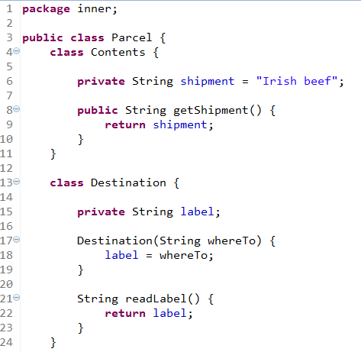
Inner Class Example Part 1

Slide 8
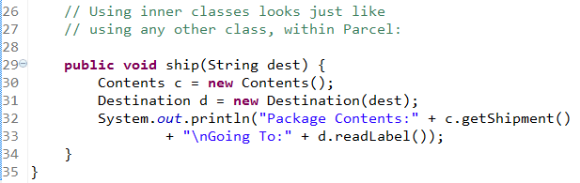
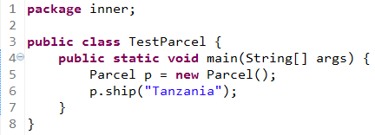
Inner Class Example Part 2
The ship() method is defined in the outer class called Parcel

Slide 9

Compilation of Inner Classes
Every class is compiled into a completely separate .class file from the outer class. The previous example has an outer class named Parcel which holds two inner classes named Contents and Destination.
When you compile this program three .class files are produced:

Slide 10
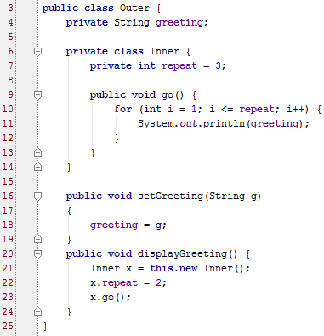
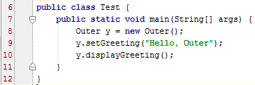
Inner Class Example 2
Running the main program causes the following sequence of events to occur:
1. An Outer object is instantiated within main and its displayGreeting method is
invoked from line 10 of the test class.
2. On line 21, an Inner object is instantiated that is associated with the Outer object. The repeat field of x is set to 2 on line 22.
4. Line 23 invokes the Inner object ’ s go method, which prints out the greeting field of y twice.
Therefore, the output is
Hello, Outer
Hello, Outer

Slide 11
Creating Inner Classes
We can create an Outside object, and by using the name of the Outside class as a qualifier, we can then create an instance of the inner class.
Outside.Inside inner = outer.new Inside ( );
Here we have created an object of the nested class type that is associated with the object, outer, created earlier. We are creating an object of type Inside in the context of the object outer.
Nested classes are typically used to define objects that at least have a strong association with objects of the enclosing class type, and often there is a tight coupling between the two.

Slide 12
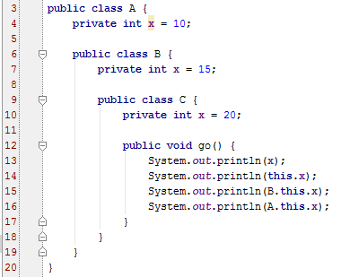
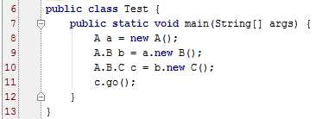
Example 3 -Use of this keyword
A breakdown of the code in the A class follows:
1. An object of type C is instantiated using an instance of A and B , and its go method is
invoked.
2. The x on line 13 is implicitly referring to this.x, so 13 and 14 display the same value,
which is 20 . (The this reference inside the C class refers to the C object.)
3. To access the x field of the B object, prefix the this keyword with the B class name:
B.this.x . Line 15 displays 15 .
4. Similarly, the x in A is A.this.x , which is displayed on line 16.
Keep in mind the syntax A.this and B.this is unique to inner classes only. The output
of running main is
20
20
15
10

Slide 13
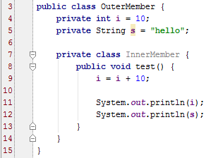

Example 4 –Private member Class
Note on line 7 that the class has been given private access
Because of this we cannot access this class outside of the OuterMember class
Note the error below in the test class

Slide 14
Local Inner Classes
Classes that are defined within a single method
Never declared with an access modifier – they are always restricted to the method in which they are declared
Hidden from outside world – not even other methods in the same class can access them
A local inner class is a nested class defined within a method. Like local variables, a local inner class declaration does not exist until the method is invoked, and it goes out of scope when the method returns.

Slide 15
Local Inner Classes
That means if you define an inner class locally, you can only create instances from within the method.
Local inner classes have the following properties:
  Local inner classes do not have an access specifier.
  Local inner classes cannot be declared static , nor can they declare static fields or methods.
  Local inner classes have access to all the fields and methods of its enclosing class.
  A local inner class does not have access to the local variables of method unless those variables are final.

Slide 16
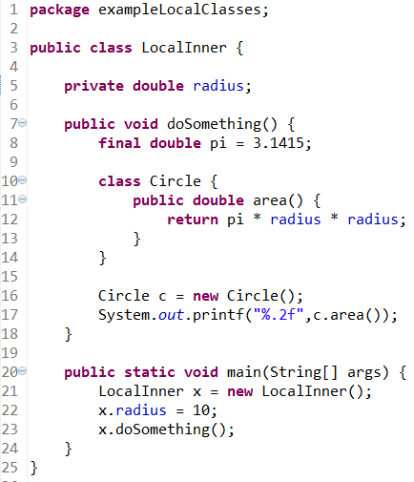
Example 1 -Local Inner Classes
This class demonstrates a local inner class:
The doSomething method contains a local inner class named Circle . The Circle class
declares a method named area that refers to the pi variable from line 8, which is only valid
because pi is final . Circle also refers to radius on line 12, which is valid because radius is a
field of the outer class.
The code compiles fine, the value of radius is 10, so the output is
314.15
By the way, compiling LocalInner.java creates two bytecode files: LocalInner.class
and LocalInner $1Circle.class . The compiler adds a 1 to the name of the Circle class
because it is possible that a different method in the class defines another local class named
Circle .

Slide 17
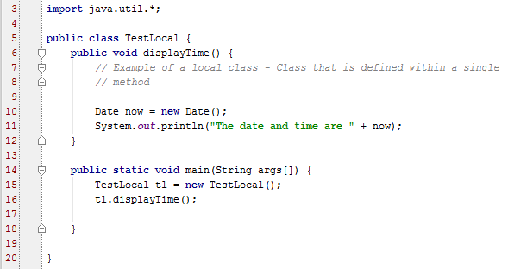
Example 2 -Local Inner Classes
This class demonstrates another local inner class which creates a Date object. Note the use of the import statement in order to use the Date class
Note also that the main method is written here as part of the outer class

Slide 18
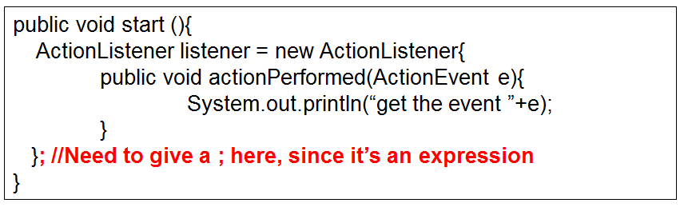
Anonymous Inner Classes
An anonymous inner class is a local inner class that does not have a name. It is declared and instantiated all in one statement using the new keyword. Anonymous inner classes either extend an existing class or implement an existing interface.
Anonymous classes have no constructors
Often used in Swing when creating GUI objects

Slide 19
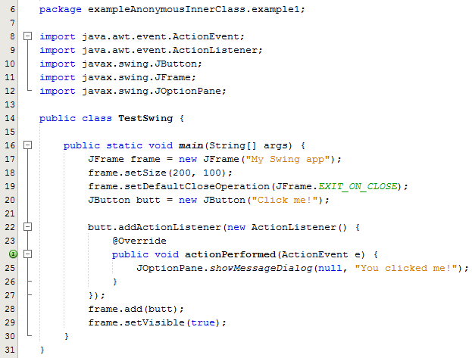
Example 1: Anonymous Inner Classes
Lines 22-27 demonstrate the use of an inner class for event handling in Java
Line 22: The method addActionlistener is called to register an event handler for the button action events
The new ActionListener is providing the code for the ActionListener interface and as that interface only has the actionPerformed method you just declare it there inside the curly brackets
The anonymous class is used as a parameter to the addActionListener method

Slide 20
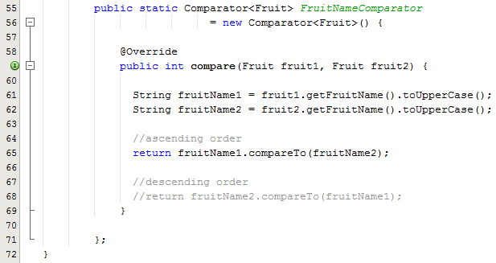
Example 2: Anonymous Inner Classes
We have created a anonymous inner class that implements the Comparator interface and an instance of this class at the same time.
This is the only time in java, where we have implemented an interface without even having a name of the class and nor using implement keyword.

Slide 21
Static Inner Classes
To make objects of an inner class independent of the enclosing (outside) class, you can declare the inner class as static.
This can have a number of consequences, one of which is the inner class loses its ability to contain other inner classes.
The following code declares a public static nested class. This nested class can access the various static members of the enclosing class.
However, unlike inner classes, it cannot access any instance variables in the enclosing class. This is an important difference between static nested classes and inner classes. Note compile error in following code

Slide 22
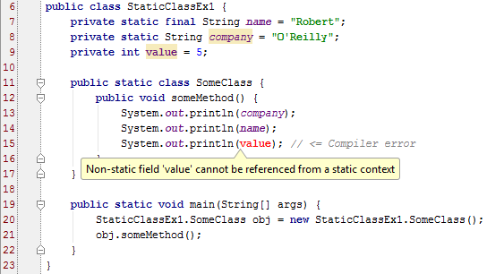
Example – Static Inner Classes
To make objects of an inner class independent of the enclosing (outside) class, you can declare the inner class as static.
This can have a number of consequences, one of which is the inner class loses its ability to contain other inner classes.
The code here declares a public static nested class. This nested class can access the various static members of the enclosing class.
However, unlike inner classes, it cannot access any instance variables in the enclosing class. This is an important difference between static nested classes and inner classes. Note compile error in following code

Slide 23
Example – Static Inner Classes
To make objects of an inner class independent of the enclosing (outside) class, you can declare the inner class as static.
This can have a number of consequences, one of which is the inner class loses its ability to contain other inner classes.
The code here declares a public static nested class. This nested class can access the various static members of the enclosing class.
However, unlike inner classes, it cannot access any instance variables in the enclosing class. This is an important difference between static nested classes and inner classes. Note compile error in following code

Slide 24
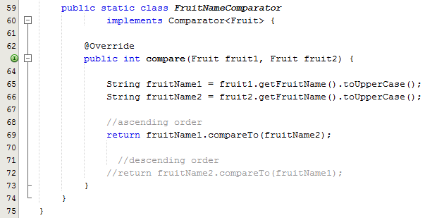
Example – Static Inner Classes
In this example we have created a custom Comparator as a static inner class
This class can access the properties of Fruit for comparison and also is only used in the context of Fruit class.
Line 19: This is the call to the sort method in the test class
Note the 2nd parameter to the sort method which is a call to the default constructor of the static class which is contained within the class Fruit

Slide 25
Reasons for Creating an Inner Class
Inner classes can access data from the enclosing class that would otherwise be private
Often used to handle events (Java Swing)
Inner classes can be hidden from classes in the same package
Anonymous inner classes are useful when you want to use a ready-made class without writing a lot of code (Java Swing Event Handling)

