Slide 1
Software Development 3
Interfaces – Part 2

Slide 2
Polymorphism and Conformance
When a class inherits from a superclass, instances of both classes are of the same type
This is known as Conformance
Example Dog is a subclass of Animal so Dog is of type Dog and of type Animal
We can say Dog is of type Dog and conforms to type Animal
This is the basis of Polymorphism
Similarly when two classes both implement the same Interface, instances of both classes are of the same type
Example from Moodle:
Book is of type LoanItem and CD is of type LoanItem
We can say Book and CD conform to type LoanItem

Slide 3
Interfaces and Polymorphism
Classes implementing the same Interface are of the type of the Interface in addition to their own type
Book is of type Book and of type LoanItem
CD is of type CD and of type LoanItem
Because of this we can use classes implementing the same Interface in a polymorphic way, as we did with inheritance
Polymorphic Collections
Polymorphic Parameters
Notes:
Intefaces allow you to define behaviours among unrelated classes.

Slide 4
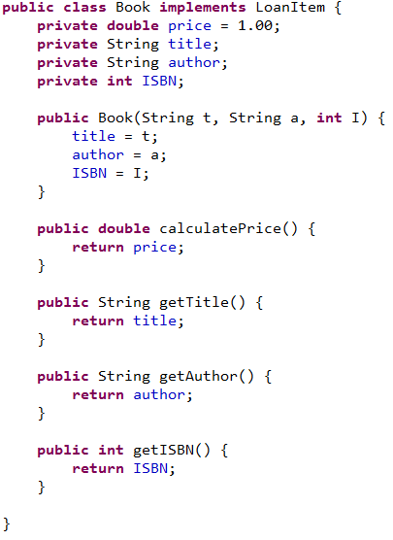
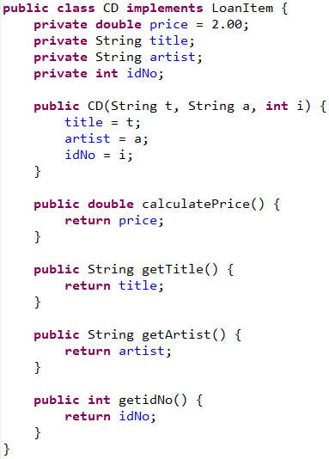
Example 1 – Polymorphic Array

Slide 5
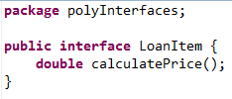
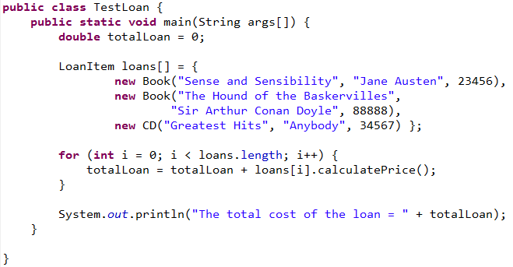
Example 1 – Polymorphic Array
Using an interface reference, we can polymorphically invoke any method
specified in the interface declaration

Slide 6
Interfaces & Polymorphism
Interface variable holds reference to object of a
class that implements the interface
Array of type LoanItem holds references to objects
of classes Book and CD that implements the interface
The type of the object is some class that implements
the LoanItem interface
Using an interface reference, we can polymorphically invoke any method specified in the interface declaration

Slide 7
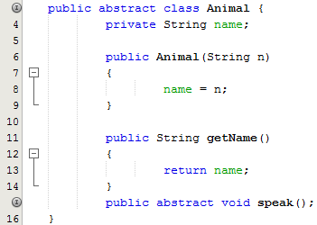

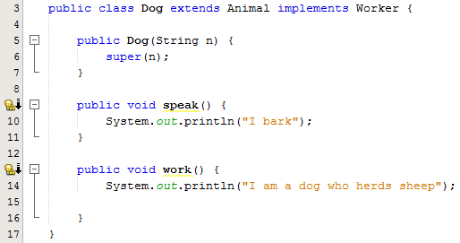
Example 2
In this example we have an interface called Worker with just 1 abstract method work
The abstract animal is defined with an abstract method called speak
The Dog class is a sub class of Animal and it also implements the interface Worker
Hence the implementation of both the speak and work methods in this class

Slide 8
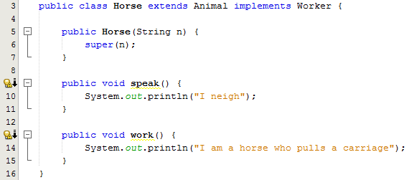
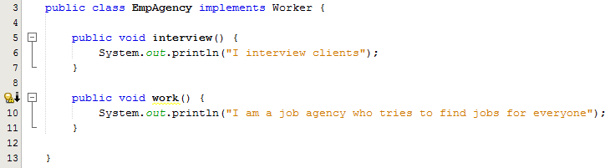
Example 2
The Horse class is a sub class of Animal and it also implements the interface Worker
However, the EmpAgency class is not part of the Animal hierarchy but it does implement the interface Worker and therefore has it’s own implementation of the work method

Slide 9
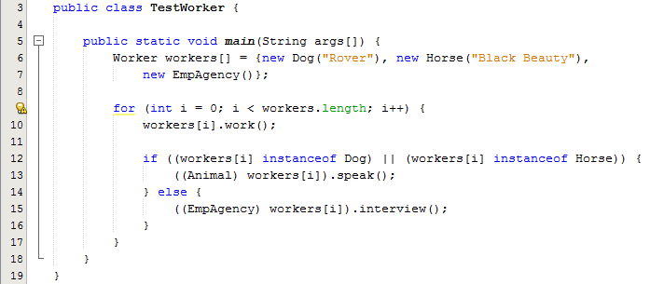
Example 2
Note the use of the Interface variable to hold references to objects of a class that implements the interface i.e. Dog, Horse, EmpAgency
The work method is called polymorphically
In order to call methods particular to the Animal and EmpAgency classes you need a cast to convert from an interface (Worker) type to a class type (Animal or EmpAgency)

Slide 10
Comparing Abstract Classes and Interfaces
You cannot instantiate either abstract classes or interfaces
Abstract classes can contain non-abstract methods but interfaces cannot
Abstract classes can contain non-static and non-final variables
In an interface all variables are public, static and final, while an abstract class can contain variables that are private, protected or default
Both interfaces and abstract classes facilitate polymorphism

