Slide 1
SOFTWARE DEVELOPMENT 3
PACKAGES

Slide 2
Packages
For a small project it's often most convenient to place all the java files we are developing into a single directory.
If the project gets larger and the code being developed has a variety of functions e.g. database access, network i/o then it becomes an organisational nightmare having all code in one directory

Slide 3
Packages
Packages are nothing more than the way we store files in directories/folders according to their functionality or usability
The package name and the directory structure must match e.g. a package called aaa.bbb.ccc will contain files in a subdirectory: aaaa/bbbb/cccc ;
e.g. you could take all your code pertaining to reading/writing files into a single package and import this code when you need it.

Slide 4
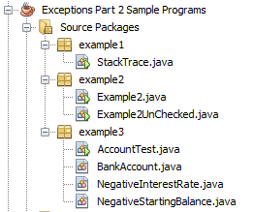
Packages
The following project has 3 packages

Slide 5
Packages
A Package is a named group of classes. They are used to provide order and structure for developers when programming large systems using many classes. The idea behind packages is to make it easier to use these classes in your program code.
Every class in Java is contained in a package. The classes you have programmed to-date have implicitly been in the default package.

Slide 6
Packages
In NetBeans you can create a package and then create your classes within this package.
When you do this the first line in your class will be the name of the package. For example:
    <code>
    package Geometry;
    public class Sphere
    {
    // Details of the class definition
    }
    </code>
If you want your classes to be accessible outside the package, you must declare them as public.

Slide 7
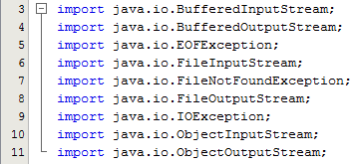
Packages
You can add all or any of the public classes in a package to your program either by:
1) using the fully qualified class name or
2) by using the standard import statement.

Slide 8
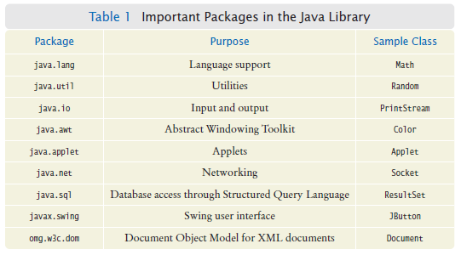
Packages
All of the standard classes that are provided with Java are stored in standard packages. There is a growing list of standard packages (209 in Java 7) but some of the most frequent are :
Source:Big Java 4th Ed Cay Horstmann

Slide 9
Package Access
If a class, field or method has no public or private modifier, then all methods of classes in the same package can access the feature
For example, if a class is declared without an access modifier, then only the other classes in the same package can use it
However if a class is declared as public, then all other classes in other packages can use it
Package access for instance variables is rarely useful and usually happens because the programmer forgot the private reserved word

Slide 10
Access Levels
As a general rule of thumb (which you can violate if you have a reason to do so):
  Classes are public
  Constructors are public
  Getter and Setter methods are public
  Instance variables are private
  Other methods must be decided on a case by case basis.

Slide 11
Class Members Accessibility Criteria
Access control modifiers vary depending on what component you are specifically referring to. For example
  Variables and methods can be at one of four access control levels:
1) public, 2) protected, 3) default, or 4) private.
  Classes can be at one of two levels:
1) public or 2) default level.
Private access is permitted in inner/nested classes
A variable, method, or class has "default" accessibility if it does not have an explicit protection modifier as part of its declaration. Such accessibility means that access is permitted from any method in classes that are members of the same package (Slide 9)

Slide 12
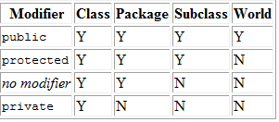
Class Members Accessibility Criteria:
Notes:
The first data column indicates whether the class itself has access to the member defined by the access level. As you can see, a class always has access to its own members. The second column indicates whether classes in the same package as the class (regardless of their parentage) have access to the member. The third column indicates whether subclasses of the class declared outside this package have access to the member. The fourth column indicates whether all classes have access to the member.

