Slide 1
SOFTWARE DEVELOPMENT 3
RANDOM ACCESS FILES

Slide 2
File Organisation
Sequential Access
  Ordered or unordered records
  Accessed sequentially from beginning to end
  Good for batch processing
    Same tasks with many records one after another
  Inappropriate for "instant-access" applications in which a particular record of information must be located immediately
  For example:
    Airline reservation systems
    Banking systems
    Other transaction-processing systems

Slide 3
File Organisation
Random Access Files (RAF)
  Real-time applications require different organisation –
      Immediate access
      This kind of access is possible with RAF
      Individual records of a random access files can be accessed directly without searching through other records
      These files are sometimes called direct-access files.
    Use calculation which provides address location of the record followed by direct access to that record

Slide 4
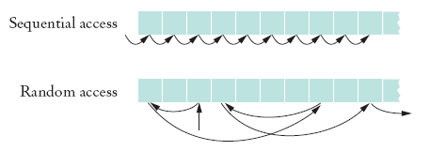
RAF
Allows access at arbitrary locations in the file
Each disk file has a special file pointer position
You can read or write at the position where the pointer is

Slide 5
RAF
You can open a file either for
Reading only ("r")
Reading and writing ("rw")
RandomAccessFile f = new RandomAcessFile("bank.dat","rw");
To move the file pointer to a specific byte f.seek(n);
To get the current position of the file pointer.
    long n = f.getFilePointer();
    // of type "long" because files can be very large
To find the number of bytes in a file
    long fileLength = f.length();

Slide 6



Sample Program
Use a random access file to store a set of bank accounts
Program lets you pick an account and deposit money into it
To manipulate a data set in a file, pay special attention to data formatting
  Suppose we store the data as text
  Say account 1001 has a balance of €900, and account 1015 has a balance of 0
  We want to deposit €100 into account 1001
  If we now simply write out the new value, the result is

Slide 7
Sample Program
A better way to manipulate a data set in a file is to give each value a fixed size that is sufficiently large
Every record has the same size
Easy to skip quickly to a given record
To store numbers, it is easier to store them in binary format

Slide 8
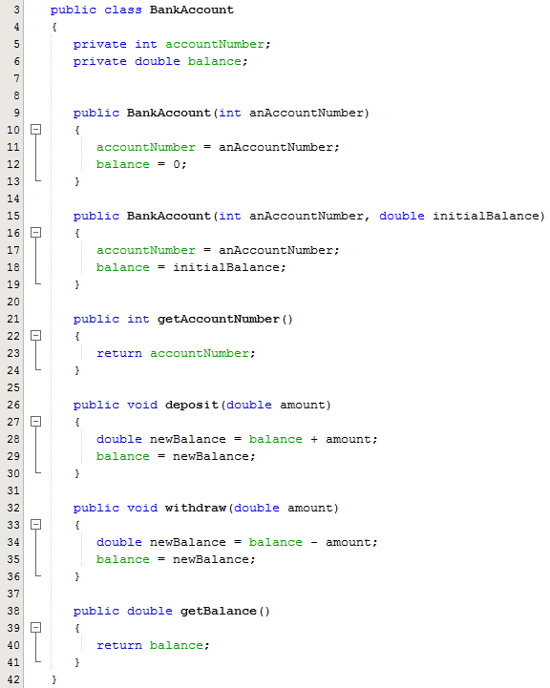
Sample Program BankAccount
This is a regular class definition for BankAccount with 2 members for account number and the bank balance
Default Constructor
Overloaded Constructor
Getter methods
deposit method
withdraw method

Slide 9
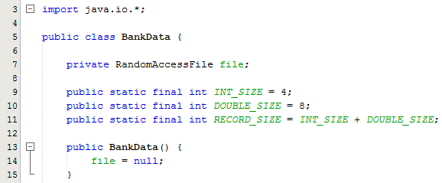
Sample Program BankData
This class has 4 members
  Reference variable of type RandomAccessFile
  3 final static integers
Line 10: This represents 4 bytes which is the number needed to store an integer – the account number is an integer
Line 11: This represents 8 bytes which is the number needed to store a double – the bank balance is a double
Line 12 is the total size of a record which is 8 and 4 added together
Constructor sets reference to null

Slide 10
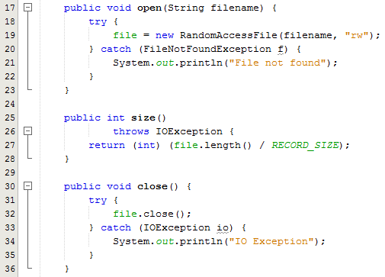
Sample Program BankData
Open method takes the name of the file to be opened as a parameter and opens the file by calling on the constructor. Note the use of the try catch block to handle the exception if the file is not found
The size method returns the number of bank accounts (records) in the file. This method doesn’t handle the IOException but declares it
The close method closes the RAF – try catch block is used for exception handling

Slide 11
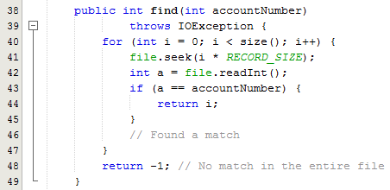
Sample Program BankAccount
The find method accepts the account number we are looking for as a parameter
Note the call to the size method in the for loop
The seek method is called to move the file pointer to a specific byte in the file in order to read the account number
The value is compared to the local parameter accountNumber and if there is a match then the account number is returned out of the method, otherwise -1 is returned indicating that the account number is not in the file

Slide 12
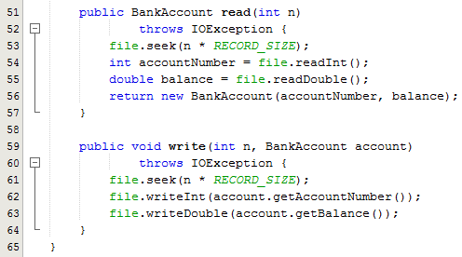
Sample Program BankAccount
The read method takes the record number as a parameter
The seek method is then called to move the file pointer to the correct byte
The two values are then read using the readInt() and readDouble() methods
The values are then passed into the BankAccount constructor and a new BankAccount object is created
The write method takes the last record number and a BankAccount object reference as parameters
The seek method is then called to move the file pointer to the correct byte
The two values are then read using the writeInt() and writeDouble() methods

Slide 13
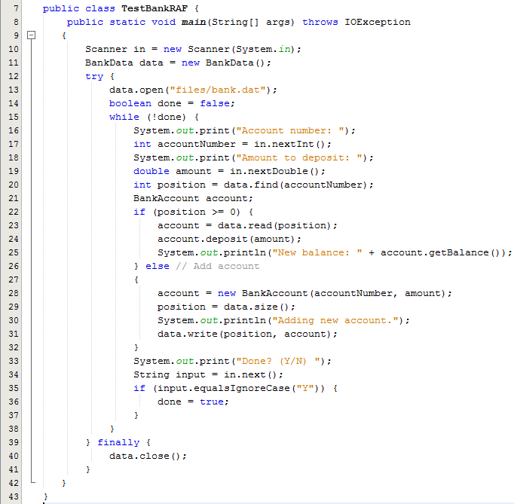
Sample Program TestBankRAF
Line 11: Instantiate the BankData class
Line 13: Open the file
Line 15: Use a loop to process the file
Ask user to enter the account number and the amount to deposit
Call the find method to search for the account
If the account is found then call the read method which returns a BankAccount object reference
Line 24: Call the deposit method to deposit the amount into the account
If the account is not found then create a new BankAccount object and write it to the file
Note the use of the try block with finally instead of catch

Slide 14
Sample Program
RandomAccessFile class stores binary data
readInt and writeInt read/write integers as four-byte quantities
readDouble and writeDouble use 8 bytes
  double x = f.readDouble();
  f.writeDouble(x);
To find out how many bank accounts are in the file
  public int size() throws IOException
    { return (int) (file.length() / RECORD_SIZE);
    // RECORD_SIZE is 12 bytes:
    // 4 bytes for the account number and
    // 8 bytes for the balance
    }

Slide 15
Sample Program
To read the nth account in the file
public BankAccount read(int n) throws IOException
  {
    file.seek(n * RECORD_SIZE);
    int accountNumber = file.readInt();
    double balance = file.readDouble();
    return new BankAccount(accountNumber, balance);
  }

Slide 16
Sample Program
To write the nth account in the file
  public void write(int n, BankAccount account) throws IOException
  {
  file.seek(n * RECORD_SIZE); file.writeInt(account.getAccountNumber()); file.writeDouble(account.getBalance());
  }

Slide 17
RAF Methods()
getFilePointer()
  Current position of file pointer
length()
  Returns length of file as a long
seek(long pos)
  Sets the file pointer at pos
Read methods
  readInt(), readDouble(), readLine(), readUTF() etc.
Write methods
  writeInt(int v), writeDouble(double v), writeUTF(String str) etc.

Slide 18
Calculate the File Size
Each record has to be the same length
The length depends on the data to be stored in the record
This is calculated by adding the number of bytes necessary to store each primitive or String
Primitive or String | No. Of Bytes
int | 4
double | 8
float | 4
long | 8
char | 2
String | 2 bytes per character
boolean | 1 bit

