Slide 1
SOFTWARE DEVELOPMENT 3
Wait(), notifyAll() methods

Slide 2
Producer Consumer Problem
This problem is one of the small collection of standard, well-known problems in concurrent programming: a finite-size buffer and two classes of threads, producers and consumers, put items into the buffer (producers) and take items out of the buffer (consumers).
A producer must wait until the buffer has space before it can put something in, and a consumer must wait until something is in the buffer before it can take something out.

Slide 3
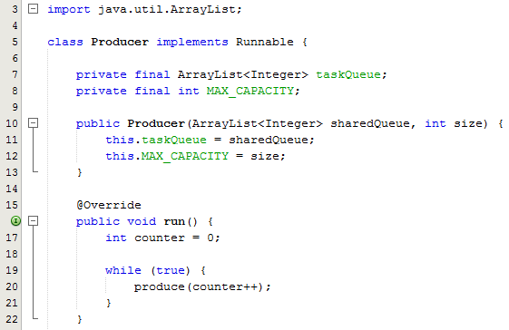
Sample Program – Part 1
Producer class implements Runnable
ArrayList which holds the integers
MAX_CAPACITY used to set the capacity of the producer
Constructor initialises both members
Run method calls the produce method. The code to call this method has been written inside an infinite loop so that producer keeps producing elements at regular intervals.

Slide 4
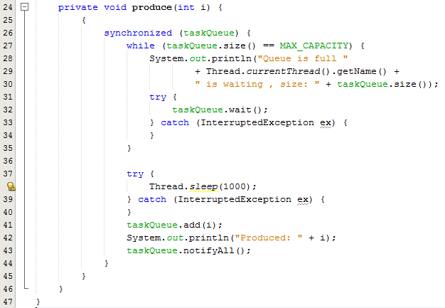
Sample Program – Part 2
Line 26: Note the use of the synchronized keyword – access to the array list will be synchronized
Lines 27-35
  A while loop is used to check if the producer has filled the capacity of the array list. While the capacity has been reached the wait() method is called – see further explanation on next slide

Slide 5
Sample Program – Part 2
Line 32: It tells the calling thread to give up the lock and wait until some other thread enters the same monitor and calls notify()
The wait() method releases the lock prior to waiting and reacquires the lock prior to returning from the wait() method
Lines 37-40 thread will sleep for 1 second
Lines 41-43 Once the wait() is over, producer adds an element in taskQueue and calls the notifyAll() method. Because the last-time wait() method was called by consumer thread (that’s why producer is out of waiting state), consumer gets the notification.

Slide 6
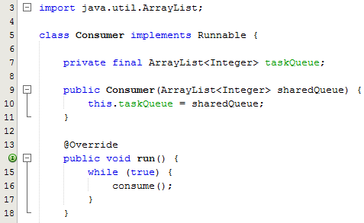
Sample Program – Part 3
Consumer class implements Runnable
ArrayList which holds the integers
MAX_CAPACITY used to set the capacity of the consumer
Constructor initialises both members
Run method calls the consume method. The code to call this method has been written inside an infinite loop so that consumer keeps consuming elements at regular intervals.

Slide 7
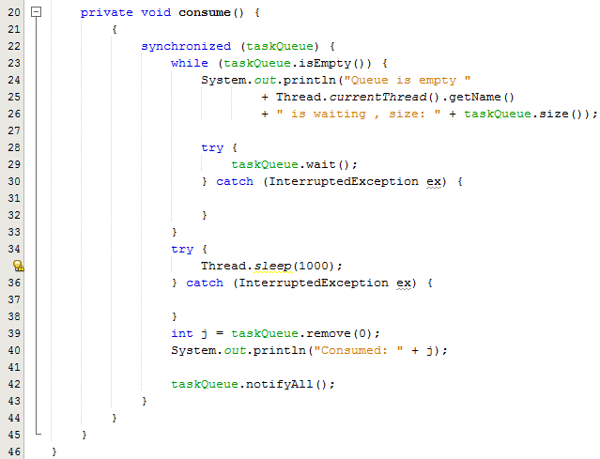
Sample Program – Part 3
Line 22: Note the use of the synchronized keyword – access to the array list will be synchronized
Lines 23-33
  A while loop is used to check if the consumer has consumed all the values in the array list. While the capacity has been reached the wait() method is called – see further explanation on next slide

Slide 8
Sample Program – Part 3
Line 29: It tells the calling thread to give up the lock and wait until some other thread enters the same monitor and calls notify()
The wait() method releases the lock prior to waiting and reacquires the lock prior to returning from the wait() method
Lines 34-38 thread will sleep for 1 second
Lines 39-42 Once the wait() is over, the consumer consumes the elements from the taskQueue and calls the notifyAll() method. Because the last-time wait() method was called by producer thread (that’s why consumer is out of waiting state), producer gets the notification.

Slide 9
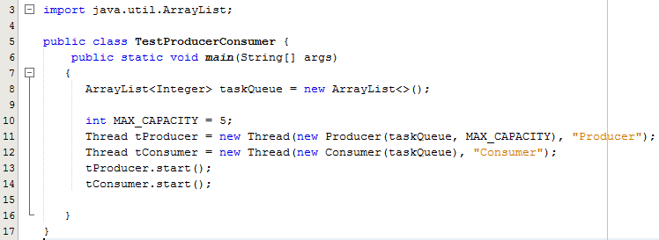
Sample Program – Part 4
Test class
  Array list created and initialised
  Line 11: Producer object created and passed as a parameter into the Thread constructor
  Line 12: Consumer object created and passed as a parameter into the Thread constructor
  Lines 13,14: Both threads are started

Slide 10
Monitor
The mechanism that Java uses to support synchronization is the monitor
A monitor is like a building that contains one special room that can be occupied by only one thread at a time. The room usually contains some data. From the time a thread enters this room to the time it leaves, it has exclusive access to any data in the room
Entering the monitor building is called "entering the monitor." Entering the special room inside the building is called "acquiring the monitor."
Occupying the room is called "owning the monitor," and leaving the room is called "releasing the monitor."
Leaving the entire building is called "exiting the monitor."

