Slide 1
INTRODUCTION TO THREADS
Software Development 3

Slide 2
Introduction to Threads
A thread is a single path of execution through a program
Simple programs – single thread executes code from first statement to last
More complex programs need multiple threads of control executing concurrently
Programs appear to be doing a number of different things at once – in reality the processor can only execute one instruction at a time
Control passes between threads
Often called time-slicing

Slide 3

Threads Concept
Multiple threads on multiple CPUs
Multiple threads sharing a single CPU
Source: Liang Introduction to Programming 7th Ed

Slide 4
Threaded Programs
Why use multiple threads?
  Data coming in from different sources on a network
  More evenly divide the computer’s power among different tasks
  A responsive user interface – the program can respond quickly when a user interacts with the GUI
  Downloading images
  To avoid system being caught in infinite loop
  To perform a long calculation
  Any other operation that is going to take a noticeable period of time

Slide 5
Multitasking vs MultiThreading
Multitasking is the ability of an operating system to execute more than one program simultaneously.
Though we say so but in reality no two programs on a single processor machine can be executed at the same time.
The CPU switches from one program to the next so quickly that appears as if all of the programs are executing at the same time.
Multithreading is the ability of an operating system to execute different parts of the program, called threads, simultaneously.

Slide 6
Multitasking vs MultiThreading
The program has to be designed well so that the different threads do not interfere with each other
This concept helps to create scalable applications because you can add threads as and when needed
Individual programs are all isolated from each other in terms of their memory and data, but individual threads are not as they all share the same memory and data variables
Hence, implementing multitasking is relatively easier in an operating system than implementing multithreading

Slide 7

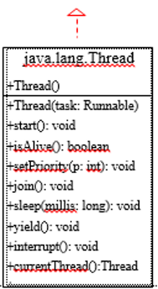
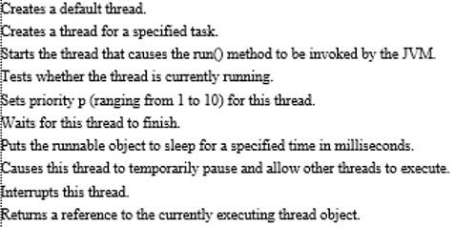
Some Thread Class Methods

Slide 8
Properties of Threads
Each thread begins execution at a predefined, well-known location.
Each thread executes code from its starting location in an ordered, predefined sequence
Each thread executes its code independently of the other threads in the program
The threads appear to have a certain degree of simultaneous execution. The degree of simultaneity depends on several factors--programming decisions about the relative importance of various threads

Slide 9
Some Points to note on Threads
Each thread is separate, so that local variables in the methods that the thread is executing are separate for different threads
These local variables are completely private
If two threads happen to execute the same method, each thread gets a separate copy of the local variables of that method
Objects and their instance variables, on the other hand, can be shared between threads in a Java program
Objects are usually run inside threads
Java threads cannot arbitrarily access each other's data objects

Slide 10
Using Threads
In Java, there are two ways to create threaded programs:
Implement the Runnable interface (more usual by far) or
Extend the Thread class
If you are planning on overriding the run() method of Runnable and not implementing any of the other methods of Thread, then you should implement runnable
All that is necessary to spawn a thread in Java is to
instantiate an object of type Thread and start its run
method.

Slide 11
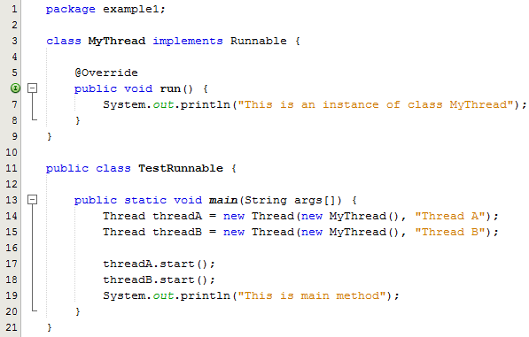


Example 1
As you can see, this program defines a new class named MyThread which implements the Runnable interface
MyThread overrides the run() method which executes when the start() method of Thread is called
In MyThread the run() method displays information about the thread implemented by an object of the MyThread class.
The code in main() instantiates two objects of type Thread using one of several available Thread constructors.

Slide 12
Example 1: Further Explanation
This particular constructor requires two parameters:
  The first parameter is an object of any class that implements the Runnable interface.
  The second parameter is a string which specifies a name for the thread.
Additional code in main() starts the two threads running by invoking the start() method on each of the thread objects.
The threads stop and the program terminates when the threads have nothing more to do.

Slide 13
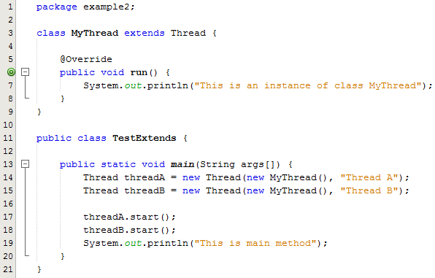
Example 2: Extending the Thread Class
This approach can be used when the class being used to instantiate the thread object is not required to extend some other class, and therefore, can extend the Thread class.
With this approach, the new class named MyThread extends the Thread class (Line 3) and does not implement the Runnable interface directly.
Note: It is not usual to do it this way. The Java API advises against it unless you wish to override one or more of the methods of Thread
The output from the program is the same as above.

Slide 14
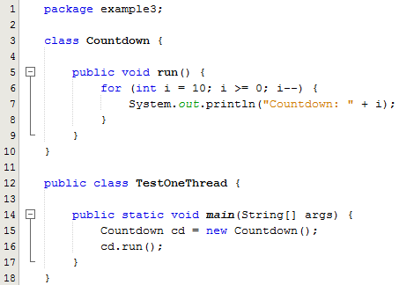


Example 3: One Thread of Execution – Main Thread
All that is happening here is that we are accessing the public method run( ) of the countDown, class
The cycle of execution would begin with MainThreadDemo executing the method main( ), proceed with instantiating an object of type countDown, execute the run( ) method of the newly instantiated object and then exiting main( )

Slide 15
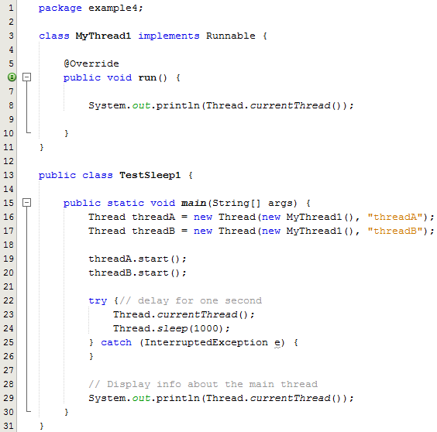


Example 4: Thread Sleeping
Line 8: The println statement in the run method calls the static currentThread() method of Thread
An attempt to display info on the current thread will implicitly call toString()
The toString() method displays the thread name, its priority and the thread group
The sleep() method is invoked on the main thread to implement a one-second delay approximately.

Slide 16
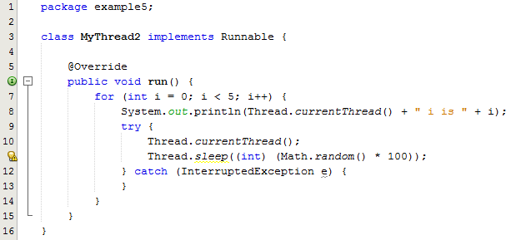

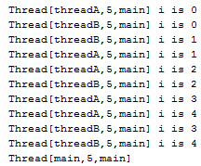
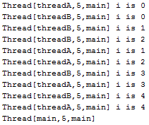
Example 5: sleep() method
Each thread counts from zero to four and displays the count along with its name for each count.
Line 8: The method currentThread() is called to display information about each thread
Each thread also sleeps a random amount of time between counts. Because of the use of a random sleep time, the output from every run will be different.
See sample output from 2 runs of the program

Slide 17
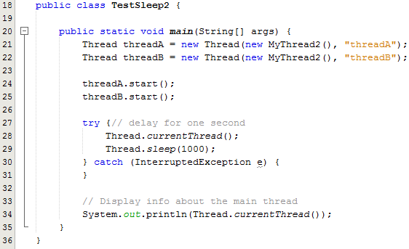
Example 5: sleep() method
Lines 21, 22: This program instantiates two independent Thread objects
Lines 24, 25 calls the start() method to start each thread running
Line 29: Each thread will sleep for 1 second.
Line 34: The method currentThread() is called to display information about the main thread

Slide 18
Program Explanation
You can see how each thread
    activates, counts, displays, and sleeps,
independently of the activities of the other thread (except that they must share available resources when both are awake).
The output from each thread is intermingled with the output from the other. This is because the two threads are running concurrently and asynchronously.
Both run() methods are
    running at the same time,
    competing for resources if not sleeping, and
    displaying their output whenever they have something to display and can gain control of the standard output stream.
A Java program can have many threads, and those threads can run concurrently, either asynchronously (at the same time) or synchronously (one after another).

