Slide 1
THREAD PRIORITIES
Software Development 3

Slide 2
Thread Priorities
All threads have a priority which determines which thread is executed when several threads are waiting for their turn
This makes it possible to give one thread more access to processor resources than another
The possible values for thread priority are defined in static data members of the class Thread
These members are of type int, and declared as final
getPriority() returns this thread’s priority (an int)

Slide 3
Setting Priority
The maximum thread priority is defined MAX_PRIORITY which has value 10
The minimum priority is MIN_PRIORITY defined as 1
The value of the default priority that is assigned to the main thread in a program is NORM_PRIORITY which is set to 5
When you create a thread, its priority will be the same as that which created it.
Priority can be increased or decreased using the setPriority(int newPriority)
Can be set to any value between MIN_PRIORITY and MAX_PRIORITY

Slide 4
Priorities at Work
The chosen thread keeps running until:
  It sleeps
  It ceases to be runnable by:
    dying
    entering a blocked state
  A higher priority thread becomes runnable because:
    it has slept long enough
    its I/O operation is complete
    someone has unblocked it
The scheduler then selects a new thread to run

Slide 5
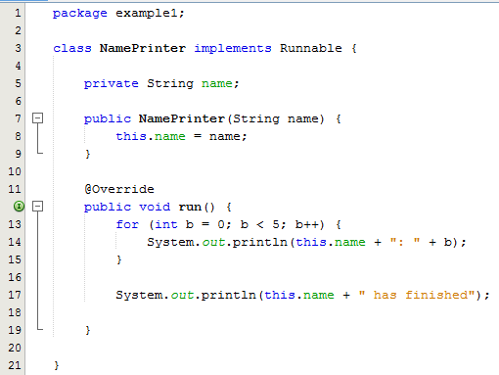
Thread Priorities – Example 1
Sample Output:
Mary: 0
Chris: 0
Chris: 1
Chris: 2
Frank: 0
Frank: 1
Frank: 2
Chris: 3
Chris: 4
Chris has finished
Mary: 1
Frank: 3
Mary: 2
Frank: 4
Mary: 3
Mary: 4
Mary has finished
Frank has finished

Slide 6
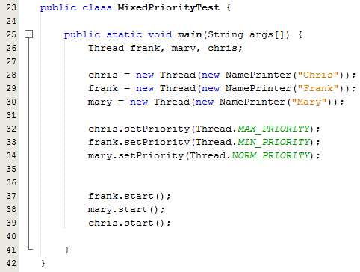
Thread Priorities – Example 1
The setPriority() method is used here to set the priorities for the threads

Slide 7
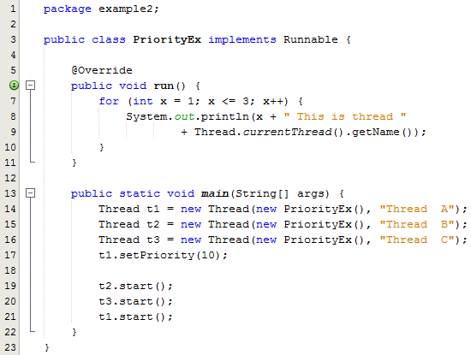
Thread Priorities – Example 2
Sample Output:
1 This is thread Thread C
1 This is thread Thread B
1 This is thread Thread A
2 This is thread Thread A
3 This is thread Thread A
2 This is thread Thread B
2 This is thread Thread C
3 This is thread Thread B
3 This is thread Thread C

