Slide 1
SOFTWARE DEVELOPMENT 4
Synchronisation

Slide 2
Simultaneous Access to Objects
In many applications, two or more threads may share access to the same object
If each call a method that changes the state of the object, they may overlap
Can result in corrupt data
  Example - the Lost Update
To avoid this happening, access must be synchronised

Slide 3
Lost Update
Account X balance €200
Thread A requests balance for lodgement of €200
Thread B requests balance for withdrawal of €100
Thread A adds €200 - new balance €400
Thread B subtracts €100 - new balance €100
Thread A writes new balance - €400
Thread B writes new balance - €100
The update performed by Thread A has been lost
Result - corrupt data

Slide 4
Managing Threads & Synchronisation
The objective of synchronisation is to ensure that, when several threads want access to a single resource, only one thread can access it at any given time
A class can have methods that are sychronized and methods that are non-synchronized

Slide 5
Synchronised Methods
When a thread calls a synchronised method it is guaranteed that the method will finish before another thread can execute a synchronised method on the same object
However other unsynchronised methods in the same object can be called
The second thread is deactivated and must wait for the first thread to finish executing its method
Synchronisation has overheads, so should only be used when objects are shared among threads

Slide 6
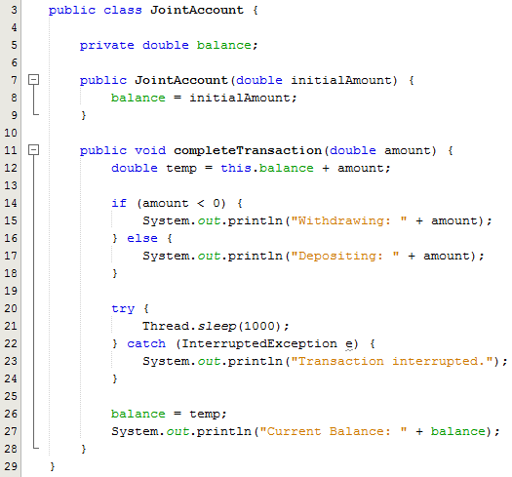
Sample Program - JointAccount
Note the use of the Thread.sleep method inside the completeTransaction() method
The completeTransaction() method() will be called by two different thread objects

Slide 7
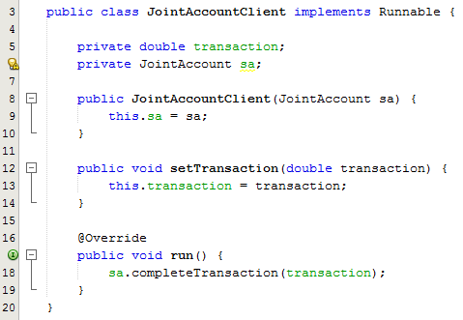
Sample Program - JointAccountClient
This class implements Runnable
Has 2 members
  Amount of the transaction
  The account we need to update
  Setter method to set the value of each transaction
  Overridden run() method which calls the completeTransaction() method in order to perform the lodgement or withdrawal

Slide 8
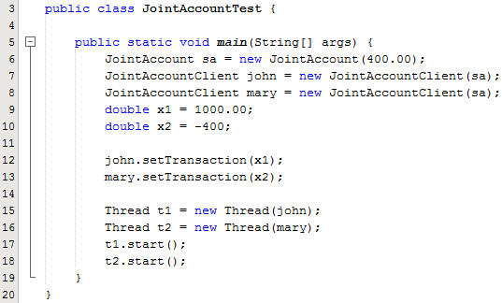
Sample Program - JointAccountTest
Create a JointAccount object
Create 2 account holders
The balance in the account is 400
John will lodge 1000
Mary will withdraw 400
Set up the two threads and start them running
Output from the program is 1400
Correct output is 1000
Lost Update problem
We fix this problem by making the completeTransaction() synchronized

Slide 9
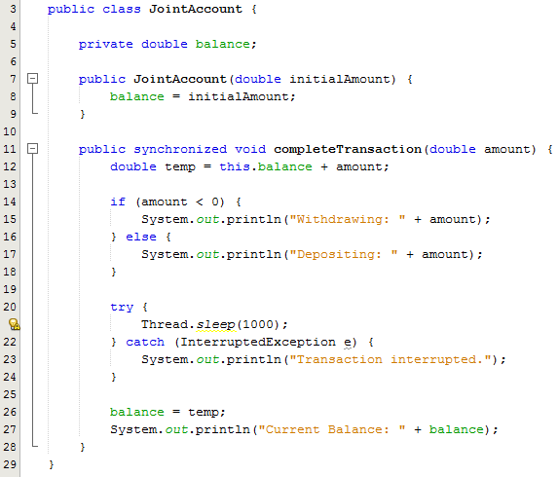
Sample Program - Synchronized
Note the use of synchronized keyword
Sample Output
  Depositing: 1000.0
  Current Balance: 1400.0
  Withdrawing: -400.0
  Current Balance: 1000.0

