Slide 1
SOFTWARE DEVELOPMENT 3
Daemons, Interrupts & Thread States

Slide 2
User Threads
A User Thread has a life of its own which is independent of the thread that creates it
It can continue execution after the thread that created it has ended
The threads in the previous examples were User Threads

Slide 3
Daemon Threads
A daemon thread is simply a background thread that is
subordinate to the thread that creates it
When the thread that created the daemon thread ends, the
daemon thread dies with it
To create a daemon thread:
        Create a thread as normal:
        Thread T1 = new Thread(new MyThread, “Thread 1”);
        In this example MyThread is a class that implements Runnable
  Call the setDaemon() method of Thread and set it to ‘true’
        T1.setDaemon(true);
  T1 will die when the thread that created it (e.g. a main method)
  dies

Slide 4
Daemon Threads
Daemon threads are “background” threads, that provide services to other threads, e.g., the garbage collection thread
The Java VM will not exit if non-Daemon threads are executing
The Java VM will exit if only Daemon threads are executing
Daemon threads die when the Java VM exits

Slide 5
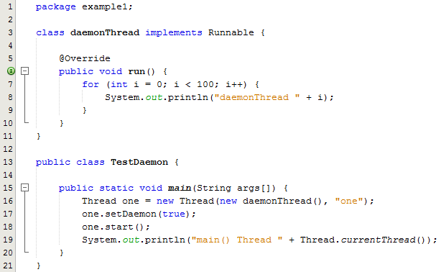
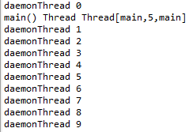
Example 1
When we execute this program, JVM creates a daemon thread first and then a user thread with a main() function.
When the main thread is finished, the program terminates and the daemon thread is also shut down by JVM.
The daemon thread never gets to print out up to 99 because it dies once the main method is finished.
Sample Output

Slide 6
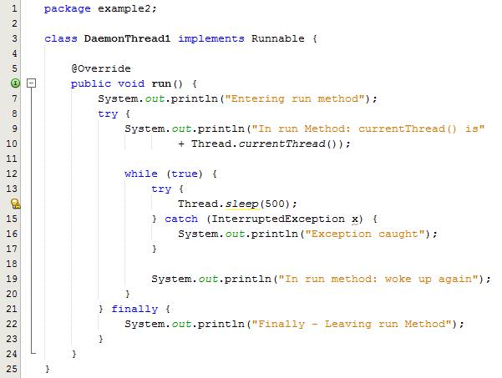
Example 2 – Part 1/2

Slide 7
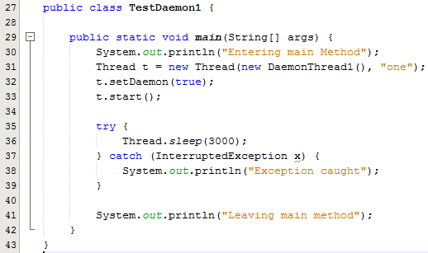
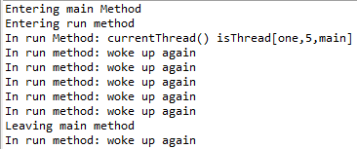
Example 2 – Part 2/2
When we execute this program, the JVM creates a daemon thread and starts it running.
The try block in the main method causes the main thread to sleep for 3000 ms which gives the daemon thread a chance to run and display some output.
When the main thread has finished sleeping it prints out a message “Leaving main method” and then the daemon thread displays its last bit of output before finishing.
Sample Output

Slide 8
Example 3
In the example program, JumbleNames (next slide):
    We create three Threads called first, second and third
    We call setDaemon() in the main() method for each thread
If you run the program a few times pressing Enter at random, you should see that the daemon threads die after the main() method returns, because from time to time, you will get output from one or other thread after the last output from main()

Slide 9
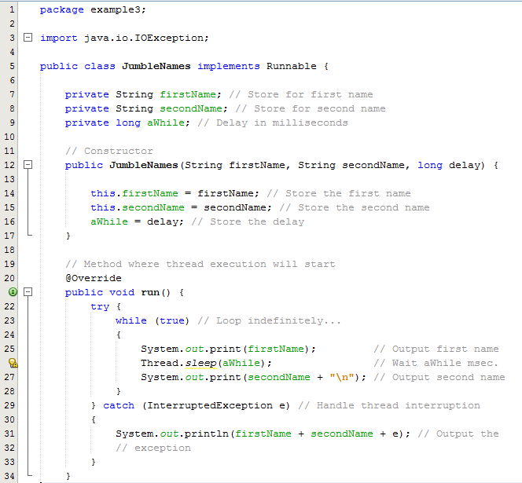
Example 3 Part 1/2

Slide 10
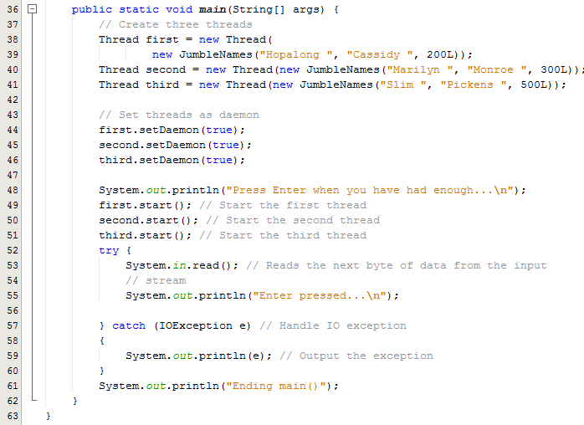
Example 3 Part 2/2
If we had User Threads in this example, they would continue executing independently of main()
If you are prepared to terminate the program yourself you can demonstrate this by commenting out the calls to setDaemon()
Pressing Enter will end main(), but the other threads will continue indefinitely

Slide 11
Interrupting a Thread
A thread can signal another thread that it
should stop executing by calling the interrupt() method for that thread object. This in itself doesn't necessarily stop the thread.
It should set a flag in the thread to be checked in the run() method to have any effect.
The sleep() method actually checks whether the thread has been interrupted and throws an exception.

Slide 12
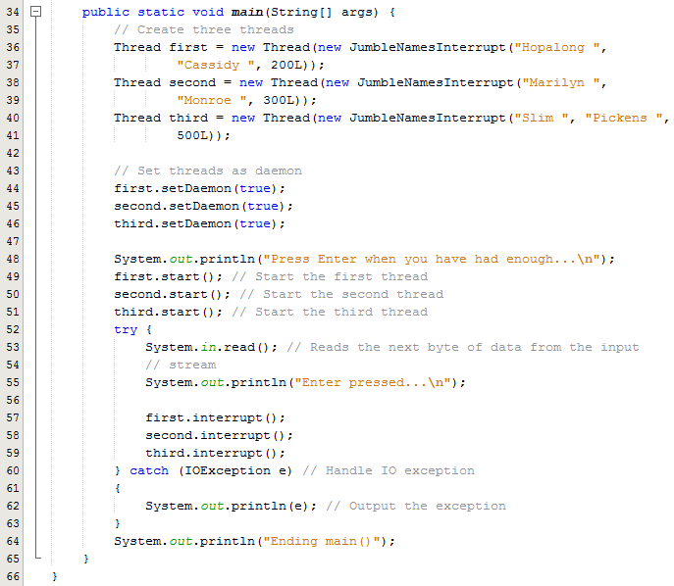
Example 4

Slide 13
What happened?
The method main() calls the interrupt() method for each of the threads after you press the Enter key, the sleep() method called in each thread registers the fact that the thread has been interrupted and throws an Interrupted Exception.
This is caught by the catch block in the run() method and produces the above output.
Because the catch block is outside the while loop, the run() method for each thread returns and each thread terminates.

Slide 14
Thread States
Java thread can be in one of these states
  New: thread allocated & waiting for start()
  Runnable: thread can begin execution
  Running: thread currently executing
  Blocked: thread waiting for event (I/O, etc.)
  Dead: thread finished
Transitions between states caused by
  Invoking methods in class Thread
    start(), yield(), sleep(), wait(), notify()…
  Other (external) events
    Scheduler, I/O, returning from run()…
In Java, states are defined by Thread.State

Slide 15
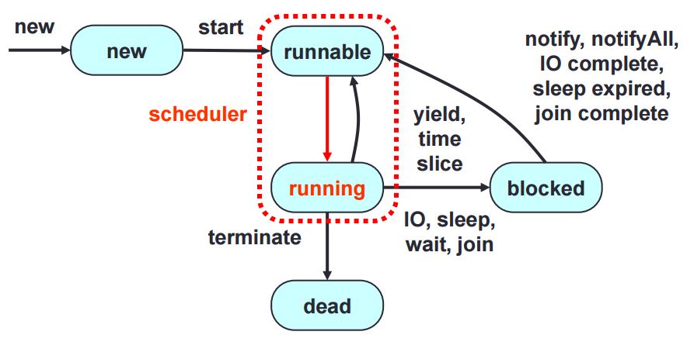
Thread State Diagram

