Slide 1
SOFTWARE DEVELOPMENT 3
Wrapper Classes, Data Formatting & final keyword

Slide 2
Wrapper Classes
The Java Programming language does not look at primitive data types as objects
For example, numerical, boolean, and character data are treated in the primitive form itself for the sake of efficiency
Java provides wrapper classes should we want to manipulate primitive data elements as objects
Such data elements are "wrapped" in an object created around them
Each Java primitive data type has a corresponding wrapper class in the java.lang package. Each wrapper class object encapsulates a single primitive value

Slide 3
Wrapper Classes
Wrapper classes allow us to look at primitive data elements as objects.
Primitive Data Type | Wrapper Class
boolean | Boolean
byte | Byte
char | Character
short | Short
int | Integer
long | Long
float | Float
double | Double

Slide 4
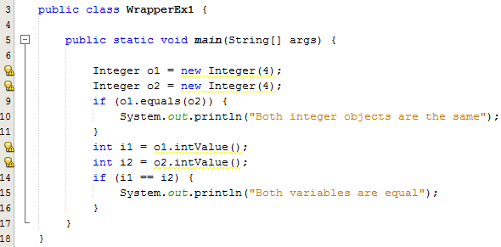
Wrapper Classes
A wrapper class object can be constructed by passing the value to be wrapped into the appropriate constructor. For example:

Slide 5
Wrapper Classes
Converting wrapper objects to primitives
All the numeric wrapper classes have six methods, which can be used to convert a numeric wrapper to any primitive numeric type. These methods are byteValue, doubleValue, floatValue, intValue, longValue, and shortValue. An example is shown below:
    Integer i = new Integer(20);
Parser methods
The six parser methods are parseInt, parseDouble, parseFloat, parseLong, parseByte, and parseShort. They take a String as the argument and convert it to the corresponding primitive.
double d = Double.parseDouble("4.23");

Slide 6
Use of toString()
If you just want to extract the primitive value from the object, there is an object method in each wrapper class that does the job. See segment of code below taken from sample program WrapperEx2.java
  ……………..
  String strTest3 = Integer.toString(myInt);
  System.out.println("String value is: " + strTest3);
  String strTest4 = Double.toString(myDbl);
  System.out.println("String value is: " + strTest4);
  ………………

Slide 7
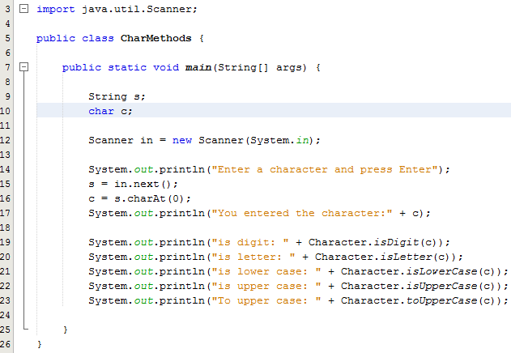
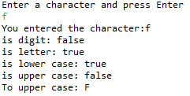
Use of Character Class example
Program Output
charAt() method is
in the String class.
It returns the char
value at the specified
index

Slide 8
Data Formatting Using Decimal Format
0
The DecimalFormat class can be used to format a floating point value.
It allows you to specify the number of decimal places that you want
Need to import java.text.DecimalFormat in order to use this class

Slide 9
Constructor
Variable name
parameter
DecimalFormat decFor = new DecimalFormat(String pattern);
class
The pattern may contain:
One period which corresponds with the decimal
Any symbols before and/or after the number specifications
All of this should be enclosed in quotes

Slide 10
The 0 and the #
0 specifies that a 0 should be printed even if there is no value specified for this position.
# specifies that a number should be printed if there is any, otherwise leave blank.

Slide 11
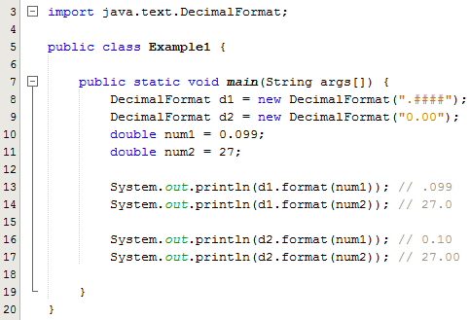

Example 1
Program Output

Slide 12
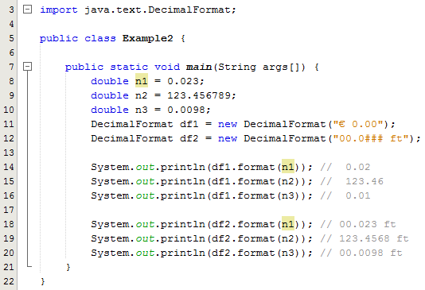

Example 2
Program Output

Slide 13
Constants – keyword “final”
A constant is an identifier that is similar to a variable except that it holds the same value during its entire existence
As the name implies, it is constant, not variable
The compiler will issue an error if you try to change the value of a constant
In Java, we use the final modifier to declare a constant
final int MIN_HEIGHT = 69;

Slide 14
Constants – keyword “final”
Constants are useful for three important reasons
  First, they give meaning to otherwise unclear literal values
    For example, MIN_HEIGHT means more than the literal 69
  Second, they facilitate program maintenance
    If a constant is used in multiple places, its value need only be updated in one place
  Third, they formally establish that a value should not change, avoiding inadvertent errors by other programmers

Slide 15
“final” methods and classes
You use the final keyword in a method declaration to indicate that the method cannot be overridden by subclasses
Note that you can also declare an entire class final. A class that is declared final cannot be subclassed.

