Slide 1
SOFTWARE DEVELOPMENT 4
Collections

Slide 2
Java Collections
A collection is a general term that means something like "a group of objects stored in a structured manner"
Examples might include:
  a simple list of strings
  a mapping or association of strings to strings (e.g. country names to the names of their capitals)
  a list that imposes some constraint, e.g. keeping strings in alphabetical order, or not allowing duplicates in the list

Slide 3
Java Collections
The Java Collections Framework— often called simply (Java) Collections— is a library of classes that implement these and various other data structures. The collections framework also provides utility methods to perform functions such as sorting a list of data

Slide 4
List
When we refer to a list in Java, we mean specifically a collection of objects that:
  has a fixed order (when we add an object to the list, it will stay in the place we put it)
  allows objects to be referred to by position, so we can get or set the "4th element in the list"
  generally speaking, does not have a fixed number of elements, unlike an array

Slide 5
List vs ArrayList
List is an interface and ArrayList is an implementation of the List interface.
The arraylist class has only a few methods in addition to the methods available in the List interface. The only difference is, you are creating a reference of the parent interface in the first one i.e
  List tempList = new ArrayList();
and a reference of the class which implements the List i.e. the ArrayList class in the second.
  ArrayList tempList = new ArrayList();

Slide 6
List vs ArrayList
If u use the first, you will be able to call the methods available in the List interface and you cannot make calls to the new methods available in the ArrayList class
Where as, u are free to use all the methods available in the ArrayList, if u use the second one
The first approach is a better one because, when you are developing java applications, when you are supposed to pass the collection framework objects as arguments to the methods, then it is better to go with:
  List tempList = new ArrayList();
  somemethodcall(tempList);

Slide 7
List vs ArrayList
In future, if you are changing the implementation to use a linkedlist or some other classes which implements the List interface, instead of ArrayList, you can change at only one point (i.e) only the instantiation part
Else you will need to change at all the areas, where ever you have used the specific class implementation as method arguments

Slide 8
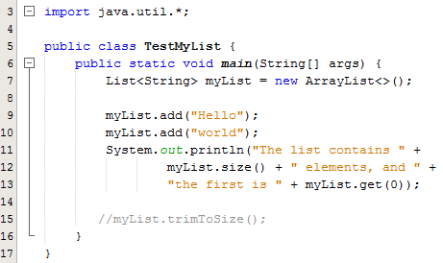
Example
A key feature of Java used in the collections framework is the notion of interfaces and implementations.
An interface is a "blueprint" for a class: it specifies a series of methods, but does not contain any code inside those methods.
In this example we only have access to the methods defined in the List class.
If we try and call the trimtoSize() method that is part of the ArrayList class we will get a syntax error

Slide 9
Sets
A List such as an ArrayList is useful in cases where we want to store some arbitrary large group of objects in a fixed order
If your only necessary criterion is present or not and you don't need the extra functionality of a list (such as ordering, being able to retrieve the nth item), then it is possible to use a more efficient data structure. That's generally what Java's set implementations do

Slide 10
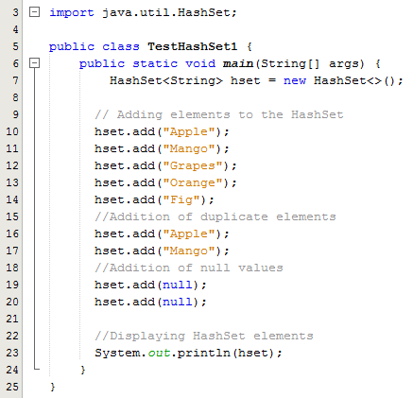
HastSet – Example 1
This class implements the Set interface
HashSet doesn’t maintain any order, the elements would be returned in any random order
HashSet doesn’t allow duplicates. If you try to add a duplicate element in HashSet, the old value would be overwritten
HashSet allows null values however if you insert more than one nulls it would still return only one null value
HashSet is non-synchronized (Synchronized means only one thread can modify a hash table at one point of time. Basically, it means that any thread before performing an update will have to acquire a lock on the object while others will wait for lock to be released)
Sample Output:
[null, Apple, Grapes, Fig, Mango, Orange]

Slide 11
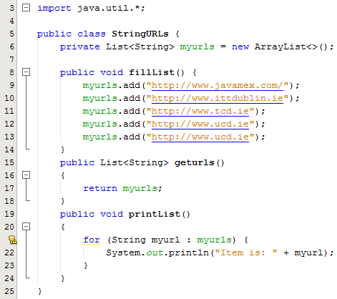
HashSet – Example 2
An arraylist called myurls is created and the method fillList adds 5 urls to the arraylist including duplicates

Slide 12
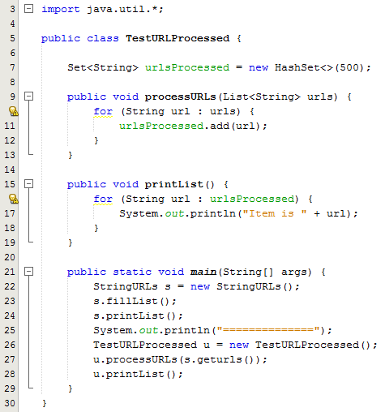
HashSet – Example 2
Line 7: Creates a hashset
Lines 9-13: This method takes the list of urls as a parameter, iterates through the list and adds the urls to the hash set
Lines 15-19: Prints out the contents of the hash set
Lines 21-29: Creates a StringURLs object and uses this to call the fillList method to fill the arraylist with the urls. Line 24 then prints out the contents of the arraylist. Line 26 creates a TestURLProcessed object and uses this to call the procesURLs method which fills the hash set with the urls from the arraylist. Line 28 then prints out the contents of the hash set
The hash set does not contain any duplicate urls

Slide 13
Maps
An object that maps keys to values. A map cannot contain duplicate keys; each key can map to at most one value.
In programming terms, a map is a set of associations between pairs of objects. It crops up extremely frequently in programming in all sorts of cases where we want to deal with cases of "for X, what is the Y"?
The syntax for creating a map is largely similar to lists and sets
But this time we need to specify the type of object we want to map from and the type to map to.
Let's say we want to store an association of country codes with country names, in other words, String to String – see example on the next slide

Slide 14
HashMaps
This implementation provides all of the optional map operations, and permits null values and the null key
The HashMap class is unsynchronized and permits nulls
This class makes no guarantees as to the order of the map; in particular, it does not guarantee that the order will remain constant over time

Slide 15
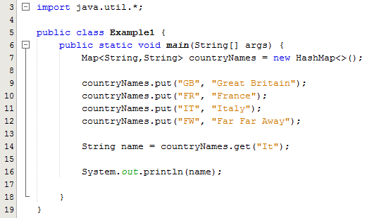
HashMaps - Example
In this example we use the common map implementation HashMap
As with the set, we supply an estimate of the number of mappings we expect to add, to help the map operate more efficiently
To add an association to the map, we use a method called put()
Line 14: To retrieve the country name for a particular code, we call the get method
The items that we associate from are called keys; the items they are associated to (the country names here) are called values.
It allows null for both key and value
If for a particular key there is no associated value, then get() returns null.
This class makes no guarantees as to the order of the map
The value you supply to the get method is case sensitive

Slide 16
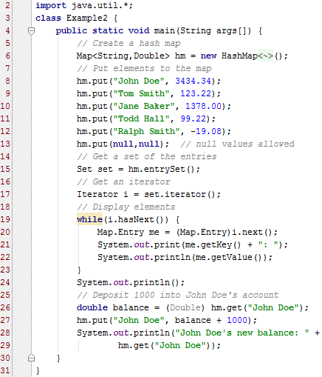
HashMap - Example
The program begins by creating a hash map and then adds the mapping of names to balances
Next, the contents of the map are displayed by using a set-view, obtained by calling entrySet()
The keys and values are displayed by calling the getKey() and getValue() methods that are defined by Map.Entry
Pay close attention to how the deposit is made into John Doe's account
The put() method automatically replaces any pre-existing value that is associated with the specified key with the new value
Thus, after John Doe's account is updated, the hash map will still contain just one "John Doe" account

Slide 17
Iterator
Often, you will want to cycle through the elements in a collection. For example, you might want to display each element
The easiest way to do this is to employ an iterator, which is an object that implements either the Iterator or the ListIterator interface
Iterator enables you to cycle through a collection, obtaining or removing elements. ListIterator extends Iterator to allow bidirectional traversal of a list, and the modification of elements

Slide 18
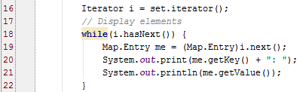
Iterator
Before you can access a collection through an iterator, you must obtain one
Each of the collection classes provides an iterator( ) method that returns an iterator to the start of the collection
By using this iterator object, you can access each element in the collection, one element at a time

Slide 19
Using HashMap with your own Class
If you intend to use the HashMap<K,V> class with your own class as the parameterized type K , then your class must override the following methods:
  public int hashCode();
    Ideally returns a unique integer for this object
  public boolean equals(Object obj);
    Indicates whether or not the reference object is the same as the parameter obj

Slide 20
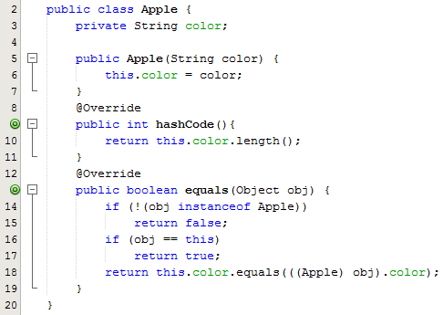
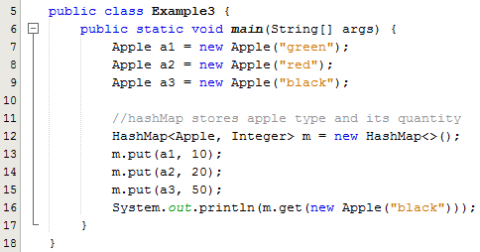
Example - HashMap
In this example, a green apple object is stored successfully in a hashMap, and the map then asked to retrieve an object
Two overridden methods equals() and hasCode() are used :
HashCode
When inserting an object into a hastable you use a key. The hash code of this key is calculated, and used to determine where to store the object internally. When you need to lookup an object in a hashtable you also use a key. The hash code of this key is calculated and used to determine where to search for the object
equals()
Is used in most collections to determine if a collection contains a given element

Slide 21
Using HashMap with your own Class
The idea behind a Map is to be able to find an object faster than a linear search
Using hashed keys to locate objects is a two-step process
Internally the Map stores objects as an array of array
The index for the first array is the hashcode() value of the key
This locates the second array which is searched linearly by using equals() to determine if the object is found
The default implementation of hashCode() in Object class returns distinct integers for different objects. Therefore, in the example above, different objects(even with same type) have different hashCodes

Slide 22

Using HashMap with your own Class
Hash Code is like a sequence of garages for storage, different stuff can be stored in different garages
It is more efficient if you organize stuff to different places instead of the same garage
So it's a good practice to equally distribute the hashCode value
The solution to our sample program is to add a hashCode method to the class. Here we just use the color string's length for demonstration.

