Slide 1
SOFTWARE DEVELOPMENT 4
Collections(2)

Slide 2
Hashing
Hashing is designed to solve the problem of needing to efficiently find or store an item in a collection.
For example, if we have a list of 10,000 words of English and we want to check if a given word is in the list, it would be inefficient to successively compare the word with all 10,000 items until we find a match.
Hashing is a technique to make things more efficient by effectively narrowing down the search at the outset.

Slide 3
How Hashing works
let's suppose that we want to map a list of string keys to string values (for example, map a list of countries to their capital cities). So let's say we want to store the data in Table 1 in the map.
Hashing is designed to solve the problem of needing to efficiently find or store an item in a collection.
For example, if we have a list of 10,000 words of English and we want to check if a given word is in the list, it would be inefficient to successively compare the word with all 10,000 items until we find a match.
Hashing is a technique to make things more efficient by effectively narrowing down the search at the outset.

Slide 4
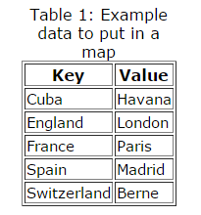
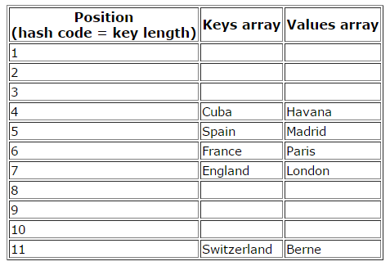
How Hashing works
let's suppose that our hash function is to simply take the length of the string. For simplicity, we'll have two arrays: one for our keys and one for the values. So to put an item in the hash table, we compute its hash code (in this case, simply count the number of characters), then put the key and value in the arrays at the corresponding index. For example, Cuba has a hash code (length) of 4. So we store Cuba in the 4th position in the keys array, and Havana in the 4th index of the values array etc. And we end up with the table on the top right

Slide 5
How Hashing works
Now, in this specific example things work quite well.
Our array needs to be big enough to accommodate the longest string, but in this case that's only 11 slots. And we do waste a bit of space because, for example, there's no 1-letter keys in our data, nor keys between 8 and 10 letters.
But in this case, the waste isn't so bad either. And taking the length of a string is nice and fast, so is the process of finding the value associated with a given key (certainly faster than doing up to five string comparisons).
We can also easily see that this method wouldn't work for storing arbitrary strings.

Slide 6
HashMaps
On the previous slide we saw that using the string length to create the hash, and indexing a simple array, could work in some restricted cases, but is no good generally: for example, we have the problem of collisions (several keys with the same length) and wasted space if a few keys are vastly larger than the majority.
Now, we can solve the problem of collisions by having an array of (references to) linked lists rather than simply an array of keys/values. Each linked list is generally called a bucket.

Slide 7
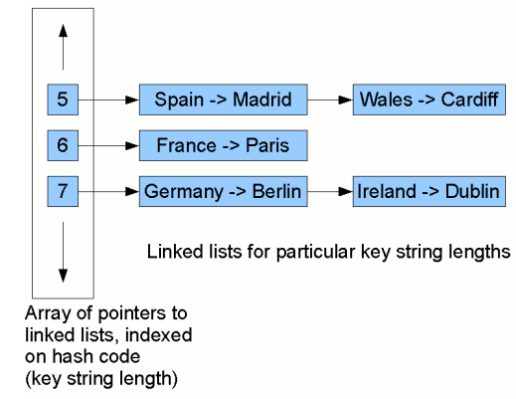
HashMaps
HashMap first finds a bucket based on the value returned by calling hashCode() on the key
If it encounters an existing Entry in that bucket whose hash equals the hash of the incoming key but where oldKey.equals(newKey) is false, it will chain the two entries together to form the new head link of a linked list
So we end up with a structure something like this

Slide 8
HashMaps
Each node in the linked lists stores a pairing of a key with a value. Now, to look for the mapping for, say, Ireland, we first compute this key's hash code (in this case, the string length, 7). Then we start traversing the linked list at position 7 in the table. We traverse each node in the list, comparing the key stored in that node with Ireland. When we find a match, we return the value from the pair stored in that node (Dublin).
In our example here, we find it on the second comparison. So although we have to do some comparisons, if the list at a given position in the table is fairly short, we'll still reduce significantly the amount of work we need to do to find a given key/value mapping.

Slide 9
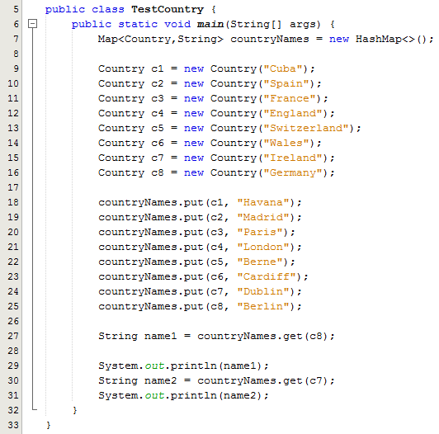
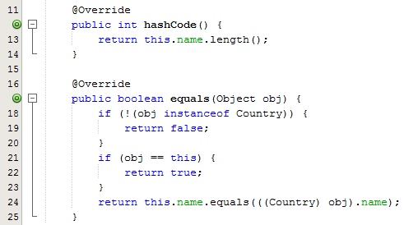
Sample Program
The hashcode used here is the length of the country
Germany and Ireland both have a string length = 7 but both get added to the hashmap through the linked list structure
Sample Output:
  Berlin
  Dublin
Both are retrieved from the hash map

Slide 10
HashMaps
The structure we have just illustrated is essentially the one used by Java's hash maps and hash sets. However, we generally wouldn't want to use the string length as the hash code – there are more adequate hash codes that can be generated but we don’t cover them in the syllabus

Slide 11
Linked List
A linked list consists of a number of links, each of which has a reference to the next link.
Adding and removing elements in the middle of a linked list is efficient.
Visiting the elements of a linked list in sequential order is efficient
listIterator provides a way to access all links
listIterator method provides an object of type ListIterator
ListIterator is an interface, so the return object from this method provides all the methods in this interface

Slide 12
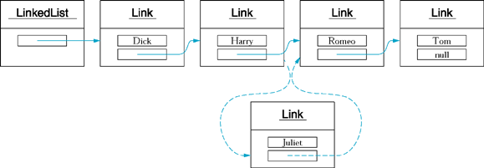
linked list

Slide 13
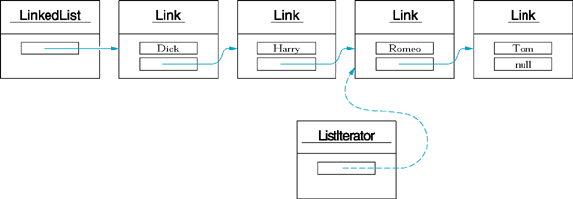
A ListIterator object

Slide 14
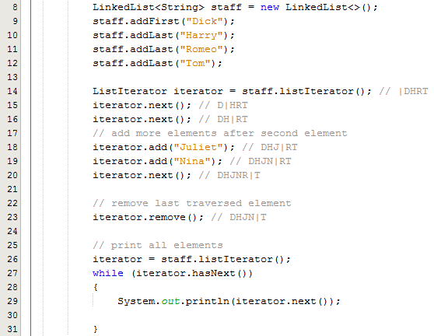
Sample Program
Line 8 creates and initializes a LinkedList reference variable
Lines 9-12 adds strings to the linked list
Line 14 declares a listiterator to traverse the linked list
Lines 15-16 moves through 2 elements in the linked list
Lines 18-19 adds two new elements
Line 20 moves to the next element (Romeo)
Line 23 removes the current element
Line 26 defines a new iterator for displaying the contents
Line 27 calls hasNext() which returns true if there is a next element
Line 29 calls the next() method which returns the string

