Slide 1
SOFTWARE DEVELOPMENT 4
Collections(3)

Slide 2
Collection
The Collection interface (java.util.Collection) is one of the root interfaces of the Java collection classes
Though you do not instantiate a Collection directly, but rather a subtype of Collection, you may often treat these subtypes uniformly as a Collection
Java does not come with a usable implementation of the Collection interface, so you will have to use one of the listed subtypes
The Collection interface just defines a set of methods (behaviour) that each of these Collection subtypes share. This makes it possible to ignore what specific type of Collection you are using, and just treat it as a Collection

Slide 3
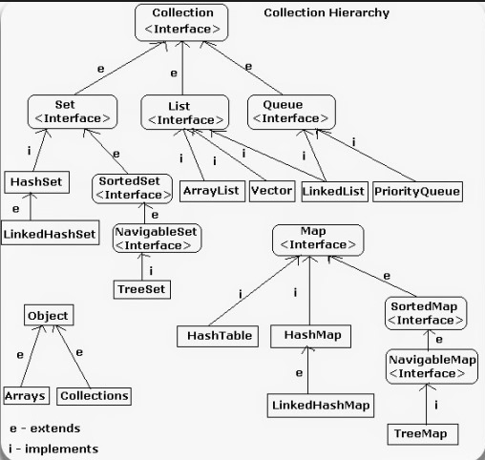
Collections Framework
Collection framework is a class library to handle group of objects
Collection framework is implemented in java.util package A collection object or container object is an object which can store a group of other objects.
A collection object has a class called 'Collection class' or 'Container class‘
All the collections classes are available in the package java.util (util stands for utility)
A group of collection classes is called a 'Collection Framework'
Source: www.javabrains.com

Slide 4
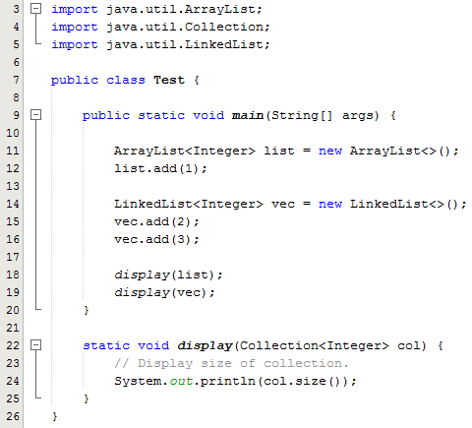
Sample Program
This program create an arraylist containing one value and a linked list containing two values
The display method is called for each collection
Line 22: Note the type of parameter used. It is of type Collection which means the parameter can be of any type that implements the Collection interface

Slide 5
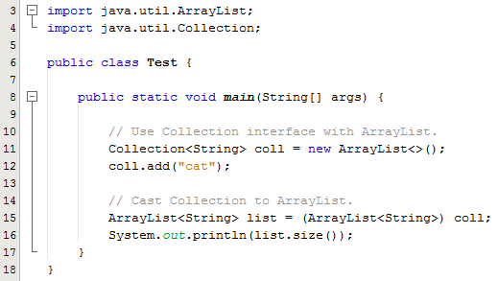
Sample Program
This program create an arraylist using a Collection interface reference and adds one item to it
Line 15: Creates a 2nd arraylist using an ArrayList reference and initializes this array list by casting the col1 collection

Slide 6
Collections Class
The java.util.Collections class consists exclusively of static methods that operate on or return collections
It contains polymorphic algorithms that operate on collections, "wrappers", which return a new collection backed by a specified collection
The methods of this class all throw a NullPointerException if the collections or class objects provided to them are null

Slide 7
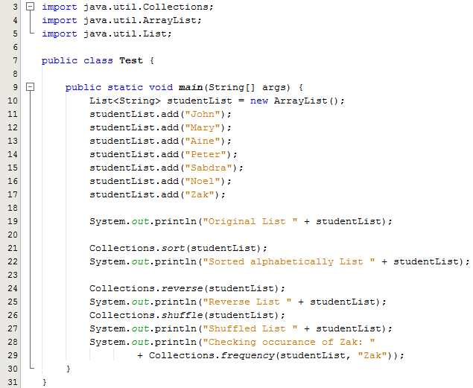
Sample Program
Note the user of the following methods that can be found in the Collections class:
Collections.sort(List myList)
Collections.reverse(List myList)
Collections.shuffle(List myList)

Slide 8
Sorting Collections
Both TreeSet and TreeMap store elements in sorted order. However, it is the comparator that defines precisely what sorted order means
The Comparator interface defines two methods: compare( ) and equals( ). The compare( ) method, shown here, compares two elements for order:
  int compare(Object obj1, Object obj2)
obj1 and obj2 are the objects to be compared. This method returns zero if the objects are equal. It returns a positive value if obj1 is greater than obj2. Otherwise, a negative value is returned

Slide 9
Sorting Collections
The equals( ) method, shown here, tests whether an object equals the invoking comparator:
  boolean equals(Object obj)
obj is the object to be tested for equality. The method returns true if obj and the invoking object are both Comparator objects and use the same ordering. Otherwise, it returns false.
Overriding equals( ) is unnecessary, and most simple comparators will not do so.

Slide 10
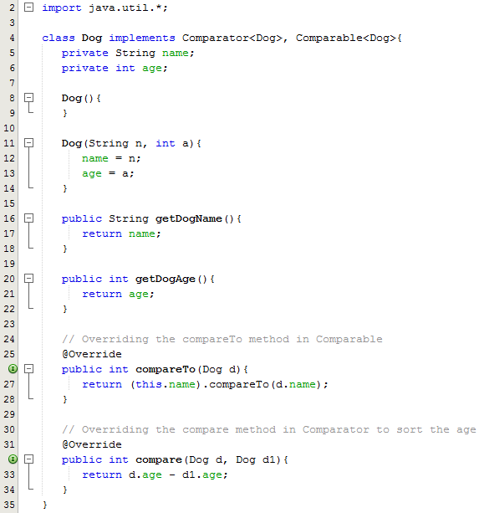
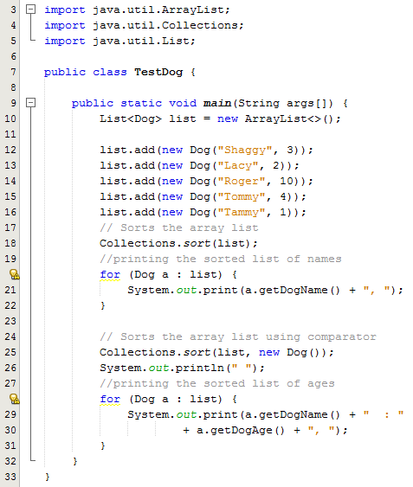
Sample Program
Collections.sort() needs a compareTo() method in order to work
Collections.sort() needs a compare() method in order to work

