Slide 1
SOFTWARE DEVELOPMENT 4
Design Patterns

Slide 2
Design challenges
Designing software for reuse is hard. One must find:
  a good problem decomposition, and the right software
  a design with flexibility and modularity
designs often emerge from trial and error
successful designs do exist
  No two designs are ever identical
  they do possess some recurring characteristics
Can designs be described, codified or standardized?
  this would short circuit the trial and error phase
  produce "better" software faster
Object-Oriented Design and Patterns, Ch. 5 (Horstmann)

Slide 3
Basic Design Patterns
Basic design patterns refer to how the internals of a component are arranged in order to solve problems
These are decided on as the problem they solve arises. e.g. An iterator is introduced when an operation must be applied to every component of a data structure
Object-Oriented Design and Patterns, Ch. 5 (Horstmann)

Slide 4
Benefits
Design patterns specify a general solution schema for problems that is known to have certain desirable properties
In the short term, the decision to use a design pattern provides a clear procedure for implementation
In the long term, the use of a standard design pattern provides a clear structure for maintenance programmers to help understand the code as well as use whatever extensibility procedures are available to the pattern
Object-Oriented Design and Patterns, Ch. 5 (Horstmann)

Slide 5
Basic Design Patterns
a solution to a common software problem in a context
  describes a recurring software structure
  is abstract from programming language
  identifies classes and their roles in the solution to a problem
  patterns are not code or designs; must be instantiated/applied
Object-Oriented Design and Patterns, Ch. 5 (Horstmann)

Slide 6
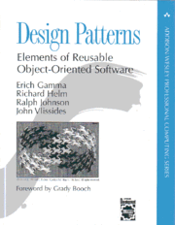
History of Patterns
the concept of a "pattern" was first expressed
in Christopher Alexander's work A Pattern
Language in 1977 (2543 patterns)
in 1990 a group called the Gang of Four or "GoF"
(Gamma, Helm, Johnson, Vlissides) compile a
catalog of design patterns
1995 book Design Patterns:
Elements of Reusable Object-Oriented
Software is a classic of the field
Object-Oriented Design and Patterns, Ch. 5 (Horstmann)

Slide 7
Gang of Four (GoF) patterns
Creational Patterns
(abstracting the object-instantiation process)
  Factory Method Abstract Factory
  Singleton Builder
  Prototype
Structural Patterns
(how objects/classes can be combined to form larger structures)
  Adapter Bridge
  Composite Decorator
  Facade Flyweight
  Proxy
Object-Oriented Design and Patterns, Ch. 5 (Horstmann)

Slide 8
Gang of Four (GoF) patterns
Behavioral Patterns (communication between objects)
  Command Interpreter Iterator
  Mediator Observer State
  Strategy Chain of Responsibility Visitor
  Template Method
Object-Oriented Design and Patterns, Ch. 5 (Horstmann)

Slide 9
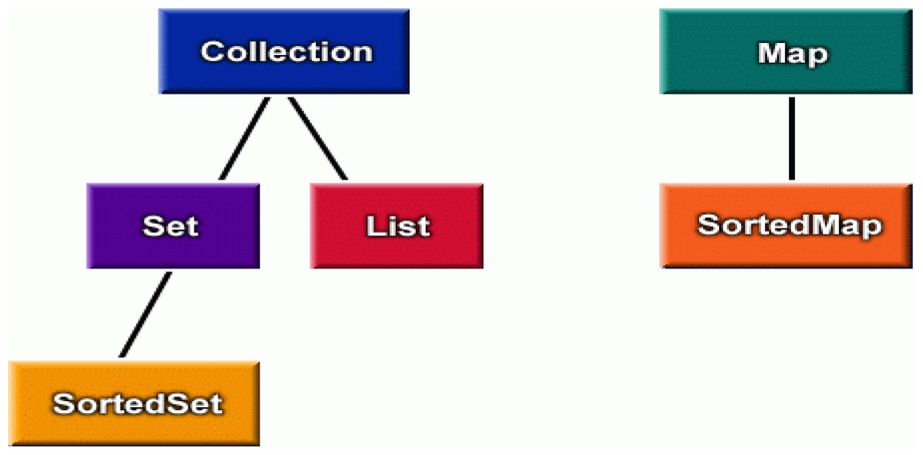
Pattern: Iterator
objects that traverse collections
Object-Oriented Design and Patterns, Ch. 5 (Horstmann)

Slide 10
Iterator pattern
iterator: an object that provides a standard way to examine all elements of any collection
  uniform interface for traversing many different data structures
  supports concurrent iteration and element removal
for (Iterator<Account> itr = list.iterator(); itr.hasNext(); ) {
Account a = itr.next();
System.out.println(a);
}
set.iterator()
map.keySet().iterator()
map.values().iterator()
Object-Oriented Design and Patterns, Ch. 5 (Horstmann)

Slide 11
Iterators in Java
all Java collections have a method iterator that returns an iterator for the elements of the collection
can be used to look through the elements of any kind of collection (an alternative to for loop)
List<Account> list = new ArrayList<Account>();
// ... add some elements ...
for (Iterator<Account> itr = list.iterator(); itr.hasNext(); ) {
Account a = itr.next();
System.out.println(a);
}
set.iterator()
map.keySet().iterator()
map.values().iterator()

Slide 12
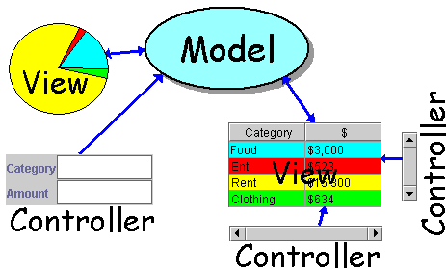
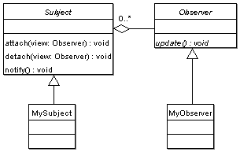
Pattern: Observer
objects whose state can be watched
Object-Oriented Design and Patterns, Ch. 5 (Horstmann)

Slide 13
Recall: model and view
model: classes in your system that are related to the internal representation of the state of the system
  often part of the model is connected to file(s) or database(s)
  examples (bank system): Account, User, UserList
view: classes in your system that display the state of the model to the user
  generally, this is your GUI (could also be a text UI)
  should not contain crucial application data
  Different views can represent the same data in different ways
    Example: Bar chart vs. pie chart
Object-Oriented Design and Patterns, Ch. 5 (Horstmann)

Slide 14
Model-view-controller
model-view-controller (MVC): common design paradigm for graphical systems
controller: classes that connect model and view
  defines how user interface reacts to user input (events)
  receives messages from view (where events come from)
  sends messages to model (tells what data to display)
  sometimes part of view (see left)
data for rendering
Model
View
View
Component
Model
updates
events
Controller
Controller
Object-Oriented Design and Patterns, Ch. 5 (Horstmann)

Slide 15
Observer pattern
observer: an object that "watches" the state of another object and takes action when the state changes in some way
  examples in Java:
    event listeners
    java.util.Observer
observable object: an object that allows observers to examine it (often the observable object notifies the observers when it changes)
Object-Oriented Design and Patterns, Ch. 5 (Horstmann)

Slide 16
Observer: Sample Program
We define a Loan class which has the interest rate as one of it’s member variables
The interest rate is subject to change and when it changes, Loan notifies to Newspaper or Internet media to display new loan interest rate
To implement this we have a Subject interface which contains methods for adding, removing and notifying Observers and an Observer interface which contains update(double interest) method which will be called by Subject implementation when interest rate changes
http://javarevisited.blogspot.ie/2011/12/observer-design-pattern-java-example.html)

Slide 17

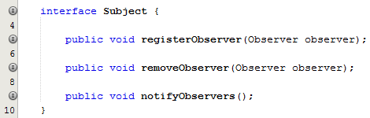
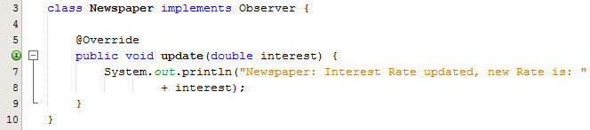
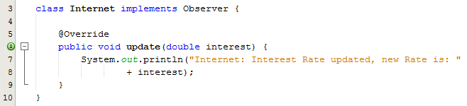
Observer: Sample Program
The Loan class implements the Subject interface and overrides all three methods
Both the Newspaper and the Internet classes implement the Observer interface which means they both override the update method
http://javarevisited.blogspot.ie/2011/12/observer-design-pattern-java-example.html)

Slide 18
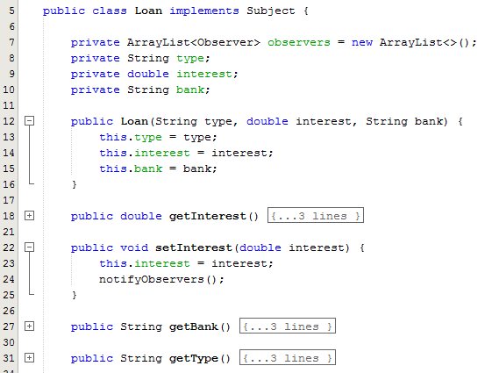
Observer: Sample Program
The Loan class contains a collection of Observer references
Line 24: Note the call to the notifyObservers() method
http://javarevisited.blogspot.ie/2011/12/observer-design-pattern-java-example.html)

Slide 19
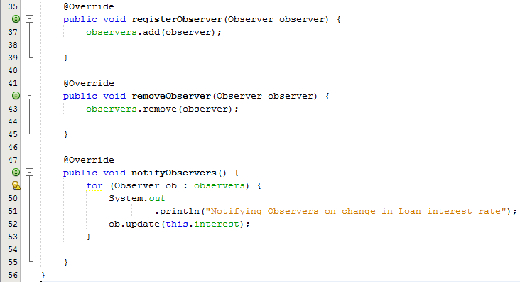
Observer: Sample Program
The registerObserver() method adds an Observer reference (either Newspaper or Internet) to the arraylist
The registerObserver() method removes an Observer reference (either Newspaper or Internet) to the arraylist
The notifyObservers() method iterates through the collection and calls the appropriate update method (polymorphism)
http://javarevisited.blogspot.ie/2011/12/observer-design-pattern-java-example.html)

Slide 20
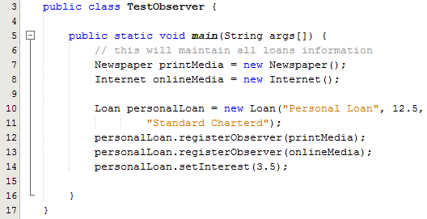
Observer: Sample Program
Line 7: Creates a Newspaper object
Line 8: Creates an Internet object
Line 10: Creates a Loan object
Line 12: Registers the Newspaper as an observer of the Loan
Line 13: Registers the Internet as an observer of the Loan
Line 14: Changes the interest rate
http://javarevisited.blogspot.ie/2011/12/observer-design-pattern-java-example.html)

Slide 21
Singleton Pattern
Singleton Pattern is the most commonly used pattern
Java Singleton pattern belongs to the family of design patterns, that govern the instantiation process. This design pattern proposes that at any time there can only be one instance of a singleton (object) created by the JVM.
The class’s default constructor is made private, which prevents the direct instantiation of the object by others (Other Classes)
A static modifier is applied to the instance method that returns the object as it then makes this method a class level method that can be accessed without creating an object
http://www.wideskills.com/java-tutorial/java-singleton-design-pattern)

Slide 22
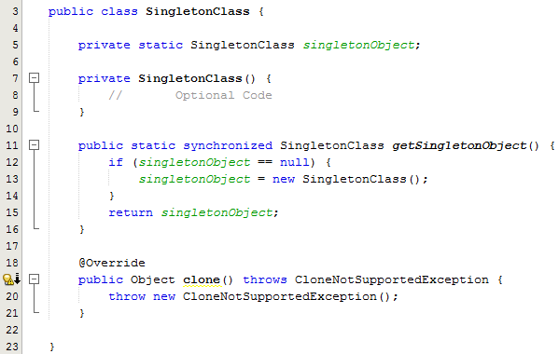
Singleton: Sample Program
Line 7: Note the private constructor
Line 11: It could happen that the access method may be called twice from 2 different classes at the same time and hence more than one object being created. This could violate the design pattern principle. In order to prevent the simultaneous invocation of the getter method by 2 threads or classes simultaneously we add the synchronized keyword to the method declaration
We can still be able to create a copy of the Object by cloning it using the Object’s clone method. This again violates the Singleton Design Pattern’s objective. So to deal with this we need to override the Object’s clone method which throws a CloneNotSupportedException exception.
http://www.wideskills.com/java-tutorial/java-singleton-design-pattern)

Slide 23
Decorator pattern
decorator: an object that modifies behavior of, or adds features to, another object
  decorator must maintain the common interface of the object it wraps up
  used so that we can add features to an existing simple object
  the object being "decorated" usually does not explicitly know about the decorator
examples in Java:
  multilayered input streams adding useful I/O methods
  adding scroll bars to GUI controls

Slide 24
Decorator example: I/O
normal InputStream class has only public int read() method to read one letter at a time
decorators such as BufferedReader or Scanner add additional functionality to read the stream more easily
// InputStreamReader/BufferedReader decorate InputStream
InputStream in = new FileInputStream("hardcode.txt");
InputStreamReader isr = new InputStreamReader(in);
BufferedReader br = new BufferedReader(isr);
// because of decorator streams, I can read an
// entire line from the file in one call
// (InputStream only provides public int read() )
String wholeLine = br.readLine();

Slide 25
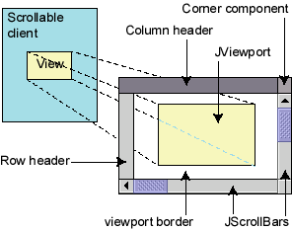
Decorator example: GUI
normal GUI components don't have scroll bars
JScrollPane is a container with scroll bars to which you can add any component to make it scrollable
// JScrollPane decorates GUI components
JTextArea area = new JTextArea(20, 30);
JScrollPane scrollPane = new JScrollPane(area);
contentPane.add(scrollPane);

