Slide 1
SOFTWARE DEVELOPMENT 4
Generics

Slide 2
Parameterized Classes, Generic Data Types
Class ArrayList is a parameterized class
  It has a parameter which is a type
Possible to declare our own classes which use types as parameters
Earlier versions of Java had a type of ArrayList that was not parameterized

Slide 3
Basics of Generics
Beginning with Java 5.0, class definitions may include parameters for types
  Called generics
Programmer now can specify any class type for the type parameter
class Sample<T>
Note use of <T> for the type parameter

Slide 4
Basics of Generics
The simplest way to think about Java generics is thinking about a new type of syntax that might spare you some casting operation:
List<Apple> box = ...;
Apple apple = box.get(0);
In the above code box is a reference to a List of objects of type Apple. The get method returns an Apple instance and no casting is required.

Slide 5
Basics of Generics
Without generics, this code would have been:
List box = ...;
Apple apple = (Apple) box.get(0);
The main advantage of generics is having the compiler keep track of types parameters, perform the type checks and the casting operations: the compiler guarantees that the casts will never fail

Slide 6
Example
You can take advantage of generics in both your own classes or the generic Java library classes.
Type Safety When Writing...
In the following code snippet, for example, we create an instance List<String> and populate it with some data:
List<String> str = new ArrayList<String>();
str.add("Hello ");
str.add("World.");

Slide 7
Example
If we tried to put some other kind of object into the List<String>, the compiler would raise an error:
str.add(1); // won't compile
... and When Reading
If we pass the List<String> reference around, we're always guaranteed to retrieve a String object from it:
String myString = str.get(0);

Slide 8
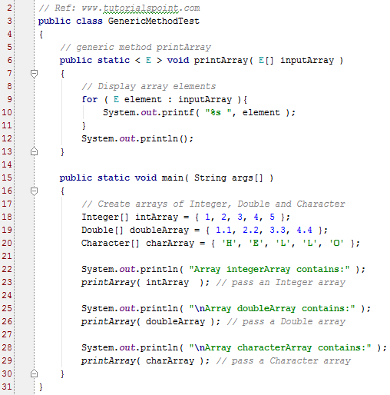
Generic method Example
A generic method is a method with a type parameter
Line 6: Note the generic method declarations with a type parameter section delimited by angle brackets (< and >) that precedes the method's return type
This method contains an enhanced for loop that prints out the contents of an array
However the type of the array that is printed can vary because of the use of the generic declaration
E is a type variable

Slide 9
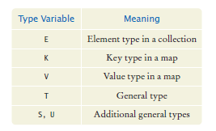
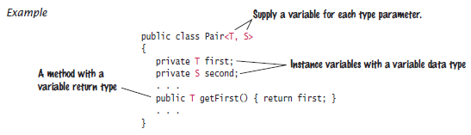
Implementing Generic Types
We need to choose variables for the type parameters. It is considered good practice to use short uppercase names for type variables such as the following:
You place the type variable for a generic class after the class name, enclosed in angle brackets

Slide 10
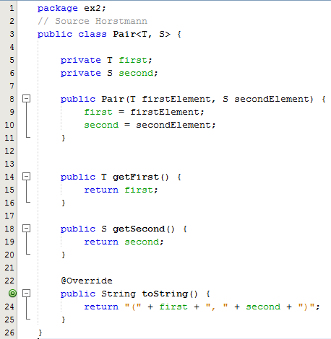
Sample Program
Line 3: Note the type variable for a generic class after the class name, enclosed in angle brackets
Note the two instance variables have types T and S
The getter method have variable return types

Slide 11
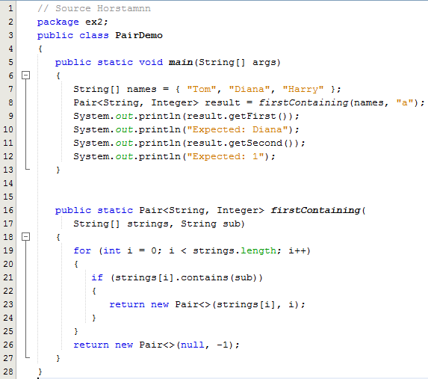
Sample Program
Line 7: declares and initialises an array with 3 strings
Line 8: calls the static method
Lines 16-27:
This method takes two parameters a string array and a string
This method returns (1) a pair containing the string found that contains “a” and (2) the index in the array where the string was found. Otherwise if there is not match a pair is returned containing null as the String value and -1

Slide 12
Constraining Type Parameters
There may be times when you'll want
  to invoke methods defined in the bounds (Example 1 Bounded Parameters)
  to restrict the kinds of types that are allowed to be passed to a type parameter. For example, a method that operates on numbers might only want to accept instances of Number or its subclasses. (Example 2 Bounded Parameters)
To declare a bounded type parameter, list the type parameter's name, followed by the extends keyword, followed by its upper bound.

Slide 13
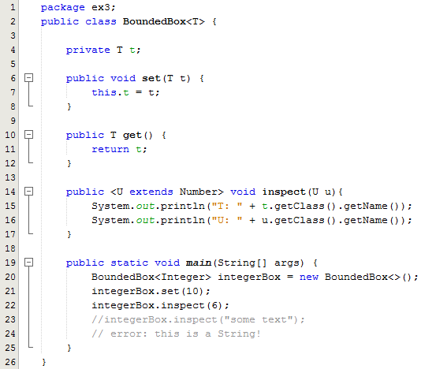
Sample Program
To declare a bounded type parameter, list the type parameter's name, followed by the extends keyword, followed by its upper bound, which in this example is Number.
Note that, in this context, extends is used in a general sense to mean either "extends" (as in classes) or "implements" (as in interfaces).
By modifying our generic method to include this bounded type parameter, compilation will now fail, since our invocation of inspect includes a string

Slide 14
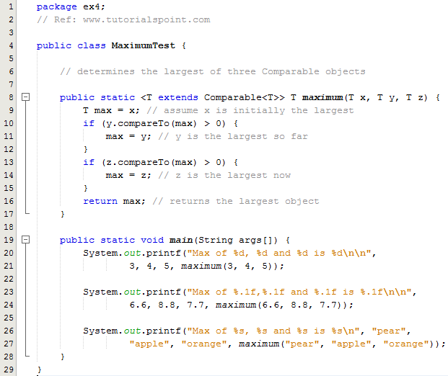
Sample Program
To declare a bounded type parameter, list the type parameter's name, followed by the extends keyword, followed by its upper bound, which in this example is Comparable
In this example the bounded type parameters allow you to invoke methods defined in the bounds i.e. the compareto() method on lines 9 and 12

Slide 15
Why use Generics
Stronger type checks at compile time
  A Java compiler applies strong type checking to generic code and issues errors if the code violates type safety
Elimination of casts
Enabling programmers to implement generic algorithms

