Slide 1
Software Development 4
JDBC - Java Database Connectivity

Slide 2
Introduction to Database Management Systems
Storing data in traditional text or binary files has its limits
well suited for applications that store only a small amount of data
not practical for applications that must store a large amount of data
simple operations become cumbersome and inefficient as data increases

Slide 3
Introduction to Database Management Systems
A database management system (DBMS) is software that is specifically designed to work with large amounts of data in an efficient and organized manner
Data is stored using the database management system
Applications written in Java or other languages communicate with the DBMS rather than manipulate the data directly
DBMS carries out instructions and sends the results back to the application

Slide 4
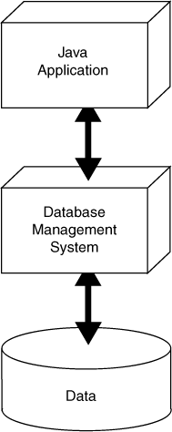
A Java Application Interacts with a DBMS, Which Manipulates Data
The Application sends a command to the DBMS
The Application displays the result to the user
The DBMS executes the command on the Data
The DBMS sends the result back to the Application

Slide 5
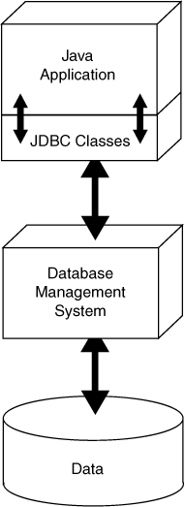
JDBC Provides Connectivity to the DBMS
JDBC stands for Java database connectivity
It is the technology that makes communication possible between the Java application and DBMS
The Java API contains numerous JDBC classes that allow your Java applications to interact with a DBMS

Slide 6
SQL Sends Commands to the DBMS
SQL stands for structured query language
A standard language for working with database management systems
Not used as a general programming language
Consists of several key words, used to construct statements known as queries
Statements or queries are strings passed from the application to the DBMS using API method calls
Serve as instructions for the DBMS to carry out operations on its data

Slide 7
JDBC Needs a DBMS
To use JDBC to work with a database you will need a DBMS
Java DB
Oracle
Microsoft SQL Server
DB2
MySQL

Slide 8
JDBC Classes
Java comes with a standard set of JDBC classes
java.sql and javax.sql
Using JDBC in a Java application requires the following steps
Get a connection to the database
Pass a string containing an SQL statement to the DBMS
If the SQL statement has results to send back, they will be sent back as a result set
When finished working with the database , close the connection

Slide 9
Using an OracleDataSource
There are three steps that must be performed to use an Oracle Data Source:
Create an Oracle data source object of the
oracle.jdbc.pool.OracleDataSource class as follows:
OracleDatasource ods = new OracleDatasource();
Set the Oracle data source object attributes using set methods:
ods.setURL("jdbc:oracle:thin:@//10.10.2.7:1521/global1");
ods.setUser("******");
ods.setPassword("******");
Connect to the database via the Oracle data source object using getConnection() method
Connection conn = ods.getConnection();

Slide 10
Getting a Database Connection
DriverManager.getConnection(DatabaseURL);
DriverManager.getConnection(DatabaseURL,
Username,
Password);
The getConnection method is used to get a connection to the database
General format of the simplest version:
General format if a user name and a password are required:
Username is a string containing a valid username
Password is a string containing a password
DatabaseURL lists the protocol used to access the database

Slide 11
Getting a Database Connection
DatabaseURL is a string known as a database URL
URL stands for uniform resource locator
A simple database URL has the following general format:
protocol is the database protocol
value is jdbc when using JDBC
subprotocol varies depending on the type of DBMS
databaseName is the name of the database
Using Java DB, the URL for the global1 database is:
protocol:subprotocol:databaseName
jdbc:oracle:thin:@//10.10.2.7:1521/global1

Slide 12
Getting a Database Connection
The OracleDataSource getConnection method
Searches for and loads a compatible JDBC driver for the database specified by the URL
Returns a reference to a Connection object
Should be saved in a variable, so it can be used later
Throws an SQLException if it fails to load a compatible JDBC driver
See example on next slide

Slide 13
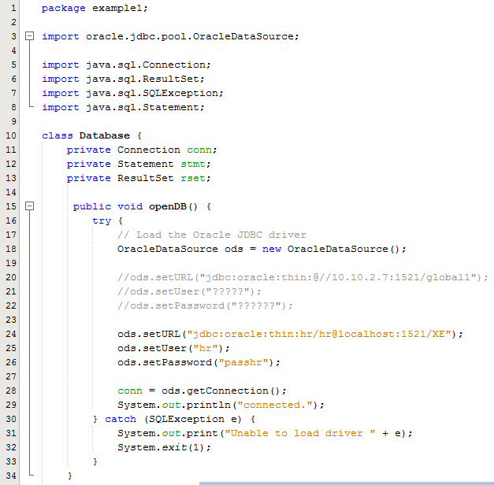
Sample Program 1
Lines 3-8: Import relevant packages
Line 18: Create an OracleDataSource object
Line 24-26: Call the setter methods
Line 28: Call the getConnection() method to return a db connection
A try catch is needed because the code on line 18 and 28 may throw an SQLException which needs to be caught

Slide 14
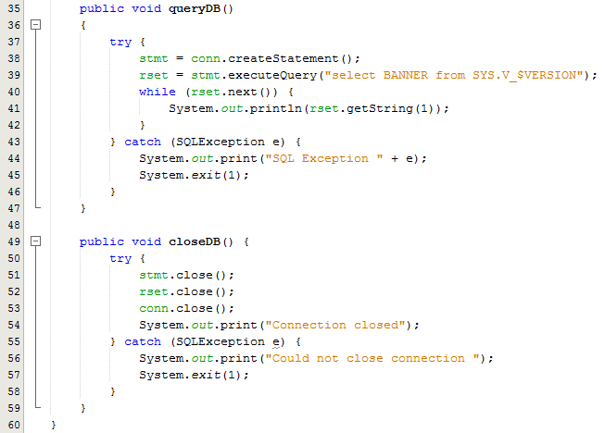
Sample Program 1
Once a connection to the database is established, that Connection object can be used to send SQL statements.
The Java JDBC's Statement objects are JDBC's way of executing SQL statements to the database.
A Statement object is used to send SQL statements to a database.
Lines 38: Initialises a Statement object
Line 39: Initialises a ResultSet object
Lines 40-41 are used to iterate the result set to display the results
Lines 49-59 closes the Statement, ResultSet and Connection objects

Slide 15
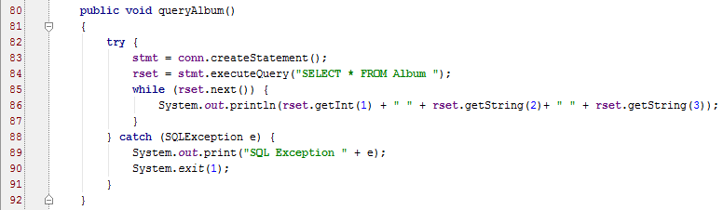
Passing an SQL Statement to the DBMS
Once you have established a connection, you must get a reference to a Statement object before you can issue SQL statements to the DBMS
A Statement object has an executeQuery method that returns a reference to a ResultSet object
A ResultSet object contains the results of the query
Example:
Statement stmt = conn.createStatement();
ResultSet rset = stmt.executeQuery("SELECT * FROM Album ");

Slide 16
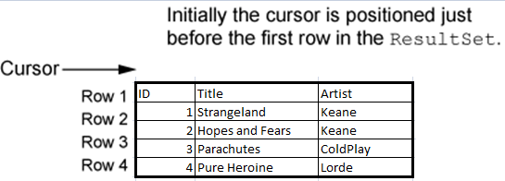
Getting a Row from the ResultSet Object
A ResultSet object has an internal cursor
Points to a specific row in the ResultSet
The row to which it points is the current row
Initially positioned just before the first row
Can be moved from row to row to examine all rows

Slide 17
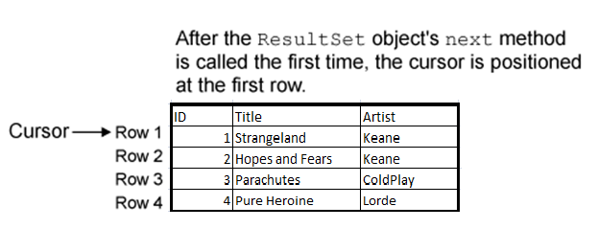
Getting a Row from the ResultSet Object
result.next();
A ResultSet object’s next method moves the cursor to the next row in the ResultSet
moves to first row in a newly created ResultSet
moves to the next row each time it is called

Slide 18
Getting a Row from the ResultSet Object
while (result.next())
{
// Process the current row.
}
A ResultSet object’s next method returns a Boolean value
true if successfully moved to the next row
false if there are no more rows
A while loop can be used to move through all the rows of a newly created ResultSet

Slide 19
Getting Columns in a ResultSet Object
while (rset.next()) {
System.out.println(rset.getInt(1) + " " + rset.getString(2)+ " " + rset.getString(3));
}
while (rset.next()) {
System.out.println(rset.getInt("ID") + " " + rset.getString("title")+ " " + rset.getString("artist"));
}
You use one of the ResultSet object’s “get” methods to retrieve the contents of a specific column in the current row.
Can pass an argument for either the column number or the column name

Slide 20
Getting Columns in a ResultSet Object
ResultSet Method | Description
double getDouble(int colNumber) double getDouble(String colName) | Returns the double that is stored in the column specified by colNumber or colName. The column must hold data that is compatible with the double data type in Java. If an error occurs, the method throws an SQLException.
int getInt(int colNumber) int getInt(String colName) | Returns the int that is stored in the column specified by colNumber or colName. The column must hold data that is compatible with the int data type in Java. If an error occurs, the method throws an SQLException.
String getString(int colNumber) String getString(String colName) | Returns the string that is stored in the column specified by colNumber or colName. The column must hold data that is compatible with the String type in Java. If an error occurs, the method throws an SQLException.

Slide 21

Specifying Search Criteria with the WHERE clause
SELECT Columns FROM Table WHERE Criteria
rset = stmt.executeQuery("SELECT * FROM Album WHERE id > 2 ");
The WHERE clause can be used with the SELECT statement to specify a search criteria
Criteria is a conditional expression
Example:
Only the rows that meet the search criteria are returned in the result set
A result set is an object that contains the results of an SQL statement

Slide 22
SQL Relational Operators
Operator | Meaning
> | Greater than
< | Less than
>= | Greater than or equal to
<= | Less than or equal to
= | Equal to
<> | Not equal to
Standard SQL supports the following relational operators:
Notice a few SQL relational operators are different than in Java
SQL equal to operator is =
SQL not equal to operator is <>

Slide 23
String Comparisons in SQL
SELECT * FROM Album WHERE artist = 'Keane'
SELECT * FROM Album WHERE artist = ‘keane'
SELECT * FROM Coffee
WHERE UPPER(Description) = 'FRENCH ROAST DARK'
Example 1:
In SQL, strings are enclosed in single quotes
Warning!
String comparisons in SQL are case sensitive
Example 2:
The UPPER() or LOWER() functions convert the string to uppercase or lowercase and can help prevent case sensitive errors when comparing strings

Slide 24
Using the LIKE Operator
SELECT * FROM Coffee WHERE Description LIKE '%Decaf%'
SELECT * FROM Coffee WHERE ProdNum LIKE '2_-00_'
SELECT * FROM Coffee
WHERE Description NOT LIKE '%Decaf%'
In SQL, the LIKE operator can be used to search for a substring
Example 1:
The % symbol is used as a wildcard for multiple characters
Example 2:
The underscore (_) is a used as a wildcard for a single character
Example 3:
The NOT operator is used to disqualify the search criteria

Slide 25
Using AND and OR
SELECT * FROM Coffee
WHERE Price > 10.00 AND Price < 14.00
SELECT * FROM Coffee
WHERE Description LIKE '%Dark%' OR ProdNum LIKE '16%'
The AND and OR operators can be used to specify multiple search criteria in a WHERE clause
Example 1:
The AND operator requires that both search criteria be true
Example 2:
The OR operator requires that either search criteria be true

Slide 26
Sorting the Results of a SELECT Query
SELECT * FROM Coffee ORDER BY Price
SELECT * FROM Coffee
WHERE Price > 9.95 ORDER BY Price DESC
Use the ORDER BY clause to sort results according to a column value
Example 1:
Sorted in ascending order (ASC) by default
Example 2:
Use the DESC operator to sort results in descending order

Slide 27
Mathematical Functions
SELECT AVG(Price) FROM Coffee
SELECT SUM(Price) FROM Coffee
SELECT MIN(Price) FROM Coffee
SELECT MAX(Price) FROM Coffee
SELECT COUNT(*) FROM Coffee
The AVG function
calculates the average value in a particular column
The SUM function
calculates the sum of a column’s values
The MIN and MAX functions
calculate the minimum and maximum values found in a column
The COUNT function
can be used to determine the number of rows in a table

Slide 28
Inserting Rows
INSERT INTO TableName VALUES (Value1, Value2, ...)
INSERT INTO Coffee
VALUES ('Honduran Dark', '22-001', 8.65)
Description: Honduran Dark
ProdNum: 22-001
Price: 8.65
In SQL, the INSERT statement inserts a row into a table
TableName is the name of the database table
Value1, Value2, ... is a list of column values
Example:
Strings are enclosed in single quotes
Values appear in the same order as the columns in the table
Inserts a new row with the following column values:

Slide 29
Inserting Rows
INSERT INTO TableName
(ColumnName1, ColumnName2, ...)
VALUES
(Value1, Value2, ...)
INSERT INTO Coffee
(ProdNum, Price, Description)
VALUES
('22-001', 8.65, 'Honduran Dark')
If column order is uncertain, the following general format can be used
ColumnName1, ColumnName2, ... is a list of column names
Value1, Value2, ... is a list of corresponding column values
Example:
Keep in mind that primary key values must be unique
For example, a duplicate ProdNum is not allowed in the Coffee table

Slide 30
Inserting Rows with JDBC
To issue an INSERT statement, you must get a reference to a Statement object
The Statement object has an executeUpdate method
Accepts a string containing the SQL INSERT statement as an argument
Returns an int value for the number of rows inserted
Example:
rows should contain the value 1, indicating that one row was inserted
String sqlStatement = "INSERT INTO Coffee " +
"(ProdNum, Price, Description)" +
" VALUES " +
"('22-001', 8.65, 'Honduran Dark')";
int rows = stmt.executeUpdate(sqlStatement);

Slide 31
Updating an Existing Row
In SQL, the UPDATE statement changes the contents of an existing row in a table
Table is a table name
Column is a column name
Value is the value to store in the column
Criteria is a conditional expression
Example:
UPDATE Table
SET Column = Value
WHERE Criteria
UPDATE Coffee
SET Price = 9.95
WHERE Description = 'Galapagos Organic Medium'

Slide 32
Updating More Than One Row
UPDATE Coffee
SET Price = 12.95
WHERE ProdNum LIKE '21%'
UPDATE Coffee
SET Price = 4.95
It is possible to update more than one row
Example:
Updates the price of all rows where the product number begins with 21
Warning!
Because this statement does not have a WHERE clause, it will change the price for every row

Slide 33
Updating Rows with JDBC
To issue an UPDATE statement, you must get a reference to a Statement object
The Statement object has an executeUpdate method
Accepts a string containing the SQL UPDATE statement as an argument
Returns an int value for the number of rows affected
Example:
rows indicates the number of rows that were changed
String sqlStatement = "UPDATE Coffee " +
"SET Price = 9.95" +
" WHERE " +
"Description = 'Brazilian Decaf'";
int rows = stmt.executeUpdate(sqlStatement);

Slide 34
Deleting Rows with the DELETE Statement
DELETE FROM Table WHERE Criteria
DELETE FROM Coffee WHERE ProdNum = '20-001'
DELETE FROM Coffee WHERE Description LIKE 'Sumatra%'
DELETE FROM Coffee
In SQL, the DELETE statement deletes one or more rows in a table
Table is the table name
Criteria is a conditional expression
Example 1:
Deletes a single row in the Coffee table where the product number is 20-001
Example 2:
Deletes all rows in the Coffee table where the description begins with Sumatra
Warning!
Because this statement does not have a WHERE clause, it will delete every row in the Coffee table

Slide 35
Deleting Rows with JDBC
To issue a DELETE statement, you must get a reference to a Statement object
The Statement object has an executeUpdate method
Accepts a string containing the SQL DELETE statement as an argument
Returns an int value for the number of rows that were deleted
Example:
rows indicates the number of rows that were deleted
String sqlStatement = "DELETE FROM Coffee " +
"WHERE ProdNum = '20-001'";
int rows = stmt.executeUpdate(sqlStatement);

Slide 36
Creating Tables with the CREATE TABLE Statement
CREATE TABLE TableName
(ColumnName1 DataType1,
ColumnName2 DataType2, ...)
"CREATE TABLE Coffee "
+ "(Description VARCHAR(25),ProdNum VARCHAR(10) NOT NULL PRIMARY KEY, Price DECIMAL(5,2))";
In SQL, the CREATE TABLE statement adds a new table to the database
TableName is the name of the table
ColumnName1 is the name of the first column
DataType1 is the SQL data type for the first column
ColumnName2 is the name of the second column
DataType2 is the SQL data type for the second column
Example:
Creates a new table named Coffee with the columns Description, ProductNum and Price

Slide 37
Creating Tables with the CREATE TABLE Statement
"CREATE TABLE Coffee "
+ "(Description VARCHAR(25),ProdNum VARCHAR(10) NOT NULL PRIMARY KEY, Price DECIMAL(5,2))";
The PRIMARY KEY qualifier is used to specify a column as the primary key
The NOT NULL qualifier is used to specify that the column must contain a value for every row
Qualifiers should be listed after the column’s data type
Example:
Creates a new table named Coffee with the columns Description, ProductNum which is the primary key and Price

Slide 38
Removing a Table with the DROP TABLE Statement
DROP TABLE TableName
DROP TABLE Coffee
In SQL, the DROP TABLE statement deletes an existing table from the database
TableName is the name of the table you wish to delete
Example:
Deletes the Coffee table
Useful if you make a mistake creating a table
Simply delete the table and recreate

