Slide 1
SOFTWARE DEVELOPMENT 4
JDBC - Java Database Connectivity 2

Slide 2
Advanced ResultSets
JDBC 2.0 introduced a support for an advanced ResultSet that allows to read the data in any direction and even allow us to update the data.
This allows them to compete more effectively with other technologies such as the Visual Basic and PowerBuilder.

Slide 3
Scrollability
A ResultSet can now have one (1) of four (4) possible scrolling attributes:
  Forward and backward
  Scroll insensitive
  Scroll sensitive

Slide 4
Scroll-Sensitive
A ResultSet that’s scroll-sensitive is “live”
TYPE_SCROLL_SENSITIVE will refresh the Cursor every time it is accessed from server
As other users modify the data reflected in the ResultSet, the ResultSet can be changed to reflect the revised view of the data
SENSITIVE ResutlSet is more costlier to system compared to INSENSITIVE

Slide 5
Scroll-Insensitive
A ResultSet that’s scroll-insensitive is a static view of the data.
If the data in the ResultSet is changed by other clients, the ResultSet isn’t updated accordingly.

Slide 6
Creating Scrollable ResultSets
(1 of 3)
To create a scrollable ResultSet we use the overloaded createStatement() and prepareStatement() methods:
Statement createStatement(
int resultSetType,
int resultSetConcurrency)
throws SQLException
PreparedStatement prepareStatement(
String SQL,
int resultSetType,
int resultSetConcurrency)
throws SQLException

Slide 7
Creating Scrollable ResultSets
(2 of 3)
Legal ResultSet types include:
  TYPE_FORWARD_ONLY
  TYPE_SCROLL_INSENSITIVE
  TYPE_SCROLL_SENSITIVE
These values are defined in the ResultSet interface.

Slide 8
Creating Scrollable ResultSets
(3 of 3)
Legal ResultSet concurrency include:
  CONCUR_READ_ONLY
  CONCUR_UPDATEABLE
These values are defined in the ResultSet interface.

Slide 9
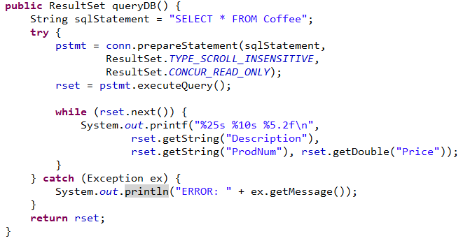
Sample Code – Prepared Query
(1 of 1)

Slide 10
Absolute Positioning
A ResultSet supports absolute positioning using the following methods:
  boolean absolute(int row)
  boolean first()
  boolean last()
  void afterLast()
  void beforeFirst()

Slide 11
Relative Positioning
A ResultSet supports relative positioning using the following methods:
  boolean relative(int row)
  boolean next()
  boolean previous()

Slide 12
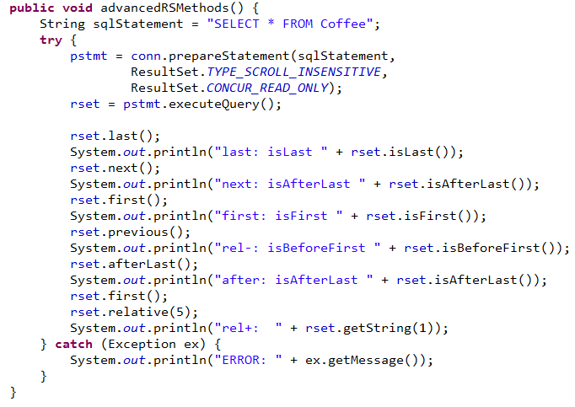
Coffee GUI Sample program

Slide 13
Testing Position
A ResultSet allows you to test for various positions:
  boolean isAfterLast()
  boolean isBeforeFirst()
  boolean isFirst()
  boolean isLast()
  int getRow()

Slide 14
Updateability
(1 of 2)
A ResultSet can be updated.
Changes made to the ResultSet object will be reflected in the underlying data store.
To be updateable, the ResultSet must have a concurrency type of CONCUR_UPDATEABLE.

Slide 15
Updateability
(2 of 2)
Only queries that meet the following restrictions can have an updateable ResultSet:
  The query references a single table.
  The query returns the primary key.
  The query returns all non-null columns that do not also have a default value.

Slide 16
Updating Rows
(1 of 3)
There are methods provided for updating each particular type of column.
Examples include:
void updateString(int col,String val)
throws SQLException
void updateString(String col,String val)
throws SQLException

Slide 17
Updating Rows
(2 of 3)
Although the data in the row has been changed, those changes haven’t yet been pushed out to the database.
To save the changes to the underlying data store, use the updateRow() method.
void updateRow()
throws SQLException

Slide 18
Updating Rows
(3 of 3)
If any of the positioning methods are invoked on the ResultSet prior to the call to the updateRow() method, then all changes made to that row will be discarded.

Slide 19
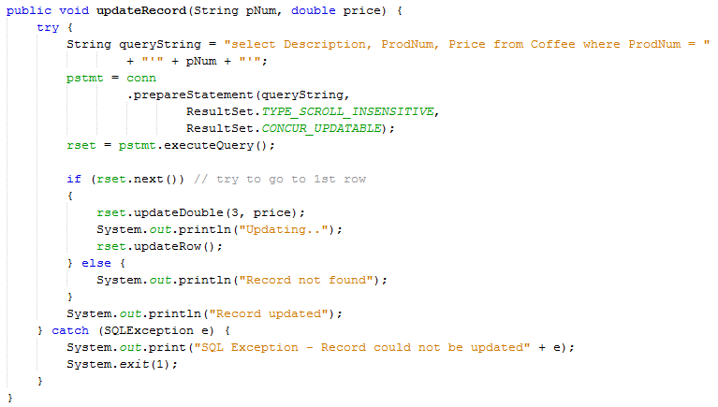
Updating Rows - Example
To save the changes to the underlying data store, use the updateRow() method.

Slide 20
Deleting Rows
To delete the current row from the underlying data store, use the deleteRow() method.
void deleteRow()
throws SQLException

Slide 21
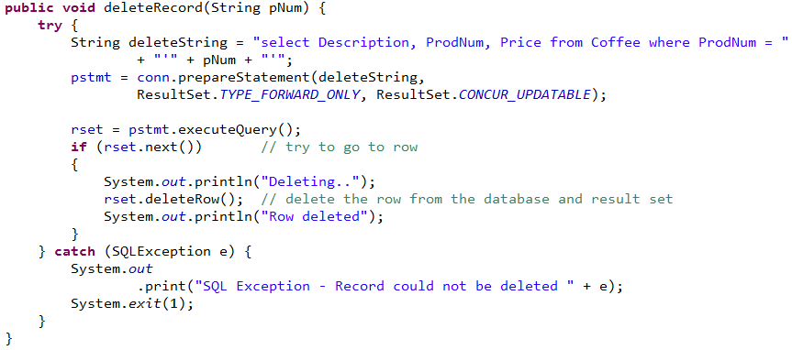
Deleting Rows - Example
To delete the current row from the underlying data store, use the deleteRow() method.

Slide 22
Inserting Rows
(1 of 5)
Inserting a new row consists of four (4) steps:
  Call the moveToInsertRow() method
  Update the columns within the new row
  Call the insertRow() method
  Returning to the original row in the ResultSet

Slide 23
Inserting Rows
(2 of 5)
First call the moveToInsertRow() method.
  This creates a new “buffer” area within the ResultSet for the new row.
It isn’t legal to call the updateRow() or deleteRow() method while the cursor is positioned on the insert row.

Slide 24
Inserting Rows
(3 of 5)
Next use the same update() methods used to update the ResultSet.
  This sets the various data members within the new row.
If you navigate off of this new row, your changes will be discarded.

Slide 25
Inserting Rows
(4 of 5)
Next call the insertRow() method.
  This performs the physical insertion of the row into the underlying data store.
Any values that haven’t been set on columns in the ResultSet are assumed to be null and will be interpreted that way by the data store.

Slide 26
Inserting Rows
The following method of ResultSet is used to move the row pointer to the row from where we jumped to the insert row: moveToCurrentRow() method.

Slide 27
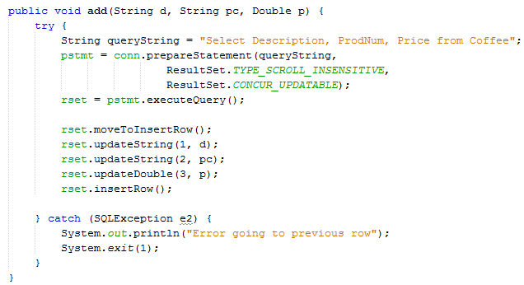
Inserting Rows - Example
Call the the moveToInsertRow() method - this creates a new “buffer” area within the ResultSet for the new row.
Next use the same update() methods used to update the ResultSet.
Next call the insertRow() method - this performs the physical insertion of the row into the underlying data store.

