Slide 1
SOFTWARE DEVELOPMENT 4
JDBC - Java Database Connectivity 2

Slide 2
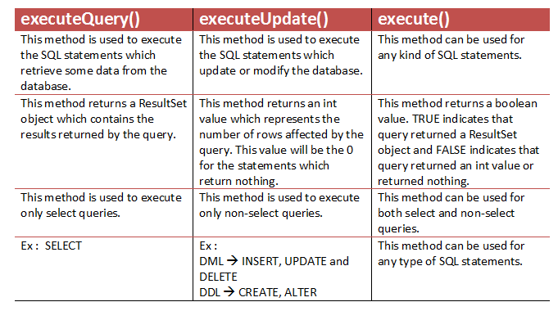
Statement Methods

Slide 3
The PreparedStatement Object
A PreparedStatement object
holds precompiled SQL statements.
Use this object for statements you want to execute more than once.
A prepared statement can contain variables that you supply each time you execute the statement.

Slide 4
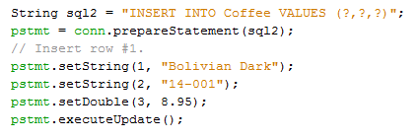
How to insert a record using a Prepared Statement – Sample Program
1. Create the prepared statement, identifying variables with a question mark (?).
2. Supply values for the variables.
3. Execute the statement.

Slide 5
Prepared Statements - SQL
ability to set up a statement once, and then execute it many times with different parameters.
replace building ad hoc query strings, and do so in a more efficient manner.

Slide 6
Placeholders- Setter methods
void | setInt(int parameterIndex, int value)
void | setString(int parameterIndex, String value)
void | setDate(int parameterIndex, java.sql.Date value)
void | setTimestamp(int parameterIndex, java.sql.Timestamp value)
void | setLong(int parameterIndex, long value)

Slide 7
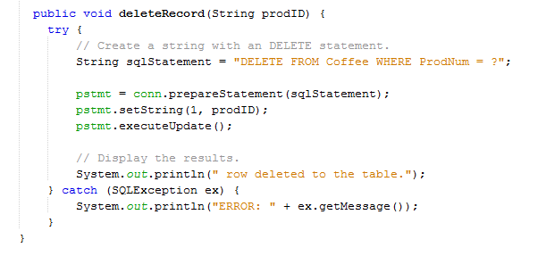
How to delete a record using a Prepared Statement – Sample Program

Slide 8
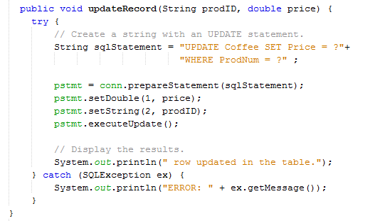
How to update a record using a Prepared Statement – Sample Program

