Slide 1
SOFTWARE DEVELOPMENT 4
Persistence(1)

Slide 2
What is JPA?
JPA stands for a java persistence API which is the Javax Persistence Package
It is a Java programming Language framework that helps developers to control relational data in java platform.
Java Persistence API is the newest of several Java persistence specifications.

Slide 3
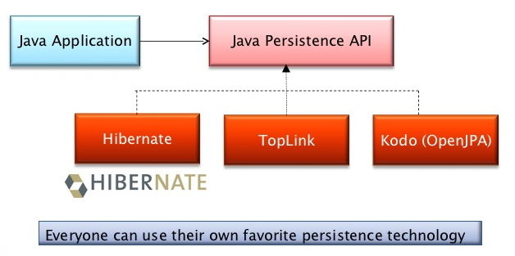
What does Persistence consist of?
Any persistence consists of there Areas:
  The API, defined in the Javax Persistence package
  The java persistence Query Language
  Object / relational meta data.

Slide 4
What does JPA do?
JPA defines a runtime Entity Manger API processing queries and transaction on objects against the database
It also defines an objects-level query language JPQL to allow querying of the objects from the database
JPQL stands for Java Persistence Query Language. It is used to make queries against entities stored in a relational database
Queries resemble SQL queries in syntax, but operate against entity objects rather than directly with database tables
Main advantage of JPQL is that it can be executed in all databases
  Select id, name,color,age from Car
The above query could be translated in to JPQL below:
  Select c from Car c

Slide 5
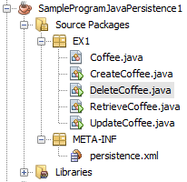
What is the persistence.xml file?
This file is responsible for all JPA environment configuration
This file must be included in a META-INF folder in the same path as the Java classes:

Slide 6
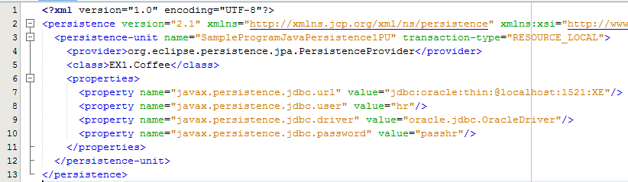
Sample persistence.xml file
Line 3: The persistence unit contains information about all classes, relationships, keys and other configurations all relating the database to your application
Line 4: Defines the JPA implementation provider. The provider is the application JPA implementation – in this case the provider is EclipseLink
Line 5: Used to declare the Java classes – required in EclipseLink
Line 6-11 Add specific JPA configurations i.e. database URL, driver, username & password

Slide 7
Entity Definitions
For JPA to correctly map database tables to classes the concept of an Entity was created
An entity must be created to support the same database table structure
JPA handles table data modification through an entity
For a Java class to be considered an entity it must follow these rules:
  To be annotated with @Entity
  A public constructor without arguments
  The Java class will need to have a field with the @Id annotation

Slide 8
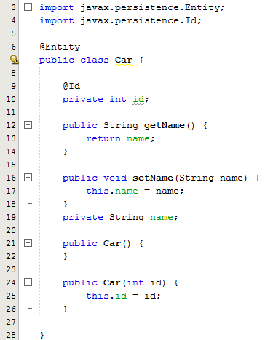
Entity Definition
This class follows all the requirements to be considered an entity
The class has the annotation @Entity above its name
There is an attribute considered to be the id of the class that is annotated with @Id
Every entity must have an id
The public constructor without arguments is mandatory

Slide 9
Managing Entities
Entities are managed by the entity manager which is represented by javax.persistence.EntityManager instances
Each instance is associated with a set of managed entity instances that exist in a particular data store
Applications create EntityManager instances by using the createEntityManagerFactory method of javax.persistence.EntityManagerFactory

Slide 10
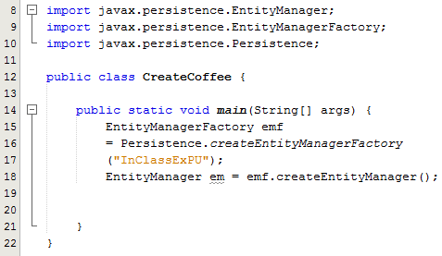
Sample Program
Lines 8-10: Imports needed in order to use the entity manager, entity manager factory & persistence methods
Line 15: Initialise an EntityManagerFactory reference first, called emf
Note the parameter to this method – it is the name of the persistence unit as defined in the persistence.xml file
Use emf to call the createEntityManager method in order to initialise an EntityManager reference

Slide 11
Create Entity Class
NetBeans has a useful wizard that we can use to create entity classes from database tables
In the class exercise we will run sql code to create the COFFEE table
We will then use the wizard to create the COFFEE entity from the COFFEE table

Slide 12
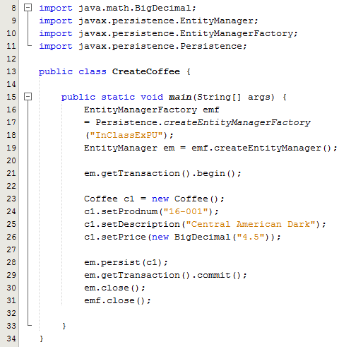
Create Operation
Line 21: Gets an EntityTransaction
The EntityTransaction API provides the regular methods begin(), commit(), rollback() etc
Lines 23-26: Creates a Coffee object and set the values of the member variables
Line 28: An explicit call to persist associates the object with an owner EntityManager em and changes its state to Managed
Line 29: The new entity object is stored in the database when the transaction is committed
Line 30: Calling the close method is essential to release resources (such as a socket in client-server mode) back to the owning EntityManagerFactory
Line 31: Closing the EntityManagerFactory closes the database file
https://blogs.oracle.com/CoreJavaTechTips/entry/the_need_for_bigdecimal

Slide 13
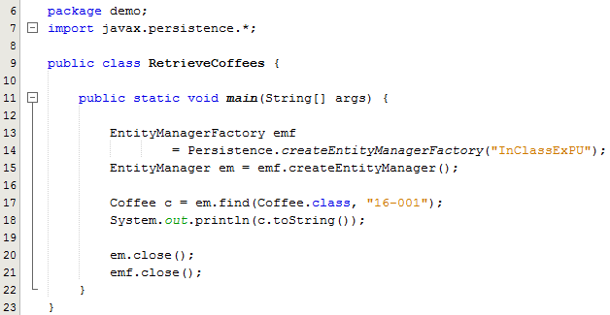
Read Operation
Every entity object can be uniquely identified and retrieved by the combination of its class and its primary key.
Given an EntityManager em, the code fragment at line 17 demonstrates retrieval of a Coffee object whose primary key is 16-001
Casting of the retrieved object to Coffee is not required because find is defined as returning an instance of the same class that it takes as a first argument (using generics)

Slide 14
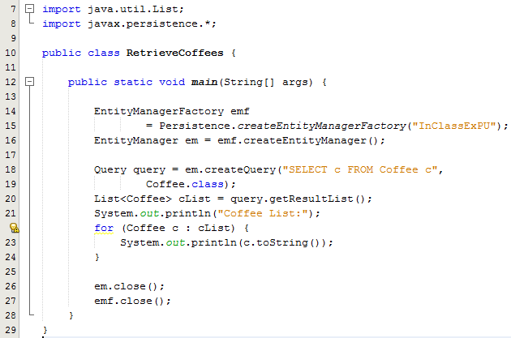
Read Operation
Using queries starts with an EntityManager
Line 18: Create a Query object and initialise it by calling on the createQuery method
The createQuery method here take two parameters: the query itself followed by the name of the entity
Line 20: The getResultList method is used to return the results of the query as a list

Slide 15
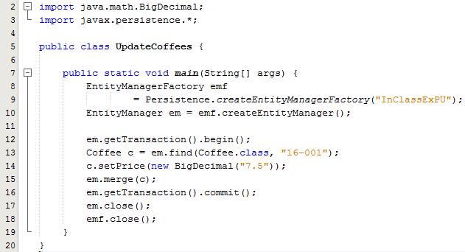
Update Operation
Line 13: Using the EntityManager em, the find method is called to retrieve a Coffee object whose primary key is 16-001
Line 14: setter method is called to update the price
Line 15: The entity is then merged back into the persistence context with the merge method
The updated entity object is updated in the database when the transaction is committed

Slide 16
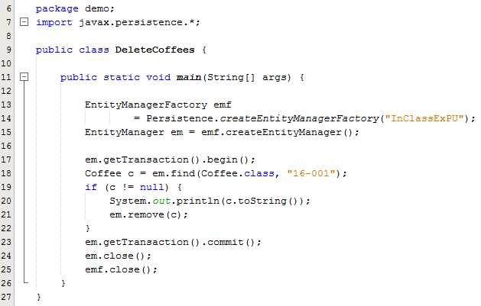
Delete Operation
Line 13: Using the EntityManager em, the find method is called to retrieve a Coffee object whose primary key is 16-001
Line 21: remove method is called to remove the entity
The database is updated when the transaction is committed

