Slide 1
SOFTWARE DEVELOPMENT 4
Persistence(2)

Slide 2
Names Queries
A named query is a statically defined query with a predefined unchangeable query string.
Using named queries instead of dynamic queries may improve code organization by separating the JPQL query strings from the Java code.
It also enforces the use of query parameters rather than embedding literals dynamically into the query string and results in more efficient queries.

Slide 3
Example 1
The following @NamedQuery annotation defines a query whose name is "Coffee.findAll" that retrieves all the Coffee objects in the database:
@NamedQuery(name = "Coffee.findAll", query = "SELECT c FROM Coffee c")
This named query is defined in the entity class and can then be called in the test class as follows:

Slide 4
Query & Typed Query
In JPA 2 the Query interface should be used mainly when the query result type is unknown or when a query returns polymorphic results and the lowest known common denominator of all the result objects is Object
When a more specific result type is expected queries should usually use the TypedQuery interface
It is easier to run queries and process the query results in a type safe manner when using the TypedQuery interface

Slide 5
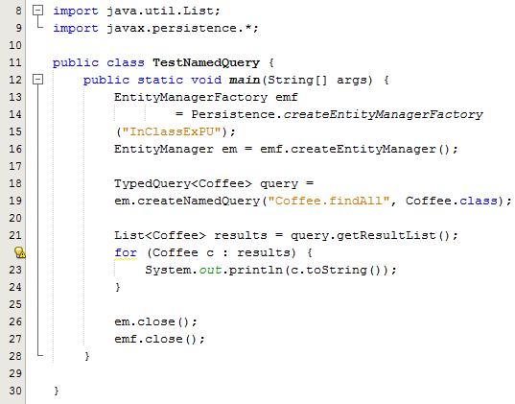
Example 1- Calling a Named Query
Lines 18-19: When building a TypedQuery instance the expected result type has to be passed as an additional argument, as demonstrated here i.e. Coffee.class
Because, in this case, the result type is known (the query returns only Coffee objects), a TypedQuery is preferred.

Slide 6
Example 2 – Names Query with a
Parameter
The following @NamedQuery annotation defines a query whose name is "Coffee.findByPrice" that retrieves all the Coffee objects in the database:
Named parameters can be easily identified in a query string by their special form, which is a colon (:) followed by a valid JPQL identifier that serves as the parameter name
@NamedQuery(name = "Coffee.findByPrice", query = "SELECT c FROM Coffee c WHERE c.price = :price")

Slide 7
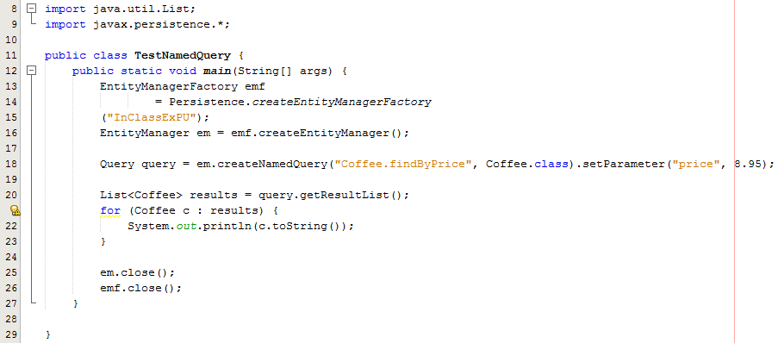
Example 2- Calling a Named Query
Line 18: the price argument to the findByPrice query is set in the query by calling setParameter

