Slide 1
SOFTWARE DEVELOPMENT 4
Persistence(3)

Slide 2
Inheritance with JPA
Inheritance is one of the core concepts of Java, therefore we can use inheritance relationships or strategies between entities
JPA support three types of inheritance strategies such as SINGLE_TABLE, JOINED_TABLE, and TABLE_PER_CONCRETE_CLASS
Employee
Project Manager
Technician

Slide 3
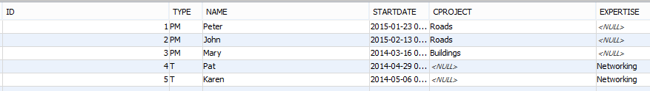
Single-Table Strategy
Single-Table strategy takes all the fields in the classes (both super and sub classes) and maps them into a single table known as SINGLE_TABLE strategy
Employee Table:

Slide 4
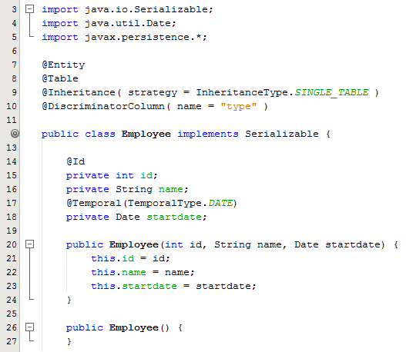
Sample program – Parent Class
The class has the annotation @Entity above its name
@Id is considered to be the id of the class
@Table specifies the primary table for the annotated entity
@Inheritance configures the inheritance using a single table for each class in the hierarchy
@DiscriminatorColumn specifies the field name (

Slide 5
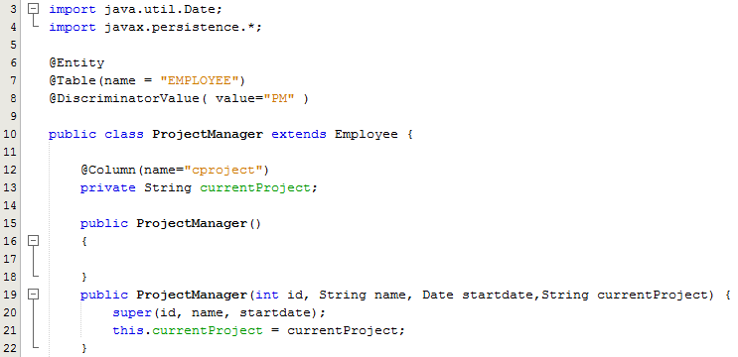
Sample program – SubClass
The class has the annotation @Entity above its name
@Table specifies the primary table for the annotated entity
@DescriminatorValue specifies the value of the type field in the Employee table

Slide 6
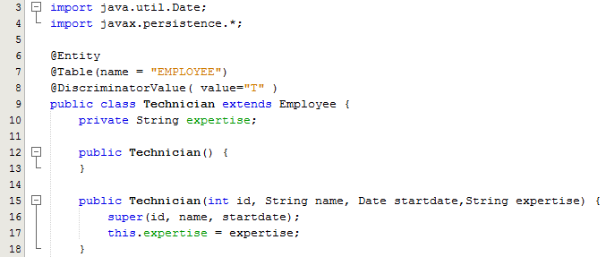
Sample program – SubClass
The class has the annotation @Entity above its name
@Table specifies the primary table for the annotated entity
@DescriminatorValue specifies the value of the type field in the Employee table

Slide 7
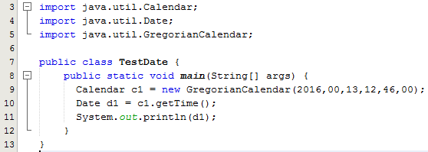

Inserting a Date object – Sample program
Java's java.util.Calendar class is used to do date and time arithmetic
The java.util.Calendar class is abstract, meaning you cannot instantiate it
The reason is that there are more than one calendar in the world
Java only comes with a Gregorian calendar implementation
Sample Output:

Slide 8
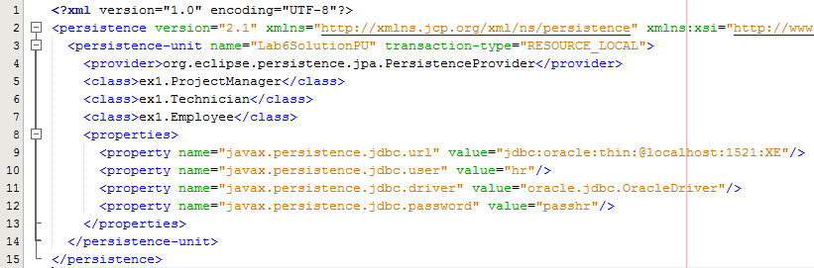
Sample Program persistence.xml file
Lines 5-7: All three classes need to be specified in this file

Slide 9
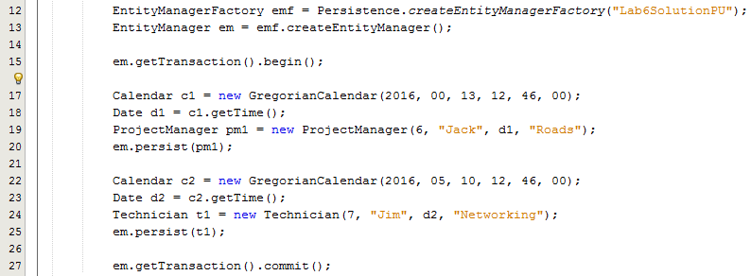
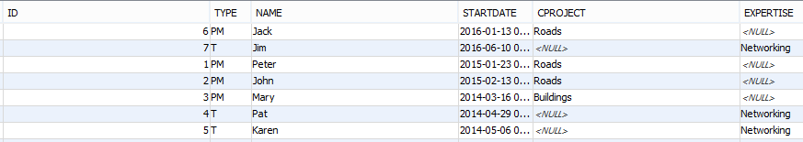
Create 2 entities
Note in the table, the TYPE column is automatically filled in

Slide 10
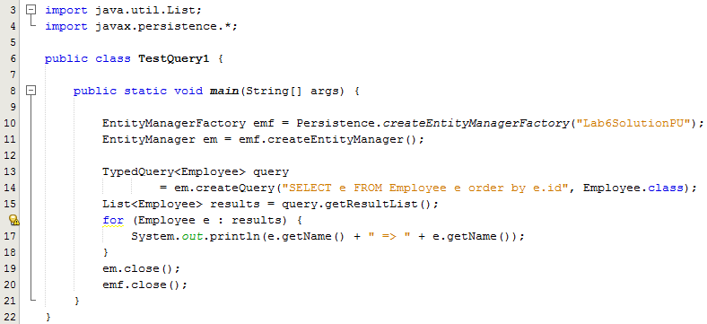
TestQuery1
The full contents of the table are retrieved into a list and printed out using an enhanced for
statement

Slide 11
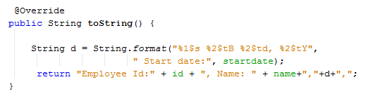
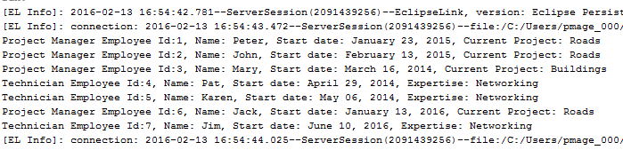
TestQuery1- Formatting the date
Date and time formatting can be done very easily using the String.format method
You use a two-letter format, starting with t and ending in one of the letters specified in the Formatter list in the API
Sample Output:
https://docs.oracle.com/javase/7/docs/api/java/util/Formatter.html

Slide 12
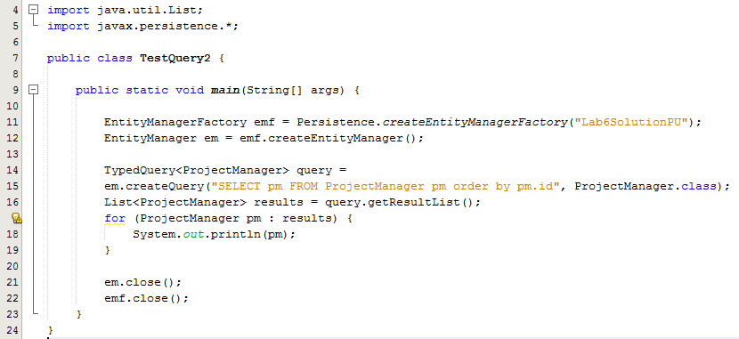
TestQuery2
Only the Project Manager entities are retrieved into a list and printed out using an enhanced for statement

Slide 13
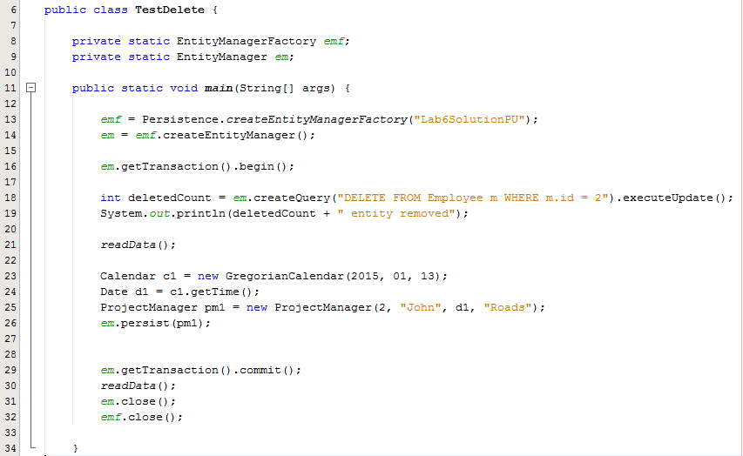
Delete an entity
DELETE queries provide an alternative way for removing entity objects from the database. Deleting objects using a DELETE query may be useful especially when many entity objects have to be deleted in one operation.

Slide 14
Joined-Table Strategy
Joined table strategy shares a referenced column which contains unique values to join the table
Like the previous example, the EMPLOYEE table contains a mandatory column for achieving inheritance using a Type column. This column will be used as a Discriminator Value. The Discriminator column will be used to determine which class that the row inserted belongs to
Unlike a Single Table Strategy, the PROJECTMANAGER and TECHNICIAN tables contains the same primary key that’s used by the EMPLOYEE table
The sub classes tables contains their columns that represents the sub classes attributes

Slide 15



Joined-Table Strategy
Employee Class
ProjectManager Class
Technician Class

Slide 16
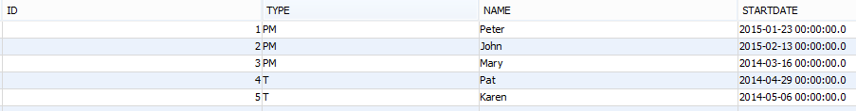


Table Structures
The PROJECTMANAGER and TECHNICIAN tables contains the same primary key that’s used by the EMPLOYEE table
EMPLOYEE Table:
TECHNICIAN Table PROJECTMANAGER Table

Slide 17
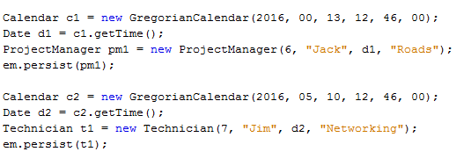
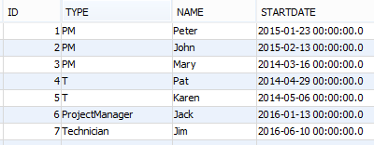


Create 2 entities – TestCreate.java
EMPLOYEE Table PROJECTMANAGER Table
TECHNICIAN Table
When the ProjectManager entity is created and persisted to the database, two table are updated. The same happens when the Technician entity is created and persisted.

Slide 18
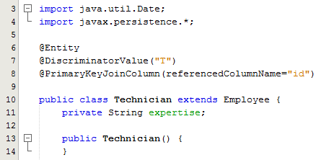
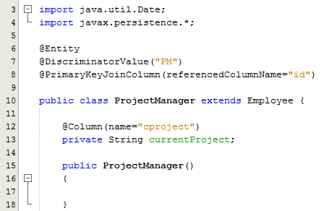
Querying the Table
In order to query the Employee entities where the tables are joined through inheritance we need the @DiscriminatorValue in each of the subclasses as shown below:

Slide 19
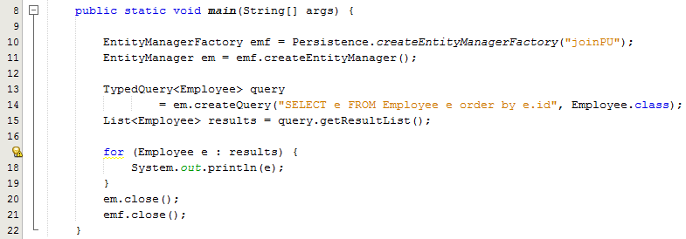
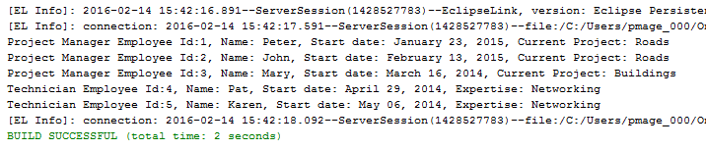
Querying the Table – TestQuery1.java
This code is exactly the same as the code written earlier for the Single-Table strategy
Output:

