Slide 1
SOFTWARE DEVELOPMENT 4
Persistence(4)

Slide 2
Mappings in JPA
In order to have relationships at all, there has to be a way to create, remove, and maintain them
The basic way this is done is by an entity having a relationship attribute that refers to its related entity in a way that identifies it as playing the other role of the relationship
It is often the case that the other entity, in turn, has an attribute that points back to the original entity
When each entity points to the other, the relationship is bidirectional
If only one entity has a pointer to the other, the relationship is said to be unidirectional

Slide 3

BiDirectionality
A relationship from an Employee to the Project that they work on would be bidirectional
The Employee should know its Project, and the Project should point to the Employee working on it
The arrows going in both directions indicate the bidirectionality of the relationship as shown below

Slide 4

UniDirectionality
An Employee and its Address would likely be modelled as a unidirectional relationship because the Address is not expected to ever need to know its resident

Slide 5
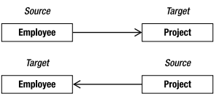
UniDirectionality
We can use the directionality of a relationship to help describe and explain a model, but when it comes to actually discussing it in persistence terms, it makes sense to think of every bidirectional relationship as a pair of unidirectional relationships
Instead of having a single bidirectional relationship of an Employee working on a Project, we would have one unidirectional “project” relationship where the Employee points to the Project they work on and another unidirectional “worker” relationship where the Project points to the Employee that works on it

Slide 6

Cardinaility
It isn’t very often that a project has only a single employee working on it
We would like to be able to capture the aspect of how many entities exist on each side of the same relationship instance. This is called the cardinality of the relationship
Each role in a relationship will have its own cardinality, which indicates whether there can be only one instance of the entity or many instances
Many Employee instances could each point to the same Department as shown below

Slide 7

Cardinaility
In our Employee and Project example, we have a bidirectional relationship, or two relationship directions
If an employee can work on multiple projects, and a project can have multiple employees working on it, then we would end up with cardinalities of “many” on the sources and targets of both directions as shown below:

Slide 8
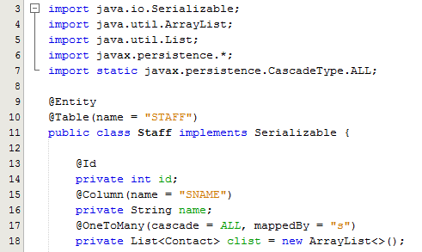
Sample program – Composition
@OneToMany specifies that one staff member can have many contacts
Cascade=all: Any persistence operation performed on the owning entity is cascaded to the target of the association
mappedBy=“s” : Sets the mappedBy element on the non-owning side of the association to the name of the field or property that owns the relationship

Slide 9
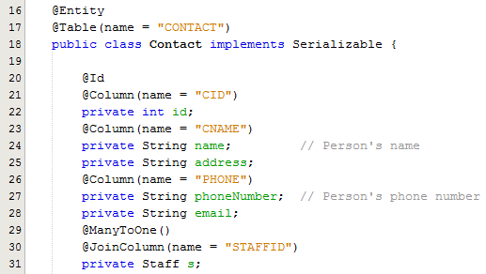
Sample program – Composition
@ManyToOne specifies that many contacts are owned by one staff member
@JoinColumn(name=“STAFFID”)
A Join Column in JPA is a column in the owner entity that refers to a key (usually a primary key) in the non-owner (Staff). In other words JoinColumns are nothing more than Foreign Key Columns

Slide 10


Table Structures
The PROJECTMANAGER and TECHNICIAN tables contains the same primary key that’s used by the EMPLOYEE table
STAFF Table:
CONTACT Table

Slide 11
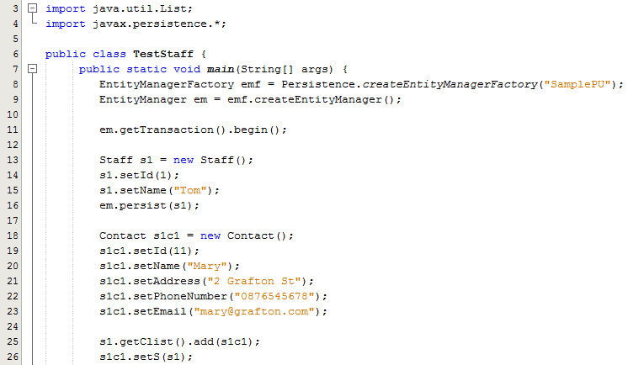
Sample program – Test Class
Lines 13-16: Creates a Staff entity instance, sets the members and persists it to the database
Lines 18-23: Creates a Contact entity instance and sets the members
Lines 25-26: Adds the Contact to the Staff list
Line 26: Sets the contact with the appropriate owner or Staff entity instance

