Slide 1
SOFTWARE DEVELOPMENT 4
Persistence(5)

Slide 2
Many To Many Relationship
In our sample program from last week we had the Staff and Contact classes
A Staff member could have a collection of Contacts. This was represented as composition and the mapping for JPA were done as a OneToMany mapping in the Staff class and a ManyToOne mapping in the Contact class
It is possible that two Staff members could have the same contact. This would lead to a ManyToMany mapping in terms of JPA
The many-to-many relationship is tricky because each side of this association plays both the Parent and the Child role
We can identify one side from where we’d like to propagate the entity state changes

Slide 3



Table Structures
STAFF Table
CONTACT Table
CONTACT_STAFF Table
In order to represent the many to many relationship in the database, we create an associate table CONTACT_STAFF

Slide 4
Many To Many Relationship
A many-to-many mapping is expressed on both the source and target entities as a @ManyToMany annotation on the collection attributes
For example, the Staff has a contacts attribute that has been annotated with @ManyToMany
Likewise, the Contact entity has an staff attribute that has also been annotated with @ManyToMany.

Slide 5
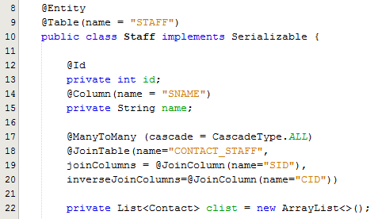
Sample Program – Staff Class
In order to map the tables, we need to add some additional metadata to the Staff class that we have designated as the owner of the relationship
The @JoinTable annotation is used to configure the join table for the relationship
The two join columns in the join table are distinguished by means of the owning and inverse sides
The join column to the owning side is described in the joinColumns element, while the join column to the
inverse side is specified by the inverseJoinColumns element

Slide 6
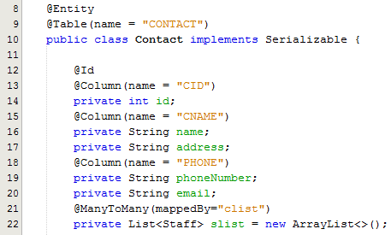
Sample program – Contact
Here we see that the Contact entity has an staff attribute that has also been annotated with @ManyToMany
In this example, we picked Staff to be the owner of the relationship, but we could have just as easily picked Contact instead
As in every other bidirectional relationship, the inverse side must use the mappedBy element to identify the owning attribute.

Slide 7
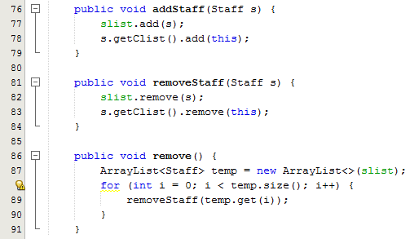
Sample program – Contact
The addStaff method takes a Staff object reference as a parameter and adds it to the staff arraylist in the Staff class and also adds it to the contacts arraylist in the Contact class
The removeStaff method takes a Staff object reference as a parameter and removes it from the staff arraylist in the Staff class and also removes it from the contacts arraylist in the Contact class
The remove method iterates through the staff list and calls the removeStaff method – we use a temporary arraylist reference in order to make sure to hold on to the original size of the arraylist before we start removing elements from it

Slide 8
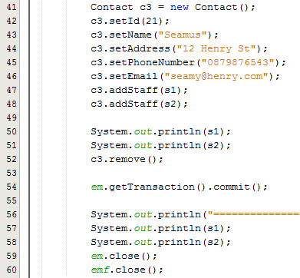
Sample program – Test Class
Lines 41-46: Creates a Contact
Line 47: Calls the addStaff method on this Contact reference passing in s1
Line 48: Calls the addStaff method on this Contact reference passing in s2
In other words Seamus is added as a contact to Tom’s list and Kevin’s list
Line 52: Calls the remove method to remove Seamus. This will remove Seamus from both Tom and Kevin’s list and it will also be removed from the database

