Slide 1
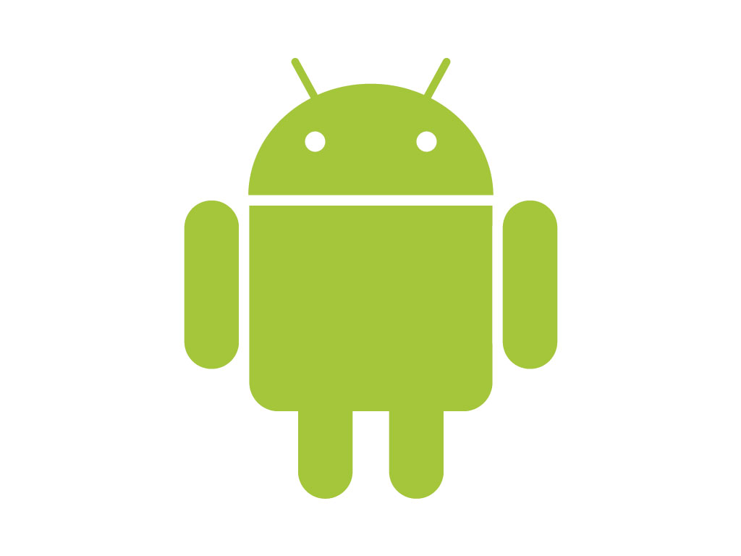
Android

Slide 2
Android Overview
  Developed by Open Handset Alliance (led by Google)
    Mobile Operators, Handset Manufacturers, Software Companies etc.
  Developer web site http://developer.android.com
  Based on Linux kernel version 2.6
  Android = a mobile operating system + APIs + libraries
  Google bought Android Inc. in 2005, Android 1.0 released in 2008 (HTC Dream)
  Open Source (most) initiative - Apache License
  > 80% of smartphone market share

Slide 3
Android Platforms
  Platform versions (named after desserts!)
    1.0, 1.1, …. ,2.2 (Froyo), 2.3 (Gingerbread)
    3.0 (Honeycomb) (tablets only), 4.0 (Ice Cream Sandwich), 4.1(Jelly Bean), 4.4 (KitKat), 5.0 (Lollipop), 6.0 (Marshmallow)
    Largest number of active devices currently run v 4.4 (KitKat, API level 19)
    Apps are forward compatible
      Can specify minimum API level for an app in manifest – keep low
      Also specify target API level (highest on which app was tested)
    Stores filter apps for devices based on API level

Slide 4
Android Platforms
    Apps support library – backward compatibility
      Allows apps to use features which are part of newer platform versions on devices running older versions of the platform e.g. action bars (API level 11), fragments (API level 11), snack bars and floating action buttons (API level 21)
  Device software can be updated
  Can develop on Windows/Linux/Mac

Slide 5
Android Runtime
  Every Android application runs in its own Linux process:
    Android Runtime Environment(ART), replacement for Dalvik VM since KitCat
      both run DEX bytecode on Linux kernel
    Process can be killed by the Android OS without warning when system resources are required by other applications.
  Lifecycle – 3 main states:
    Resumed – “running” in foreground & user can interact with it
    Paused – partially obscured by another activity, not executing
    Stopped – completely hidden, not executing

Slide 6
Android Application Development
  Source file creation ( .java )
  Source complied to bytecode ( .class )
  aapt tool combines bytecode & any data and resource files into an Android package, an archive file (.apk ) – unit of deployment to a device
  Android package deployed and transferred to device or emulators (AVDs) or to Google Play
  Applications signed to verify source (can be self-signed)

Slide 7
Development
  Android Studio or Eclipse with Android SDK under the hood
    Has emulators of devices (an Android Virtual Device (AVD))
    Will work with a real device via USB (must enable USB debugging on the device)
    Logcat – logger for debug messages

Slide 8
Anatomy of an App
  An Android App is made up of loosely coupled components bound by the application manifest
    4 components types:
      Activities
        Visual UI e.g. display a form
      Services
        No UI, run in background e.g. play music
      Content providers
        Make specific set of an app’s data available to other apps e.g. contact info, media store
      Broadcast Receivers
        React to broadcast announcement e.g. low battery
        No UI, can start an activity or notify user

Slide 9
Component Model
  Applications can use functionality available from other applications (if permitted) this offers the ability to use parts of another application
  Does not include the other application code or link to a code library, instead it starts the other application (or part of)
  This is different from traditional single point of entry application design and is a component oriented
  Intents = asynch messages used to activate activities, services, and broadcast receivers

Slide 10
Activities
  Activity = a hierarchy of views controlling a rectangular area of a window:
    Corresponds to a single screen or user task
    Applications may be comprised of a single or multiple activities
    One activity is marked as the first to be presented with the application is launched (via an intent filter)
    An activity can start another activity
    An activity typically has a single window to draw on (may not be the full screen)

Slide 11
User Interface
  UI creation
    by creating a layout file (xml) which is inflated, or programmatically
  Hierarchy of Views comprise the Activity UI:
    Widgets Views: text views, edit texts, spinners, buttons, image buttons, toggle button, progress bar, checkboxes, data picker, time picker, zoom control, radio groups and buttons, embedded browsers etc.
  ViewGroups (subclass of View) control layout of views:
    i.e. LinearLayout, AbsoluteLayout, TableLayout, RelativeLayout, FrameLayout, ScrollView, GridView, ListView

Slide 12
Application Resources
  drawable – image files in res/drawable (.gif, .jpg, .png), R.drawable class
    + alternatives for different screen resolutions e.g. res/drawable-hdpi
  layout – xml for activity layout in res/layout, R.layout
  menu – xml for menu resource (action bar, toolbar) in res/menu, R.menu
  values – simple or complex values in res/values
    strings.xml – strings – R.string
      + alternatives for different natural languages e.g. strings-es.xml
    array.xml – arrays – R.array
    colors.xml – color – R.color
    styles.xml – applied to a view or whole app (theme)– R.style

Slide 13
Supporting Different Devices
  Supporting different languages:
    Internationalize UI strings
      res/values/strings.xml
      res/values-es/strings.xml etc.
  Supporting different screens (sizes and densities):
    Define different layouts for different screen sizes, use RelativeLayout and fragments
    Provide different resolution bitmaps for different screen densities
  Supporting different platform versions:
    Specify min and target API levels in manifest
    Enable certain features in code based on detecting platform e.g. action bars on Honeycomb or later
    Apply themes

