Slide 1
HTTP PROTOCOL

Slide 2
Overview
HTTP
Network protocols (HTTP/TCP/IP)
Http Sessions
Request – Response protocol
Multi-Purpose Internet Mail Extensions (MIME)
Request Format & Response Format (Header & Body)
Web Servers

Slide 3


Client/Server Computing
Many Clients (end user computers) connected to one or more servers
Client issues requests and processes server response
Server performs requested action for clients:
Storing and retrieving files
Applications
Shared Resources
Request
Web
Server
Reply
Local
File Store/
Data
WWW Clients

Slide 4
HTTP
Basic function/operation is to fetch HTML documents and associated objects
Client issues requests, browser displays document
Server responsible for retrieving document from local file system
Client/server communications based on HTTP and TCP/IP protocols
Request
Web
Server
Reply
Local
File Store/
Data
WWW Clients

Slide 5
HTTP
HTTP is a request-response protocol to exchange or transfer hypertext (structured text which contains links to other texts)
The user agent (e.g. browser) submits an HTTP request message to the server.
The server returns a response message to the client.
The response contains completion status information about the request and may also contain requested content (html/xml/json)in the message body.
Request
Web
Server
Reply
Local
File Store/
Data
WWW Clients

Slide 6
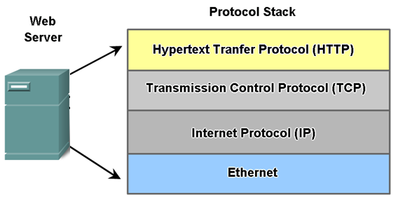
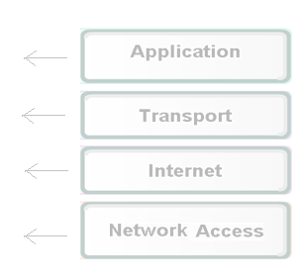
HTTP Overview
Hypertext Transfer Protocol (HTTP) is an application protocol for distributed, collaborative, hypermedia information systems
functions as a request-response protocol
Its definition presumes an underlying and reliable transport layer protocol, and Transmission Control Protocol (TCP) is commonly used
Notes:
HTTP
The Hypertext Transfer Protocol (HTTP) is an application-level protocol for distributed, collaborative, hypermedia information systems.
HTTP is an application layer protocol (application layer is aprt of the OSI protocol stack which defines a stack for implementing network communication
The OSI (Open Systems Interconnection) model
The OSI model defines internetworking in terms of a vertical stack of seven layers.
The upper layers of the OSI model represent software that implements network services like encryption and connection management.
The lower layers of the OSI model implement more primitive, hardware-oriented functions like routing, addressing, and flow control.
7 Layers
1. Application Layer – Provides a means for the user to access information on the network through an application (eg http).
2. Presentation Layer - Manages the presentation of the information in an ordered and meaningful manner (MIME).
3. Session Layer - The session layer establishes, manages, and terminates communication sessions.
4. Transport Layer – Ensures data integrity--that data transmitted between hosts is reliable and timely.
5. Network Layer - Routing of data (packets) through the network; handles the addressing and delivery of data.
6. Datalink Layer - Deals with issues such as flow regulation, error detection and control, and frames.
7. Physical Layer - Handles the bit-level electrical/light communication across the network channel
What is TCP/IP?
TCP/IP is the communication protocol for communication between computers on the Internet.
TCP/IP stands for Transmission Control Protocol / Internet Protocol.
TCP/IP defines how electronic devices (like computers) should be connected to the Internet, and how data should be transmitted between them.
TCP/IP is TCP and IP working together.
TCP takes care of the communication between your application software (i.e. your browser) and your network software.
IP takes care of the communication with other computers.
TCP is responsible for breaking data down into IP packets before they are sent, and for assembling the packets when they arrive.
IP is responsible for sending the packets to the correct destination.
RFC
HTTP standards developed – Asking people to comment on them
References
http://www.tutorialsweb.com/networking/osi-model-application-layer.htm
http://www.w3schools.com/tcpip/tcpip_intro.asp

Slide 7

HTTP – Session Overview
Client
Web Server
1
HTTP Server (Process)
Waits or “Listens” for TCP traffic on Port 80 (default port for HTTP)
Client Connect
Initiate TCP connection to http server Port 80
2
3
Accept
Accept Connection and notify client
Request
Send HTTP request (URL) via TCP connection socket
4
5
Response
Create a response containing the requested server object (e.g. HTML). Send via TCP
6
End Connection
Server terminates Session
Display
Parse the HTML received and display. If HTML references other objects (e.g. images) request each as above.
7
Time

Slide 8
HTTP & Client Server
Client/Server model
Client: browser that request, receive, and display objects
Server: Listens for requests and sends objects in response to requests
An HTTP session consists of a client request followed by a server response
Client initiates TCP connection (via socket) to server, port 80
Server accepts TCP connection
Virtual circuit established between two programs for communication
Notes:
A TCP socket is defined as an endpoint for communication.
A socket consists of the pair <IP Address,Port>

Slide 9
HTTP Request/ Response
HTTP messages exchanged between client and server
Requests/responses encoded in text
Multi-Purpose Internet Mail Extensions (MIME)
All binary data sent via HTTP and SMTP is encoded as Text
Mime is used to Indicate the file type being transferred
tells browser the original file format.
Response-Request Protocol :
Client sends request to server
followed by response from server to client
Server closes connection
Notes:
An Internet media type – formally known as MIME
Examples
image/jpeg: JPEG JFIF image;
application/javascript: JavaScript
application/xml-dtd: DTD files
application/zip ZIP archive files
audio/mpeg: MP3 or other MPEG audio;
multipart/form-data: MIME Webform
text/css: Cascading Style Sheets

Slide 10
HTTP is stateless
HTTP is “Stateless”
server maintains no information about past client requests
Maintaining state is not trivial
History must be maintained
if the server or client crashes then views of state may be inconsistent.
Notes:
An Internet media type – formally known as MIME
Examples
image/jpeg: JPEG JFIF image;
application/javascript: JavaScript
application/xml-dtd: DTD files
application/zip ZIP archive files
audio/mpeg: MP3 or other MPEG audio;
multipart/form-data: MIME Webform
text/css: Cascading Style Sheets

Slide 11
HTTP Request - Format
Request Format - Example
Request Line
GET /home/default.html HTTP/1.1
User-agent: Mozilla/4.0 (Windows 5.1)
Accept: text/html, image/gif,image/jpeg
Accept-language: en
Host: www.it-tallaght.ie
Header Lines
Blank Line (CR)
Indicating end of message
Request Body – Used with POST Method

Slide 12
HTTP Request - Header SEE: HTTP://WWW.W3.ORG/PROTOCOLS/RFC2616/RFC2616-SEC14.HTML
HTTP Request : Header Lines
Field | Description
User-Agent | Client software (the user who originated the request)
Referer | URI which caused this page to be requested (e.g. when a user click a link on a webpage, the address of that page is also sent)
Accept | Acceptable document types, encodings, languages, character sets
Authorization | Authentication info
If-Modified-Since | For use with caching
Host | For multiple web sites hosted on same server
Connection/ Proxy Connection | Keep connection alive for subsequent request or close connection
Notes:
Examples
User Agent
User-agent: Mozilla/4.0 (Windows 5.1)
Try out typing in your browser - javascript:alert(navigator.userAgent)
Referer
Referer: http://www.google.com
Accept
Accept: text/html, image/gif,image/jpeg
Authorization
Authorization: user fred:mypassword
From
From: joe.blogs@ittallaght.ie
If-Modified-Since
If-Modified-Since: Weekday, DD-Mon-YY HH:MM:SS TIMEZONE
Host
Host: www.it-tallaght.ie
Connection/ Proxy Connection
Proxy-Connection: Keep-Alive
Proxy-Connection: Close

Slide 13
HTTP Request Methods
HTTP request Methods
GET | Request for a resource
HEAD | Retrieve only the headers (meta-information), but not the resource itself. As the headers contain an entry on the document‘s length, this method is useful for quality-based transfer decisions. check for valid and broken links in Web pages. check Web pages for modifications.
POST | Send information to the server (usually information provided in a form).
PUT | upload file to URI specified
DELETE | remove file specified by URI
TRACE | returns contents of request header in response message body

Slide 14
HTTP Request Methods
GET
The browser encodes the form data into a URL using the form FIELD and ACTION values
The URL is displayed in the location bar
Max URL length is 4000 characters
Apache Web server will respond with error if longer
413 Entity Too Large
GET search?hl=en&as_q=url+length HTTP/1.1
Host: www.google.ie
Notes:
Another example of a GET URL
GET http://www.assemblesoft.com/examples/form/simpleform.html?name=sara&gender=female HTTP/1.1

Slide 15
HTTP Request Methods
POST
FIELD values (data) is sent as part of the request body
Values not displayed in browser URL (=> if encrypted channel data is not visible)
Data size is not limited
File upload supported
multipart/form-data
POST search HTTP/1.1
Host: www.google.ie
Content-type: application/x-www-form-urlencoded
hl=en&as_q=url+length
Notes:
POST http://www.2shared.com/shortLink.jsp HTTP/1.1
x-requested-with: XMLHttpRequest
Accept-Language: en-ie
Referer: http://www.2shared.com/uploadComplete.jsp?sId=x0qv77U9YaZLsjTp
Accept: text/html, */*
Content-Type: application/x-www-form-urlencoded
UA-CPU: x86
User-Agent: Mozilla/4.0 (compatible; MSIE 7.0; Windows NT 5.1; .NET CLR 2.0.50727) Paros/3.2.13
Host: www.2shared.com
Content-Length: 74
Proxy-Connection: Keep-Alive
Pragma: no-cache
Cookie: hostid=-607531214; JSESSIONID=23A1E5229FCD4B8CBC571CF710F3F8A5.dc1; __utma=210041558.1379406640.1252079330.1252079330.1252079330.1; __utmb=210041558; __utmc=210041558; __utmz=210041558.1252079330.1.1.utmccn=(organic)|utmcsr=google|utmctr=upload+a+file|utmcmd=organic
Difference between POST and GET
The HTML specifications technically define the difference between "GET" and "POST" so that former means that form data is to be encoded (by a browser) into a URL while the latter means that the form data is to appear within a message body. But the specifications also give the usage recommendation that the "GET" method should be used when the form processing is "idempotent", and in those cases only. As a simplification, we might say that "GET" is basically for just getting (retrieving) data whereas "POST" may involve anything, like storing or updating data, or ordering a product, or sending E-mail.
Ref: http://www.cs.tut.fi/~jkorpela/forms/methods.html
In HTTP there are various ways to POST data e.g application/x-www-form-urlencoded
application/x-www-form-urlencoded
For application/x-www-form-urlencoded, the body of the HTTP message sent to the server is essentially one giant query string -- name/value pairs are separated by the ampersand (&), and names are separated from values by the equal symbal (=). An example of this would be:
MyVariableOne=ValueOne&MyVariableTwo=ValueTwo

Slide 16
HTTP Response Example
Response Format – Example
HTTP/1.1 200 OK
Server: Microsoft-IIS/5.0
Date: Tue, 29 Jul 2008 14:58:42 GMT
X-Powered-By: ASP.NET
Connection: close
Content-Type: text/html
Status Line
Header Lines
Blank Line (CR)
<!DOCTYPE html PUBLIC "-//W3C//DTD XHTML 1.0 Transitional//EN" "http://www.w3.org/TR/xhtml1/DTD/xhtml1-transitional.dtd">
<html xmlns=http://www.w3.org/1999/xhtml>
<head>
<!--ITT_homepage→
<title>Institute of Technology, Dublin: home</title>
<meta http-equiv="Content-Type" content="text/html; charset=UTF-8" />
<meta http-equiv="Content-Subject” ……………………etc..
Body – Data

Slide 17
HTTP Response
Status Line
HTTP version
Status-codes classes:
1xx: informational, request received
2xx: success, request accepted
3xx: redirection
4xx: client error
5xx: server error
Reason phrase
a short phrase describing the status-code (typically in English).

Slide 18
HTTP Response
Example Response codes
200 OK | Standard response for successful HTTP request, requested object later in this message
301 Moved Permanently | requested object moved, new location specified later in this message (Location:)
400 Bad Request | request message not understood by server
404 Not Found | requested document not found on this server
500 Internal Server Error | A generic error message, given when an unexpected condition was encountered and no more specific message is suitable.
505 HTTP Version Not Supported | The server does not support the HTTP protocol version used in the request

Slide 19
HTTP Response
HTTP Response : Header Lines
Field | Description
Location | redirection
Server | server software e.g Server: Apache/2.4.1 (Unix)
WWW-Authenticate | request for authentication, indicates the authentication scheme that should be used to access the requested entity. e.g WWW-Authenticate: Basic
Allow | list of methods supported (GET, HEAD, etc)
Content-Encoding | x-gzip
Content-Length | The length of the response body in octets (8-bit bytes)
Content-Type | The MIME type of this content e.g Content-Type: text/html; charset=utf-8
Expires | Gives the date/time after which the response is considered stale
Last-Modified | The last modified date for the requested object

Slide 20
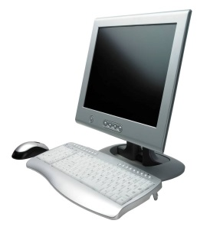
HTTP Request – Response Overview
HTTP Request
Request
Get index.html HTTP/1.1
Header
Host: www.dit.ie
User-agent: mozilla (Windows 5.1)
Accept: */*
Date: Mon, 7 Jul 2013 11:11:20 GMT
Body
(empty)
Web server
Fetch
Page
HTTP Response
HTML
Page
Response
HTTP/1.1 200 OK
Header
Server: Microsoft-IIS/5.0
Date: Mon, 7 Jul 2013 11:11:21 GMT
Body
<HTML>
….
</HTML>
Web client

Slide 21
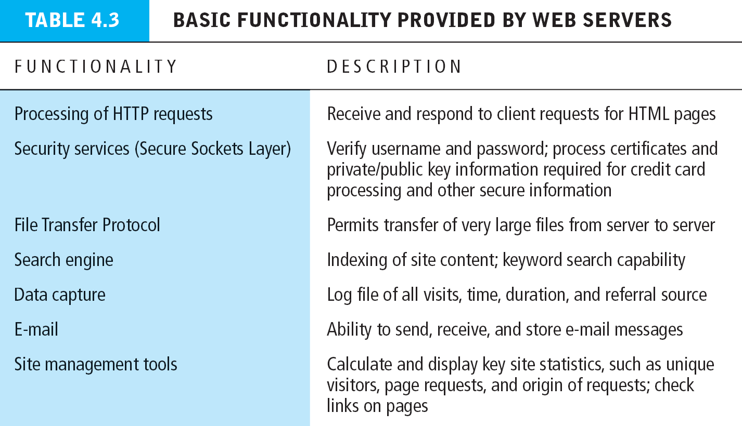
WWW Server functionality
Source: E-Commerce 2012 Table 4.3, Page 218, Copyright © 2012 Pearson Education Inc.

