Slide 1
CSC 123 – Animating characters
Hierarchical modeling

Slide 2
Characters
In order to create compelling stories, you need compelling characters
Character animation is hard…

Slide 3
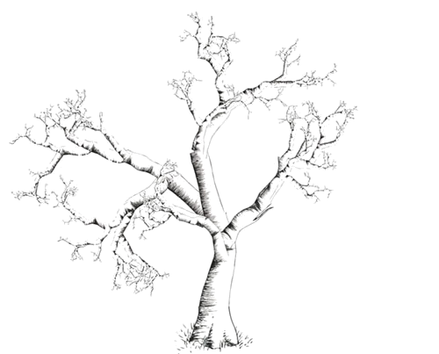
Hierarchical Modeling
Many objects are naturally modeled hierarchically.
Example: A tree.
  The trunk starts out at the ground.
  The large branches start out from the trunk.
  The small branches start out from the large branches.
  The leaves start out from the small branches.
It is best to describe each successive
“child” frame (trunk, big branch,
small branch, leaf) with respect to
its previous parent frame.

Slide 4
Many characters
Stick people

Slide 5
Hierarchical modeling
Main idea is to define transforms
  Translate
  Scale
  Rotate
with respect to other parts of the character
Not with respect to the world
T
B
A
B
A
R
P
Q

Slide 6
transforms
Some comments on transforms
  Each transform is a matrix applied to each vertex
  These matrices move each vertex drawn after the transform using mathematics
  e.g. translate(2, 3) -> (x+2, y+3)
  e.g. scale(2) -> (2*x, 2*y)

Slide 7
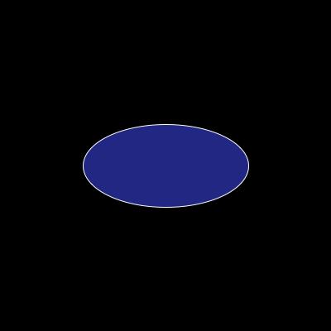
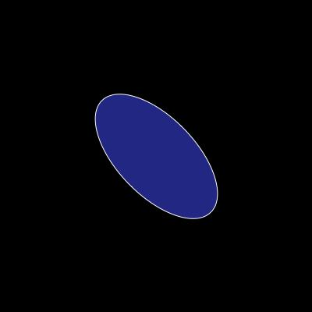

transforms
As you know, “where” you do transforms matters
  Rotation around the origin
  Rotation around the objects center

Slide 8
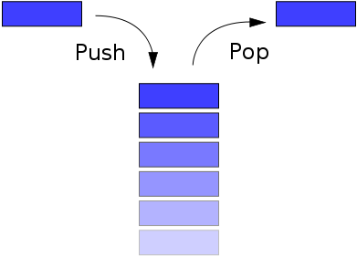
transforms
In order to make sure that transforms only apply to certain parts of our scene or character use
    pushMatrix()
    popMatrix()
    Stack

Slide 9
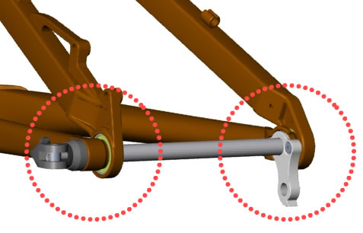
Hierarchical modeling
To get our character to move correctly, we have to carefully move its parts with respect to “pivot points”

Slide 10
Making an Articulated Arm
A minimal 2D jointed object:
  Two pieces, A (“forearm”) and B (“upper arm”).
  Attach point Q on B to point R on A (“elbow”).
T
B
A
B
A
R
P
Q

Slide 11
How To Do It
Draw A and B in their local object frame.
B is hiding behind A.
A
R

Slide 12
How To Do It
1. Translate A by (-R_{x}, -R_{y})
B
A
R

Slide 13
How To Do It
2. Rotate A by +θ (the “elbow” angle).
θ
A
B

Slide 14
How To Do It
3. Translate A by (Q_{x}, Q_{y}) to align the points R and Q.
A
B
Q

Slide 15
How To Do It
4. Translate A & B by (-P_{x}, -P_{y}).
A
B
P

Slide 16
How To Do It
5. Rotate CW by ϕ (the “shoulder” angle).
ϕ
B
A

Slide 17
How To Do It
6. Translate by (T_{x}, T_{y}) to the final shoulder position T.
T
B
A

Slide 18
Transformation Hierarchies
Translate T
This is the build-an-arm sequence, represented as a tree.
Interpretation:
  Leaves are geometric primitives.
  Non-leaves are transformations.
  Transformations apply to everything under them — start at the bottom and work your way up.
Rotate CW ϕ
Translate -P
Translate Q
B
Rotate CCW θ
Translate -R
A

Slide 19
Transformation Hierarchies
Translate T
You can build a wide range of models this way.
Rotate CW ϕ
Translate -P
Translate Q
B
Control Knob
Rotate CCW θ
Primitive
Translate -R
Structural
A

Slide 20
What have we done?
Seems more complicated than just translating and rotating each piece separately.
We have the following control knobs:
  T: shoulder position (point at which P winds up.)
  ϕ: shoulder angle (A and B rotate together about P.)
  θ: elbow angle (A rotates about R, which stays attached to P.)
ϕ, θ, and T are parameters of the model.
  Changing them wiggles the arm.
P, Q, and R are structural constants.
  Changing them dismembers the arm.

Slide 21
The Right Control Knobs
The set of “control knobs” (parameters) make it easy to move our stick person.
Without it, the model falls apart as soon
as you change something.

Slide 22
A Schematic Humanoid
The root can be anywhere.
We chose the hip.
You get control knobs for each joint angle, plus global position and orientation.
A realistic human would be much more complex.
  But stick persons are also people...
Hip
Torso
l.Leg1
r.Leg1
Shoulder
l.Leg2
r.Leg2
l.Arm1
r.Arm1
Neck
l.Arm2
r.Arm2
Head

Slide 23
Processing example
void drawDuck() {
pushMatrix();
//move the entire duck
translate(Dloc.x, Dloc.y);
scale(2); //scale the entire duck
fill(245, 226, 12);
ellipse(0, 0, 40, 30); //body
//draw neck and head with possible animation transforms
pushMatrix();
translate(-16, 0); //move back into draw position
rotate(neckR); //rotate by neckR parameter
translate(16, 0); //move neck and head to pivot point
ellipse(-16, -10, 10, 18); //neck
ellipse(-16, -17, 14, 14); //head
fill(0);
ellipse(-16, -19, 4, 4); //eye
fill(155, 111, 16);
triangle(-26, -18, -20, -21, -20, -15); //beak
popMatrix();
popMatrix();
}

Slide 24
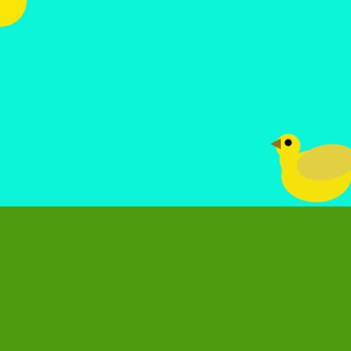
Lab
Incomplete duck animation
  Add legs

