Slide 1
Origins of Computer Science
We will aim to answer such questions as, “What is the origin of...” by giving a historical perspective of the various sub-topics in Computer Science.
We provide an opportunity to think about Computer Science, its past, its future, is a broad way.
We will also aim to give you a grounding in research techniques, group work and technical writing.
You will have an opportunity to see many of the different members of lecturing staff.

Slide 2
Learning objectives I
To understand the historical background of many aspects of Computer Science, and gain insight into future directions.
To gain skills in researching technical material.
To merge and interpret multiple sources of material, create and articulate your own opinion on technical matters.

Slide 3
Learning objectives II
To articulate a technical argument in a concise
and coherent manner to a technical audience.
To further your technical writing skills, particularly in style, grammar and formatting.
To learn technical presentation skills, and gain confidence in presenting to your peer-group.

Slide 4
Demo
At the end of the course, we will have extended demo sessions, where you will work in groups to produce a demo.
More details on the format of demos closer to the time.
For now, remember to keep a record of anything you find interesting or exciting.

Slide 5
Coursework
3 x individual one-page topic précises (20% each)
1 x group demo (40%)
There is no exam for COMS12303.

Slide 6
HOW TO DO RESEARCH!

Slide 7
Researching in steps
1) Identify a topic that interests you;
2) Whittle it down to a few keywords;
3) Find some material related to one keyword;
4) Read the material;
5) Digest the material;
6) Follow up on any leads from the material; GOTO 4
7) Repeat for the other keywords;
8) Make sure you stop!

Slide 8
If I can't dance, I don't want to be part of your revolution.

Slide 9
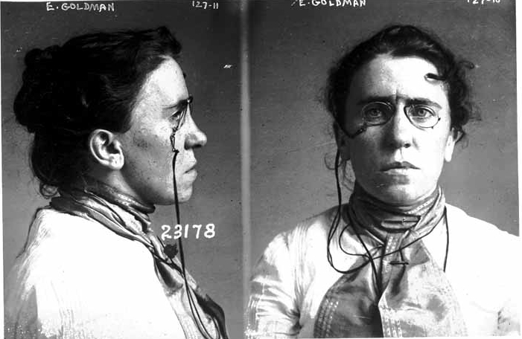
Emma Goldman
Picture “mug shot from Chicago 1901” is from wikipedia.

Slide 10
At the dances I was one of the most untiring and gayest. One evening a cousin of Sasha, a young boy, took me aside. With a grave face, as if he were about to announce the death of a dear comrade, he whispered to me that it did not behoove an agitator to dance. Certainly not with such reckless abandon, anyway. It was undignified for one who was on the way to become a force in the anarchist movement. My frivolity would only hurt the Cause.
I grew furious at the impudent interference of the boy. I told him to mind his own business. I was tired of having the Cause constantly thrown into my face. I did not believe that a Cause which stood for a beautiful ideal, for anarchism, for release and freedom from convention and prejudice, should demand the denial of life and joy. I insisted that our Cause could not expect me to become a nun and that the movement would not be turned into a cloister. If it meant that, I did not want it. "I want freedom, the right to self-expression, everybody's right to beautiful, radiant things." Anarchism meant that to me, and I would live it in spite of the whole world — prisons, persecution, everything. Yes, even in spite of the condemnation of my own closest comrades I would live my beautiful ideal.

Slide 11
It requires less mental effort to condemn than to think and it is less interesting.

Slide 12
Babylonian mathematics
A translation of a Babylonian tablet which is preserved in the British museum goes as follows:-
4 is the length and 5 the diagonal. What is the breadth ?
Its size is not known.
4 times 4 is 16.
5 times 5 is 25.
You take 16 from 25 and there remains 9.
What times what shall I take in order to get 9 ?
3 times 3 is 9.
3 is the breadth.
http://www-history.mcs.st-and.ac.uk/HistTopics/Babylonian_Pythagoras.html

Slide 13
Babylonian mathematics
A translation of a Babylonian tablet which is preserved in the British museum goes as follows:-
4 is the length and 5 the diagonal. What is the breadth ?
Its size is not known.
4 times 4 is 16.
5 times 5 is 25.
You take 16 from 25 and there remains 9.
What times what shall I take in order to get 9 ?
3 times 3 is 9.
3 is the breadth.
http://www-history.mcs.st-and.ac.uk/HistTopics/Babylonian_Pythagoras.html

Slide 14
Who is there, my friend, can climb to the sky?
Only the gods dwell forever in sunlight.
As for man, his days are numbered,
whatever he may do, it is but wind.
en.wikiquote.org and www.gutenberg.org/babylonian-collection.yale.edu/highlights

Slide 15
Wikipedia
Everyone can and should edit wikipedia.
It is a great story teller.
Like all great story tellers it tells storys that sound true, but sometimes aren't.

Slide 16
Books
Textbooks – good for background.
Often require step by step reading.
Graduate textbooks – advanced material.
“Edited books” collections of “review style” articles by people who owe the editors a favour.
The University is full of libraries, eg there is one in the Queen's Building.

Slide 17
Journals and Proceedings
Main source of scholarly information.
Most of science – appears in journals.
Some of computer science – appears in conference proceedings.
Regarded as authorative in that people who care a lot about their reputation stake their reputation on their papers.
Also “refereed”. People who referee your papers are the worst, everyone is a great referee.

Slide 18
Journals
Many journals charge. The university has a subscription for lots.
They can only be accessed through the university system
You can use a university computer
Or log on to one remotely using a VPN
https://www.bris.ac.uk/it-services/advice/homeusers/uobonly/uobvpn/

Slide 19
Journals
Many Journals are now free.
Almost all journals allow authors to “self-archive” their papers.
Most funding bodies now require that researchers they fund publish in free or free-after-6-months journals.
Never pay to read an article!

Slide 20
Searching for Papers
scholar.google.com
ieeexplore.ieee.org or computer.org
portal.acm.org
citeseer.ist.psu.edu
liinwww.ira.uka.de/bibliography

Slide 21
Older papers
May only exist in book form – a bound set of journals.
These may be in the library. If not they can be requested using inter-library loan.
Many have been digitized.
Many are on jstor (http://www.jstor.org/) – who are evil – to whom the University has a subscription.

Slide 22
Worth reading!
“I assume that the reader is familiar with the idea of extrasensory perception, and the meaning of the four items of it, viz., telepathy, clairvoyance, precognition and psychokinesis. These disturbing phenomena seem to deny all our usual scientific ideas. How we should like to discredit them! Unfortunately the statistical evidence, at least for telepathy, is overwhelming. It is very difficult to rearrange one's ideas so as to fit these new facts in. Once one has accepted them it does not seem a very big step to believe in ghosts and bogies. The idea that our bodies move simply according to the known laws of physics, together with some others not yet discovered but somewhat similar, would be one of the first to go.”
from Turing, Alan (October 1950), "Computing Machinery and Intelligence", Mind LIX (236): 433–460, doi:10.1093/mind/LIX.236.433 – ie the Turing Test paper.

Slide 23
Citation
Turing, Alan (1950), "Computing Machinery and Intelligence", Mind LIX (236): 433–460,
doi:10.1093/mind/LIX.236.433

Slide 24
Writing
Always stick to word limits or page lengths.
We will be very strict about this!
Don't squeeze things in.
No tiny margins.
Use defaults for page sizes etc.
Follow any font size instructions.

Slide 25
Writing
One paragraph one idea!
Have an argument.
Progress through the argument.
Begining
Middle
End

Slide 26
Don't write to amuse yourself.
“If you here require a practical rule of me, I will present you with this: ‘Whenever you feel an impulse to perpetrate a piece of exceptionally fine writing, obey it—whole-heartedly—and delete it before sending your manuscript to press. Murder your darlings.”
Arthur Quiller-Couch
http://www.slate.com/blogs/browbeat/2013/10/18/_kill_your_darlings_writing_advice_what_writer_really_said_to_murder_your.html

Slide 27
Writing
Write long and then edit.
Read it out loud.
Sleep on it.
Get a friend to read it.

Slide 28
Citations
Back things up with citations – unsupported statements are the essence of bad writing
Citations allow the reader to
check up on facts.
learn more.
attribute progress correctly.

Slide 29
“However, the precise role of the cerebellum in movement is still debated; it is proposed, for example, that the cerebellum is a computational engine for deciding precise levels of muscle activation [17]–[20], or an organ of prediction, predicting the sensory consequence of movement [21]–[24] or that its has a role in proprioception [25], [26].”
“[17] Marr D (1969) A theory of cerebellar cortex. Journal of Physiology 202: 437–470.”
Houghton, C. (2014). Supervised Learning with Complex Spikes and Spike-Timing-Dependent Plasticity.

Slide 30
MAKE YOU BIBLIOGRAPHY CONSISTIENT.

Slide 31
AVOID PLAGARISM!

