Slide 1
Origins of Computer Science
We will aim to answer such questions as, “What is the origin of...” by giving a historical perspective of the various sub-topics in Computer Science.
We provide an opportunity to think about Computer Science, its past, its future, is a broad way.
We will also aim to give you a grounding in research techniques, group work and technical writing.
You will have an opportunity to see many of the different members of lecturing staff.

Slide 2
Learning objectives I
To understand the historical background of many aspects of Computer Science, and gain insight into future directions.
To gain skills in researching technical material.
To merge and interpret multiple sources of material, create and articulate your own opinion on technical matters.

Slide 3
Learning objectives II
To articulate a technical argument in a concise
and coherent manner to a technical audience.
To further your technical writing skills, particularly in style, grammar and formatting.
To learn technical presentation skills, and gain confidence in presenting to your peer-group.

Slide 4
Demo
At the end of the course, we will have extended demo sessions, where you will work in groups to produce a demo.
More details on the format of demos closer to the time.
For now, remember to keep a record of anything you find interesting or exciting.

Slide 5
Coursework
1 x group presentation (practice)
3 x individual one-page topic précises (20% each)
1 x group demo (40%)
There is no exam for COMS12303.

Slide 6
If I can't dance, I don't want to be part of your revolution.

Slide 7
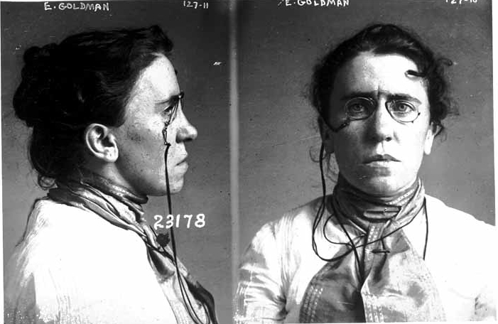
Emma Goldman
Picture “mug shot from Chicago 1901” is from wikipedia.

Slide 8
At the dances I was one of the most untiring and gayest. One evening a cousin of Sasha, a young boy, took me aside. With a grave face, as if he were about to announce the death of a dear comrade, he whispered to me that it did not behoove an agitator to dance. Certainly not with such reckless abandon, anyway. It was undignified for one who was on the way to become a force in the anarchist movement. My frivolity would only hurt the Cause.
I grew furious at the impudent interference of the boy. I told him to mind his own business. I was tired of having the Cause constantly thrown into my face. I did not believe that a Cause which stood for a beautiful ideal, for anarchism, for release and freedom from convention and prejudice, should demand the denial of life and joy. I insisted that our Cause could not expect me to become a nun and that the movement would not be turned into a cloister. If it meant that, I did not want it. "I want freedom, the right to self-expression, everybody's right to beautiful, radiant things." Anarchism meant that to me, and I would live it in spite of the whole world — prisons, persecution, everything. Yes, even in spite of the condemnation of my own closest comrades I would live my beautiful ideal.

