Slide 1
A History of Neuroscience from the
Computer Sciences

Slide 2
Three debates
The brain versus the mind
Neurons versus the reticulum
Local versus holistic

Slide 3
https://www.youtube.com/watch?v=NUMegZC4DvQ

Slide 4
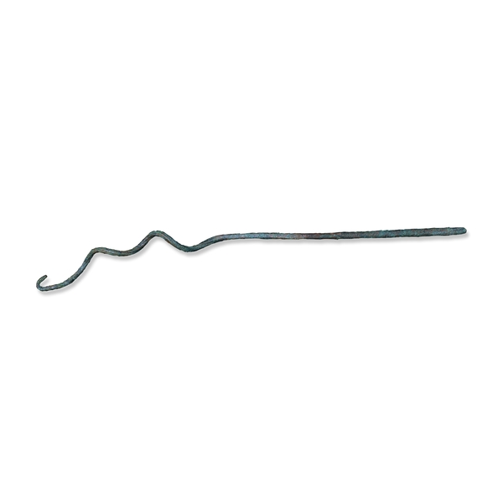
Egypt
From Egypt Late Period, after 664 BC
http://www.britishmuseum.org/explore/highlights/highlight_objects/aes/b/bronze_probe.aspx

Slide 5
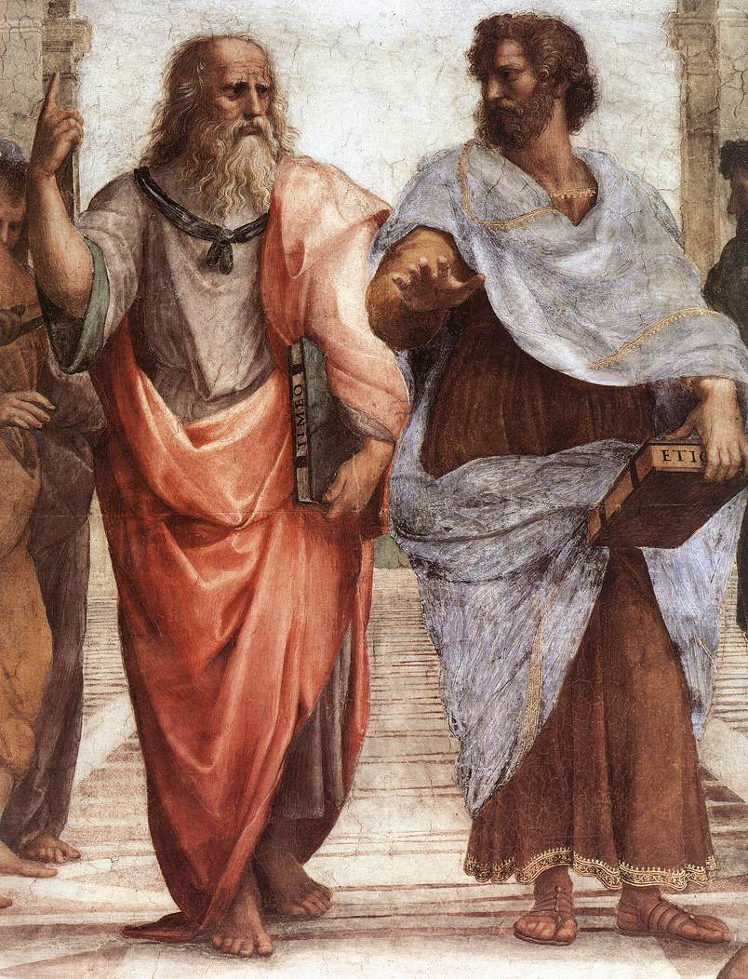
Plato v's Aristotle the brain v's the heart
Detail from The School of Athens by Raphael. (1509 – 1511)
Picture from Wikipedia.

Slide 6
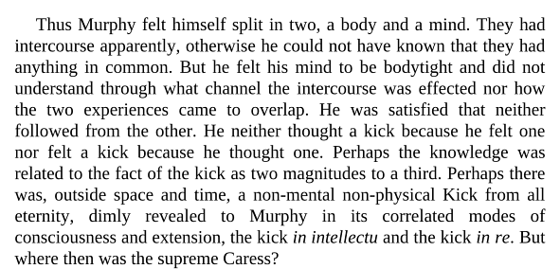
Descartes
From Murphy by Samuel Beckett

Slide 7
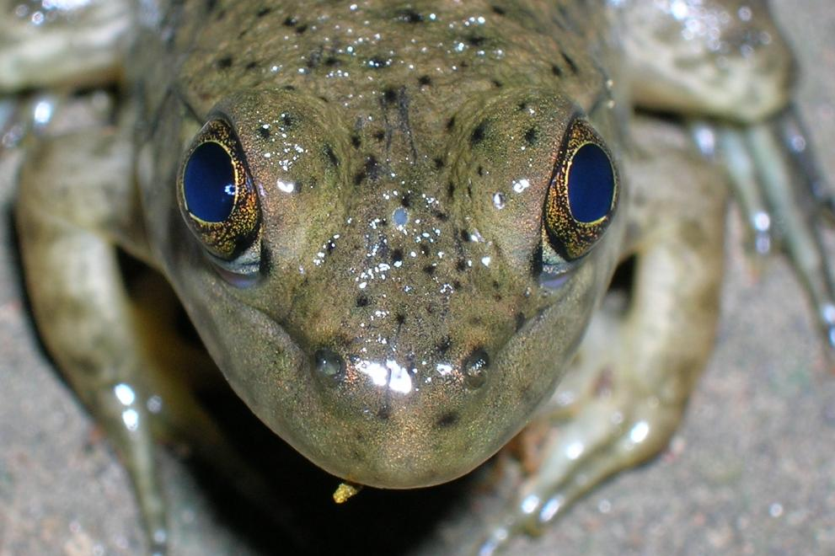
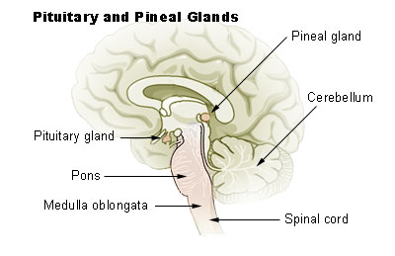
Pineal gland
The parietal eye (very small grey
oval between the regular eyes)
of a juvenile bullfrog. From
Wikipedia
From Wikipedia

Slide 8
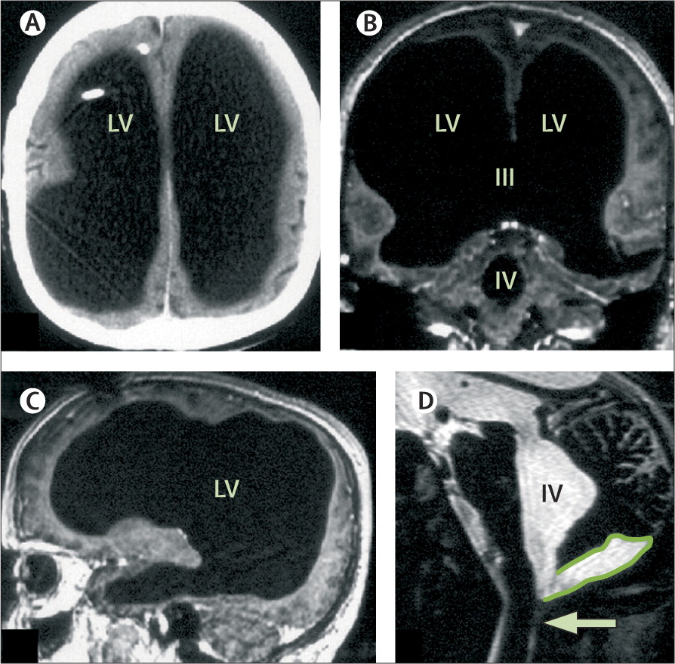
Feuillet, L., Dufour, H., & Pelletier, J. (2007).
Brain of a white-collar worker. The Lancet, 370(9583), 262.

Slide 9
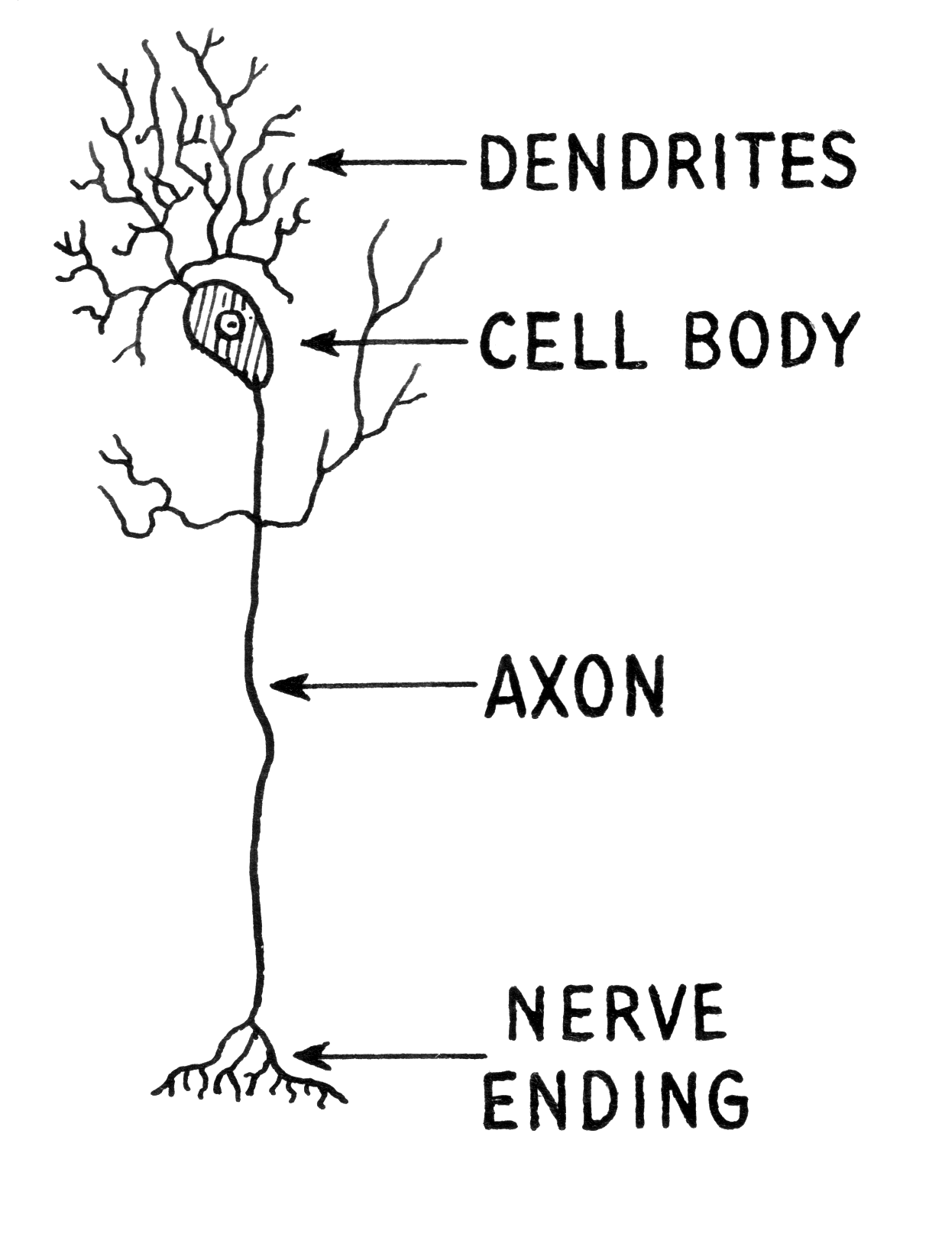
Neuron
wikimedia commons: http://commons.wikimedia.org/wiki/File:Dendrite_(PSF).png

Slide 10
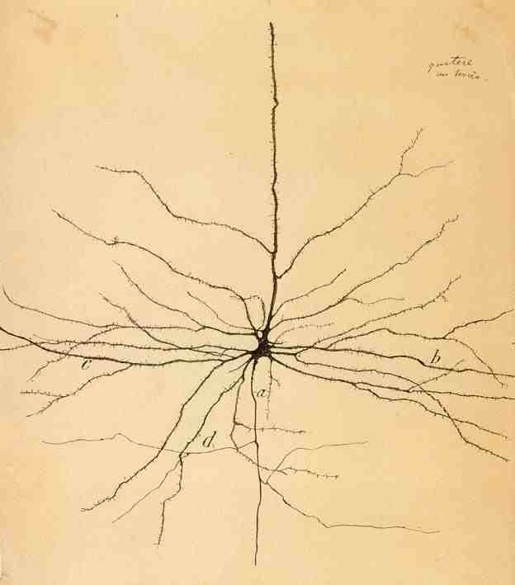
Cajal – Pyramidal Neuron

Slide 11
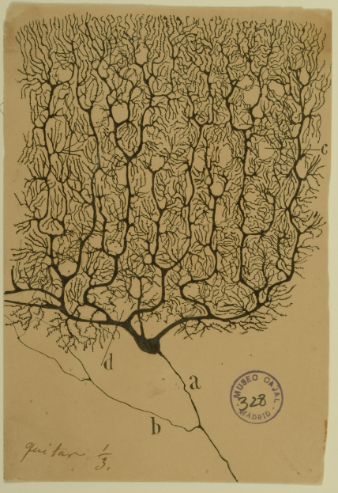
Cajal – Purkinje Cell

Slide 12
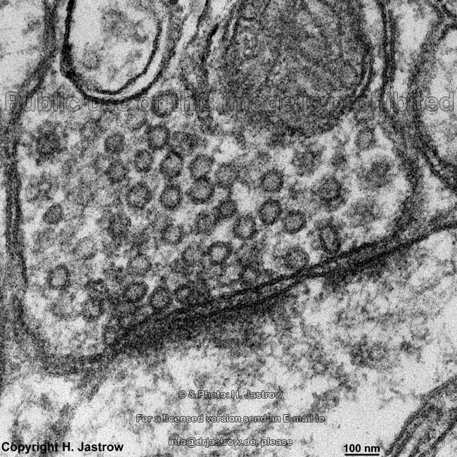
Synapse
http://www.science20.com/measuring_mind/getting_fired_about_synapses

Slide 13
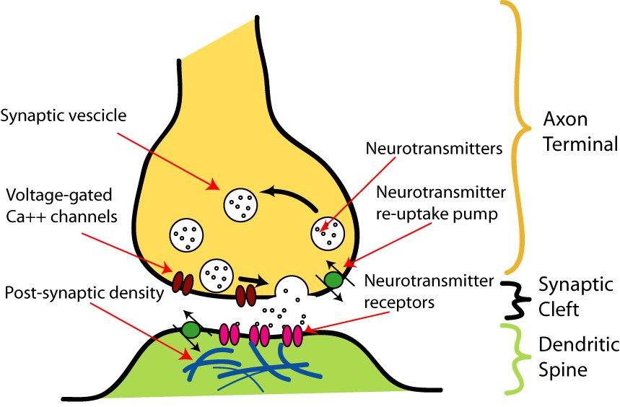
Synapse
http://upload.wikimedia.org/wikipedia/commons/b/b2/SynapseIllustration2.png

Slide 14
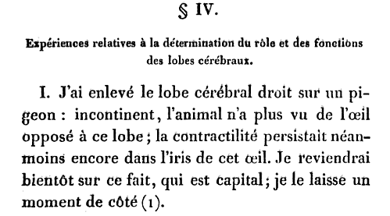
Jean Pierre Flourens
Jean Pierre Flourens (1822) Recherches experimentales sur les propriétés et les
fonctions du système nerveux dans les animaux vertébrés.

Slide 15
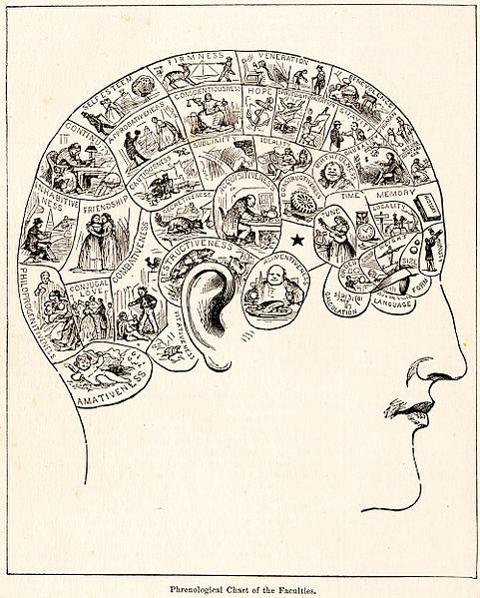
Phrenology and Franz Joseph Gall
Picture from wikipedia

Slide 16
History of the Discovery that the Cerebellum is the Organ of the instinct of Reproduction.
A young widow, a short time after the death of her husband, was attacked by melancholy and violent convulsions. These affections were preceded by a very disagreeable tension and feeling of heat in the nape of her neck. A few moments afterwards, she fell to the ground in a state of rigidity, to such an extent that at last the nape of her neck and vertebral column were strongly drawn backwards. The crisis never failed to terminate by an evacuation, which was accompanied by a convulsive voluptuousness, and a real ecstasy ; after which she continued free from attacks for some time.
Franz J. Gall (1838) On the functions of the cerebellum.

Slide 17
Tan / Hodor
https://www.youtube.com/watch?v=h5X6Qn9hQHk

Slide 18
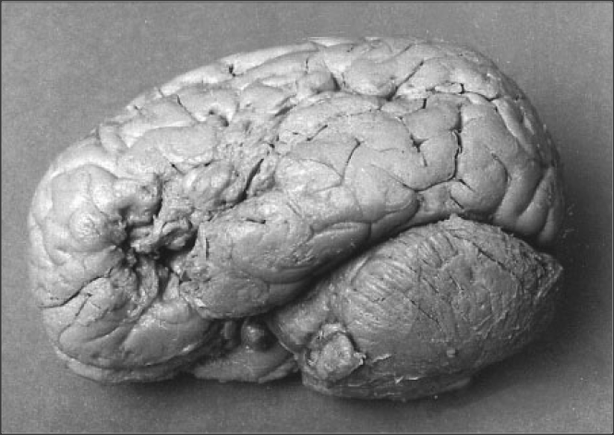
The brain of Paul Broca's patient Mr Leborgne, known as “Tan”
http://cogpsy.info/language/brocas-most-famous-patient/

Slide 19
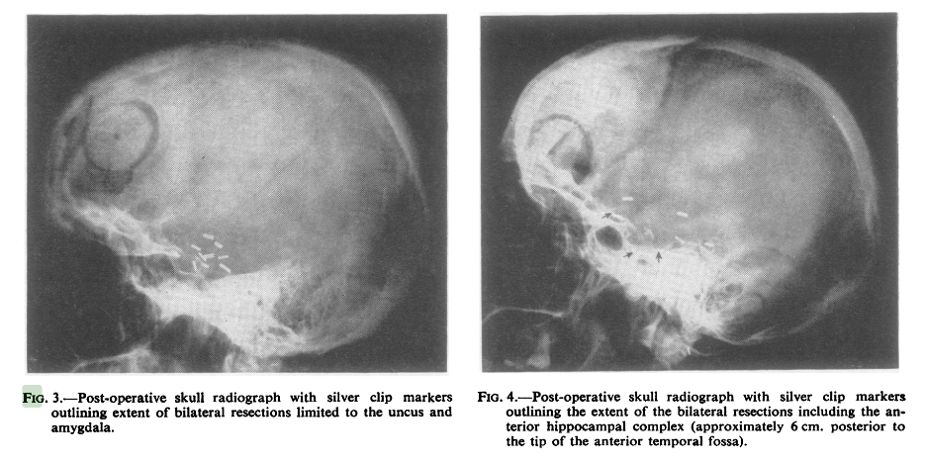
H.M. - Henry Molaison
Scoville, W. B., & Milner, B. (1957).
Loss of recent memory after bilateral hippocampal lesions.
Journal of neurology, neurosurgery, and psychiatry, 20(1), 11.

Slide 20
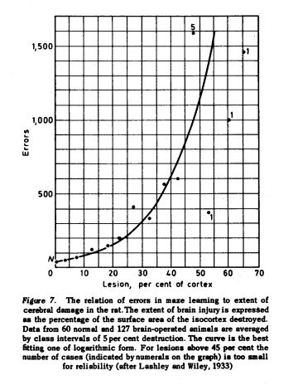
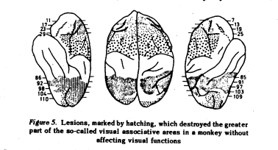
Karl S. Lashley
Lashley, K. S. (1950). In search of the engram.

Slide 21
Wilder Penfield
https://www.youtube.com/watch?v=Nu-PzIN0pFs

Slide 22
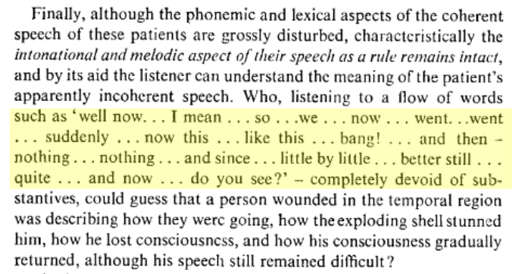
Secondary zone of left temporal region
A.R. Luria (1973) The working brain, an introduction to neuropsychology. p140

