Slide 1
Clumsy phrasing
“The reason for its success was because it was the first of its kind”
=>
“It succeeded because it was the first of its kind”

Slide 2
Didn't explain essential point
“During WWII, the German Navy used a variation of the Enigma machine to encrypt messages being sent via radio broadcast. This version of the Enigma machine had a few extra levels of security set up to make it more difficult for the British cryptanalysts to break. These included the addition of 3 extra rotor wheels, on top of the standard military 5, to choose from and the rotors in the naval version were wired up differently, they also caused the next rotor to tick over at different points along the cycle.”

Slide 3
Vague praise.
Charles Babbage, an English mathmetician and mechanical engineer, is often referred to as the “father of the computer”, and is credited with the invention of the first mechanical computer by some.
=> “by some”, by whom? Leaving out the “by some” doesn't change anything, but the real problem is vagueness.

Slide 4
How many ideas?
“Lee de Forest was a Yale graduate interested in reflecting and amplifying signals at the end of their transmission lines. de Forest had several ideas, experimenting with electric currents in gas flames and two-electrode tubes. He named his dual-filament tubes Audion.”
=> The reader worries if they have heard all the ideas, should they be counting. How many is several?

Slide 5
Wrong “where”, see also “its” and “there”
Lyons and Co. was a British teashop chain who had over 250 high street shops, and where instrumental in bringing computing into business.
“where” => “were”; beware of shibboleths.
“Then said they unto him, Say now Shibboleth: and he said Sibboleth: for he could not frame to pronounce it right. Then they took him, and slew him at the passages of Jordan”

Slide 6
If you must reference unrefereed sources then be like this!
[5] - Williams, C. (2011, November 10). How a chain of tea shops kickstarted the computer age. Retrieved from The Telegraph: http://www.telegraph.co.uk/technology/news/8879727/How-a-chain-of-tea-shops-kickstarted-the-computer-age.htm

Slide 7
Not enough research
References
https://www.ibiblio.org/apollo/ForDummies.html 20/10/17
https://history.nasa.gov/computers/Ch2-5.html
25/10/17
also, not a good referencing style.

Slide 8
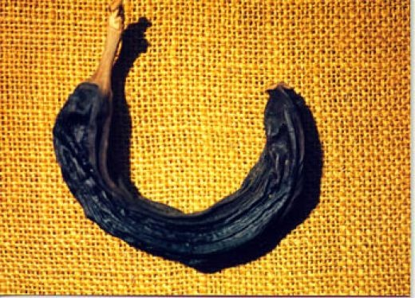
Not enough context
“The Pascaline revolutionized computing and till today, they are preserved in museums.”
Need to contextualize this, what came before? Preservation in a museum isn't a proof.
http://www.internationalbananamuseum.com

Slide 9
Avoid truisms
“Computers are no doubt a daily necessity that can perform a wide range of tasks, providing great convenience.”
=> If there is no doubt there is no need to say it.

Slide 10
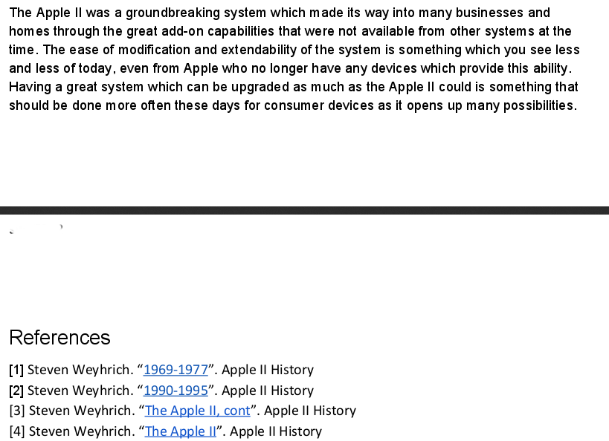
Boosterism

