Slide 1
Computer science is no
more the study of
computers than
astronomy is the
study of telescopes.

Slide 4
Tan / Hodor
https://www.youtube.com/watch?v=h5X6Qn9hQHk

Slide 5

Broca and Wernicke areas
https://en.wikipedia.org/wiki/File:BrocasAreaSmall.png

Slide 6

Secondary zone of left temporal region
A.R. Luria (1973) The working brain, an introduction to neuropsychology. p140

Slide 7
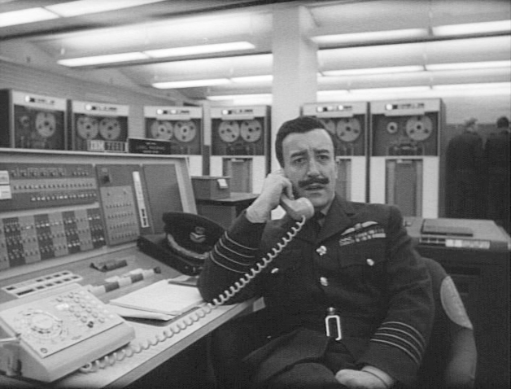

Slide 8


Slide 9

Cajal – Pyramidal Neuron

Slide 10

Cajal – Purkinke Cell

Slide 11
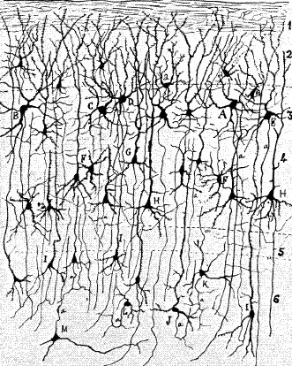

Slide 12

Action Potential
Hodgkin, A.L., and Huxley, A.F. (1939).
Action potentials recorded from inside a nerve fiber
Nature, 144:710

Slide 13
A retinal ganglion cell spiking
https://www.youtube.com/watch?v=KE952yueVLA

Slide 14
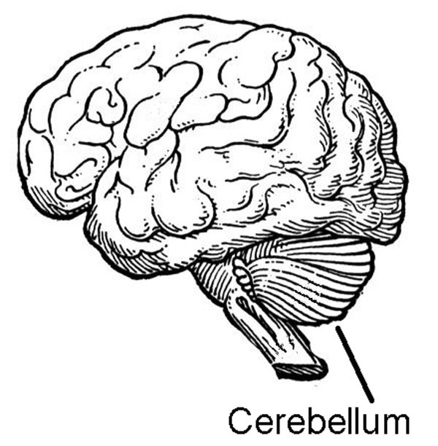

Slide 15

Cerebellar ataxia.
https://en.wikipedia.org/wiki/File:Thomas-fig68,69-p127.png

Slide 16
Blind Cave Fish
https://www.youtube.com/watch?v=MWdtGuDd8z0

Slide 17

H.M. - Henry Molaison
Scoville, W. B., & Milner, B. (1957).
Loss of recent memory after bilateral hippocampal lesions.
Journal of neurology, neurosurgery, and psychiatry, 20(1), 11.

Slide 18
Clive Wearing
https://www.youtube.com/watch?v=Vwigmktix2Y

Slide 19
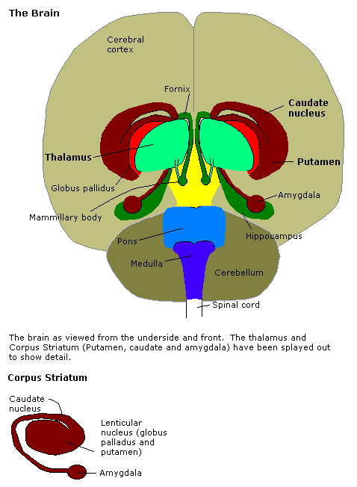
Amygdala
http://en.wikipedia.org/Amygdala

Slide 20
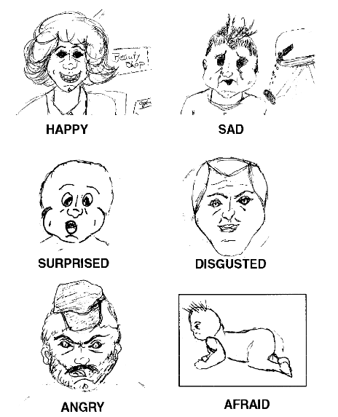
Drawing by S.M.
Adolphs, R., Tranel, D., Damasio, H., & Damasio, A. R. (1995).
Fear and the human amygdala.
The Journal of Neuroscience, 15(9), 5879-5891.

Slide 21
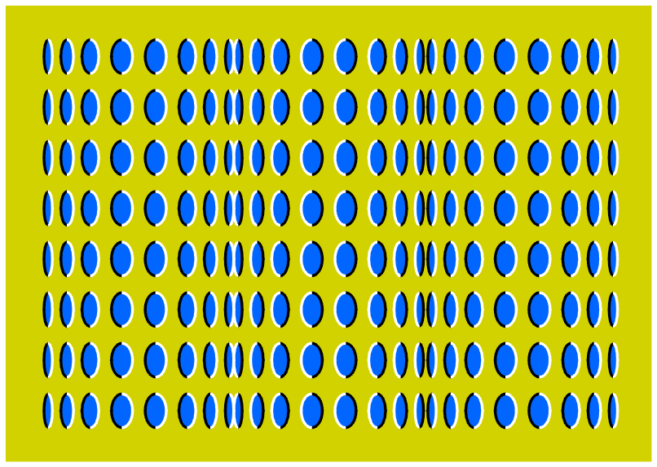

Slide 22
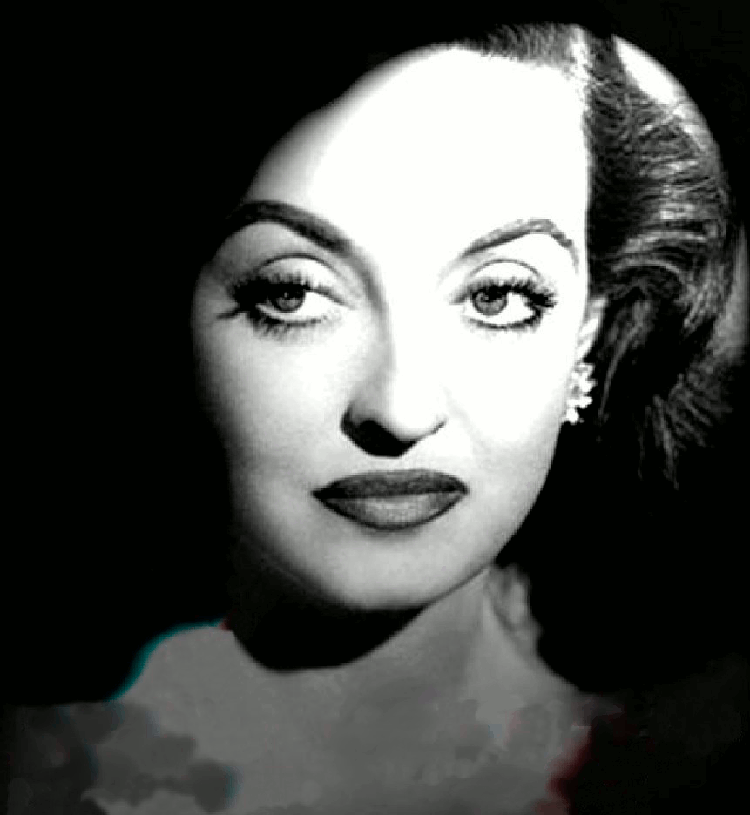

Slide 24
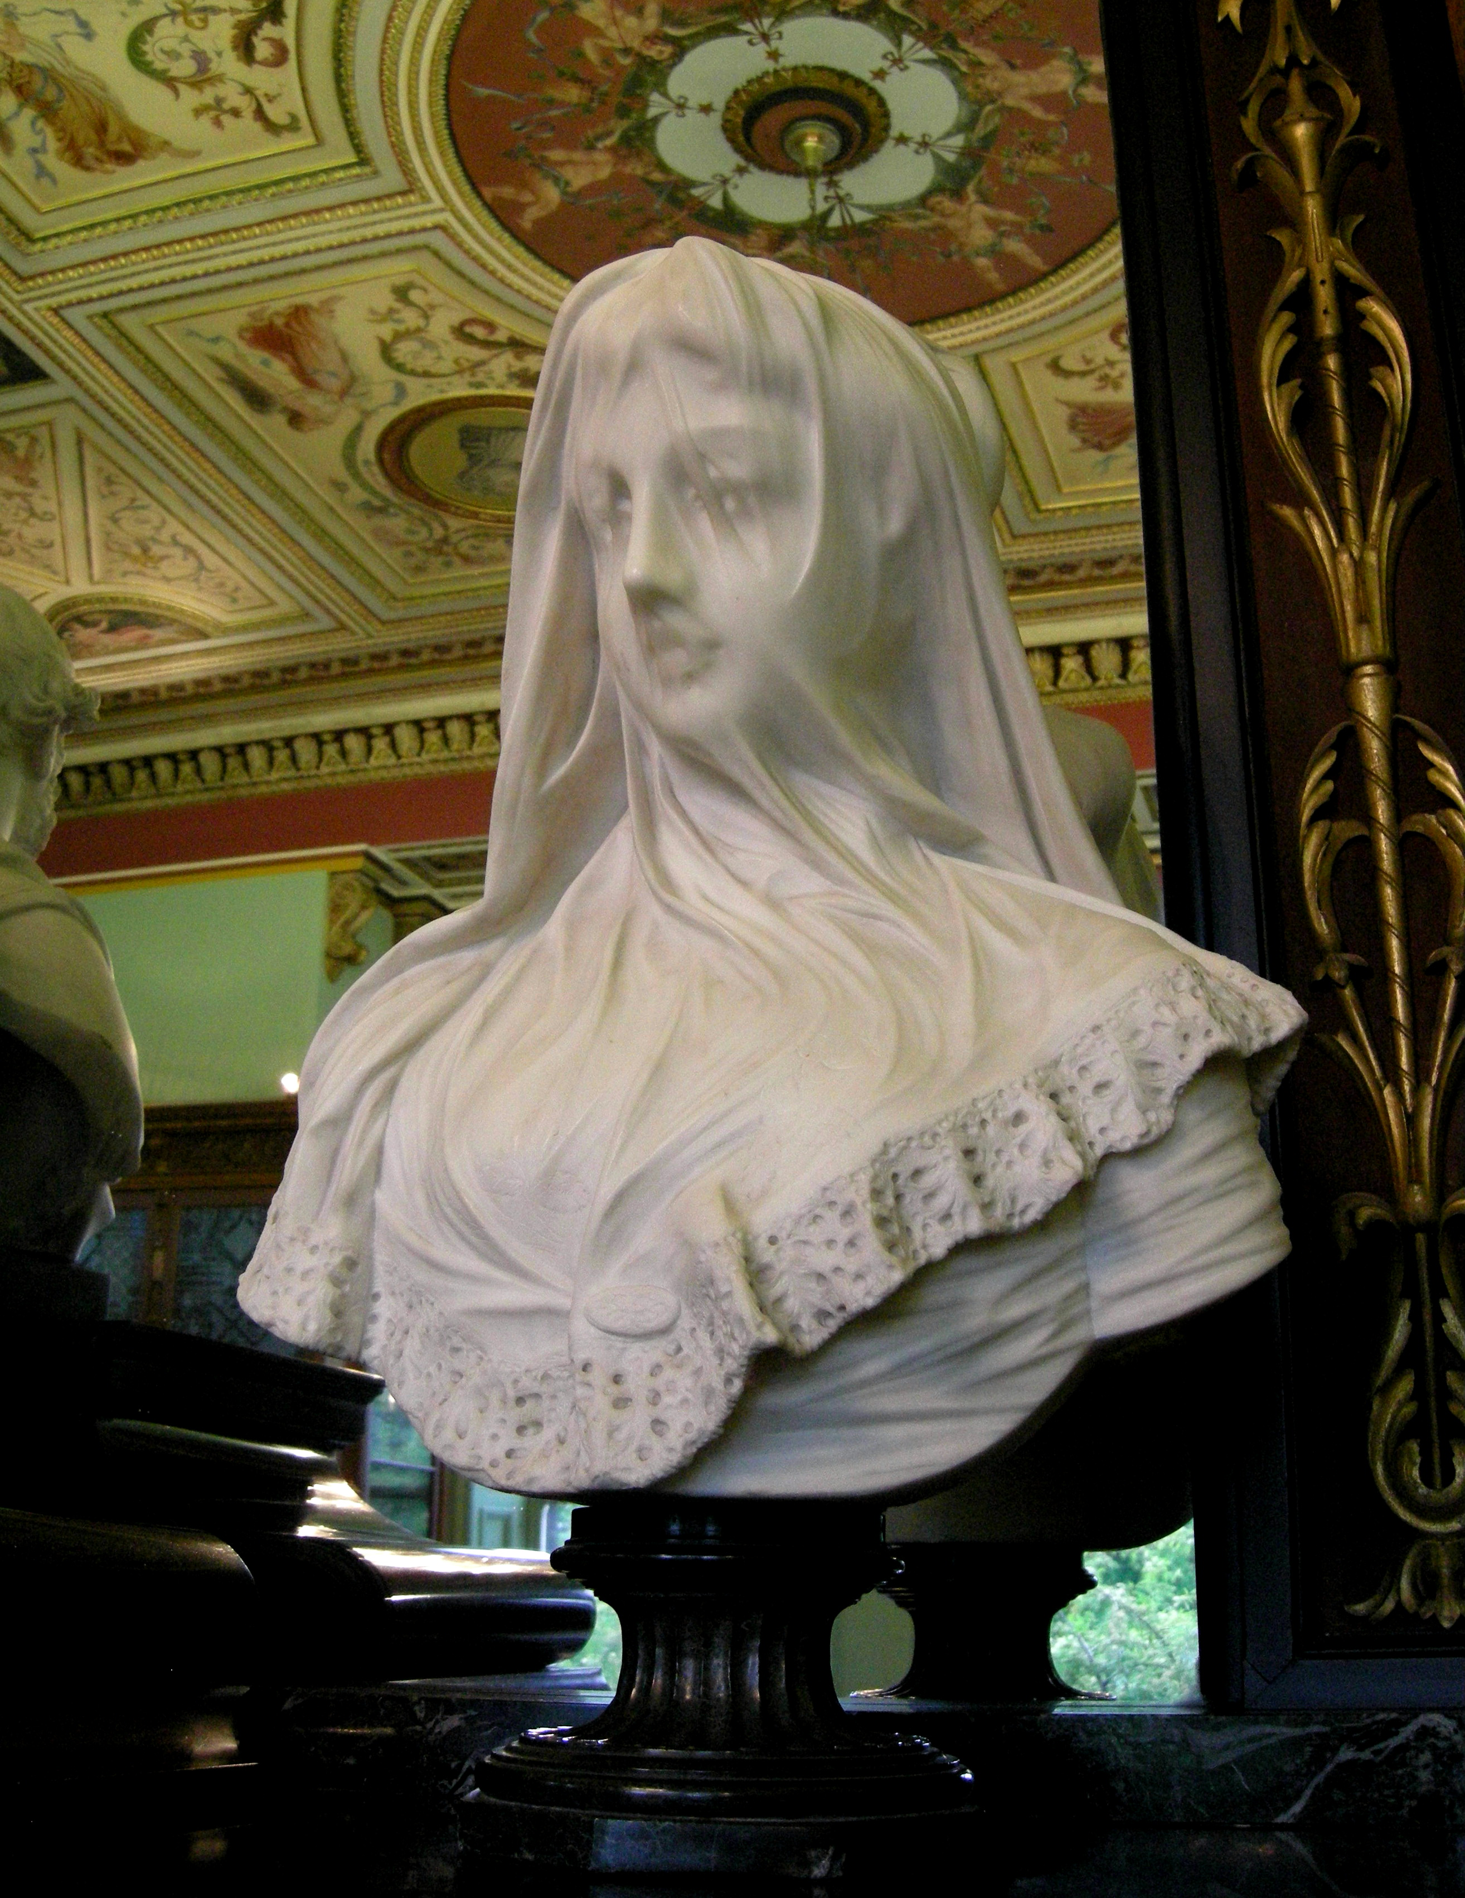
statue in the Bankfield museum
wikipedia.org

Slide 25
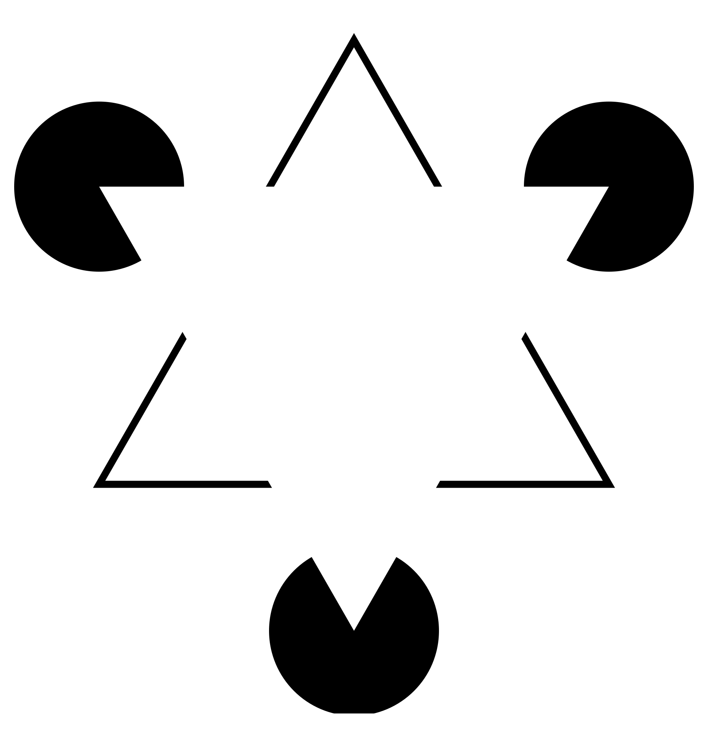
Kaniza triangle

Slide 26
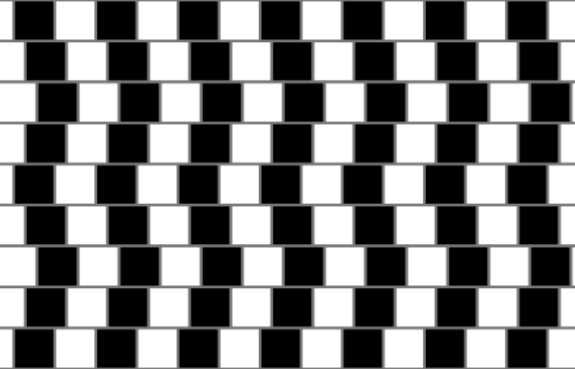
cafe wall illusion
wikipedia.org

Slide 27
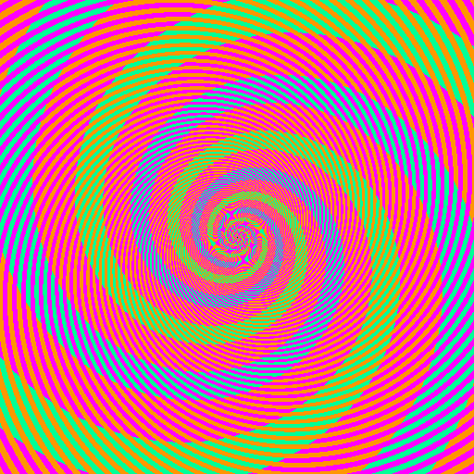
Benzold effect
discovermagazine.com

Slide 28
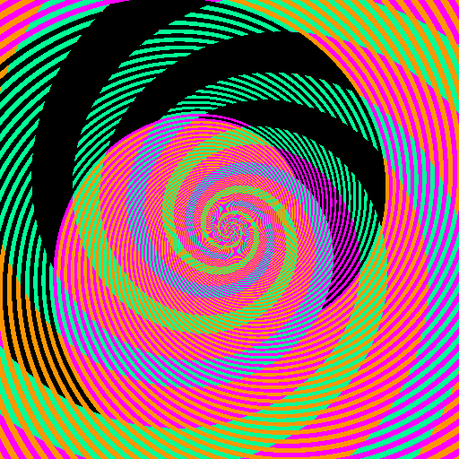
Benzold effect - ruined
discovermagazine.com

Slide 29
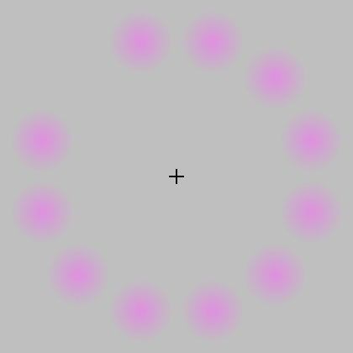
Lilac chaser
wikipedia.org

Slide 30
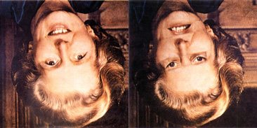
Thatcher illusion
blogs.scientificamerican.com

Slide 31
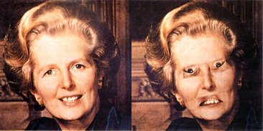

Slide 32
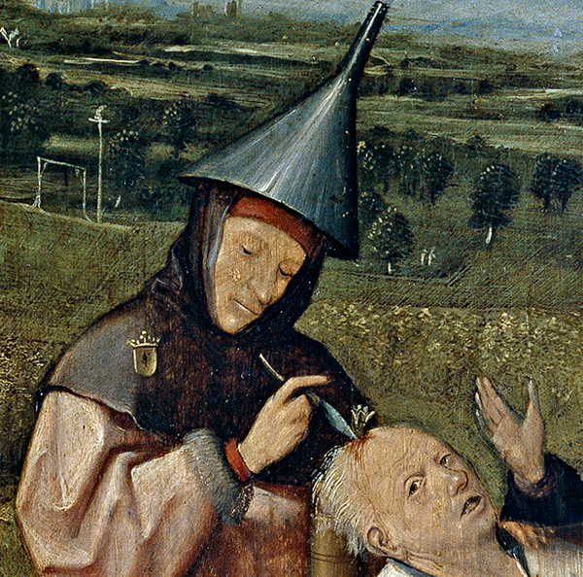
From “Cutting the Stone” by Hieronymous Bosch.

