Slide 1
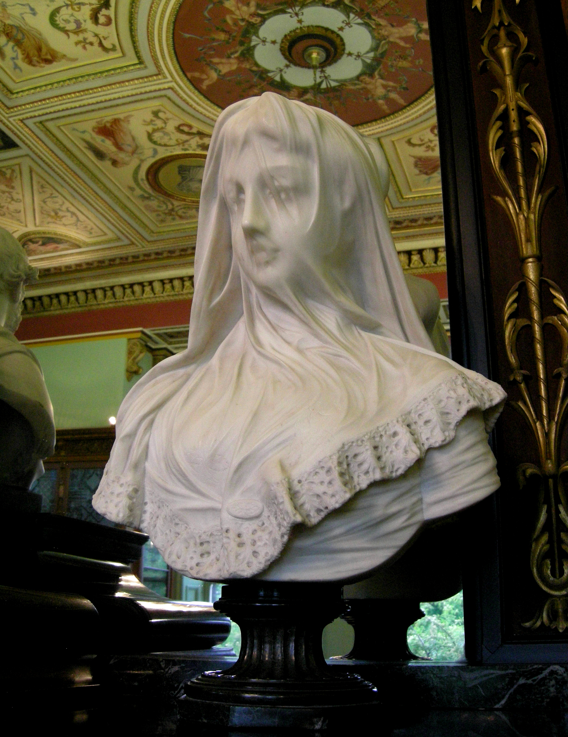
statue in the Bankfield museum
wikipedia.org

Slide 2
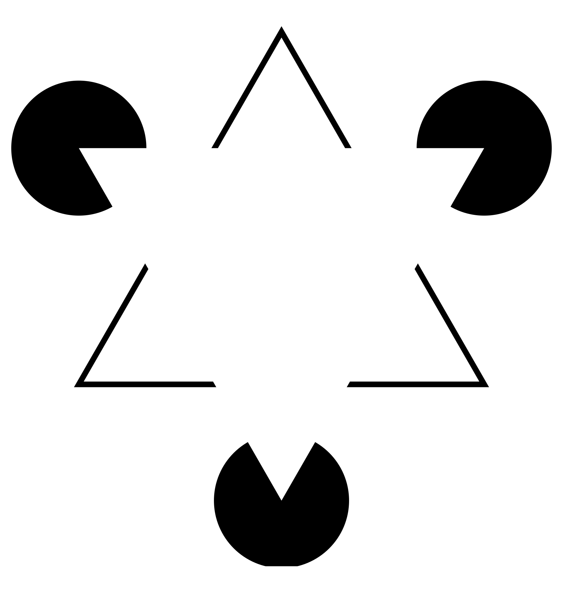
Kaniza triangle

Slide 3
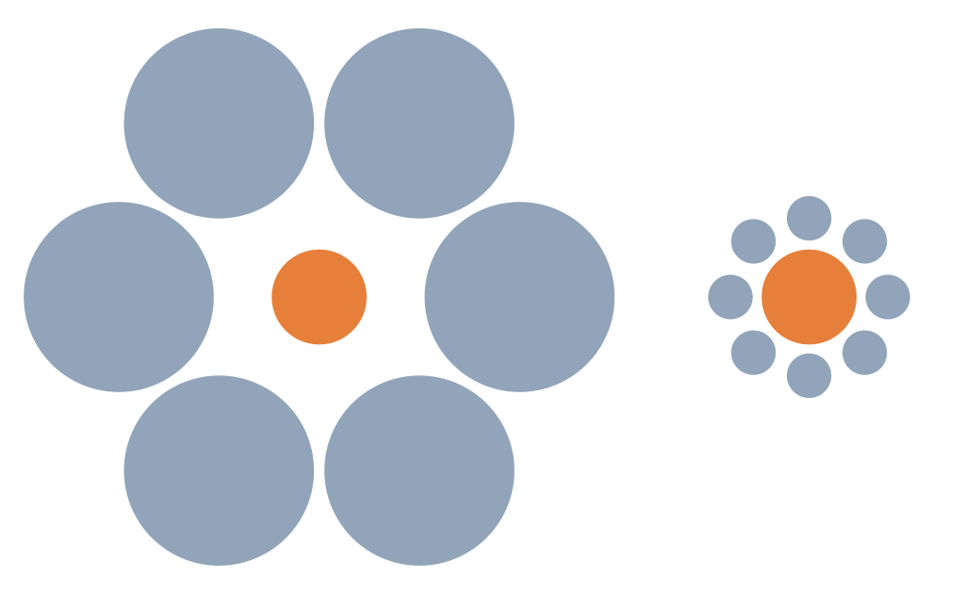
Ebbinghaus illusion

Slide 4
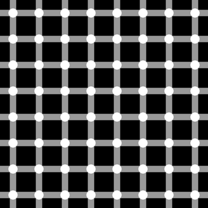
Hermann grid illusion
daviddarling.info

Slide 5
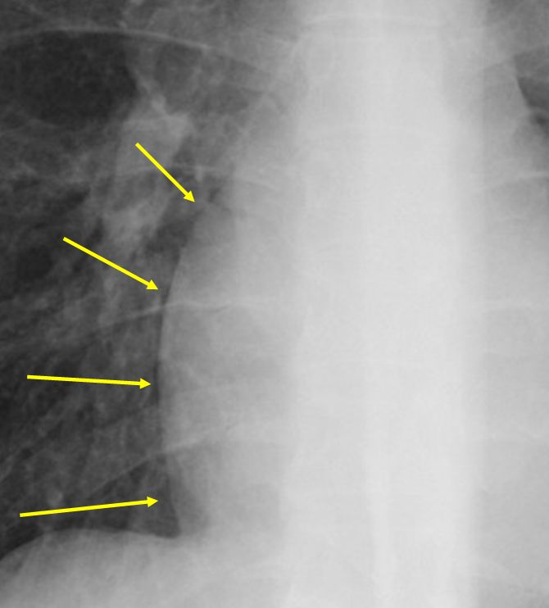
Mach bands
robochest.com

Slide 6
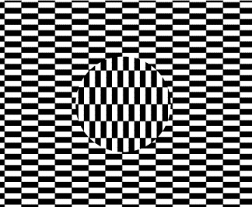
Ouchi illusion
Mathworld.wolfram.com

Slide 7
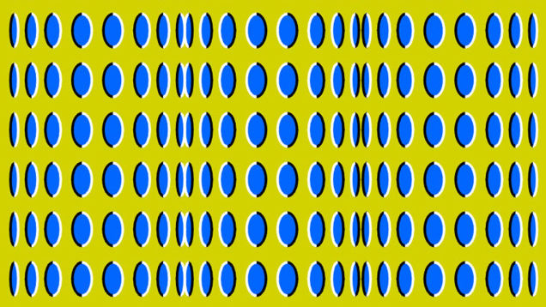

Slide 8
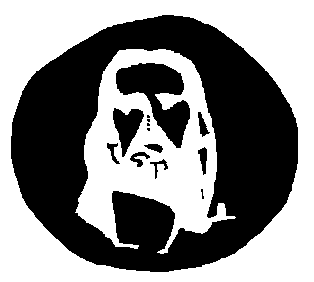
Jesus illusion

Slide 9
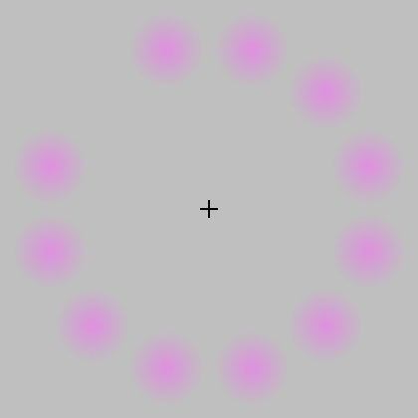
Lilac chaser
wikipedia.org

Slide 10
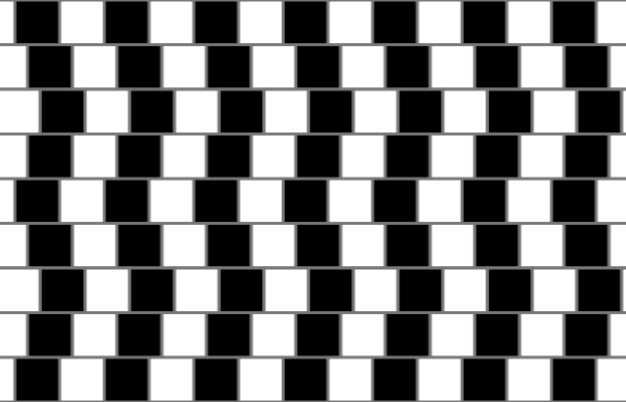
cafe wall illusion
wikipedia.org

Slide 11
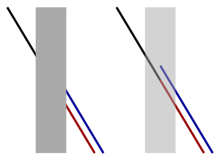
Poggendorf illusion
wikipedia.org

Slide 12
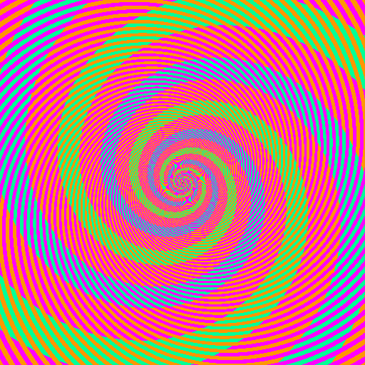
Benzold effect
discovermagazine.com

Slide 13
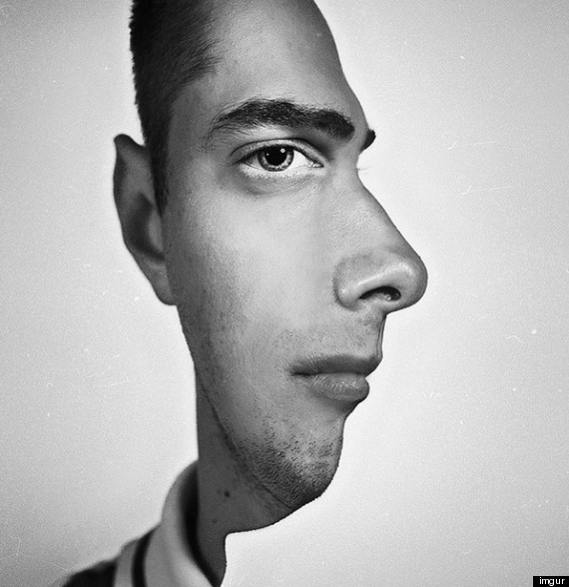
face profile illusion
brainden.com

Slide 14
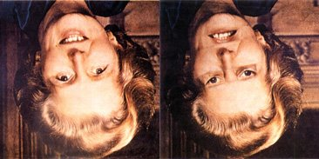
Thatcher illusion
blogs.scientificamerican.com

Slide 15
