Slide 1
Computer science is no
more the study of
computers than
astronomy is the
study of telescopes.

Slide 2
INTERESTING MATHEMATICS
BIO-
INFORMATICS
THEORETICAL
PHYSICS
MATHEMATICAL
NEUROSCIENCE
GENETICS
CURES
FOR THE SICK
“WHY ARE WE
HERE?” QUESTIONS

Slide 3
Mathematics is the art of giving the same name to different things - Henri Poincaré

Slide 4
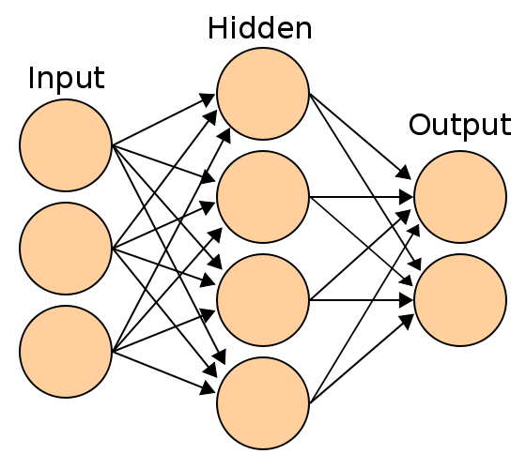
Picture from wikipedia

Slide 5
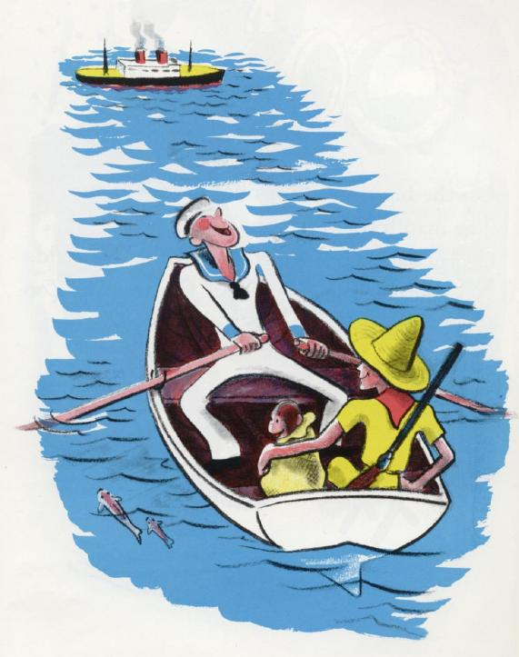

Slide 6
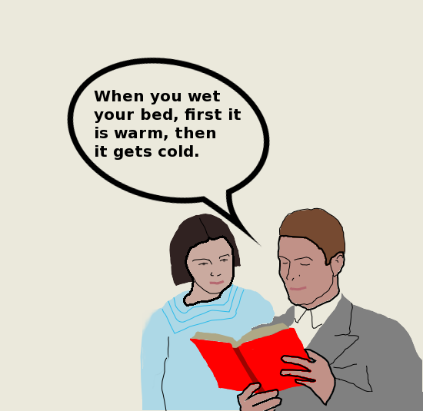

Slide 7
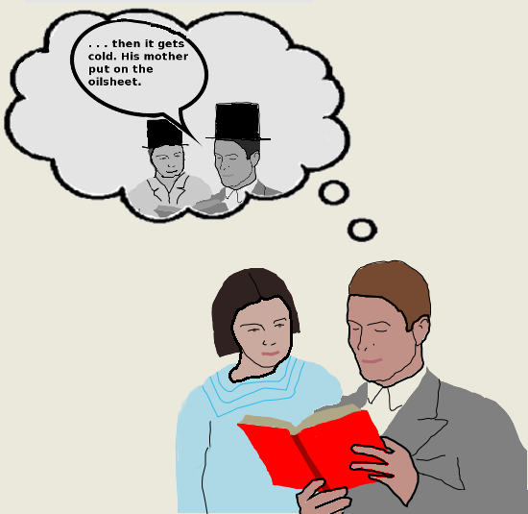

Slide 8
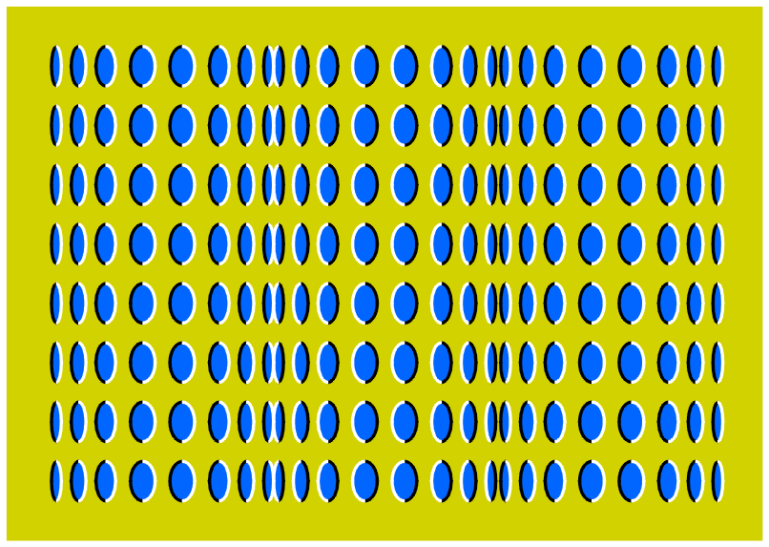

Slide 9
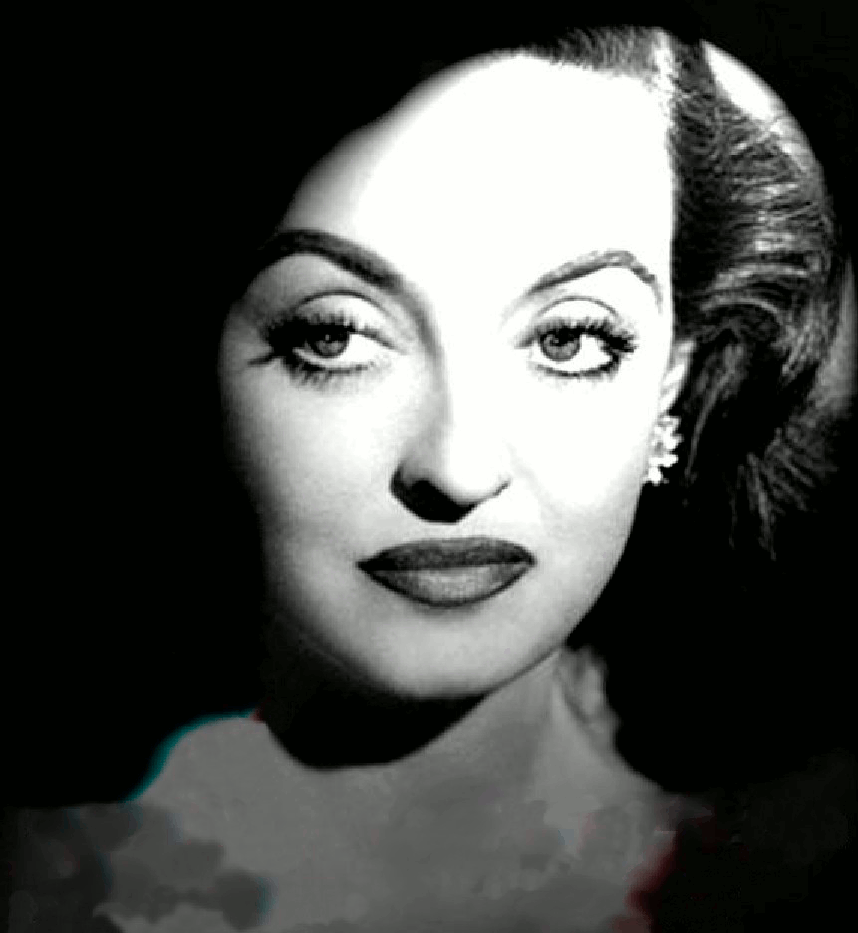

Slide 11
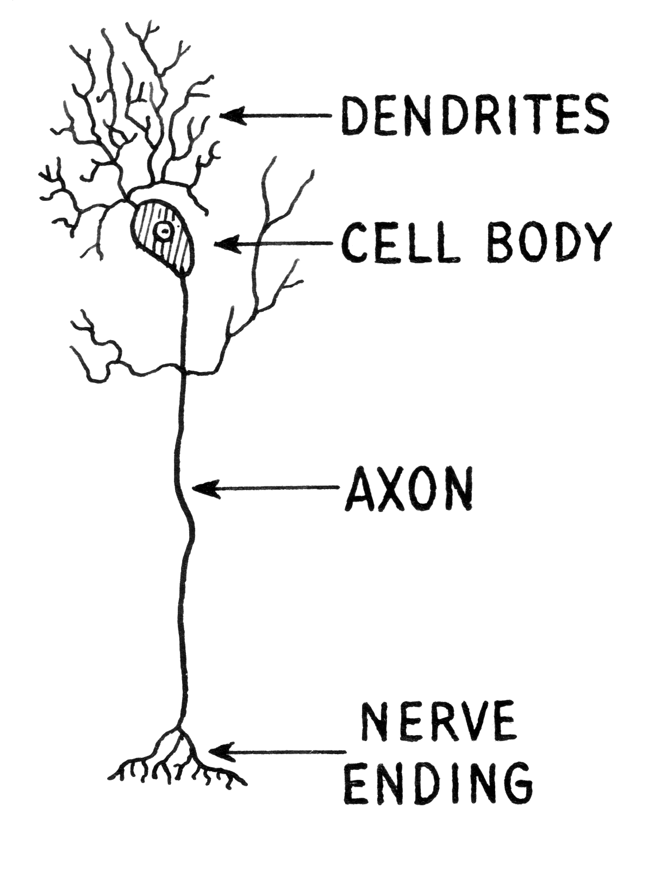
NEURON
wikimedia commons: http://commons.wikimedia.org/wiki/File:Dendrite_(PSF).png

Slide 12

Cajal – Pyramidal Neuron

Slide 13

Cajal – Purkinke Cell

Slide 14
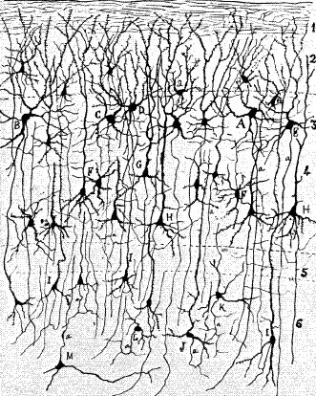

Slide 15

Action Potential
Hodgkin, A.L., and Huxley, A.F. (1939).
Action potentials recorded from inside a nerve fiber
Nature, 144:710

Slide 16
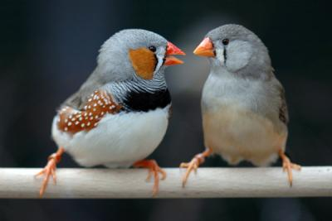

Slide 17
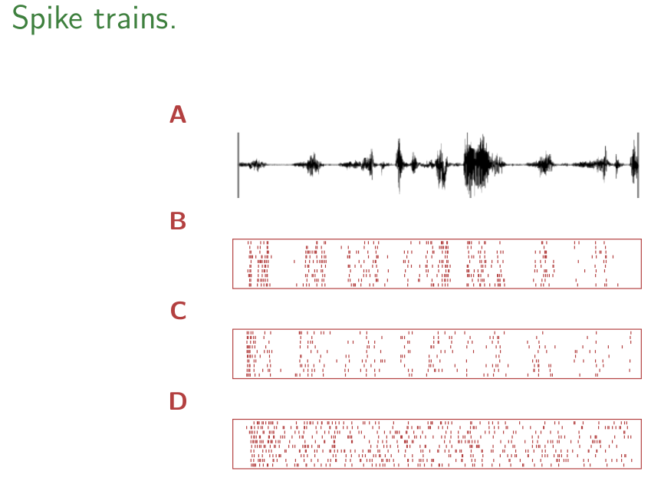

Slide 18
A retinal ganglion cell spiking
https://www.youtube.com/watch?v=KE952yueVLA

Slide 19
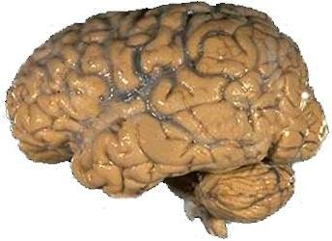
A brain
https://upload.wikimedia.org/wikipedia/commons/4/49/Human_brain_NIH.jpg

Slide 20

Cerebellar ataxia.
https://en.wikipedia.org/wiki/File:Thomas-fig68,69-p127.png

Slide 21
Blind Cave Fish
https://www.youtube.com/watch?v=MWdtGuDd8z0

Slide 22
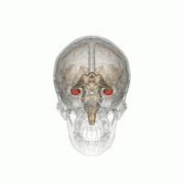
Hippocampus
https://commons.wikimedia.org/wiki/File:Hippocampus_small.gif

Slide 23

H.M. - Henry Molaison
Scoville, W. B., & Milner, B. (1957).
Loss of recent memory after bilateral hippocampal lesions.
Journal of neurology, neurosurgery, and psychiatry, 20(1), 11.

Slide 24
Clive Wearing
https://www.youtube.com/watch?v=Vwigmktix2Y

Slide 25
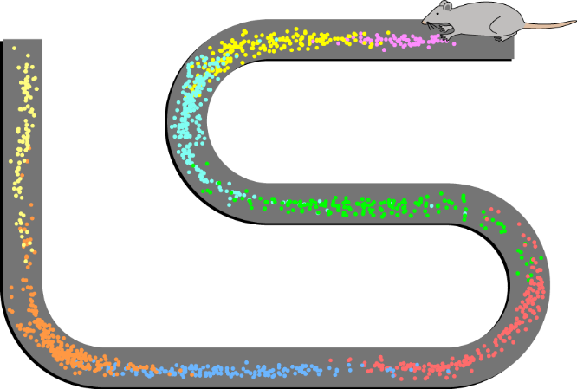
Image from wikipedia

Slide 26


Slide 27
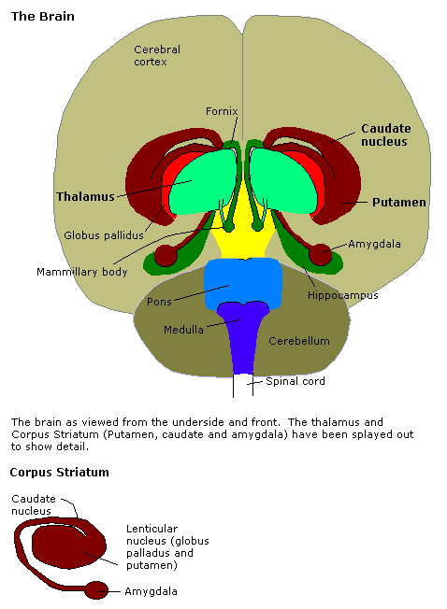
Amygdala
http://en.wikipedia.org/Amygdala

Slide 28
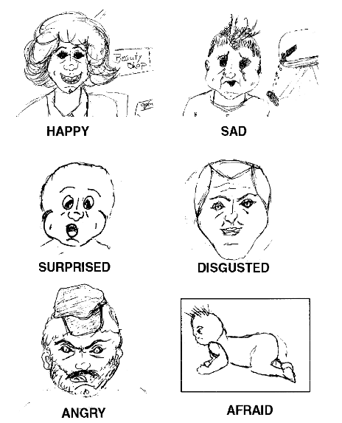
Drawing by S.M.
Adolphs, R., Tranel, D., Damasio, H., & Damasio, A. R. (1995).
Fear and the human amygdala.
The Journal of neuroscience, 15(9), 5879-5891.

Slide 29
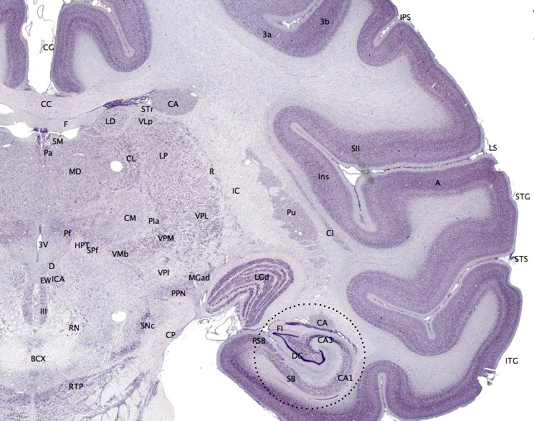
Macaque cortex
https://en.wikipedia.org/wiki/File:Brainmaps-macaque-hippocampus.jpg

Slide 30
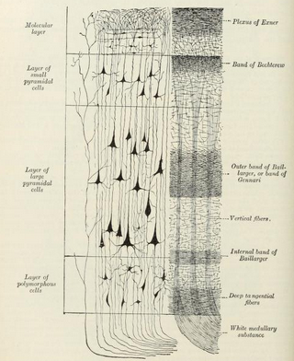
Layers of the neocortex
Gray's anatomy

Slide 31
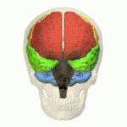
Lobes of the cortex
Orange – Frontal Lobe, Yellow – Parietal Lobe
Green – Temporal Lobe, Pink – Occipital Lobe
https://en.wikipedia.org/wiki/File:Four_lobes_animation_small2.gif

Slide 32
Tan / Hodor
https://www.youtube.com/watch?v=h5X6Qn9hQHk

Slide 33

Broca and Wernicke areas
https://en.wikipedia.org/wiki/File:BrocasAreaSmall.png

Slide 34

Secondary zone of left temporal region
A.R. Luria (1973) The working brain, an introduction to neuropsychology. p140

Slide 35


