Slide 1
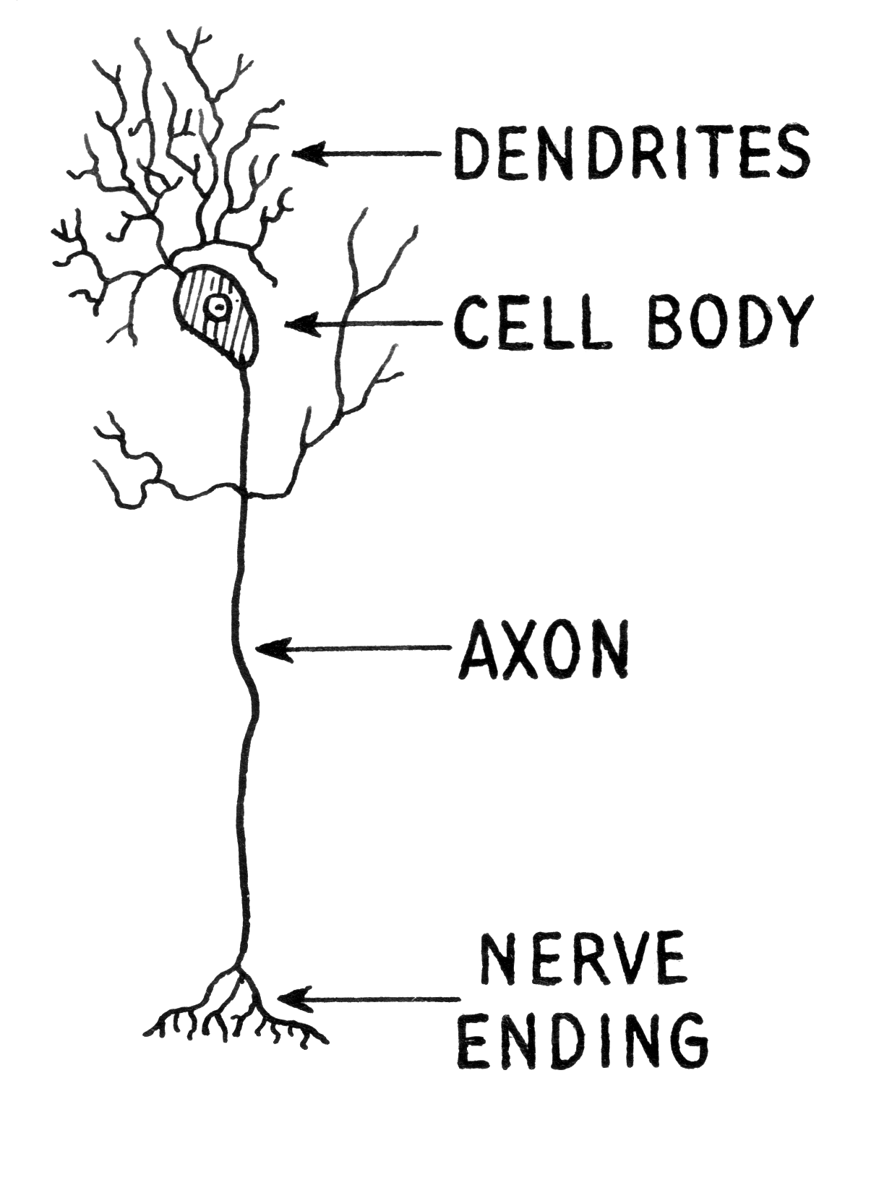
NEURON
wikimedia commons: http://commons.wikimedia.org/wiki/File:Dendrite_(PSF).png

Slide 2

Cajal – Pyramidal Neuron

Slide 3

Cajal – Purkinke Cell

Slide 4

Action Potential
Hodgkin, A.L., and Huxley, A.F. (1939).
Action potentials recorded from inside a nerve fiber
Nature, 144:710

Slide 5
Voltage dynamics
The voltage inside the cell lower than outside, this is called the membrane potential, between -70mV and -55mV.
Inputs from other cells change the voltage, inhibitory cells decrease it, excitatory cells increase it.
If the voltage exceeds a threshold the neuron sends out a spike.

Slide 6
A retinal ganglion cell spiking
https://www.youtube.com/watch?v=KE952yueVLA

Slide 7
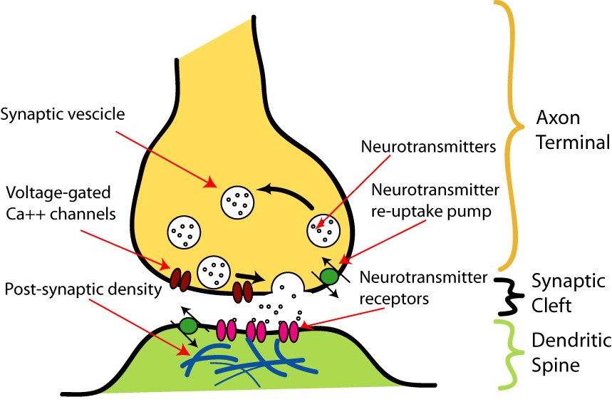
Synapse
http://upload.wikimedia.org/wikipedia/commons/b/b2/SynapseIllustration2.png

Slide 8
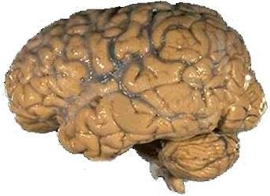
A brain
https://upload.wikimedia.org/wikipedia/commons/4/49/Human_brain_NIH.jpg

Slide 9
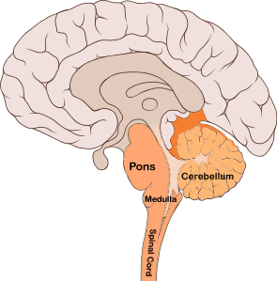
Sagital view
https://commons.wikimedia.org/wiki/File:Brain_bulbar_region.PNG

Slide 10

Cerebellar ataxia.
https://en.wikipedia.org/wiki/File:Thomas-fig68,69-p127.png

Slide 11
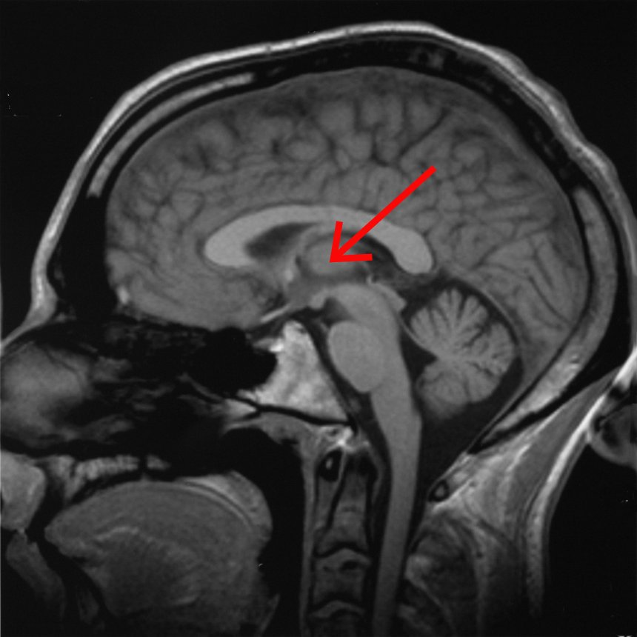
Thalamus
https://en.wikipedia.org/wiki/File:Brain_chrischan_thalamus.jpg

Slide 12
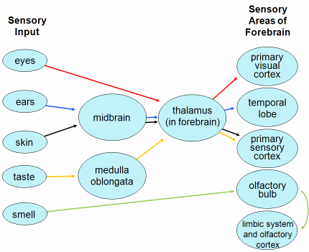
Thalamus - routing
http://faculty.clintoncc.suny.edu/faculty/michael.gregory/default.htm
http://creativecommons.org/licenses/by-nc-sa/3.0/deed.en_US

Slide 13
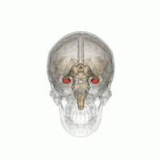
Hippocampus
https://commons.wikimedia.org/wiki/File:Hippocampus_small.gif

Slide 14

H.M. - Henry Molaison
Scoville, W. B., & Milner, B. (1957).
Loss of recent memory after bilateral hippocampal lesions.
Journal of neurology, neurosurgery, and psychiatry, 20(1), 11.

Slide 15
Clive Wearing
https://www.youtube.com/watch?v=Vwigmktix2Y

Slide 16
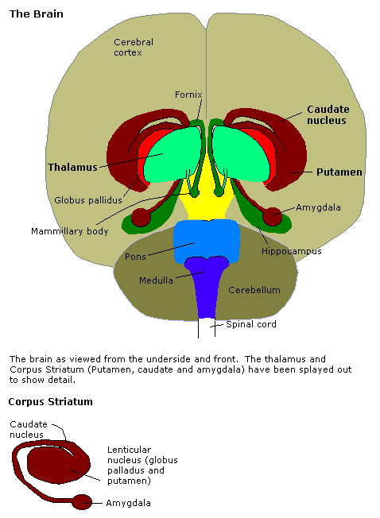
Amygdala
http://en.wikipedia.org/Amygdala

Slide 17
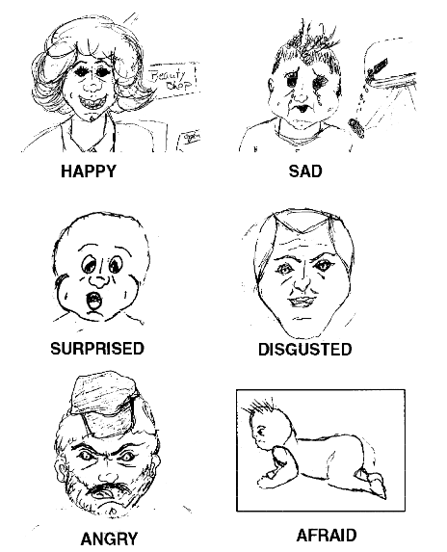
Drawing by S.M.
Adolphs, R., Tranel, D., Damasio, H., & Damasio, A. R. (1995).
Fear and the human amygdala.
The Journal of neuroscience, 15(9), 5879-5891.

Slide 18
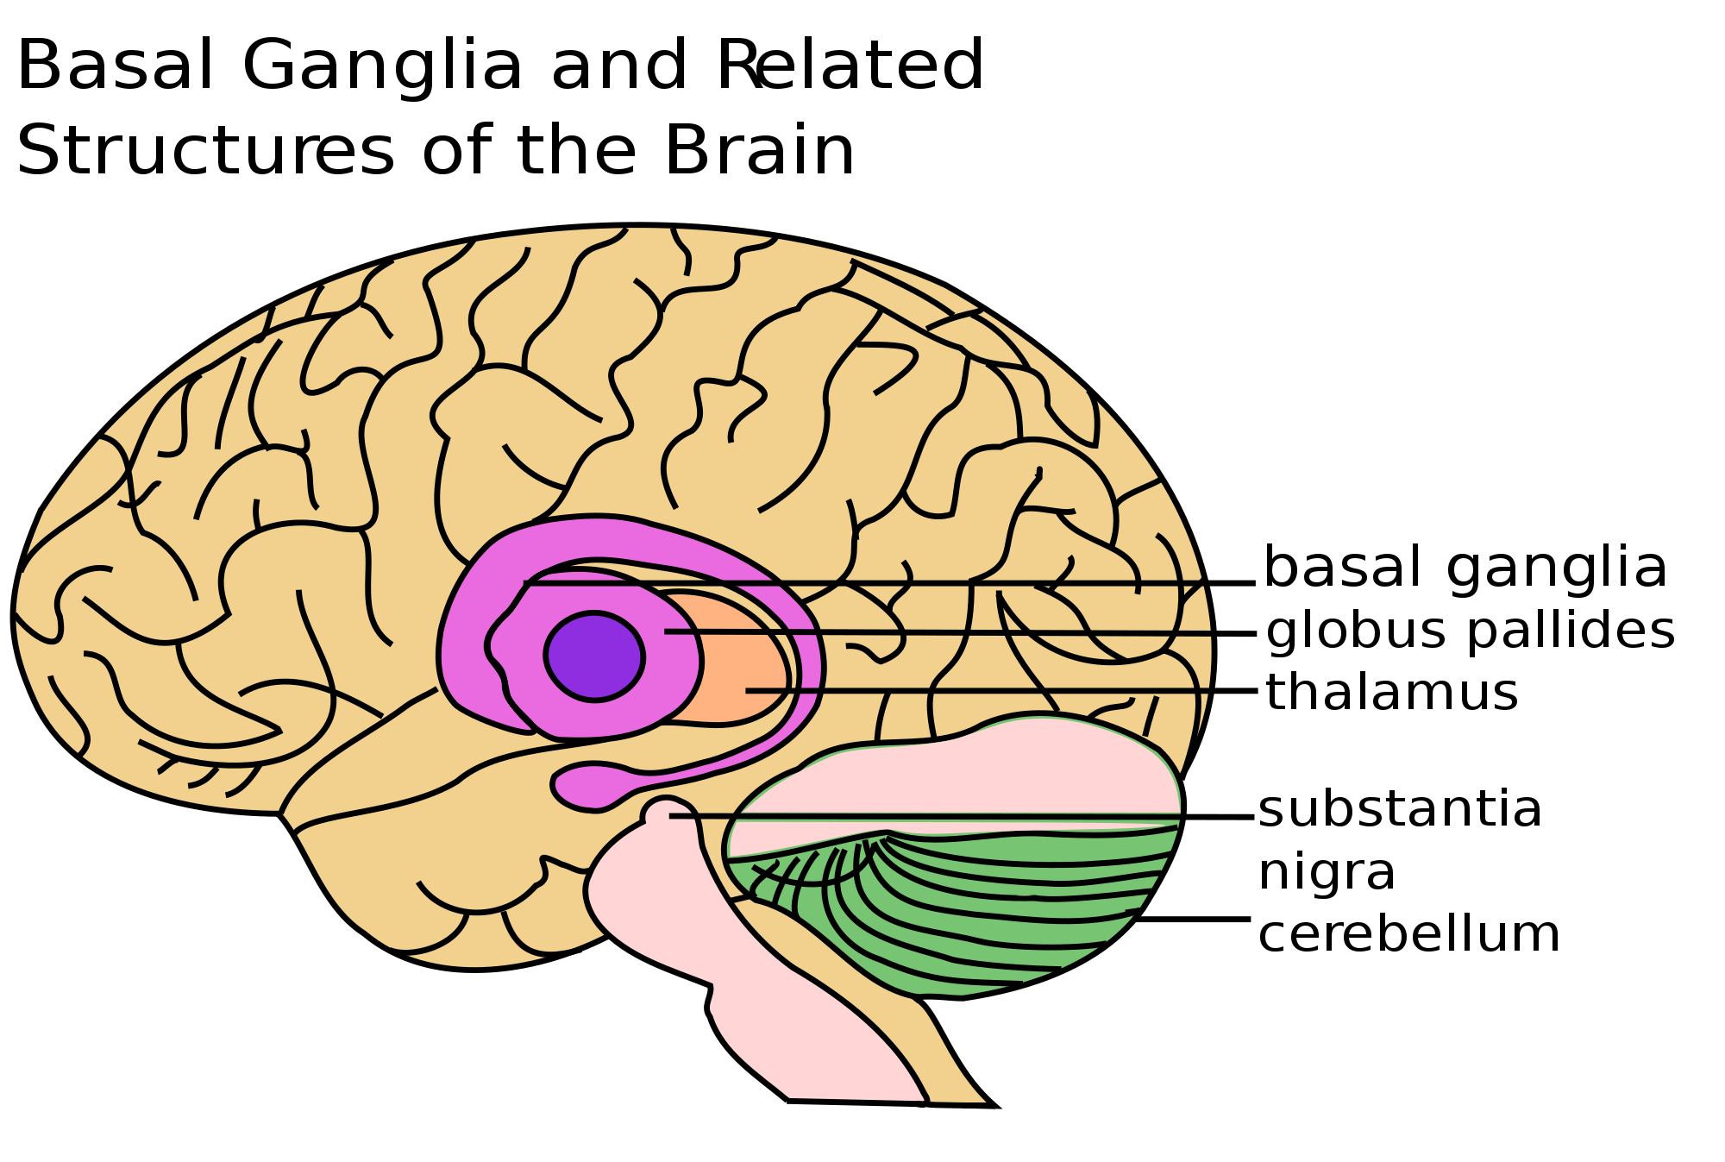
Basal Ganglia
https://en.wikipedia.org/wiki/File:Basal_Ganglia_and_Related_Structures.svg

Slide 19
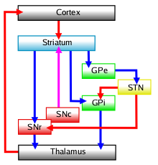
Basal ganglia – decides between cortical areas competing for motor control.
https://en.wikipedia.org/wiki/File:Basal-ganglia-classic.png

Slide 20
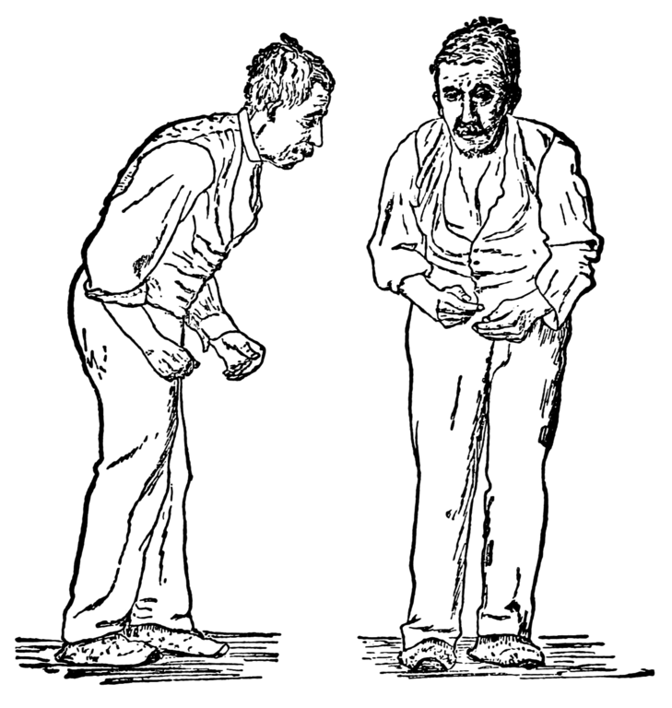
Parkinsonian gait
http://en.wikipedia.org/wiki/Parkinson's_disease

Slide 21
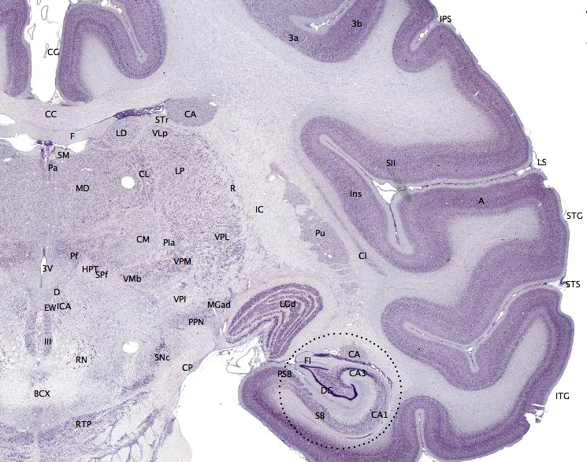
Macaque cortex
https://en.wikipedia.org/wiki/File:Brainmaps-macaque-hippocampus.jpg

Slide 22
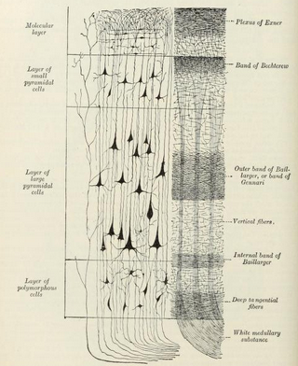
Layers of the neocortex
Gray's anatomy

Slide 23
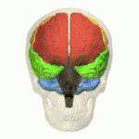
Lobes of the cortex
Orange – Frontal Lobe, Yellow – Parietal Lobe
Green – Temporal Lobe, Pink – Occipital Lobe
https://en.wikipedia.org/wiki/File:Four_lobes_animation_small2.gif

Slide 24
Tan / Hodor
https://www.youtube.com/watch?v=h5X6Qn9hQHk

Slide 25

Broca and Wernicke areas
https://en.wikipedia.org/wiki/File:BrocasAreaSmall.png

Slide 26

Secondary zone of left temporal region
A.R. Luria (1973) The working brain, an introduction to neuropsychology. p140

Slide 27
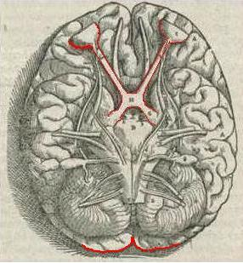
Andreas Vesalius' sketch of the visual pathway from 1543.
https://en.wikipedia.org/wiki/File:1543,Vesalius%27Fabrica,VisualSystem,V1.jpg

Slide 28
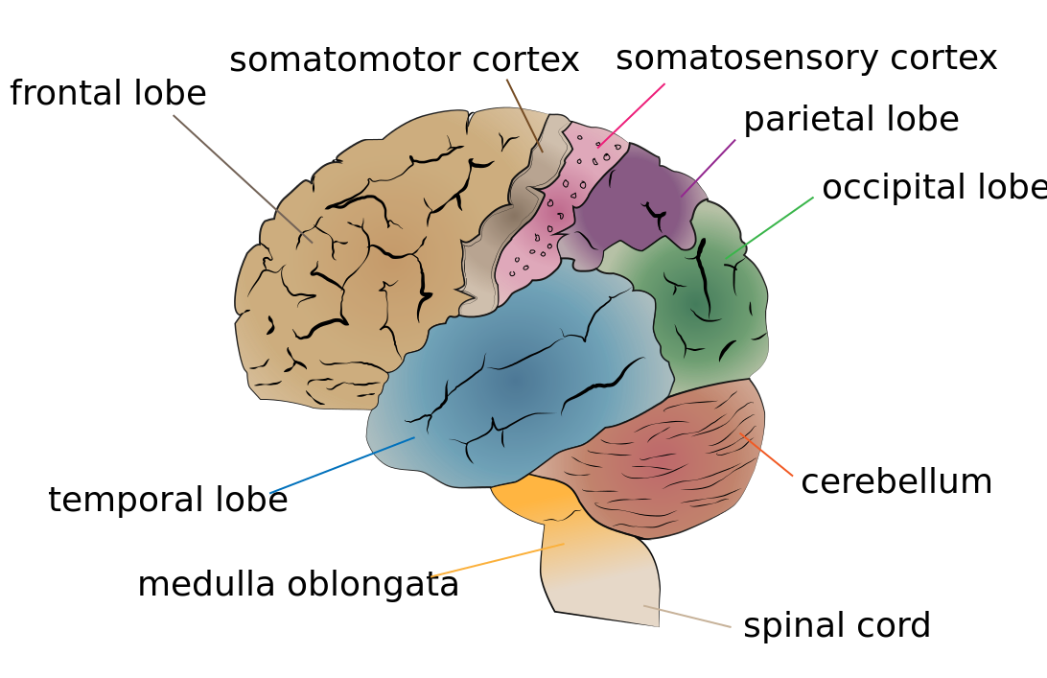
Somatomotor and somatosensory cortex
https://en.wikipedia.org/wiki/File:Cerebrum_lobes.svg

Slide 29
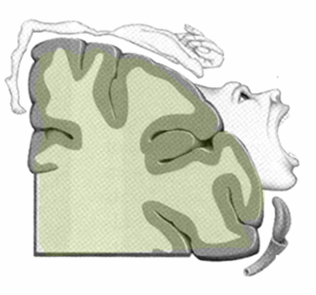
The motor homunculus
http://commons.wikimedia.org/wiki/File:Homunculus.PNG

Slide 30
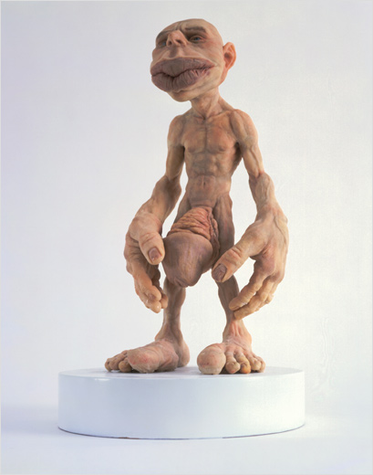
The sensory homunculus
http://commons.wikimedia.org/wiki/File:Homunculus.jpg

Slide 31
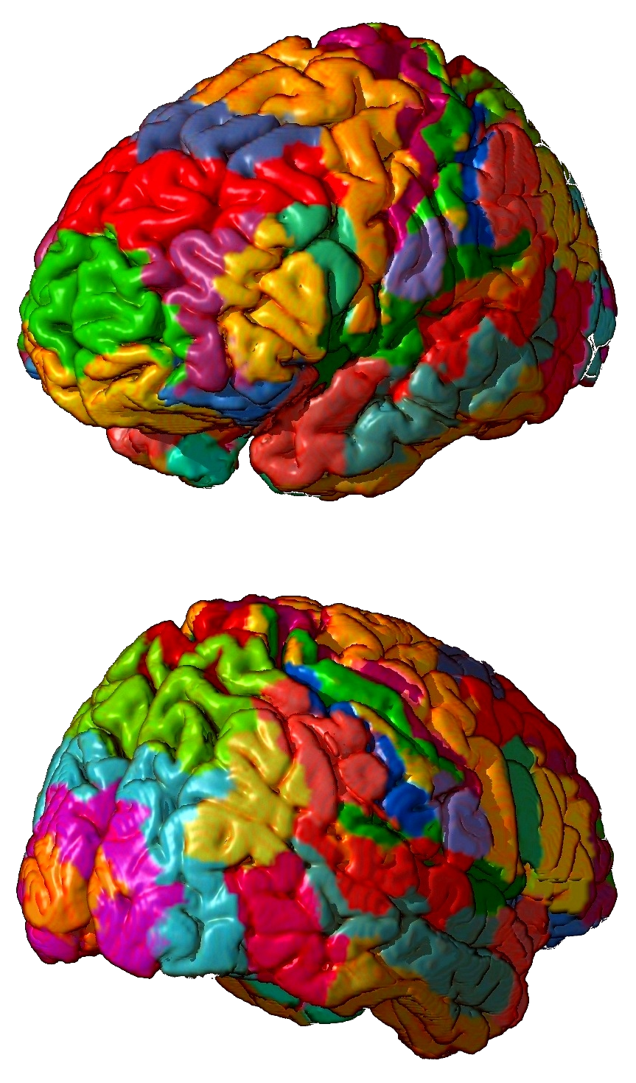
Brodmann areas
https://en.wikipedia.org/wiki/Brodmann_area

Slide 32
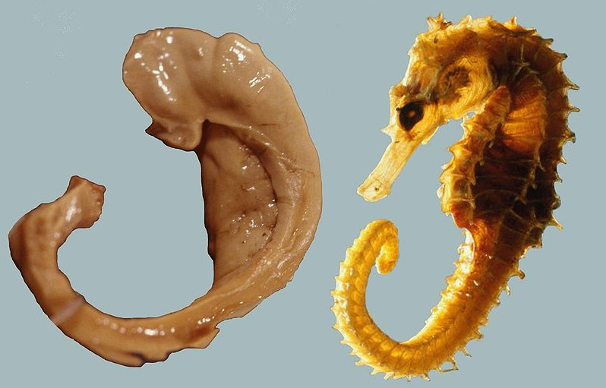
Names often reflect shape not function
Abbreviations are often used – see the list on the website.
Names of brain areas.
https://en.wikipedia.org/wiki/File:Hippocampus_and_seahorse_cropped.JPG

