Slide 1
Computer science is no
more the study of
computers than
astronomy is the
study of telescopes.

Slide 2
Tan / Hodor
https://www.youtube.com/watch?v=h5X6Qn9hQHk

Slide 3

Broca and Wernicke areas
https://en.wikipedia.org/wiki/File:BrocasAreaSmall.png

Slide 4

Secondary zone of left temporal region
A.R. Luria (1973) The working brain, an introduction to neuropsychology. p140

Slide 5
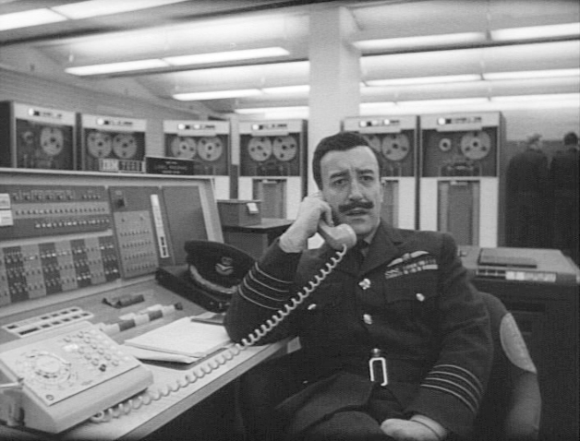

Slide 6


Slide 7

Cajal – Pyramidal Neuron

Slide 8

Cajal – Purkinke Cell

Slide 9
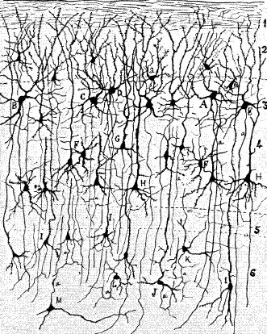

Slide 10

Action Potential
Hodgkin, A.L., and Huxley, A.F. (1939).
Action potentials recorded from inside a nerve fiber
Nature, 144:710

Slide 11
A retinal ganglion cell spiking
https://www.youtube.com/watch?v=KE952yueVLA

Slide 12
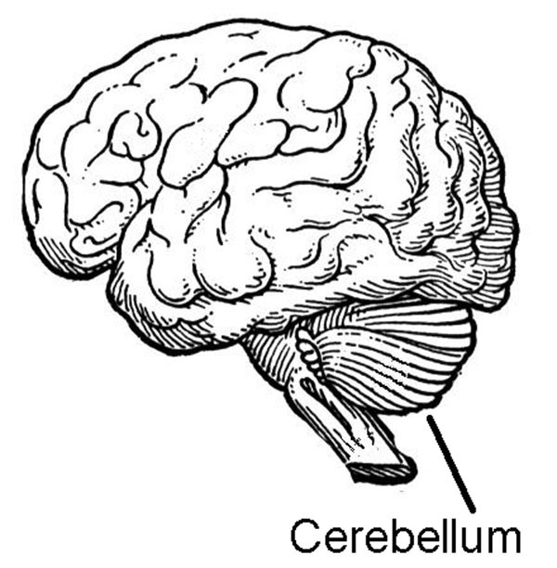

Slide 13

Cerebellar ataxia.
https://en.wikipedia.org/wiki/File:Thomas-fig68,69-p127.png

Slide 14
Blind Cave Fish
https://www.youtube.com/watch?v=MWdtGuDd8z0

Slide 15

H.M. - Henry Molaison
Scoville, W. B., & Milner, B. (1957).
Loss of recent memory after bilateral hippocampal lesions.
Journal of neurology, neurosurgery, and psychiatry, 20(1), 11.

Slide 16
Clive Wearing
https://www.youtube.com/watch?v=Vwigmktix2Y

Slide 17
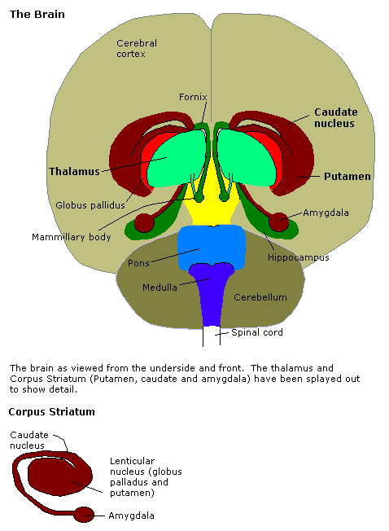
Amygdala
http://en.wikipedia.org/Amygdala

Slide 18
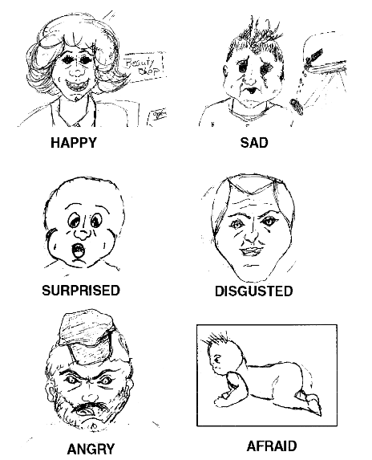
Drawing by S.M.
Adolphs, R., Tranel, D., Damasio, H., & Damasio, A. R. (1995).
Fear and the human amygdala.
The Journal of neuroscience, 15(9), 5879-5891.

Slide 19
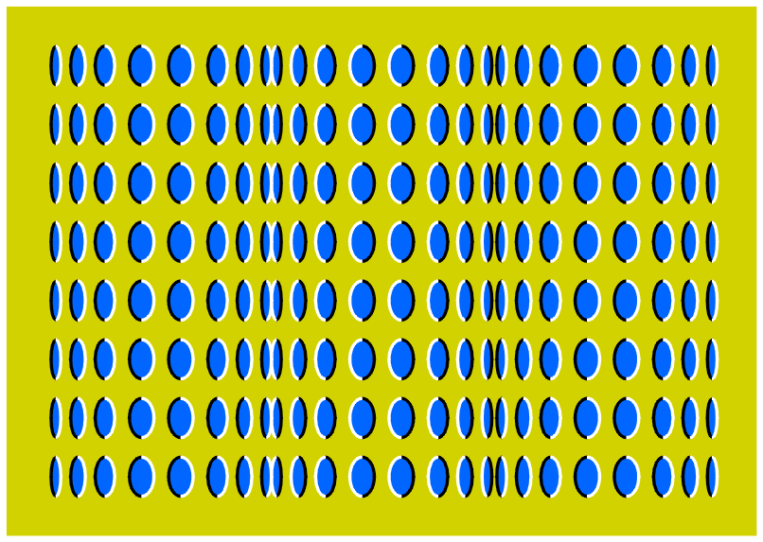

Slide 20
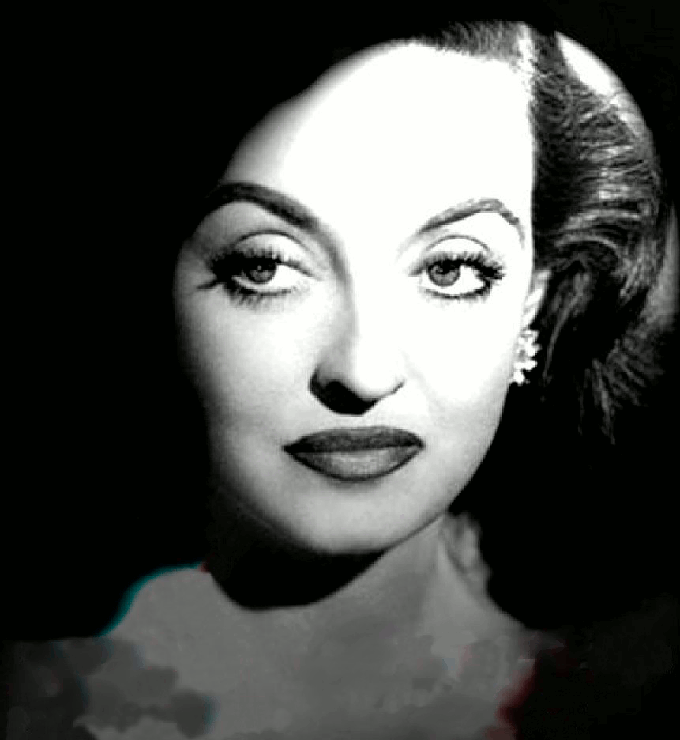

Slide 22
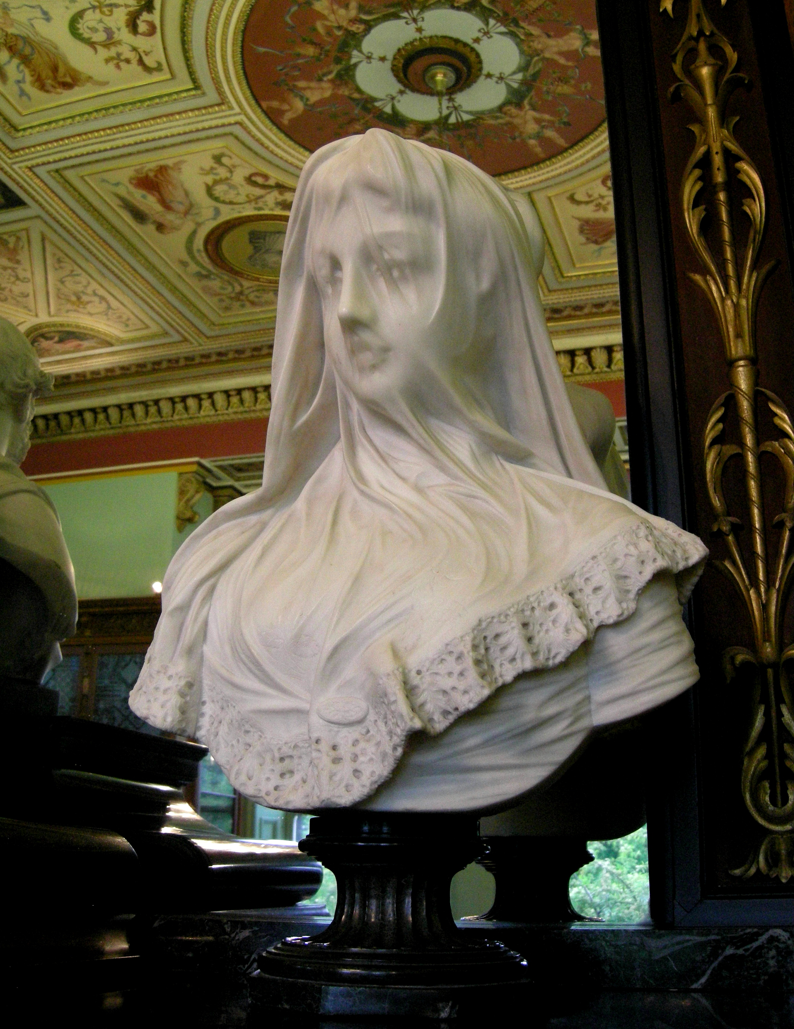
statue in the Bankfield museum
wikipedia.org

Slide 23
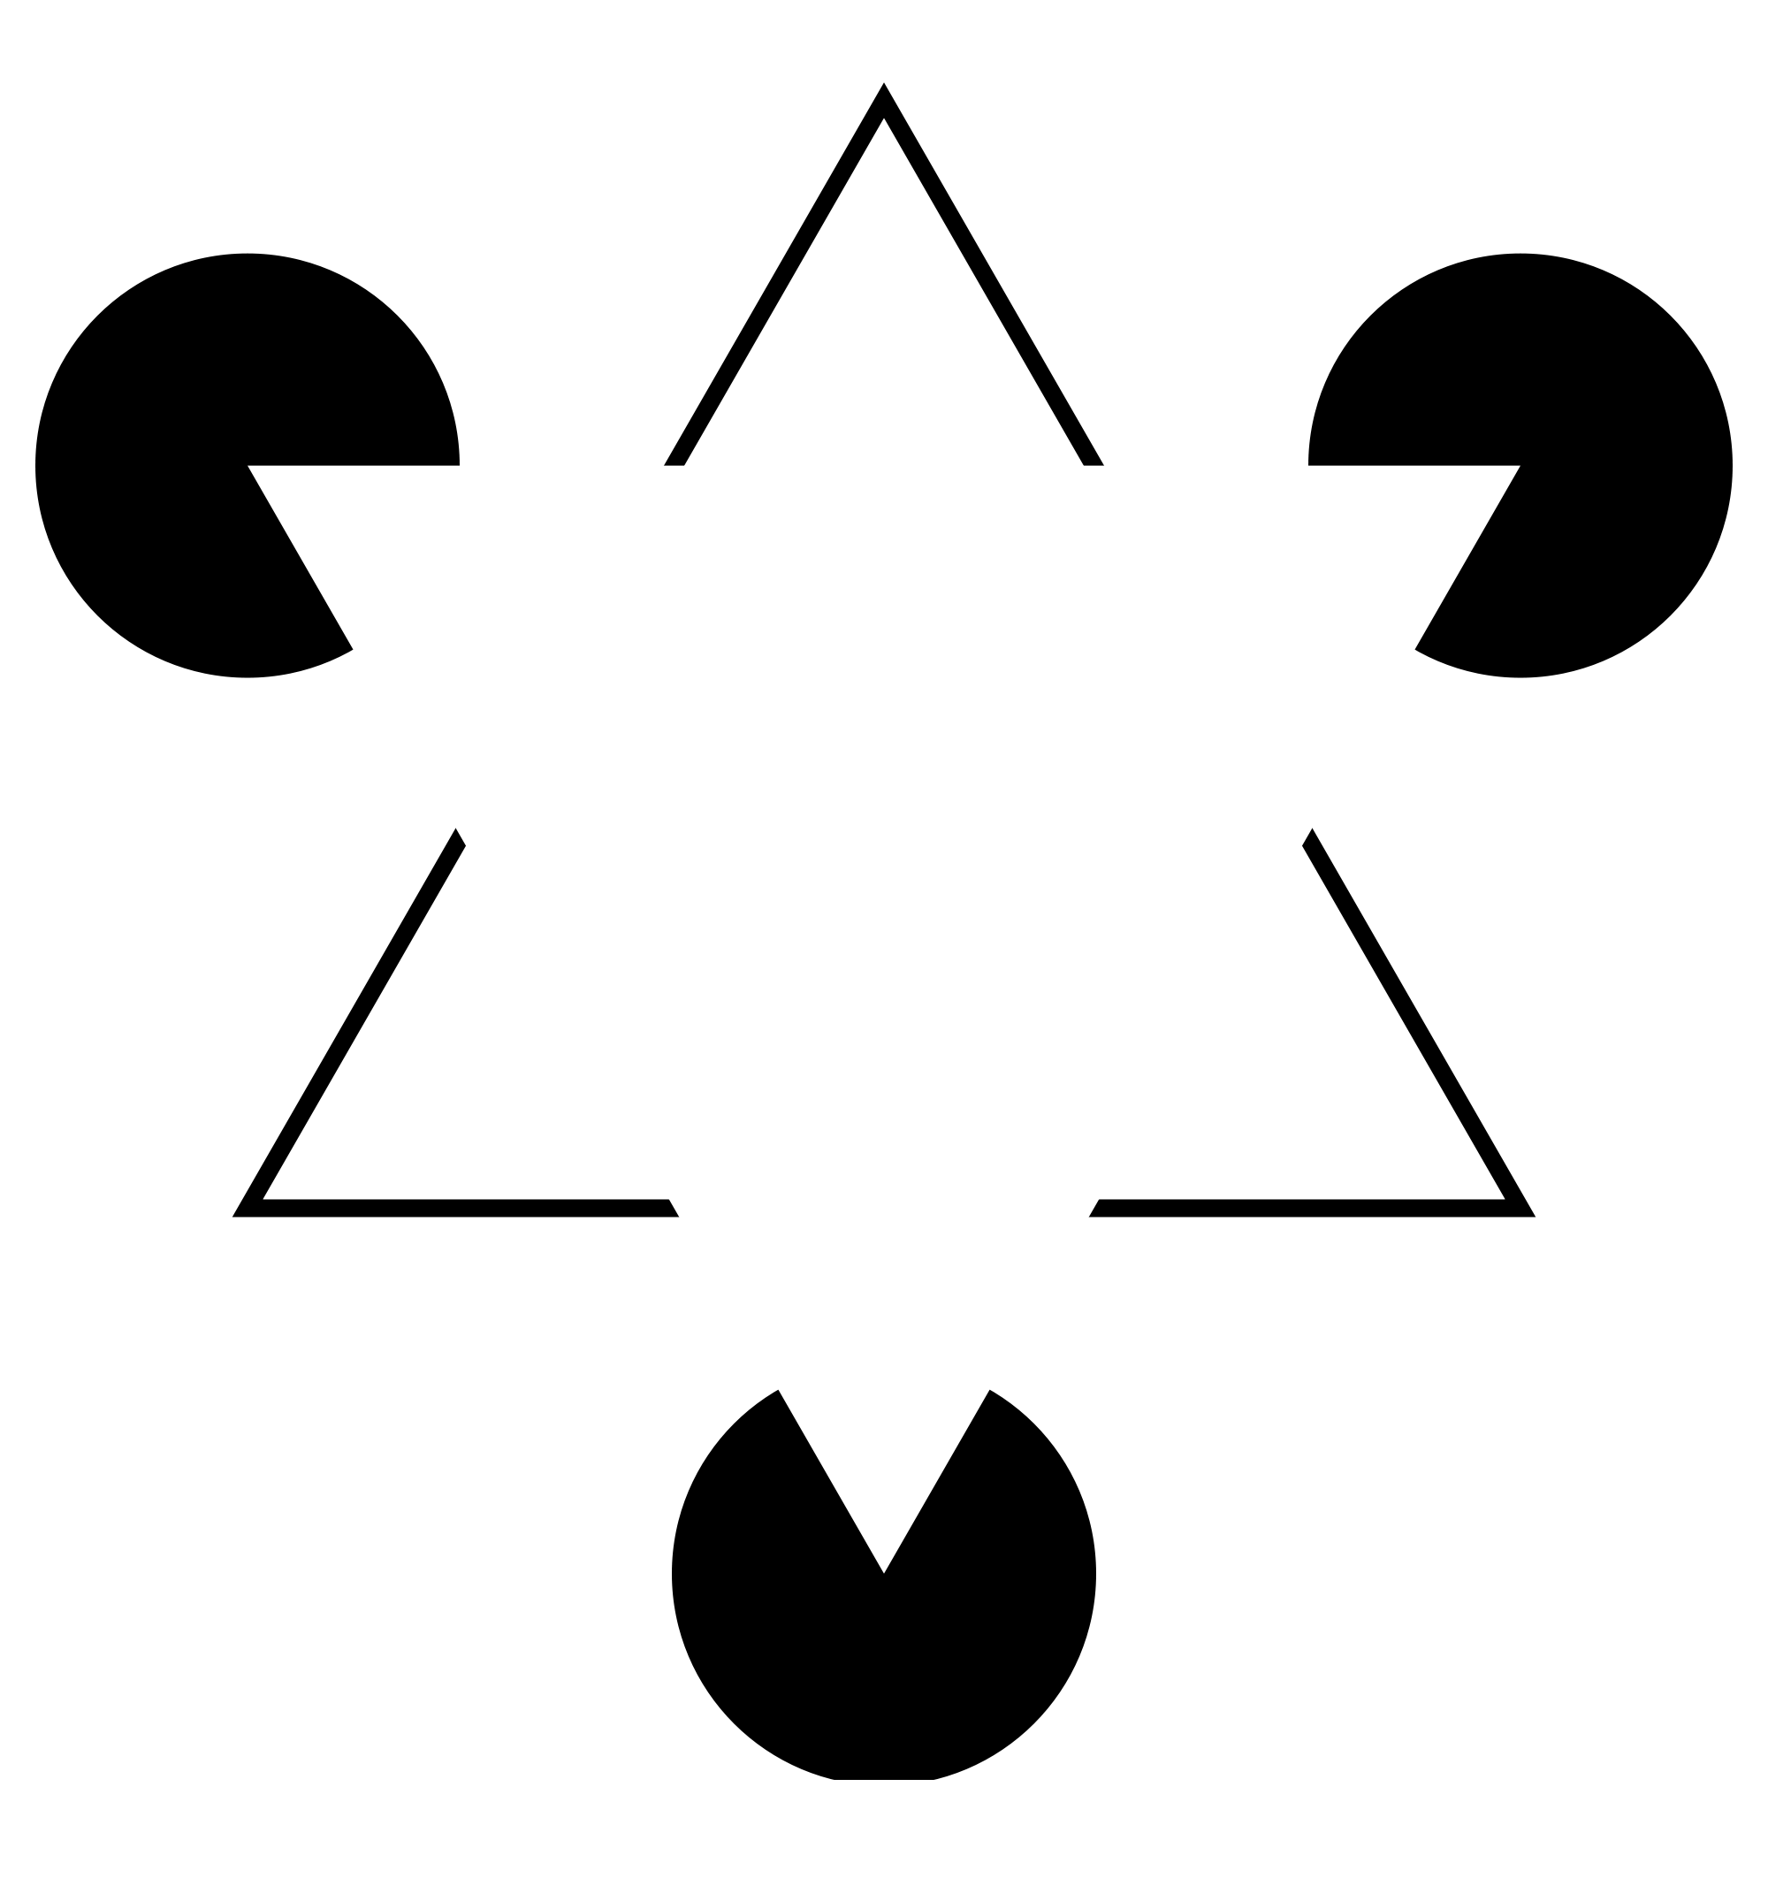
Kaniza triangle

Slide 24

cafe wall illusion
wikipedia.org

Slide 25
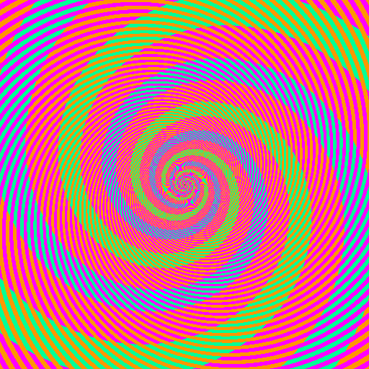
Benzold effect
discovermagazine.com

Slide 26
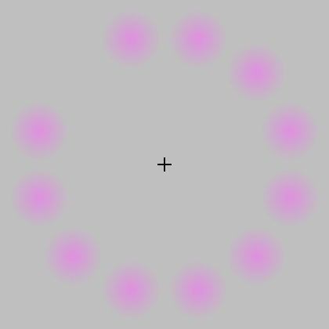
Lilac chaser
wikipedia.org

Slide 27
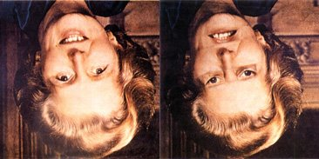
Thatcher illusion
blogs.scientificamerican.com

Slide 28


