Slide 1
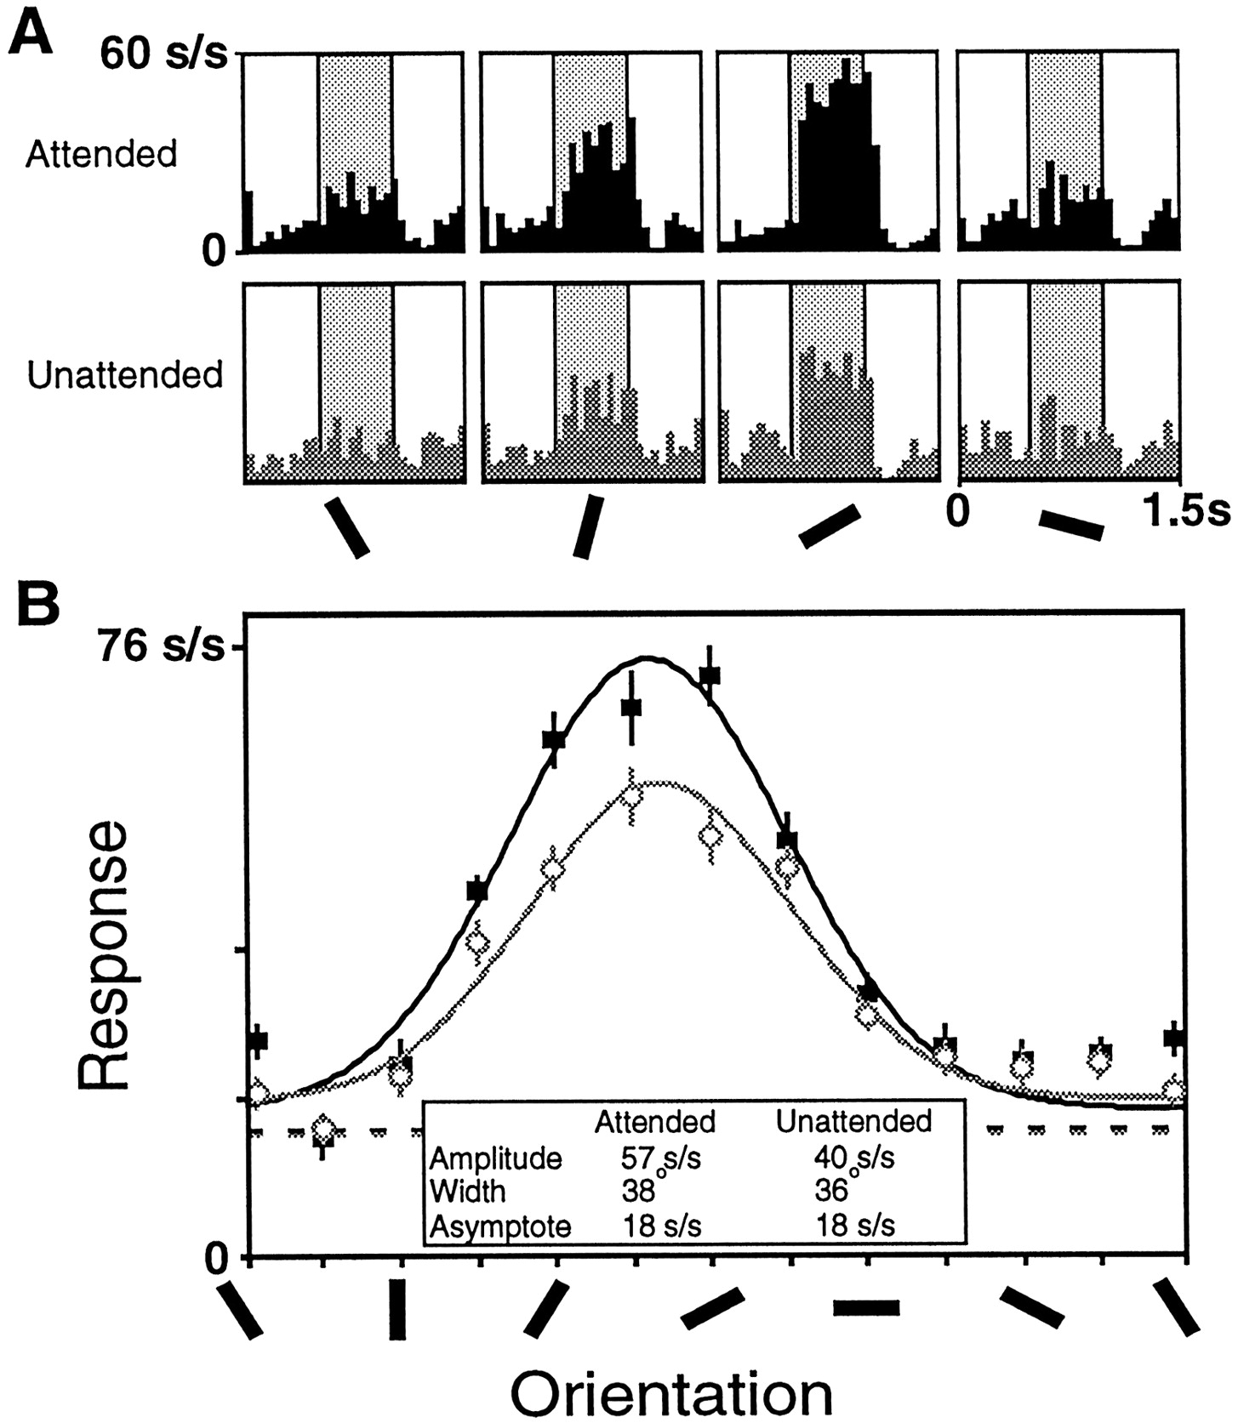

Data from one V4 cell showing enhanced responses in the attended mode (black) relative to the unattended mode (gray).
McAdams C J , and Maunsell J H R J. Neurosci. 1999;19:431-441
©1999 by Society for Neuroscience
Notes:
Data from one V4 cell showing enhanced responses in the attended mode (black) relative to the unattended mode (gray). A, Histograms showing the responses elicited by sample stimuli of four different orientations. The histograms in the top row were taken from trials when the animal was attending to the receptive field stimulus, and the histograms in the bottom row were taken from trials when the animal was attending to the stimulus outside the receptive field. The average response during the sample period (shaded) was used to construct tuning curves.B, Tuning curves were constructed for this neuron for each task mode by fitting the responses for each condition to a Gaussian. This cell had a significant increase in amplitude in the attended mode (solid symbols) relative to the unattended mode (open symbols), but no significant changes in the preferred orientation, width, or asymptote. The undriven activity of the cell during the attended trials is shown in the black dashed line, and the undriven activity of the cell during the unattended trials is represented by the gray dashed line.

