Slide 1
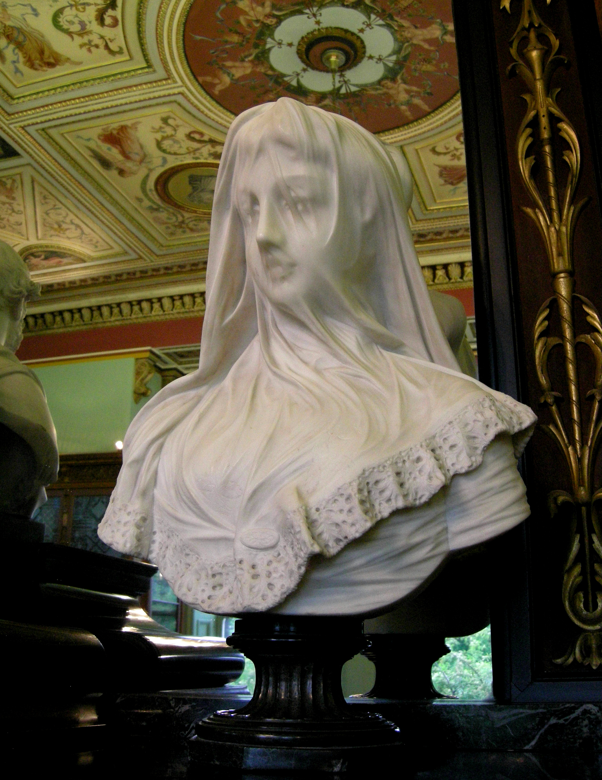
statue in the Bankfield museum
wikipedia.org

Slide 2
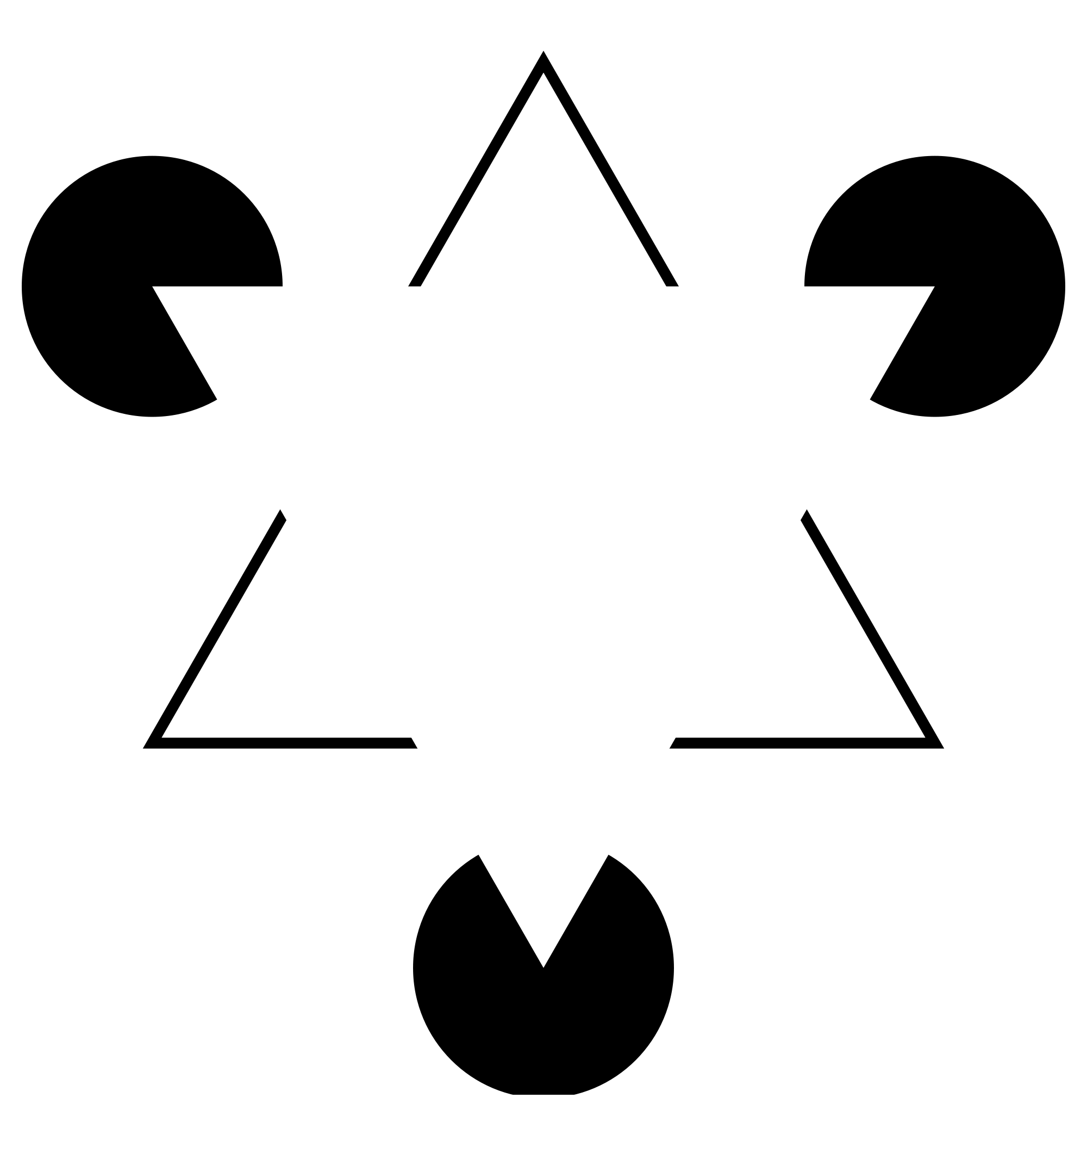
Kaniza triangle

Slide 3
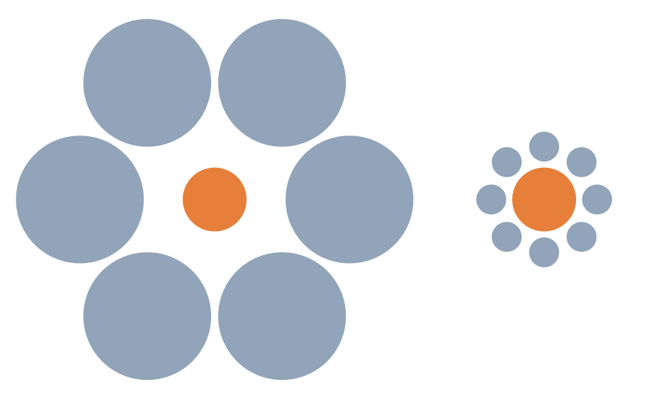
Ebbinghaus illusion

Slide 4
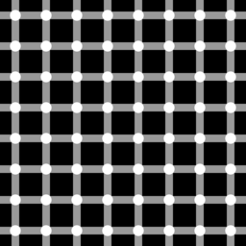
Hermann grid illusion
daviddarling.info

Slide 5
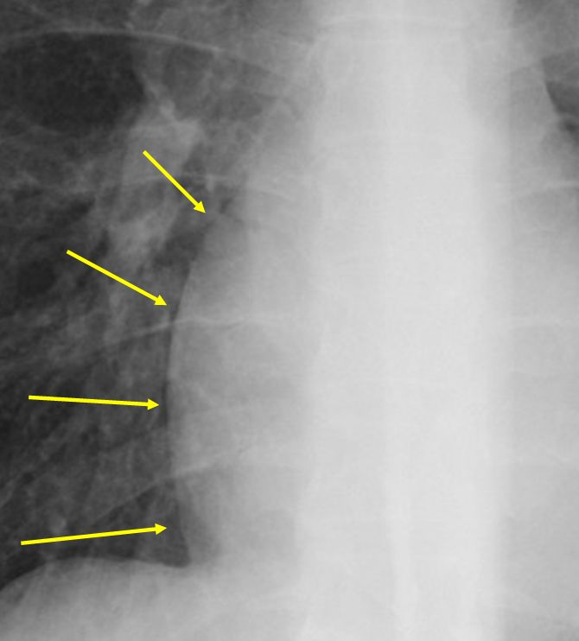
Mach bands
robochest.com

Slide 6
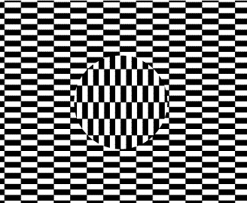
Ouchi illusion
Mathworld.wolfram.com

Slide 7
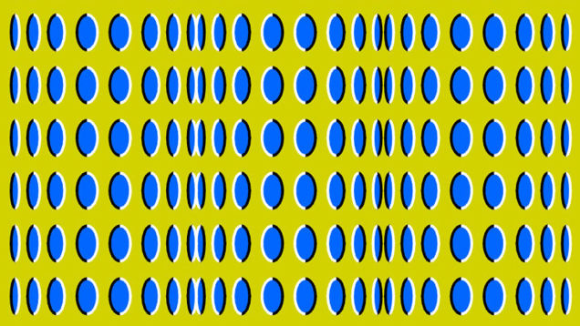

Slide 8
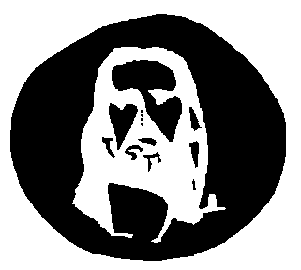
Jesus illusion

Slide 9
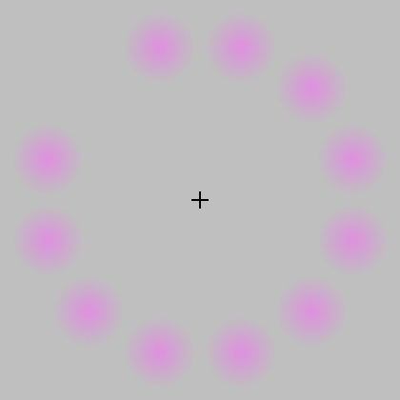
Lilac chaser
wikipedia.org

Slide 10
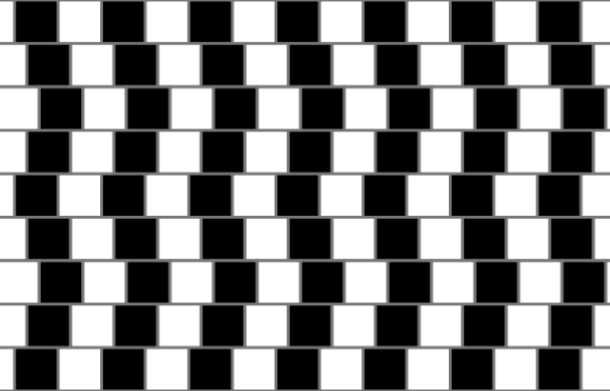
cafe wall illusion
wikipedia.org

Slide 11
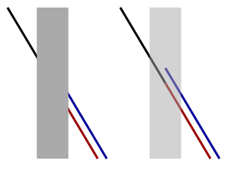
Poggendorf illusion
wikipedia.org

Slide 12
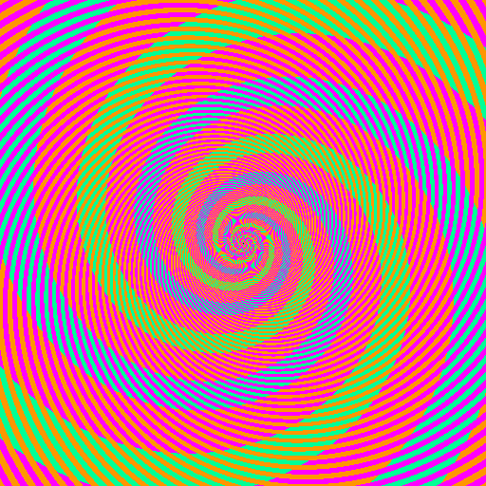
Benzold effect
discovermagazine.com

Slide 13
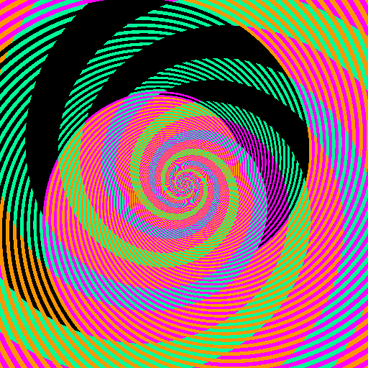
Benzold effect - ruined
discovermagazine.com

Slide 14
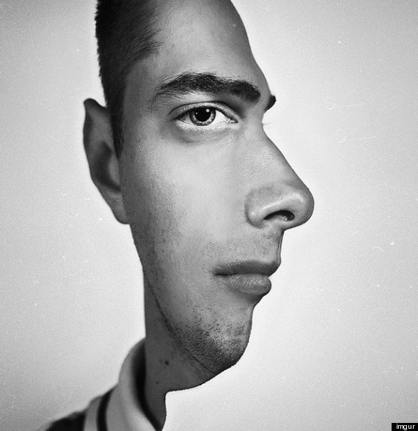
face profile illusion
brainden.com

Slide 15
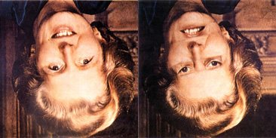
Thatcher illusion
blogs.scientificamerican.com

Slide 16
