Slide 1
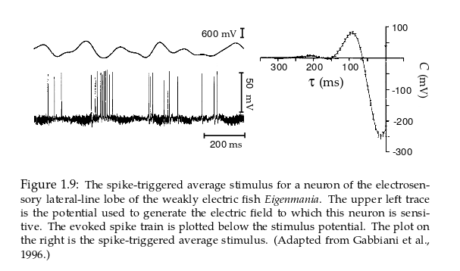
Spike triggered average
From Dayan and Abbott Theoretical Neuroscience.

Slide 2
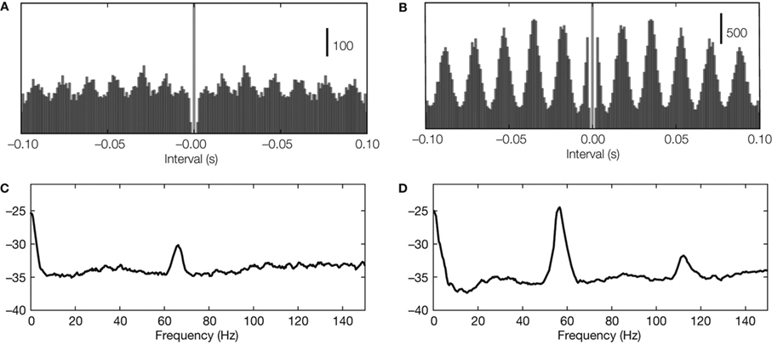
Autocorrelograms
Detecting neural oscillations. (A,B) Oscillations in autocorrelations in two example recordings
(spike trains recorded from LGN in cat) with oscillation score 10 and 29,
respectively. (C,D) Oscillations in spectral power (same spike trains as used for panel A).
From Exploring the function of neural oscillations in early sensory system, Koepsell, Wang,
Hirsch and Sommer (2010) Front. Neurosci. 3:00010

Slide 3
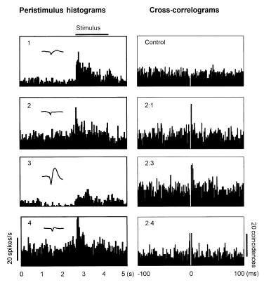
Peristimulus & cross correlogram
Peristimulus time histograms (left) and cross-correlograms (right) for neurons recorded from inferior temporal cortex for monkeys performing prompted memory tasks.
From Recognition memory: neuronal substrate of the judgment of prior occurrence. Brown and Xiang. (1997) Prog. In Neurobiology 55:149

Slide 4
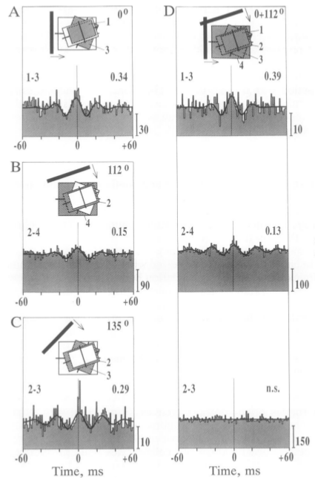
Cross correlograms
Cross correlograms for neurons in V1 in cat showing synchronous activity.
From Direct physiological evidence for scene segmentation by temporal coding Engel, Koenig and Singer. (1991) PNAS 88:9126

Slide 5
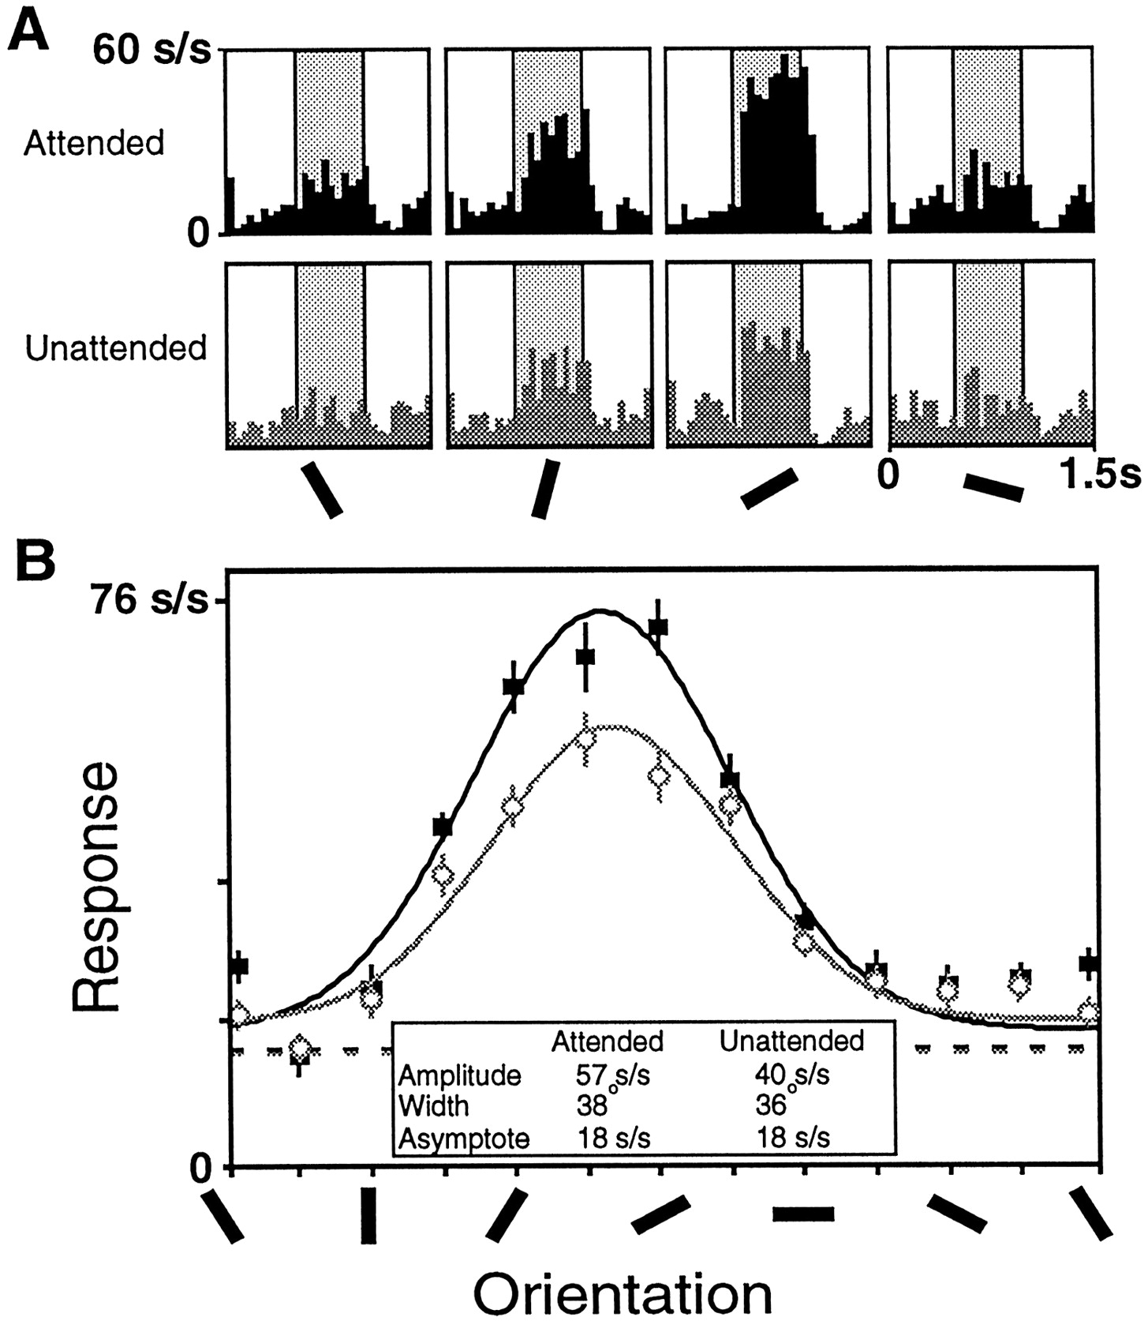

Data from one V4 cell showing enhanced responses in the attended mode (black) relative to the unattended mode (gray).
McAdams C J , and Maunsell J H R J. Neurosci. 1999;19:431-441
©1999 by Society for Neuroscience
Notes:
Data from one V4 cell showing enhanced responses in the attended mode (black) relative to the unattended mode (gray). A, Histograms showing the responses elicited by sample stimuli of four different orientations. The histograms in the top row were taken from trials when the animal was attending to the receptive field stimulus, and the histograms in the bottom row were taken from trials when the animal was attending to the stimulus outside the receptive field. The average response during the sample period (shaded) was used to construct tuning curves.B, Tuning curves were constructed for this neuron for each task mode by fitting the responses for each condition to a Gaussian. This cell had a significant increase in amplitude in the attended mode (solid symbols) relative to the unattended mode (open symbols), but no significant changes in the preferred orientation, width, or asymptote. The undriven activity of the cell during the attended trials is shown in the black dashed line, and the undriven activity of the cell during the unattended trials is represented by the gray dashed line.

Slide 6
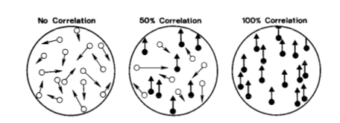
Moving dot task
From The analysis of visual motion: a comparison of neuronal and psychophysical performance Britten, Shalden, Newsome and Movshon (1992) J. Neuroscience 12:4745

Slide 7
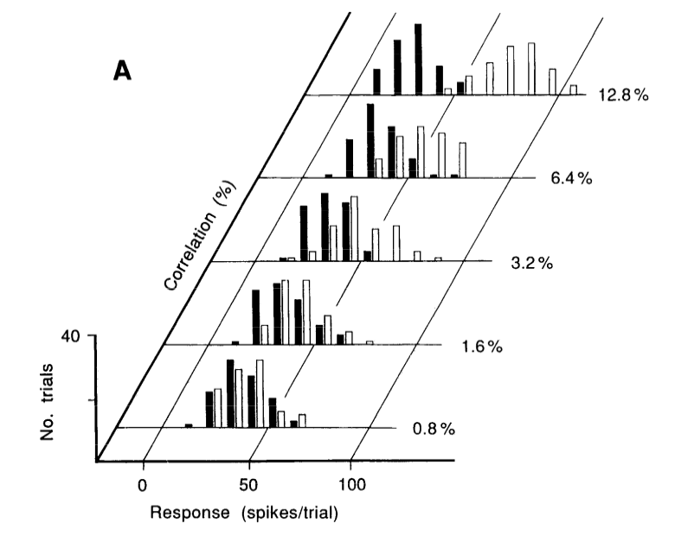
Neuronal responses
From The analysis of visual motion: a comparison of neuronal and psychophysical performance Britten, Shalden, Newsome and Movshon (1992) J. Neuroscience 12:4745

Slide 8
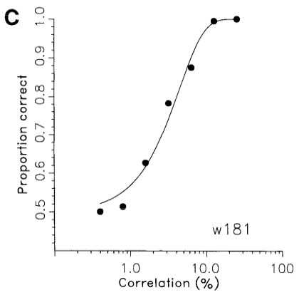
Performance – real and ideal
From The analysis of visual motion: a comparison of neuronal and psychophysical performance Britten, Shalden, Newsome and Movshon (1992) J. Neuroscience 12:4745

