Slide 1
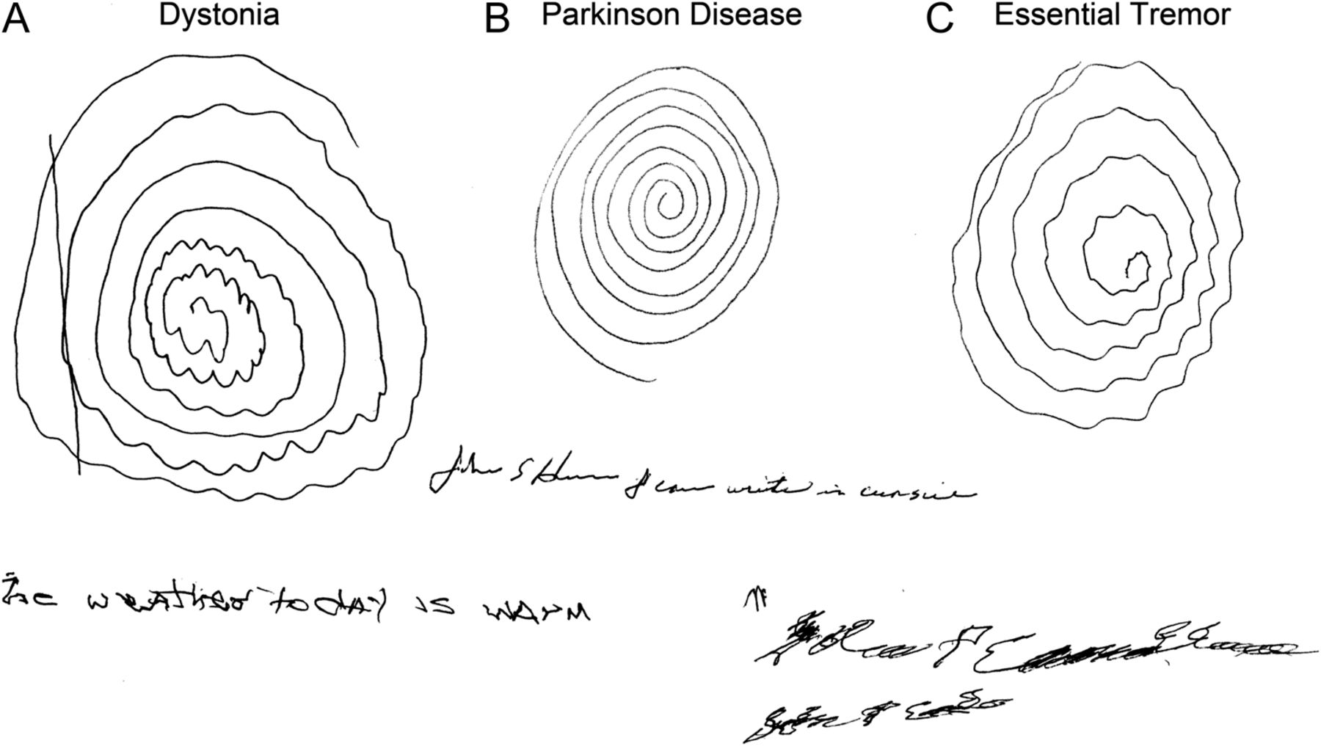
Olga Klepitskaya, Alexander J. Neuwelt, Tam Nguyen and Maureen Leehey
Neurol Clin Pract December 2013 vol. 3 no. 6 469-474

Slide 2
From https://www.youtube.com/watch?v=rgNSCDBfjNw

Slide 3
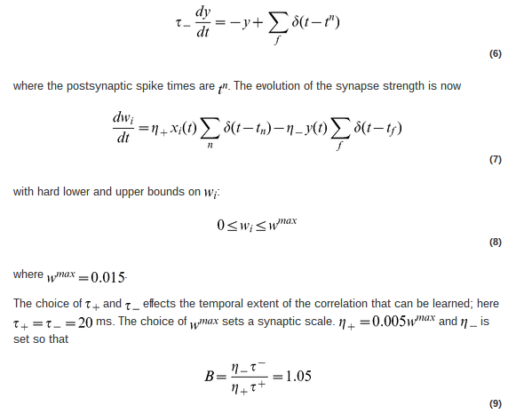

Slide 4
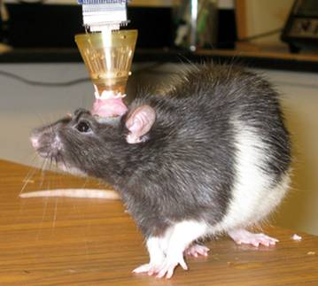
Image from http://neuroscience.cornell.edu/images/rat2.jpg

Slide 5


Slide 6
serotonin
norepinephrine
acetylcholine
dopamine

Slide 7
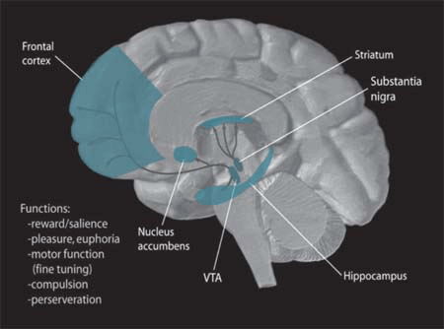

Slide 8
Wikipedia: “The ventral tegmental area is
important in cognition, motivation, orgasm,
drug addiction, intense emotions relating
to love, and several psychiatric disorders.”

Slide 9

Image from Wikipedia

Slide 10
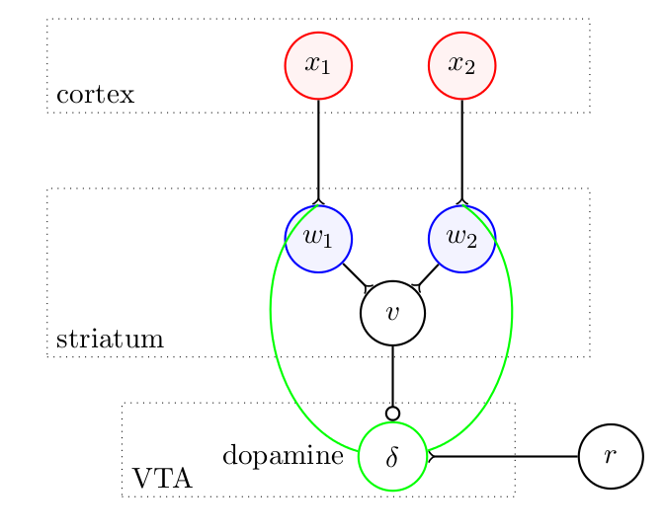

Slide 11
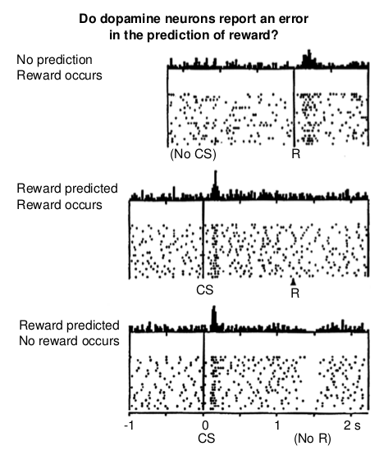
Schultz W, Dayan P and
Montague PR. (1997)
A neural substrate of
prediction and
reward.
Science 275: 1593–9.

Slide 12
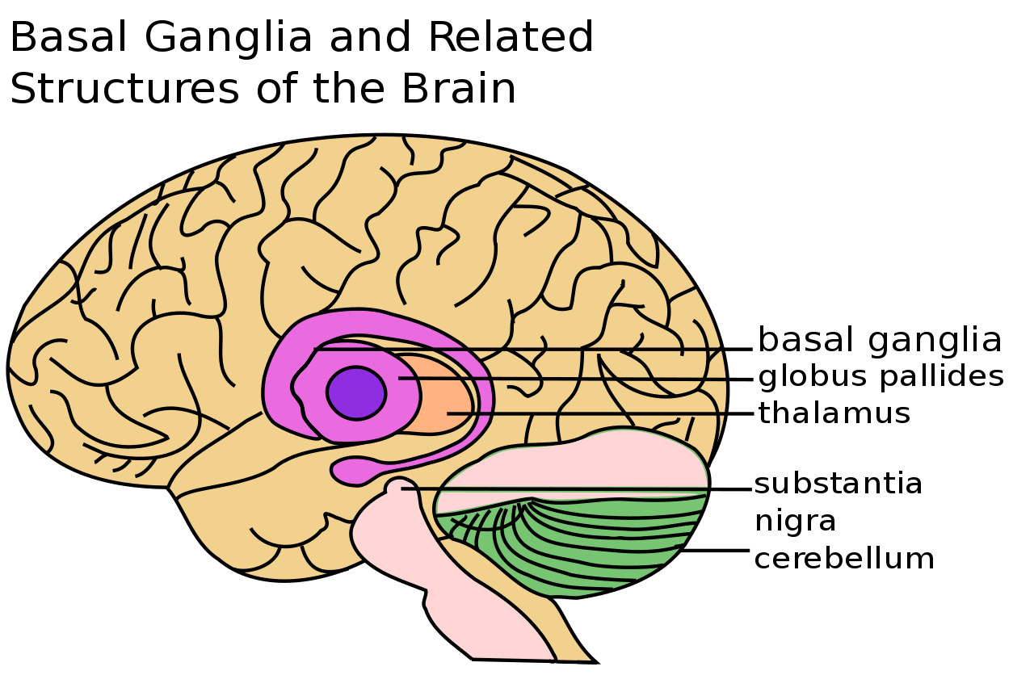
Image from Wikipedia

Slide 13


Slide 14
From https://www.youtube.com/watch?v=Pz_FfiCvJRk

Slide 15
From https://www.youtube.com/watch?v=Pz_FfiCvJRk

Slide 16
I have become much more optimistic than I was
when I […] wrote Awakenings,
for there has been a significant number of patients who, following the
vicissitudes of their first years on L-DOPA,
came to do – and still do – extremely well.
Such patients have undergone an enduring awakening,
and enjoy possibilities of life which had been impossible,
unthinkable,
before the coming of L-DOPA. - Oliver Sacks in 1982.

Slide 17

Image:
"Harold-pinter-atp"
by Illuminations Films
– from Wikipedia

Slide 18
From https://www.youtube.com/watch?v=hTA_aeD2_KM

Slide 19


