Slide 1

Festivly
A recommender system

Slide 2
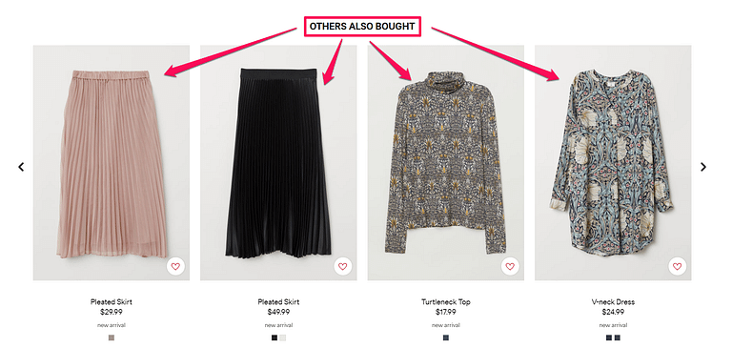
What is a recommender system?
A recommender system is a type of information filtering system. By drawing from huge data sets, the system’s algorithm can pinpoint accurate user preferences. Once you know what your users like, you can recommend them new, relevant content, from movies and music, to romantic partners.

Slide 3




Project Description
Recommender system that will offer users a range of content based on their inputs
Initially Content Based, may change to collaborative-based system as I learn more during the project
Coded using Python, HTML5, CSS3, Flask and Jinja
Aim to further understand the algorithms behind recommender systems

Slide 4

Work done to date
Login/ Register System for Users w/ Authentication
Homepage
Recommender Input Page
Results Page

Slide 5
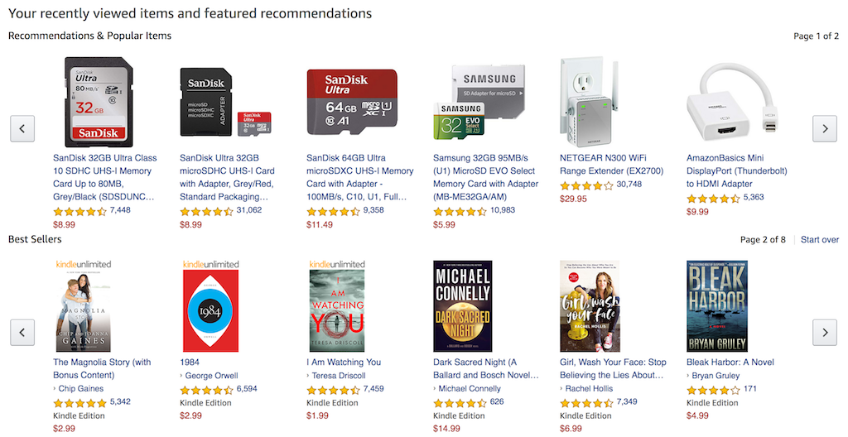
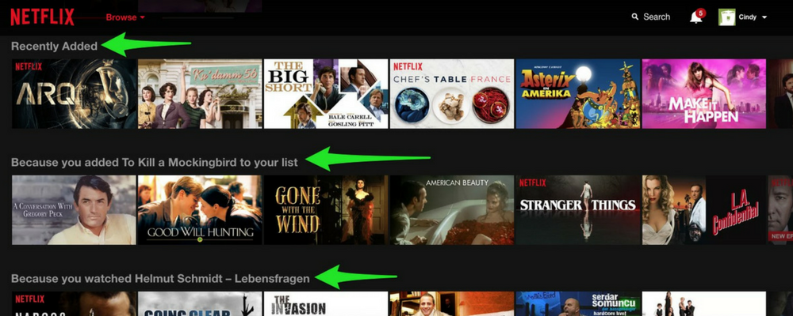
Research
Examples of Recommendation Systems used in popular industries
Amazon currently uses item-to-item collaborative filtering, which scales to massive data sets and produces high-quality recommendations in real time.
Their most successful algorithm, Netflix Recommendation Engine (NRE), is made up of algorithms which filter content based on each individual user profile. The engine filters over 3,000 titles at a time using 1,300 recommendation clusters based on user preferences.

Slide 6
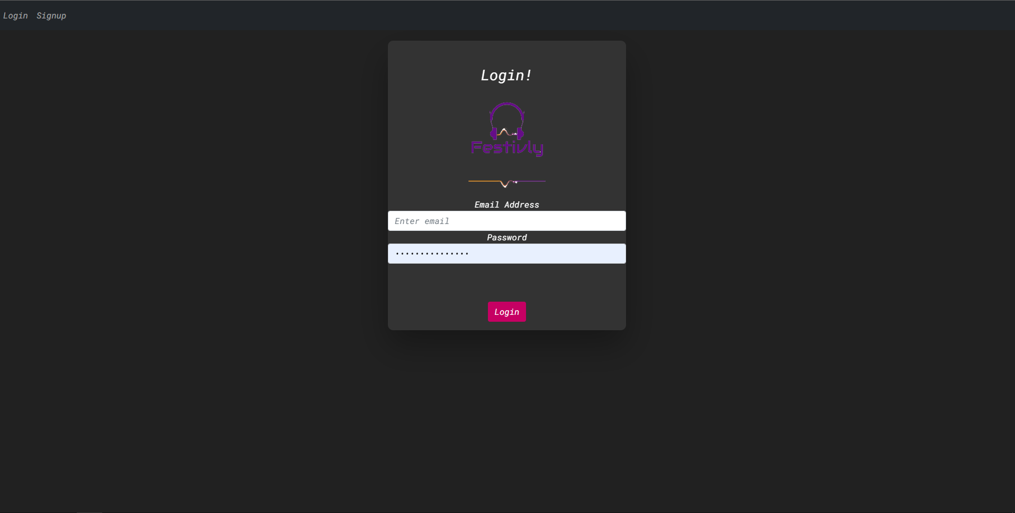
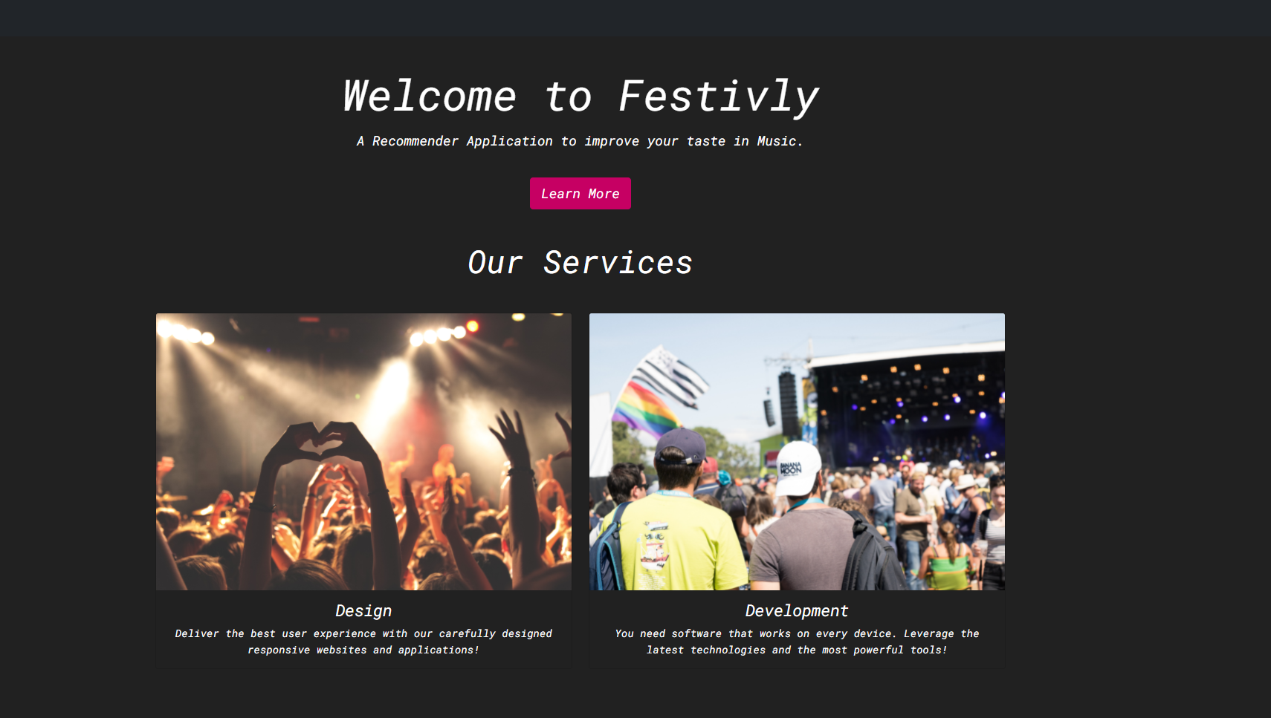
Coding

Slide 7

What's next?
Improve the Recommender System, make more advanced i.e Research Collab-Based Filtering
Add Rating system to each item to assist in recommendations
User Dashboard
View Pages to display more information about each item

