Slide 1
Disposable Web Apps with LLMs
Tiny, task-specific UIs. Customized for your data and needs.

Slide 2
LLMs unlock new human capabilities
Automation of existing tasks
Enabling new types of tasks

Slide 3
”Disposable” webapps
Tiny, task-specific pages that wrap your data
Extremely fast to build with modern AI tools
No expertise in web development needed

Slide 4
Disclaimer: sensitive data
Always use your HBS ChatGPT account
Consult people like Matt Nemesure to ensure you are handling sensitive data properly
All data used in these slides are synthetic and for demonstration purposes.

Slide 5
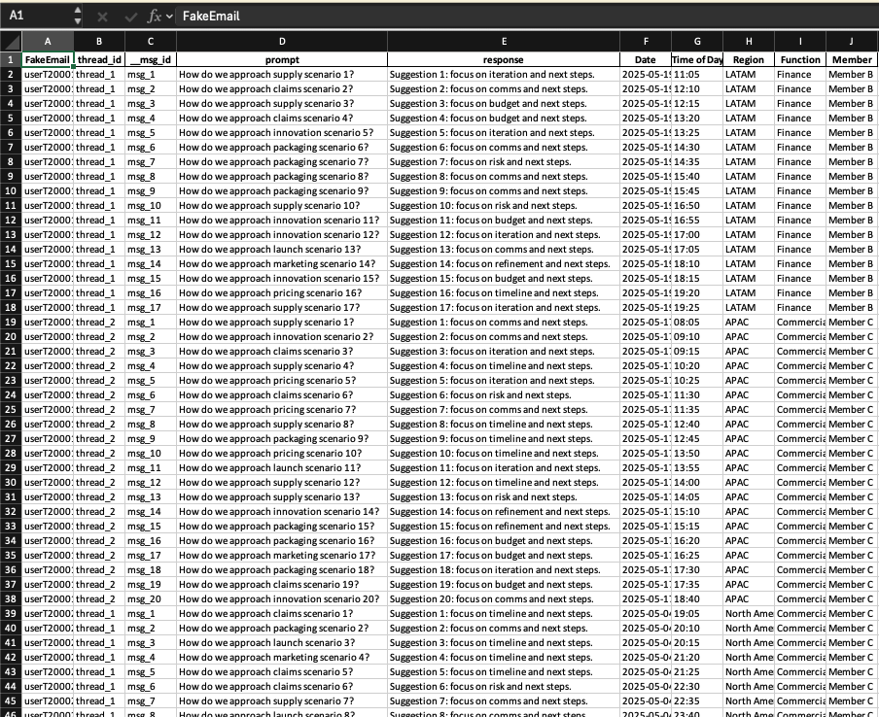
Example 1: Pattern you can reuse

Slide 6
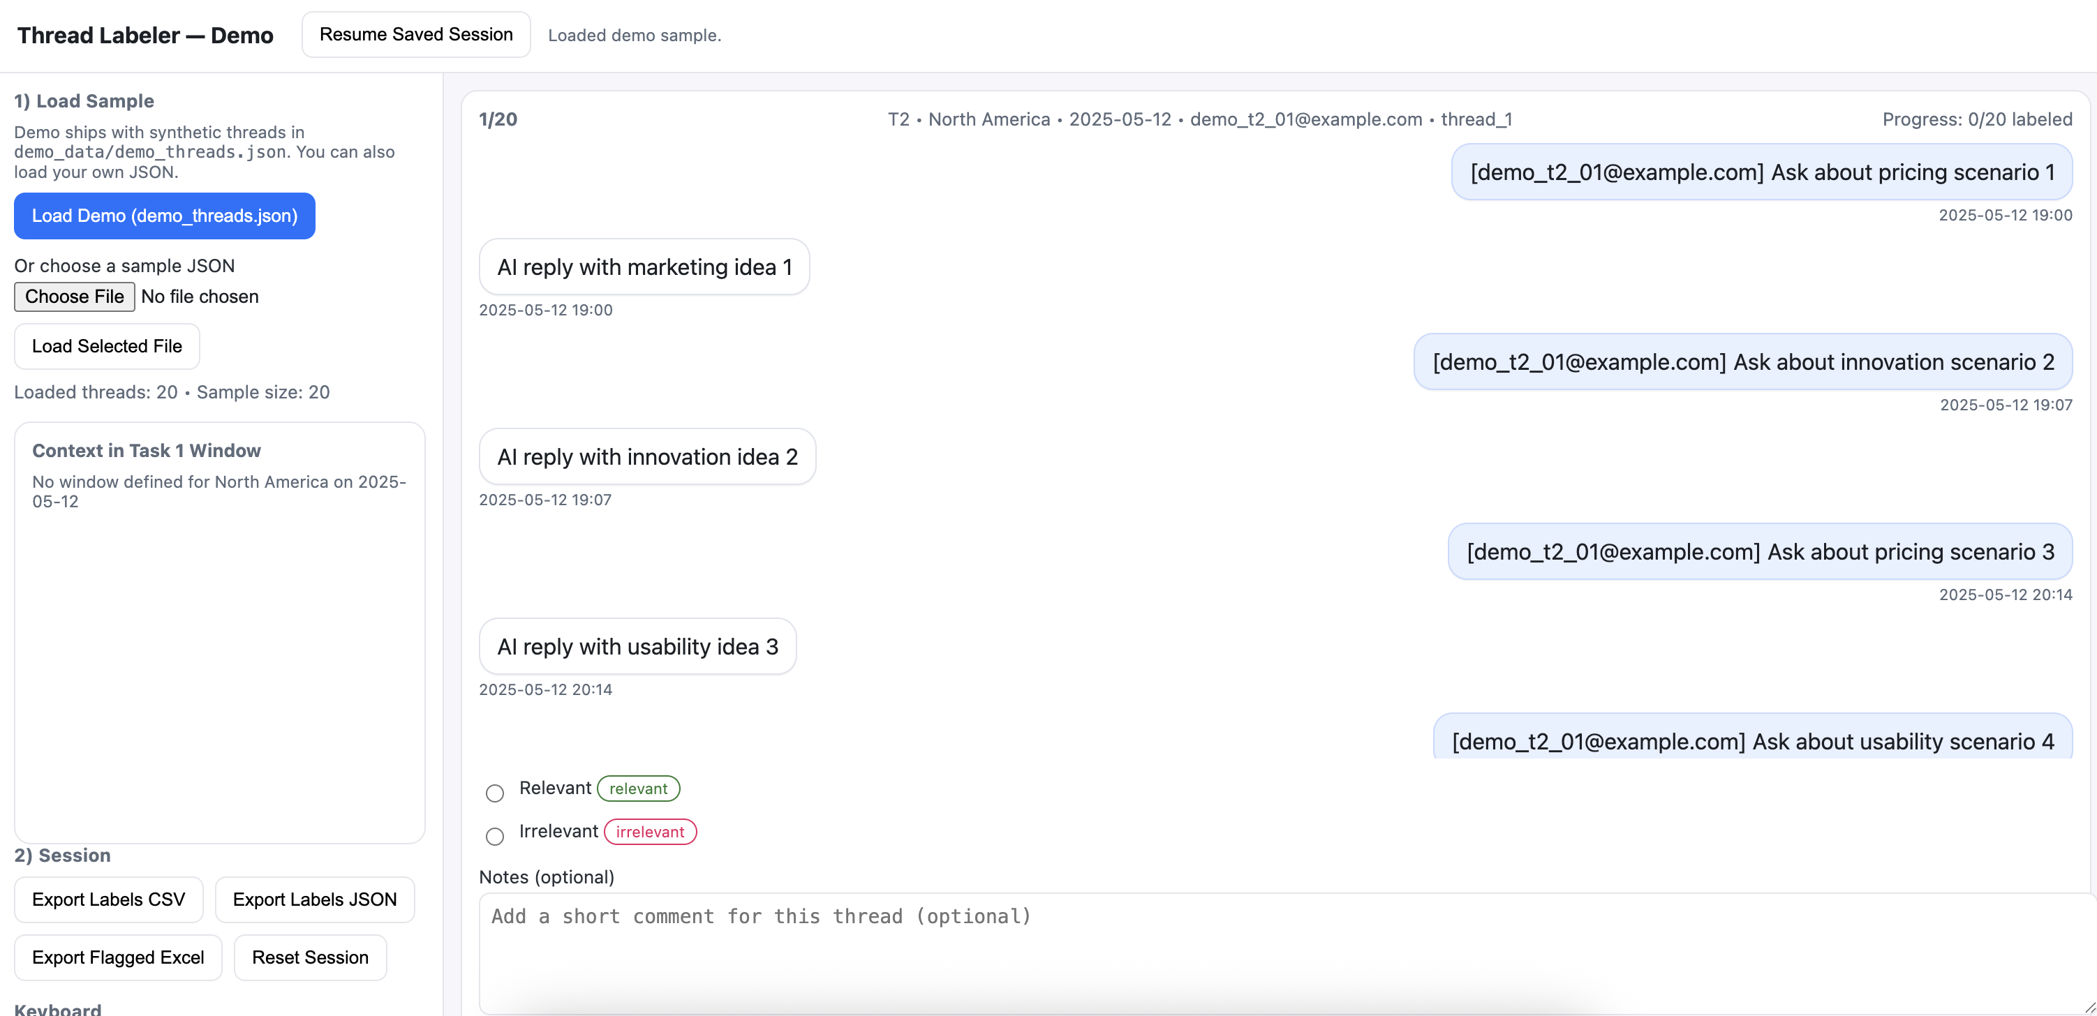
Example 1: Labeler

Slide 7
Example 1: What it enabled
Read conversations like a chat
Time spent labeling cut in half

Slide 8
Example 1: Pattern you can reuse
Transform tabular data to be easier to view/use

Slide 9
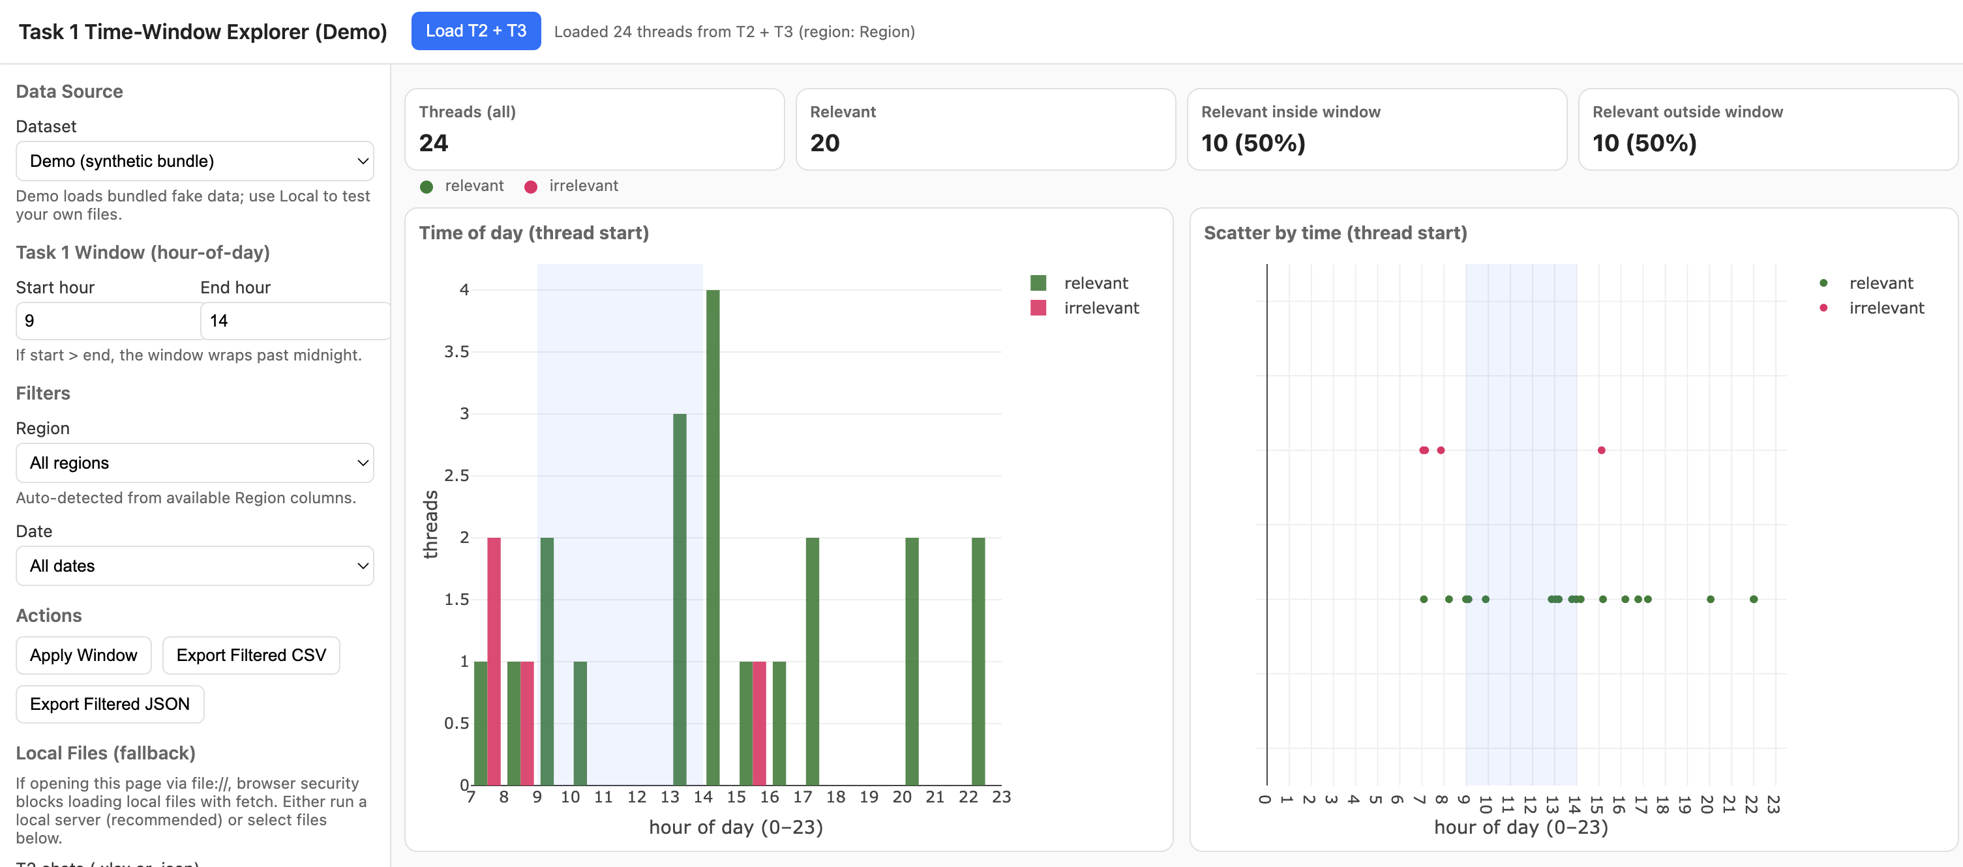
Example 2: Time-Window Explorer (UI highlights)

Slide 10
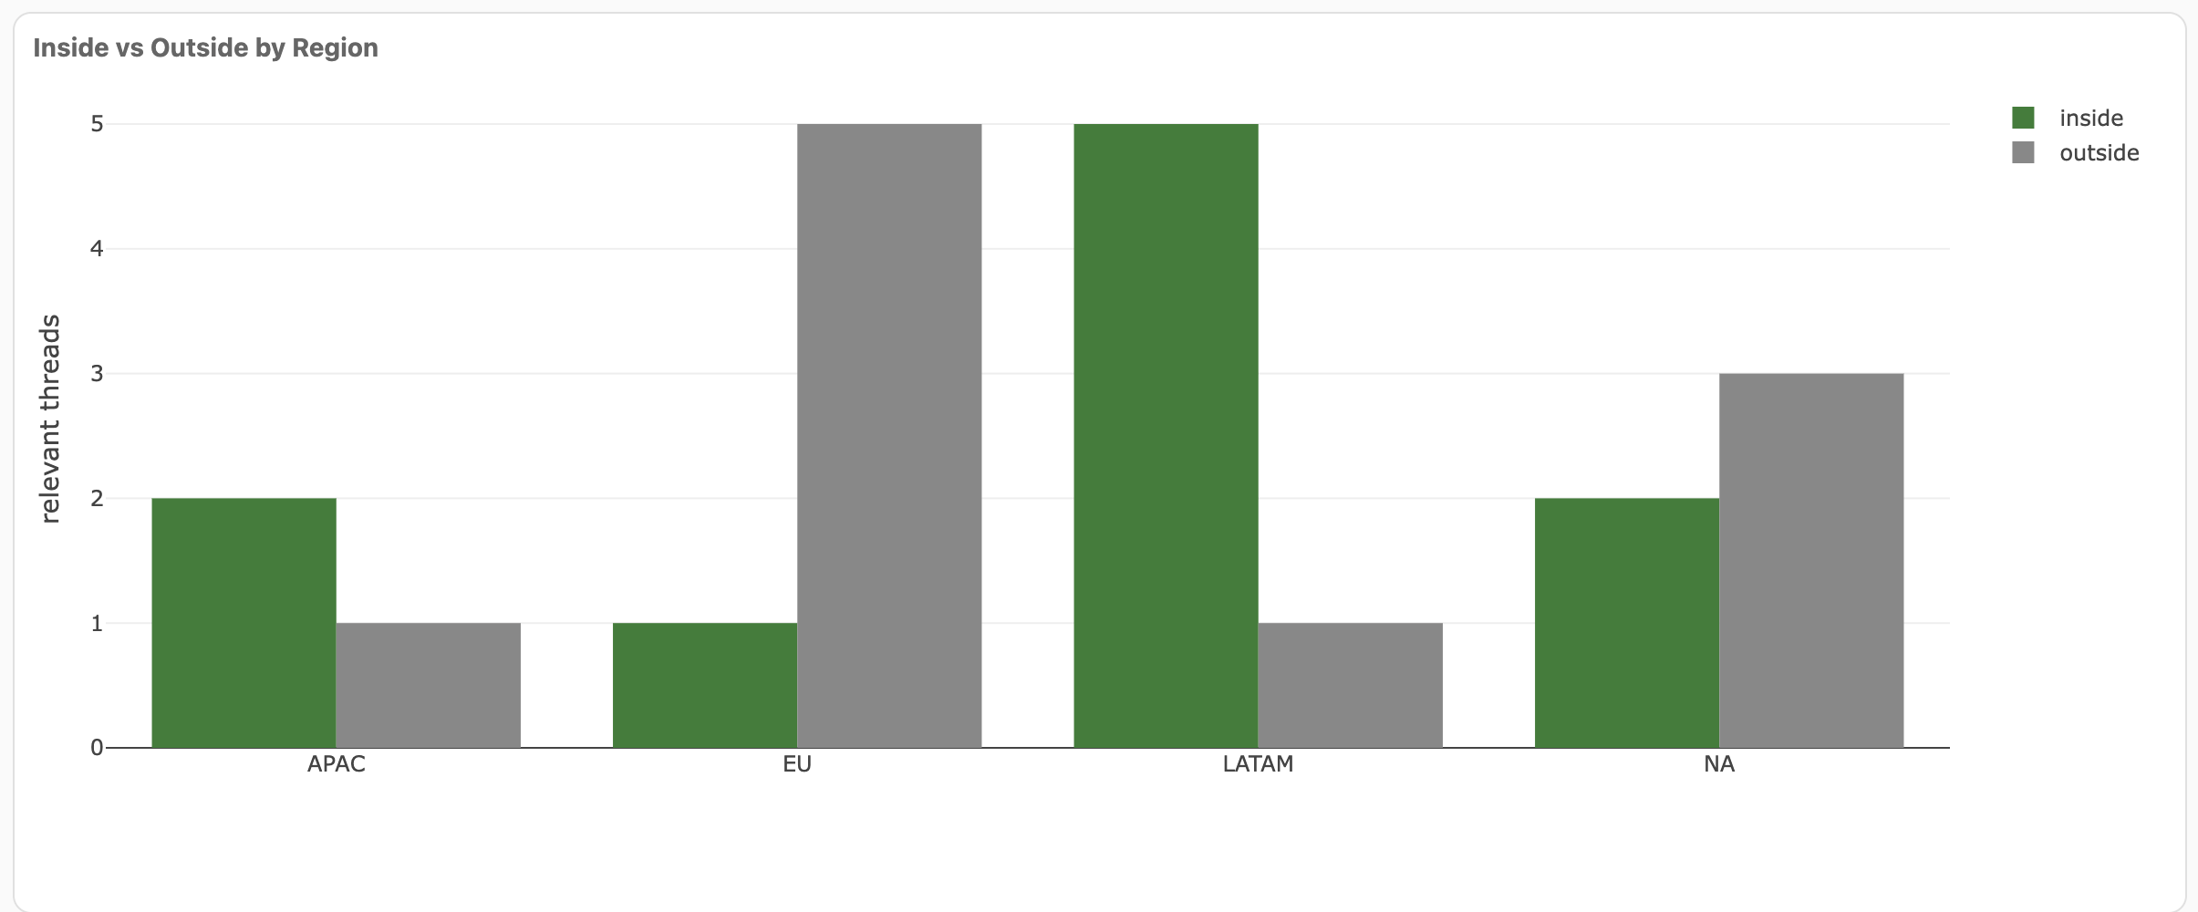
Example 2: Time-Window Explorer (UI highlights)

Slide 11
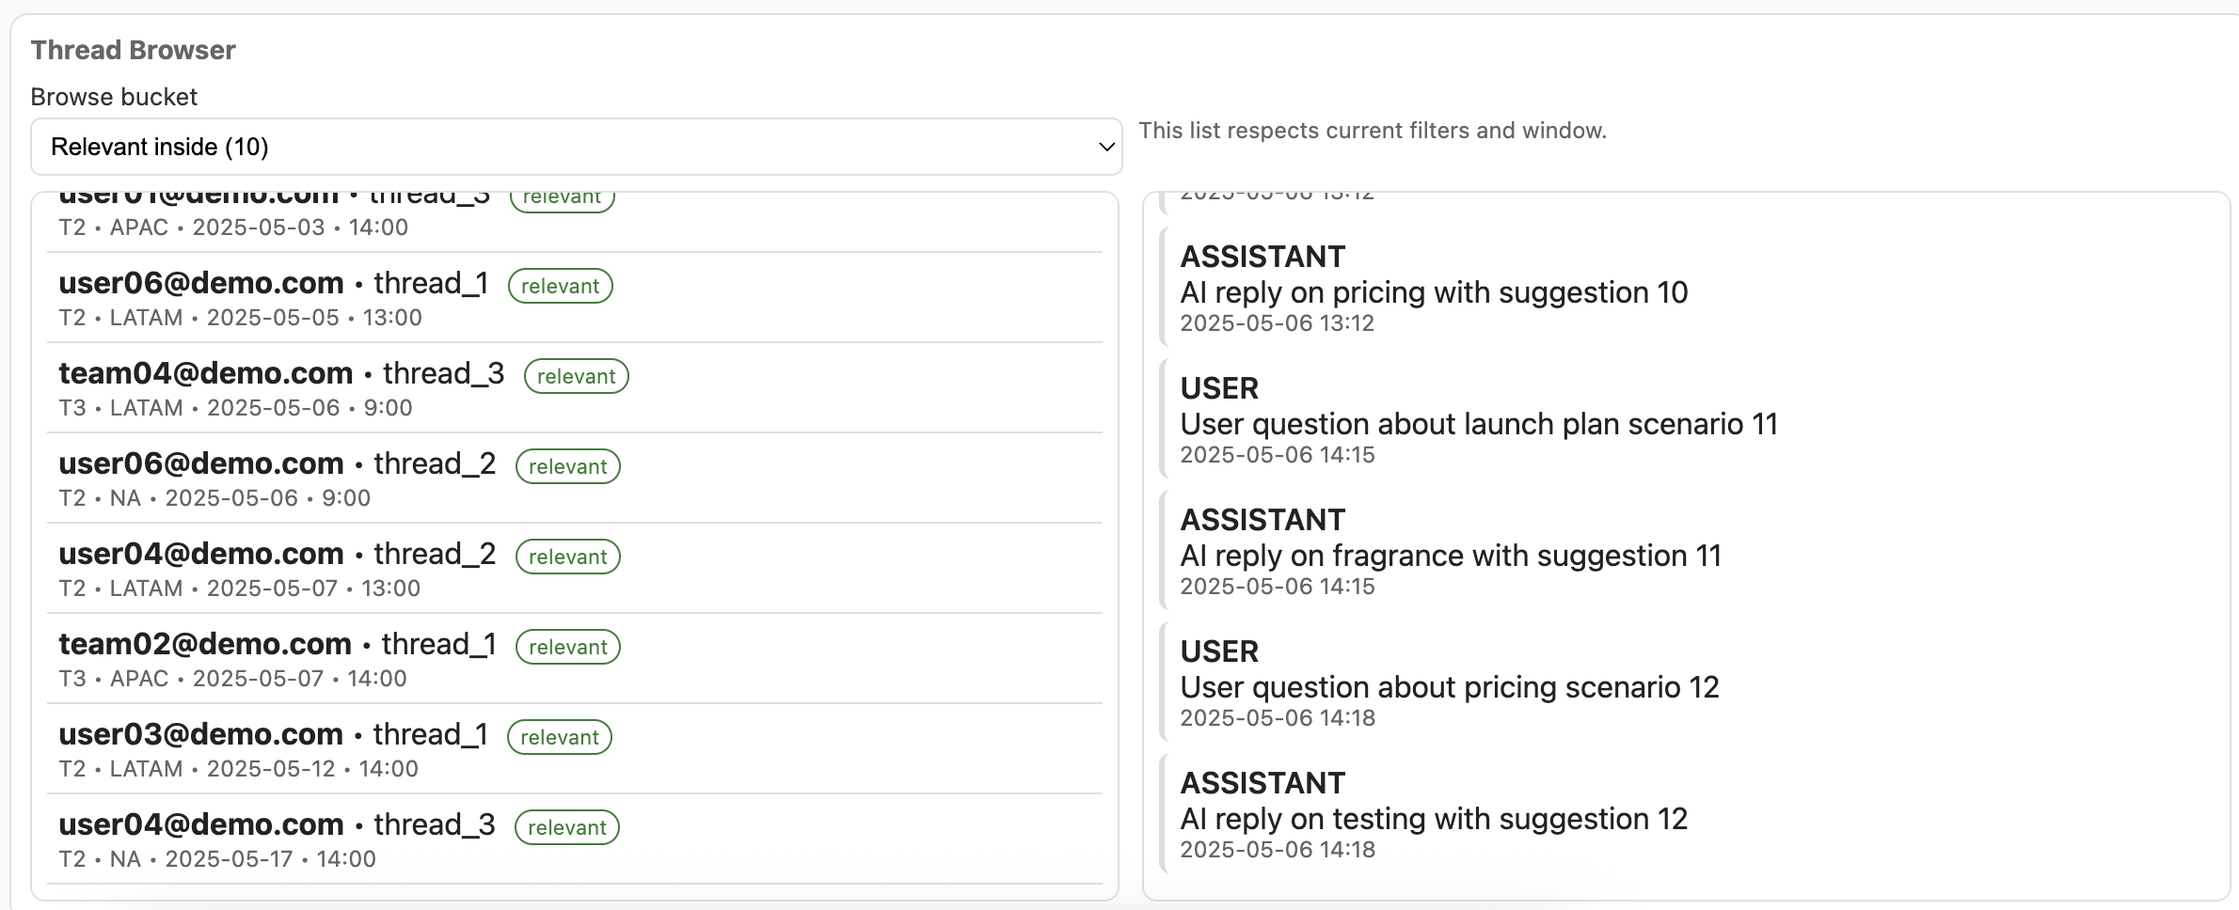
Example 2: Time-Window Explorer (UI highlights)

Slide 12
Example 2: What it enabled
Observe how the data changes during cleaning
Inspect outliers or anomalies without needing to hunt them down in Excel

Slide 13
Example 2: Patterns you can reuse
Interactive charts and graphs with filters
Window to inspect data granularly

Slide 14
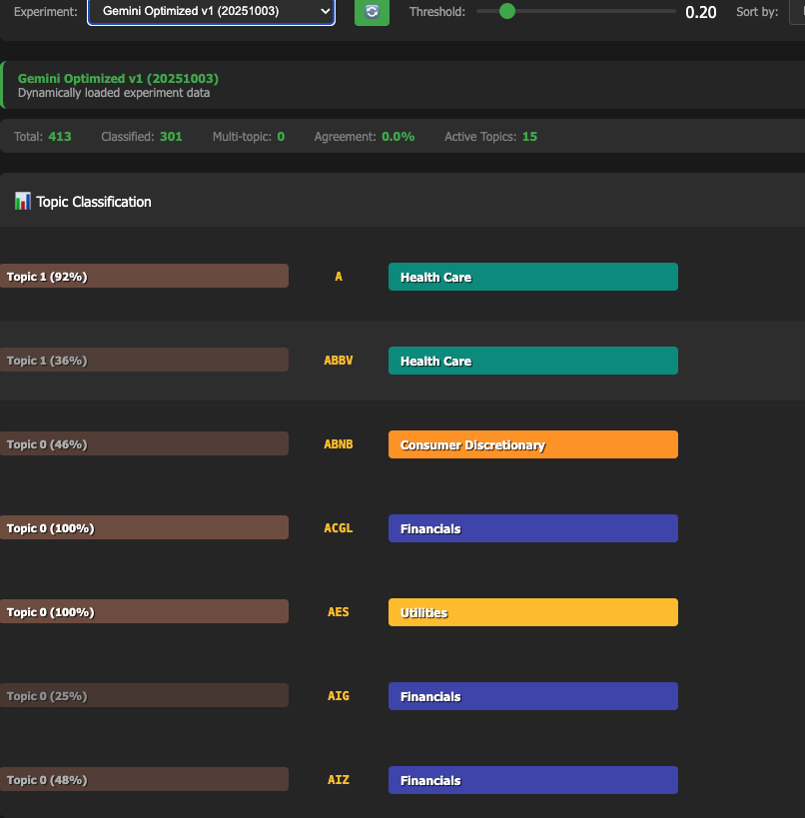
Example 3: Industry classification

Slide 15
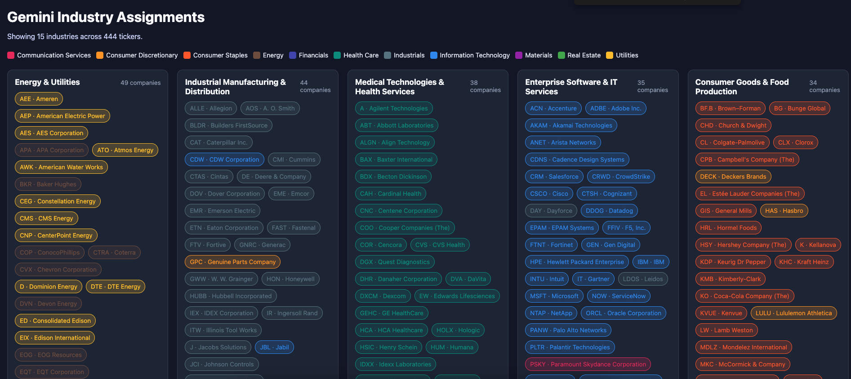
Example 3: Industry classification

Slide 16
Example 3: What it enabled
Comparing two classifications of ~500 companies
Simplified communication of results with coworkers in meetings

Slide 17
Example 3: Patterns you can reuse
Explore possible ways to visualize your data to find the best
  These web apps are cheap and easy to make, so you can make lots of them and try lots of things

Slide 18
Prompting techniques: data briefing
Describe schema: columns, types, what a row represents, units.
Provide 2–5 sample rows to de-risk parsing.

Slide 19
Prompting techniques: project briefing
Explain your project
  This context can help the AI avoid simple mistakes
Explain your objective for the current task

Slide 20
Prompting techniques: defining deliverables
Be explicit about a few deliverables, like a bar chart with xyz columns
Keep it simple, start small

Slide 21
More on GitHub
github.com/conormackey/disposable-webapps

