Slide 1
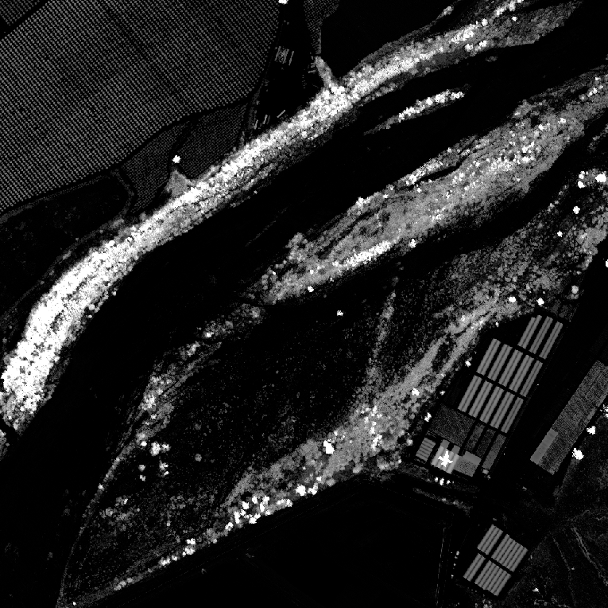
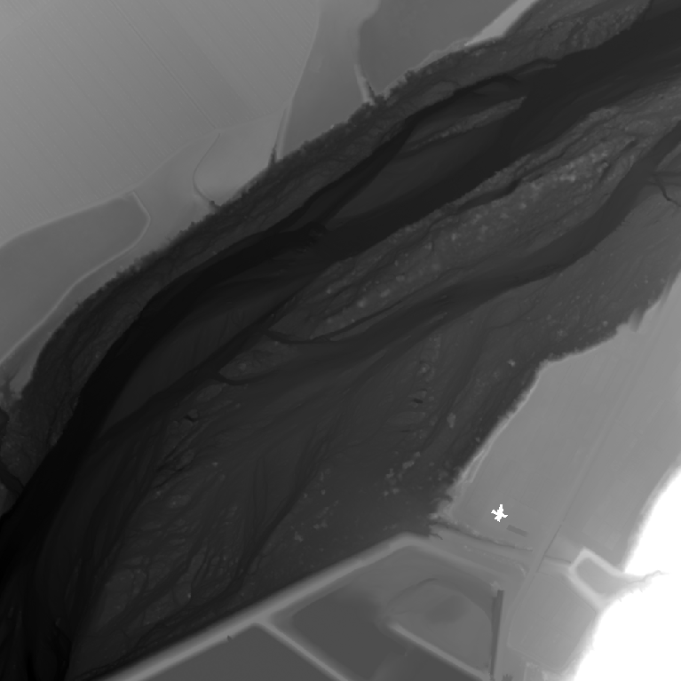
chm_tile_889_303997_3797006.tif
dem_tile_889_303997_3797006.tif
Natural Vegetation
Power Lines
Buildings

