Slide 1
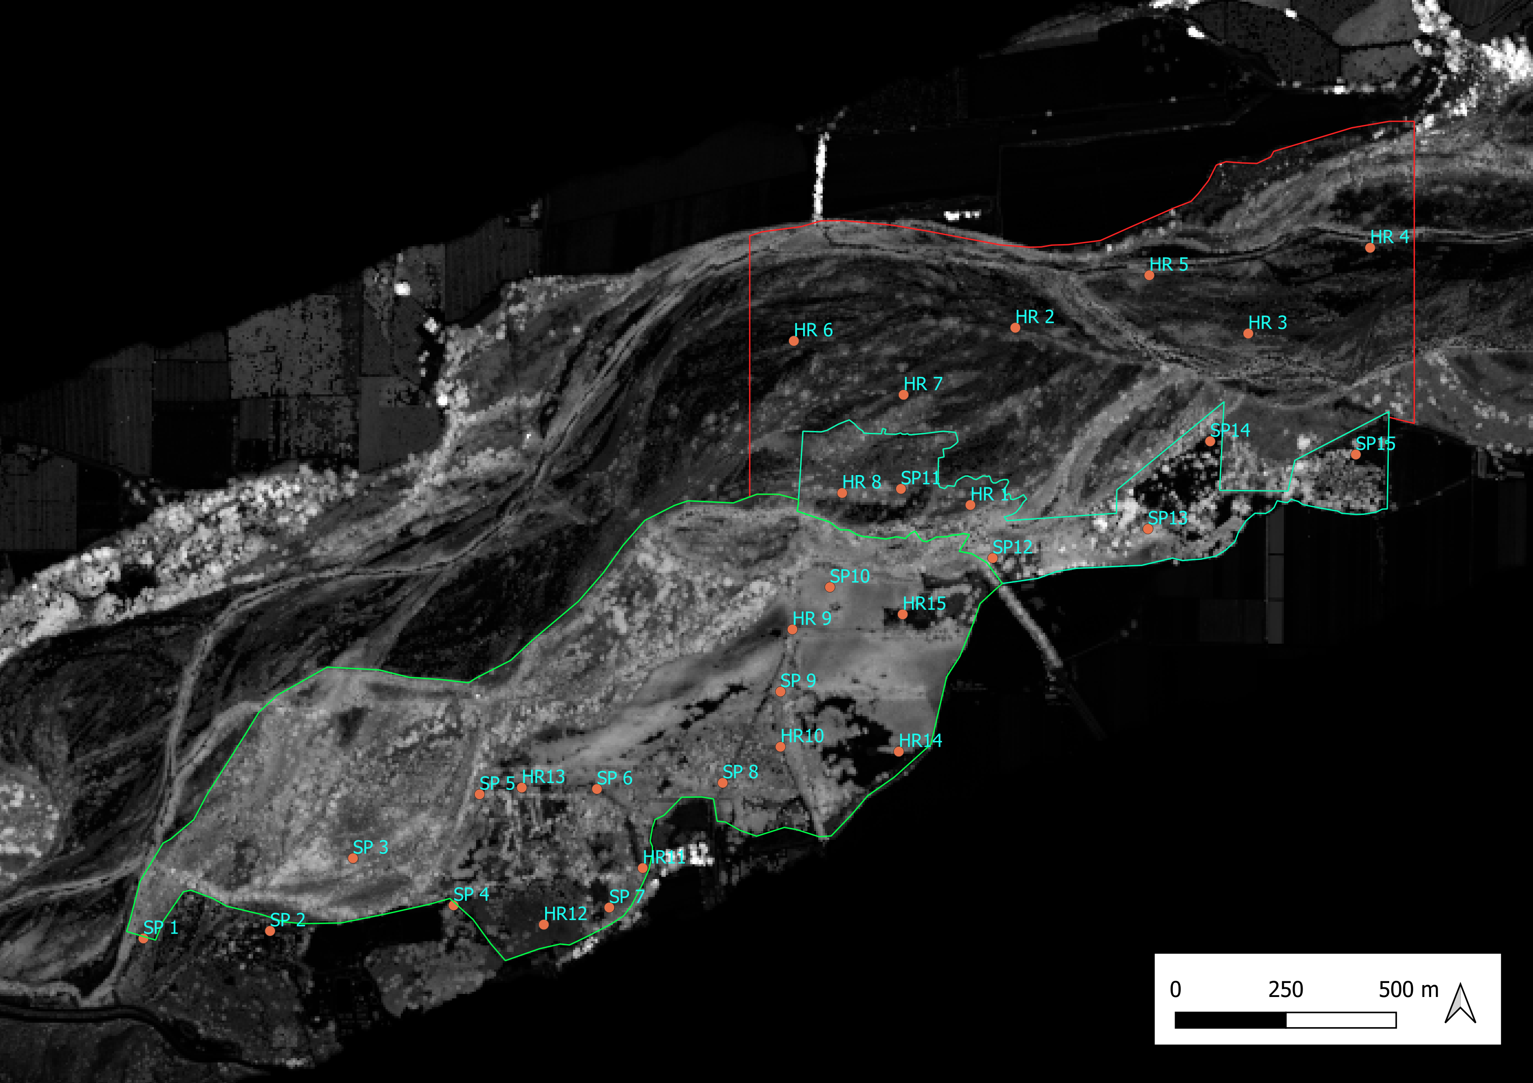
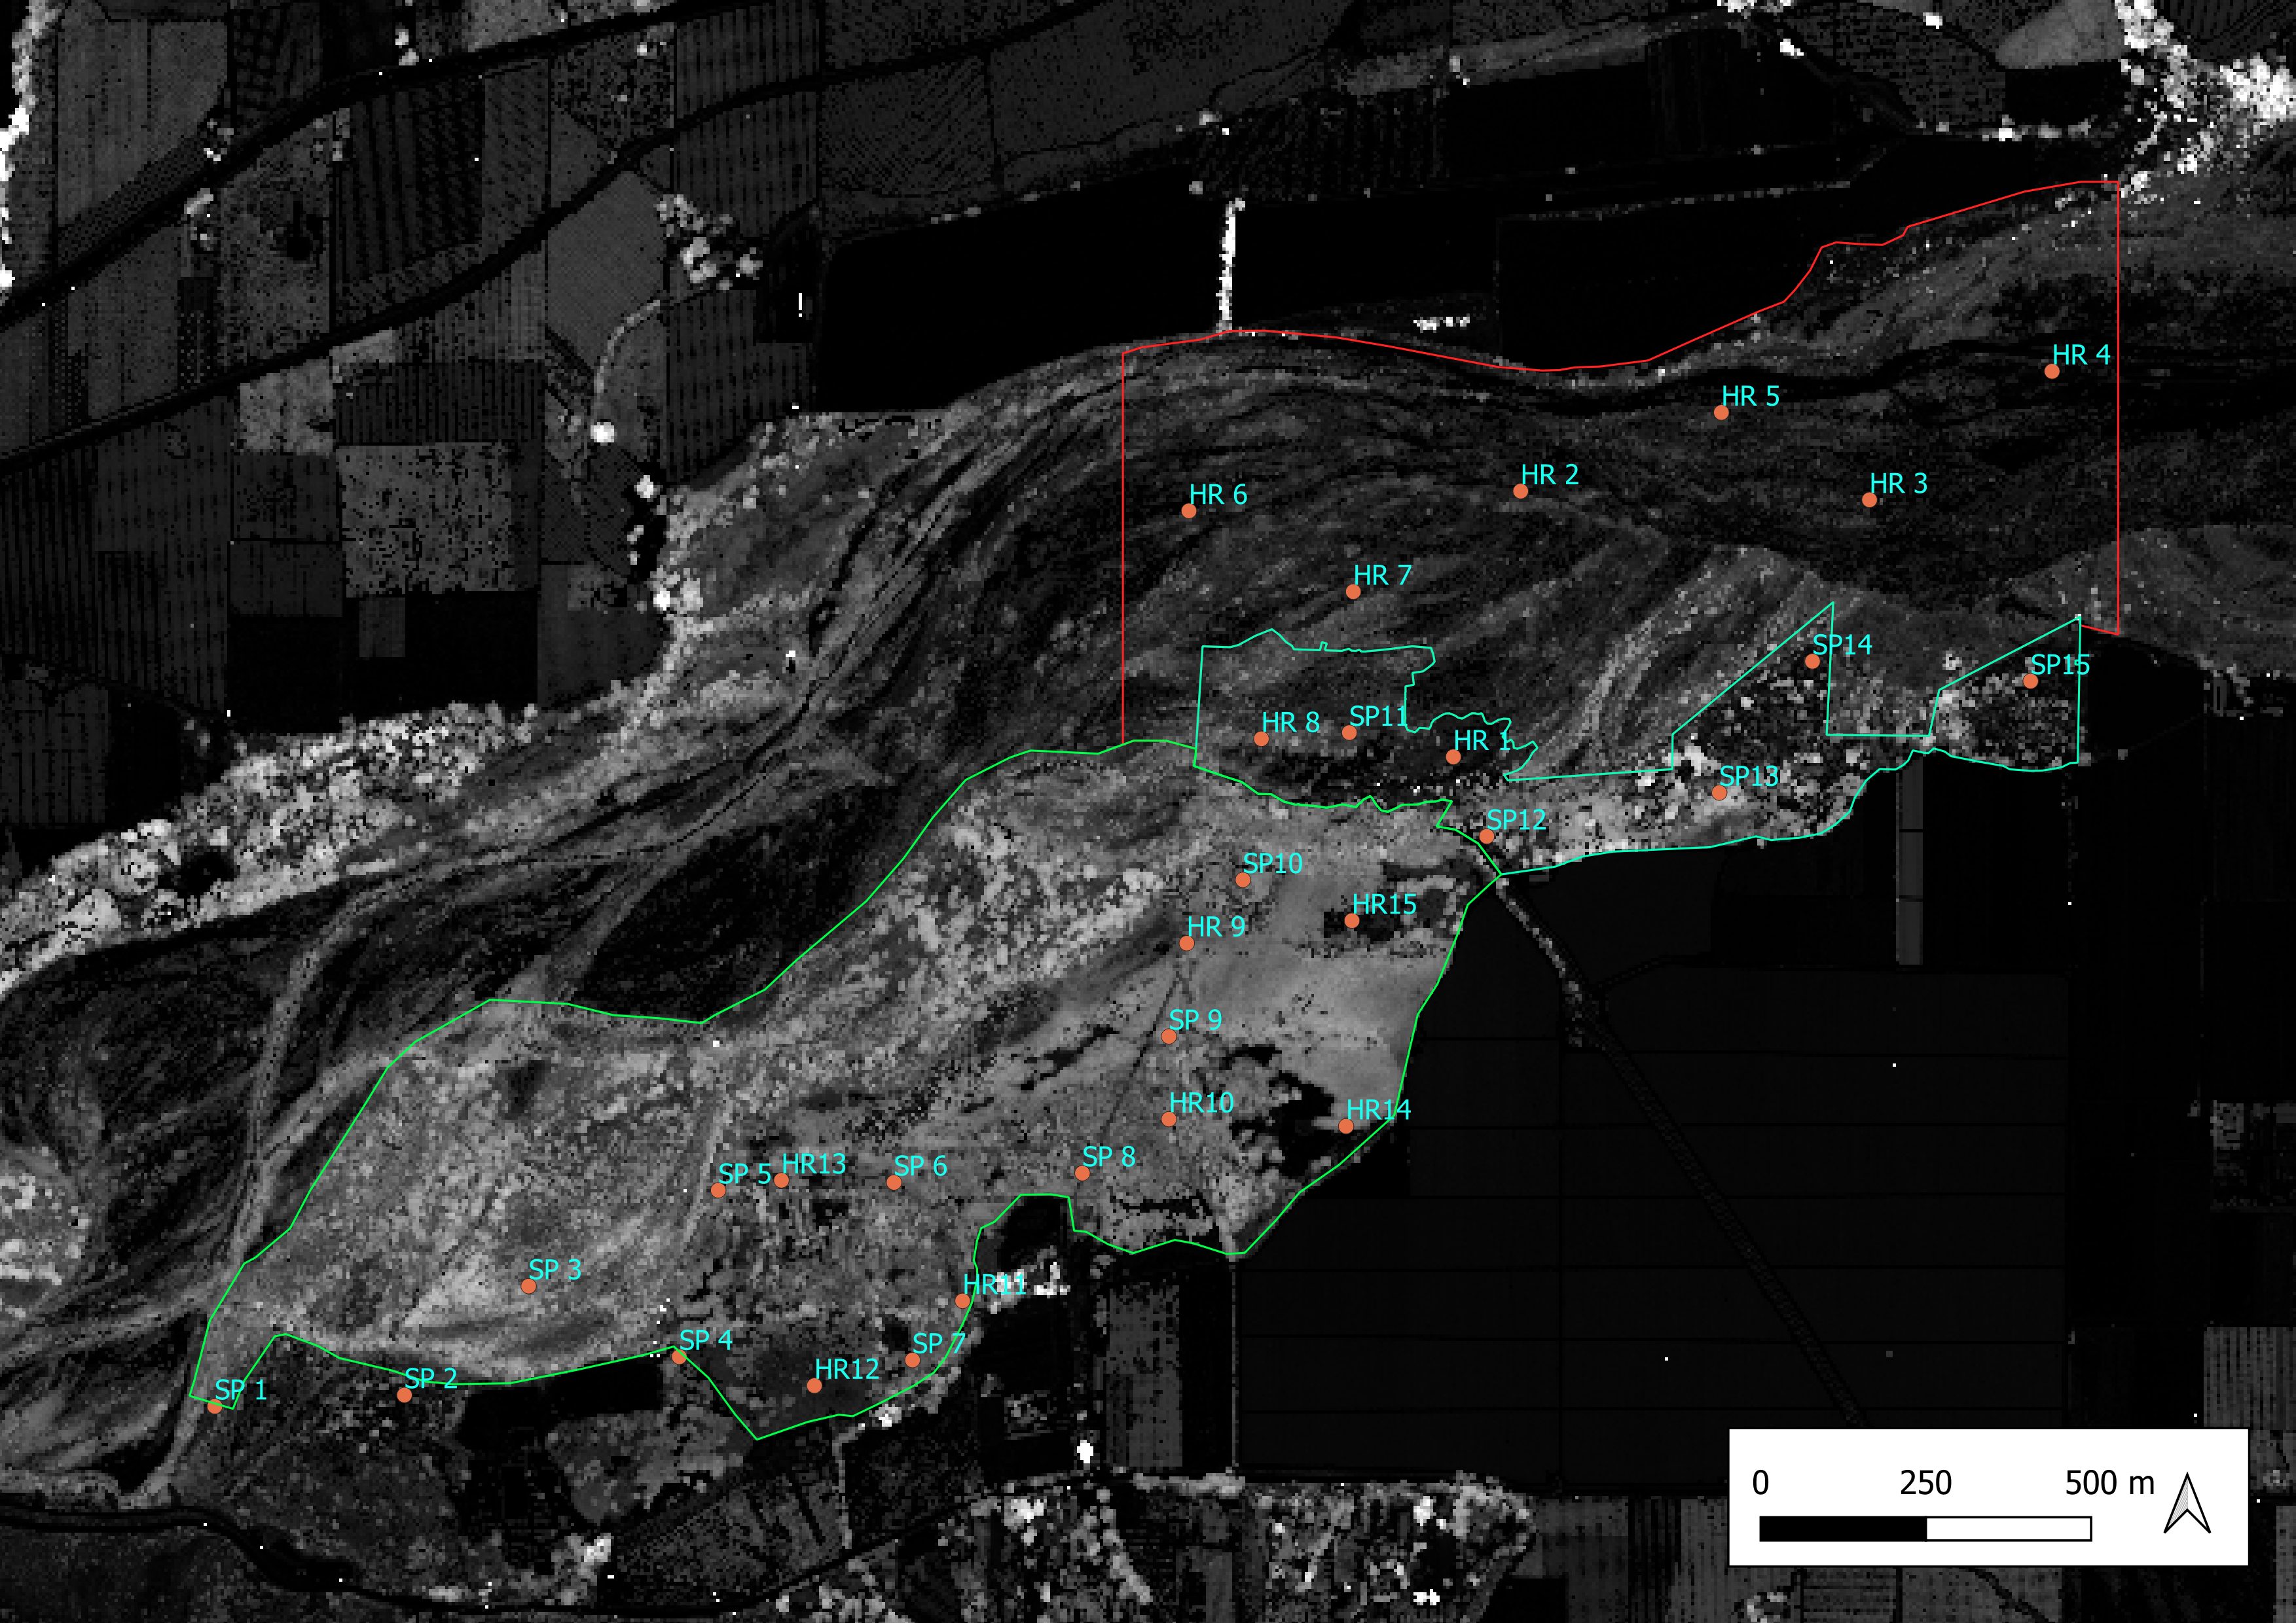
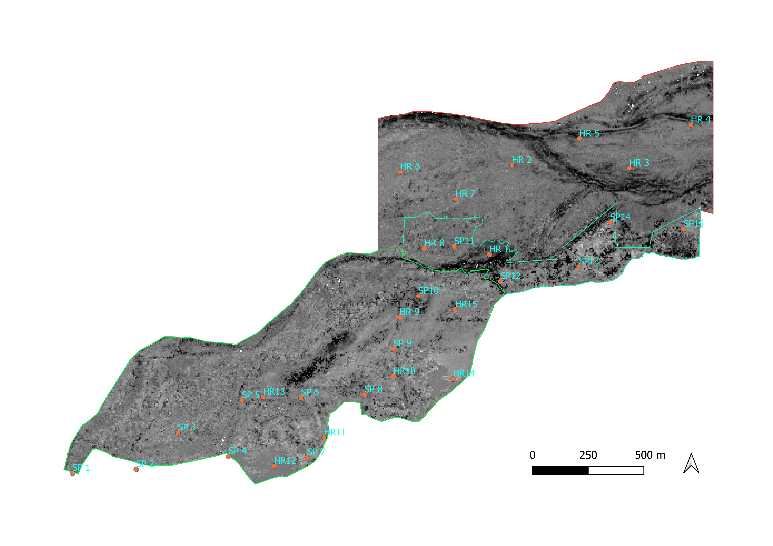
2015 Canopy Height
25 m
0 m
25 m
0 m
2018 Canopy Height
Canopy Height Change
10 m
-10 m

Slide 2
