Slide 1
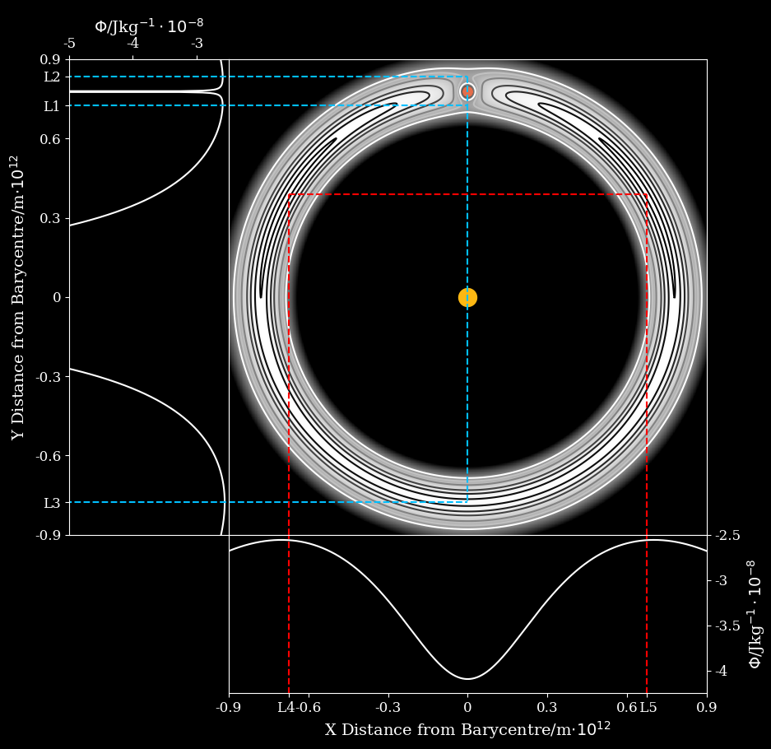
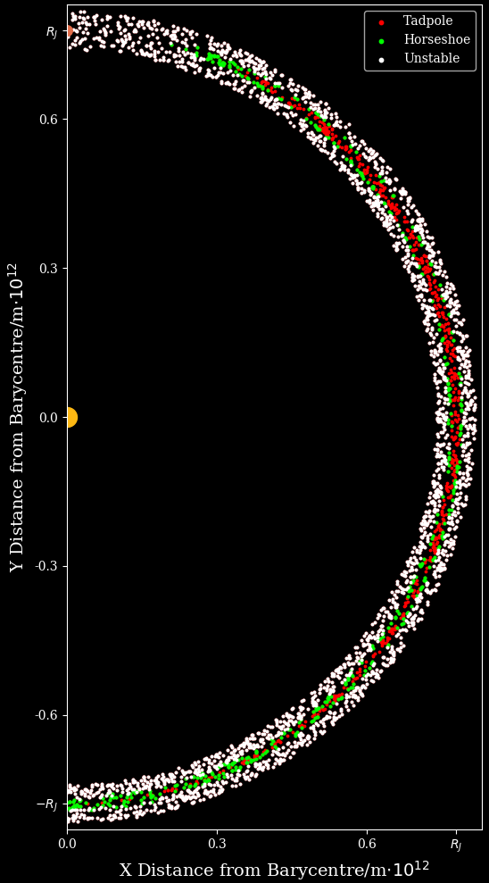
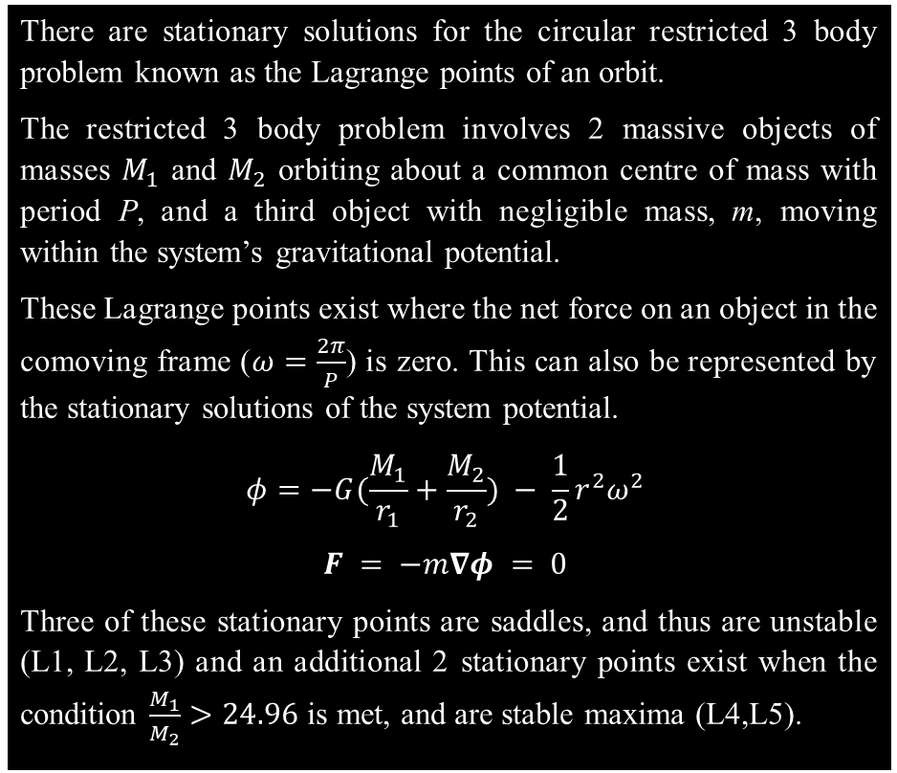
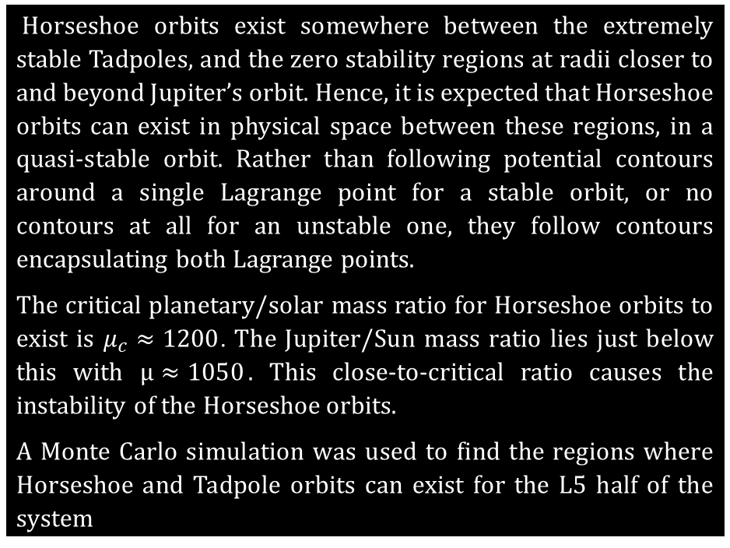
Trojan Horseshoe Orbits
Lagrange Points
There are stationary solutions for the circular restricted 3 body problem known as the Lagrange points of an orbit.
The restricted 3 body problem involves 2 massive objects of masses $M_{1}$ and $M_{2}$ orbiting about a common centre of mass with period P, and a third object with negligible mass, m, moving within the system’s gravitational potential.
These Lagrange points exist where the net force on an object in the comoving frame ($ω=\frac{2π}{P}$) is zero. This can also be represented by the stationary solutions of the system potential.
$$φ=−G(\frac{M_{1}}{r_{1}}+\frac{M_{2}}{r_{2}}) − \frac{1}{2}r^{2}ω^{2}$$
$$F = −m∇φ = 0$$
Three of these stationary points are saddles, and thus are unstable (L1, L2, L3) and an additional 2 stationary points exist when the condition $\frac{M_{1}}{M_{2}}>24.96$ is met, and are stable maxima (L4,L5).
Sun-Jupiter Trojans
The period of an object at a Lagrange point is equal to that of the orbital system, hence they maintain a constant distance from either massive object. In the Sun-Jupiter system, this results in asteroids at L4 and L5 closely following Jupiter in its orbit – these are known as the Trojans.
Object orbits can also follow equipotential lines (FIG 1) around these Lagrange points, meaning multiple asteroids can oscillate about the stable point, with varying degrees of stability.
One class of orbit are the extremely stable Tadpoles, which follow contours close to one of L4 or L5. Their orbit draws out a tadpole shape in the comoving frame.
Another class of orbit are the quasi-stable Horseshoes, which follow contours encapsulating both L4 and L5. Their orbit draws out a horseshoe shape in the comoving frame.
Today, almost every Trojan follows a variation of the Tadpole orbit, with no known Horseshoe orbits currently existing.
Horseshoe Regions
Horseshoe orbits exist somewhere between the extremely stable Tadpoles, and the zero stability regions at radii closer to and beyond Jupiter’s orbit. Hence, it is expected that Horseshoe orbits can exist in physical space between these regions, in a quasi-stable orbit. Rather than following potential contours around a single Lagrange point for a stable orbit, or no contours at all for an unstable one, they follow contours encapsulating both Lagrange points.
The critical planetary/solar mass ratio for Horseshoe orbits to exist is $μ_{c}≈1200$. The Jupiter/Sun mass ratio lies just below this with $μ≈1050$. This close-to-critical ratio causes the instability of the Horseshoe orbits.
A Monte Carlo simulation was used to find the regions where Horseshoe and Tadpole orbits can exist for the L5 half of the system
REFERENCES REFERENCES REFERENCES REFERENCES REFERENCES REFERENCES REFERENCES REFERENCES REFERENCES REFERENCES REFERENCES REFERENCES REFERENCES REFERENCES REFERENCES REFERENCES REFERENCES REFERENCES REFERENCES REFERENCES

