Slide 1

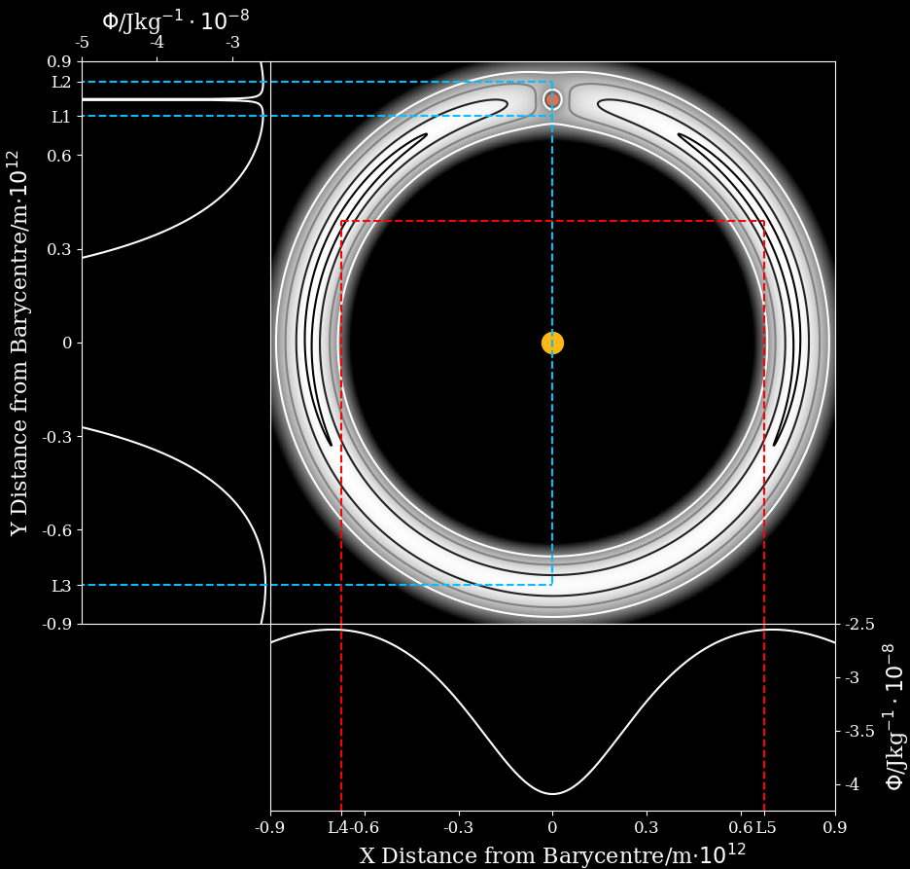

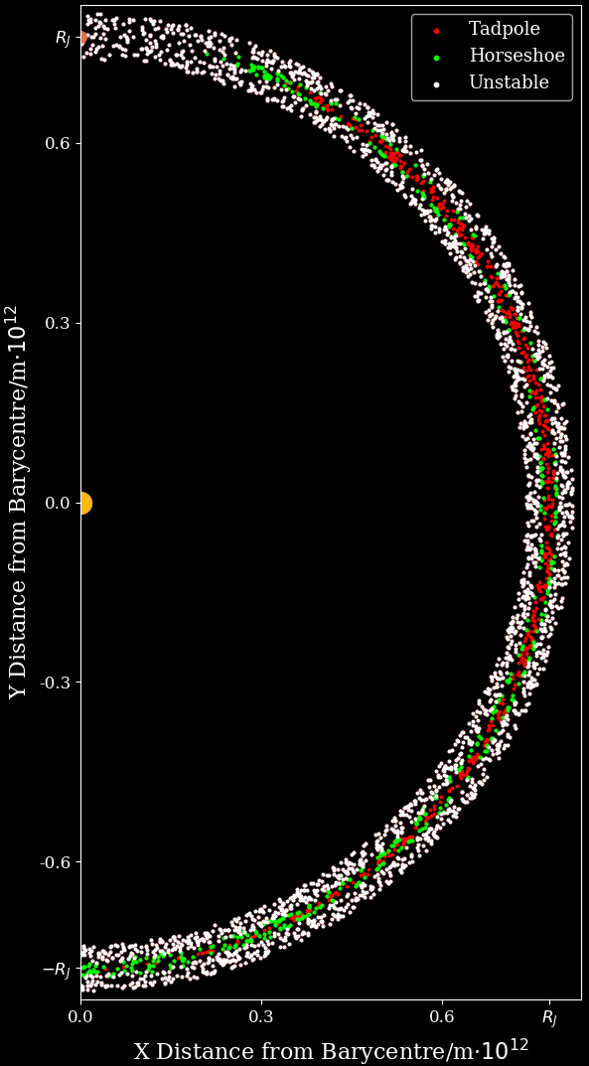
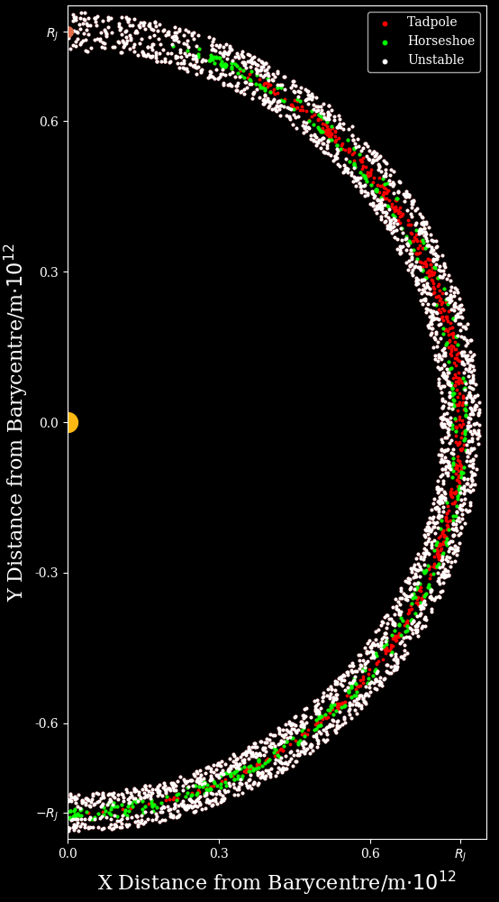
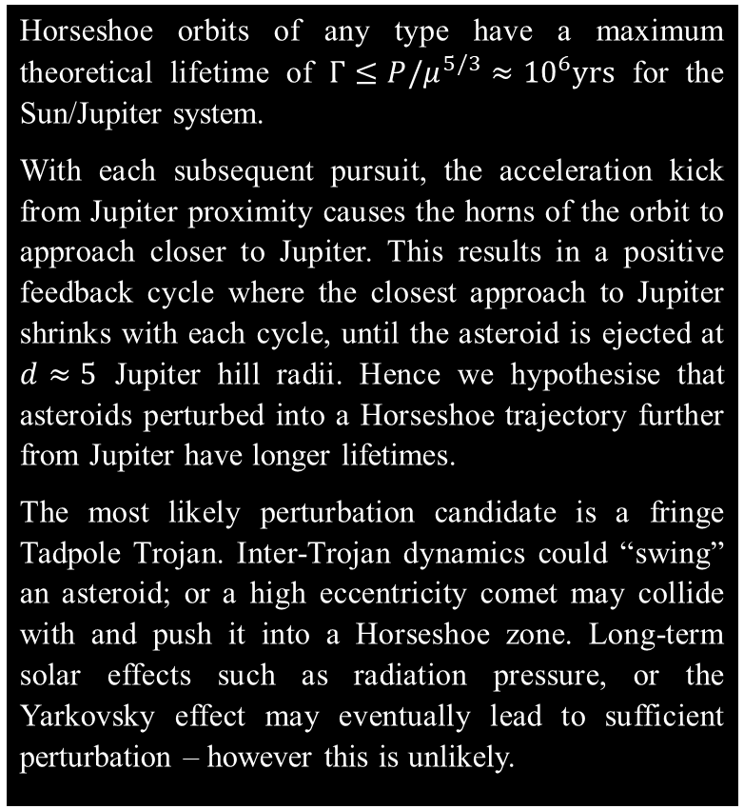

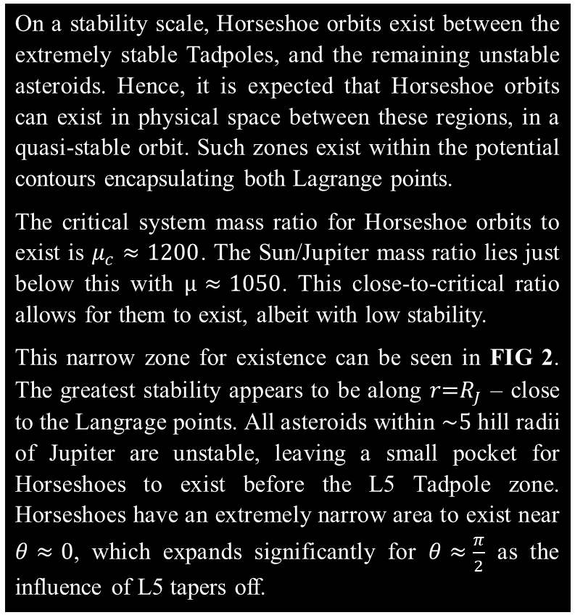
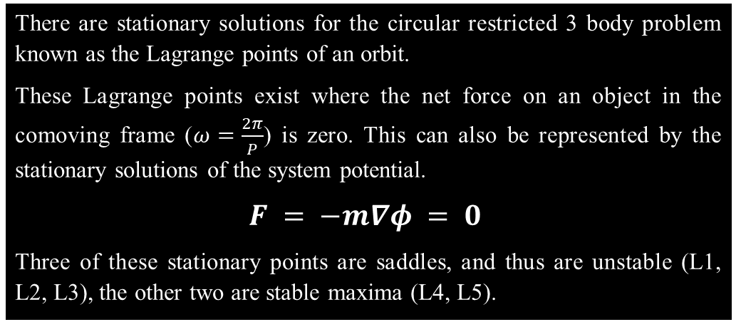
Trojan Horseshoe Orbits
Conor Diver Durham University
Lagrange Points
There are stationary solutions for the circular restricted 3 body problem known as the Lagrange points of an orbit.
These Lagrange points exist where the net force on an object in the comoving frame ($ω=\frac{2π}{P}$) is zero. This can also be represented by the stationary solutions of the system potential.
$$F = −m∇φ = 0$$
Three of these stationary points are saddles, and thus are unstable (L1, L2, L3), the other two are stable maxima (L4, L5).
Sun-Jupiter Trojans
In the Sun-Jupiter system asteroids L4 and L5 closely following Jupiter in its orbit – these are known as the Trojans. There are two types:
TADPOLES orbit L4 or L5. They are extremely stable, and follow potential contours around either L4 or L5 – they draw out their namesake in a comoving frame with Jupiter. Their distance oscillations from Jupiter as they orbit L4/5 are low amplitude, and are of a constant period.
HORSESHOES orbit both L4 and L5. They are quasi-stable, and follow potential contours around both L4 and L5 in a horseshoe shape. They have a higher amplitude distance oscillation, with a more erratic period. They exist in a pursuit orbit with Jupiter – catching up decelerates them into a higher orbit with the
FIG 1 shows the potential contours of the Sun-Jupiter system. The Lagrange points exist where the potential is at a maxima. The darkest contour is representative of a Tadpole. The adjacent contour is representative of a Horseshoe.
sun, and getting caught accelerates them into a lower one. The orbits “wobble” in the comoving frame is due to the orbit shape not being exactly circular. Currently no Trojan Horseshoe orbits are known to exist.
Horseshoe Regions
Horseshoe Lifetime
On a stability scale, Horseshoe orbits exist between the extremely stable Tadpoles, and the remaining unstable asteroids. Hence, it is expected that Horseshoe orbits can exist in physical space between these regions, in a quasi-stable orbit. Such zones exist within the potential contours encapsulating both Lagrange points.
The critical system mass ratio for Horseshoe orbits to exist is $μ_{c}≈1200$. The Sun/Jupiter mass ratio lies just below this with $μ≈1050$. This close-to-critical ratio allows for them to exist, albeit with low stability.
This narrow zone for existence can be seen in FIG 2. The greatest stability appears to be along $r\text{=}R_{J}$ – close to the Langrage points. All asteroids within $\sim 5$ hill radii of Jupiter are unstable, leaving a small pocket for Horseshoes to exist before the L5 Tadpole zone. Horseshoes have an extremely narrow area to exist near $θ≈0$, which expands significantly for $θ≈\frac{π}{2}$ as the influence of L5 tapers off.
Horseshoe orbits of any type have a maximum theoretical lifetime of $Γ≤P/μ^{5/3}≈{10}^{6}yrs$ for the Sun/Jupiter system.
With each subsequent pursuit, the acceleration kick from Jupiter proximity causes the horns of the orbit to approach closer to Jupiter. This results in a positive feedback cycle where the closest approach to Jupiter shrinks with each cycle, until the asteroid is ejected at $d≈5$ Jupiter hill radii. Hence we hypothesise that asteroids perturbed into a Horseshoe trajectory further from Jupiter have longer lifetimes.
The most likely perturbation candidate is a fringe Tadpole Trojan. Inter-Trojan dynamics could “swing” an asteroid; or a high eccentricity comet may collide with and push it into a Horseshoe zone. Long-term solar effects such as radiation pressure, or the Yarkovsky effect may eventually lead to sufficient perturbation – however this is unlikely.
FIG 2 is a Monte Carlo simulation of $N≈2300$ asteroids with conditions $0.95R_{J}≤r≤\text{1.}05R_{J}$;$−\frac{π}{2}≤θ≤\frac{π}{2}$. Each dot represents the initial position of an asteroid generated with a “stable” velocity, which was then simulated over $\sim 340$yrs and subsequently classified as a Tadpole, Horseshoe, or Unstable asteroid. The Tadpoles and Horseshoes generally follow the previously described potential contours. The system is symmetric about $y=0$, and hence L4 is identical to L5.
REFERENCES REFERENCES REFERENCES REFERENCES REFERENCES REFERENCES REFERENCES REFERENCES REFERENCES REFERENCES REFERENCES REFERENCES REFERENCES REFERENCES REFERENCES REFERENCES REFERENCES REFERENCES REFERENCES REFERENCES

